Slide 1
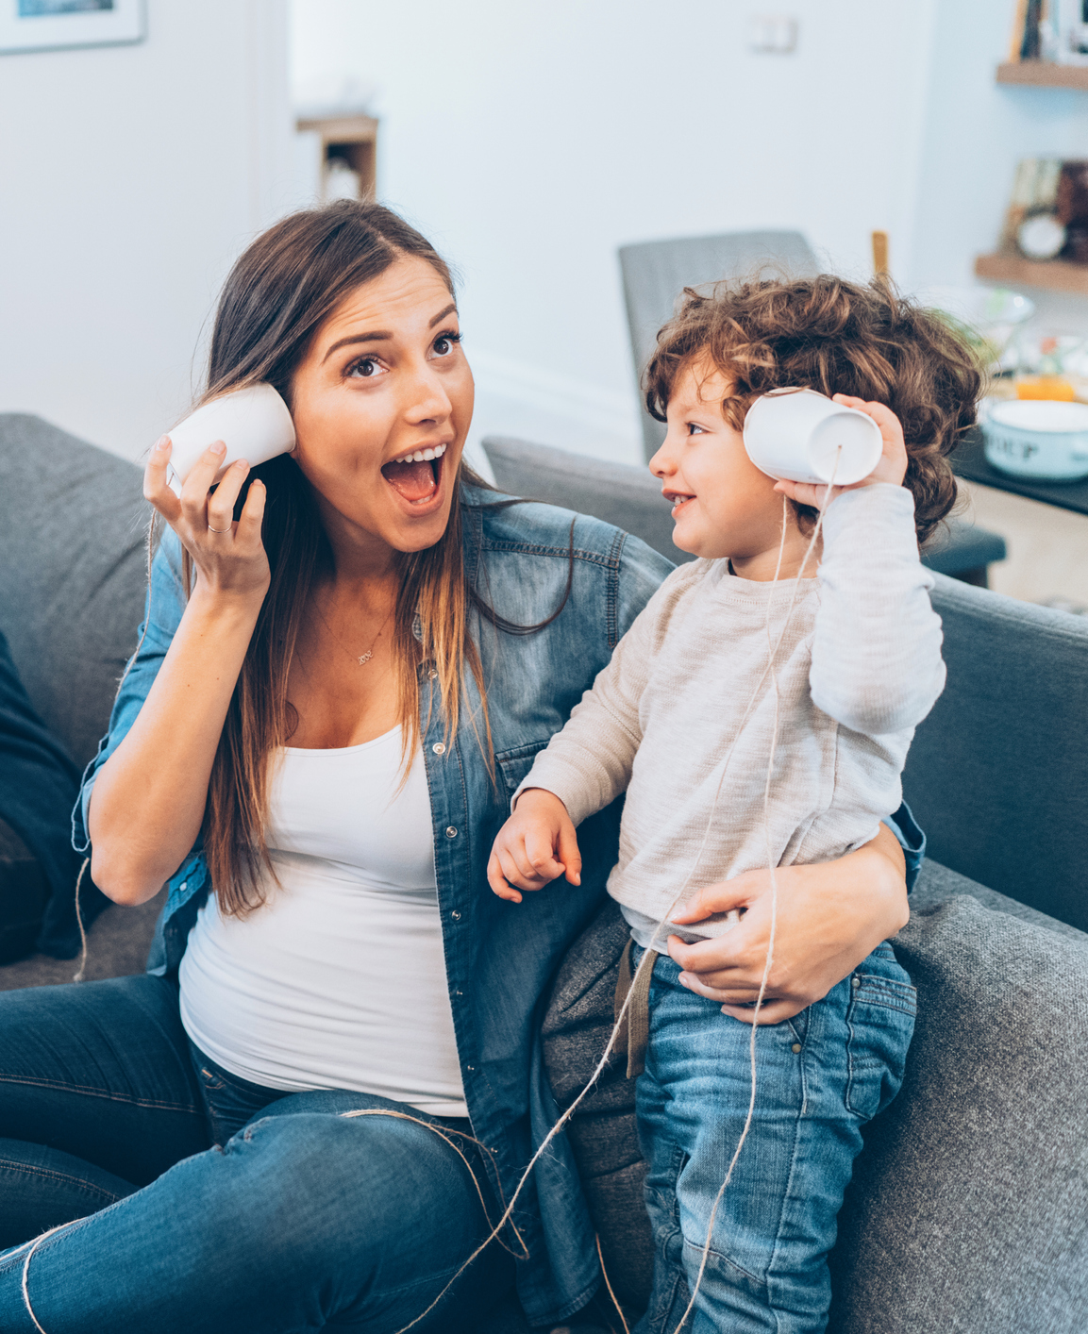
Help Me Grow National
Messaging & Communications
Network
Breakout #2
Kimberly Martini-Carvell
Executive Director
Help Me Grow National Center
July 16, 2024
Part of Connecticut Children’s Office for Community Child Health
www.helpmegrownational.org

Slide 2
Help Me Grow National Messaging & Communications Network
Have your HMG messaging efforts changed over time?
For families?
For physicians?
Are you able to message HMG as a system-building effort and not a program?
If so, can you share how you have done this?
What works vs. what doesn’t work?
What audiences receive this easily vs. which do not?
What HMG National efforts have most impacted your messaging strategies? (i.e. GCC, FEDM, Birth to Five Watch me Thrive!, Frameworks)
Notes:
KIMBERLY FACILITATES
MORGAN RUNS TECH AND CHAT

Slide 3
Wrap-Up
Next MCN session: HMG Isn't a Program. It's a Collective Effort to Ensure an Efficient System of Care is There for Families. Let's Talk About It.
Monday, September 16 at 03:00 PM ET
Visit the HMG Messaging & Communications Network resource page for today’s recording, slides, and state lead report
Know someone who might like to join this Network? Send them the MCN Sign-Up Link!
Have suggestions for the HMG Messaging & Communications Network? Reach out to Sarah Zucker, szucker@connecticutchildrens.org
Notes:
MORGAN PRESENTS
Resource page: HMG Messaging & Communications Network resource page
MCN Sign-Up: MCN Sign-Up Link
BOTH THANK THE GROUP FOR THEIR TIME AND INPUT

Slide 4
HELPMEGROWNATIONAL.ORG

