Slide 1
Title
Help Me Grow: So All Children Can Shine
Family-Engaged Developmental Monitoring: Implications and Applications
ZERO TO THREE LEARN Conference
Melissa Passarelli, MA
Associate Director of Implementation and Systems Building, Help Me Grow National Center
Part of Connecticut Children’s Office for Community Child Health
www.helpmegrownational.org

Slide 2
Learner Objective
Identify what family-engaged developmental monitoring is and how it fits into a framework for children’s healthy development and family well-being

Slide 3
The Framework for Children’s Healthy Development and Wellbeing

Slide 4
A Roadmap for Advancing Family-Engaged Developmental Monitoring
Supported by the CDC’s Learn the Signs. Act Early Campaign and created in partnership with the Association for University Centers on Disabilities
The Roadmap introduces and describes family-engaged developmental monitoring (FEDM) as a key component of a framework for children’s healthy development and family wellbeing
Evidence-informed:
Literature
Phases 1 & 2 of the project
CIDSEI HMG Affiliate Work Group and CIDSEI Advisory Committee
Key definitions and concepts delineated
Program and Systems-level Self-Assessments

Slide 5
Terminology
For the purposes of the Roadmap and this presentation:
“Provider” refers to all those that interact with young children and their families, inclusive of medical, education, social service, community-based, faith-based, and other child serving sectors
“Family” refers to the people with whom the child has a close personal relationship and who are responsible for the well-being and development of the child
“Early Identification” means the timely detection of concern for developmental delay or disability
Child development requires a “holistic approach” that considers multiple factors across the social ecology that may contribute to overall health and well-being, inclusive of “social drivers of health” (community and societal factors that can impact health outcomes)

Slide 6
The Evolution of Early Identification
Historically, the focus of early identification has been on detecting the presence of a developmental delay or disability. This attends to only a subset of children and misses those vulnerable to adverse outcomes
The process should be universal for all children, and therefore needs to include the elicitation of parent opinions and concerns
Centering the family voice and experience is an evolution away from focusing on the identification of disorders
Switching to a focus on family well-being, inclusive of family priorities and needs such as concrete and social supports, can lead to positive outcomes for all young children

Slide 7
Early Identification Process
A Framework for Early Identification
A Framework for Children’s Healthy Development & Family Well-Being
Broader conceptualization of the process
Asset-based approach with overall goal of promoting positive outcomes
Recognizes families as leaders in their child’s development

Slide 8
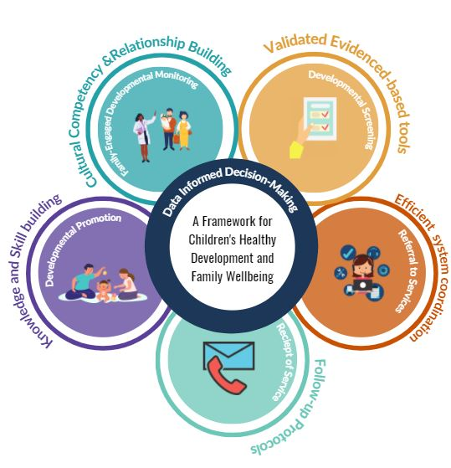
A Framework for Children’s Healthy Development & Family Well-Being
Framework describes the process needed to support child and family wellbeing, inclusive of early identification
Inclusive of ongoing monitoring of young children who are not in need of early intervention but have identified risk factors for developmental delay
Includes developmental promotion (re: education/interaction) activities as a discrete component
Universal strategies:
Developmental promotion (ongoing)
FEDM (ongoing)
Screening (at recommended ages)
Targeted strategies:
Referral to services
Receipt of services

Slide 9
Family-Engaged Developmental Monitoring (FEDM)
FEDM is an intentional partnership of families and providers combining their knowledge to recognize child’s developmental milestones and identify opportunities for support and education
Three essential attributes:
Families are the experts
Holistic picture of child’s development
Development is discussed longitudinally

Slide 10
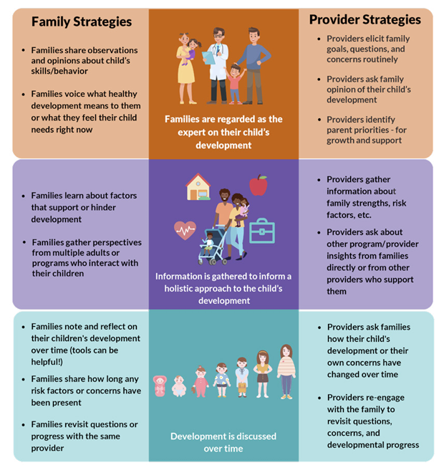
Family & Provider Strategies

Slide 11
FEDM: An Approach to Advancing Equity
Practicing FEDM can support shifting the power dynamic back into the hands of families
Developmental screening and evaluation may not be the best method of early identification for all families, due to historical institutionalized and structural racism
FEDM is more accessible than components like screening, lending itself to broad utilization and acting as a strategy for targeted universalism

Slide 12
Distinguishing between Developmental Promotion and FEDM
Developmental Promotion
FEDM
The Roadmap supports a clearer delineation between developmental promotion and FEDM
Developmental promotion promotes child development and shared knowledge between provider and family

Slide 13
Difference between FEDM and screening
As part of FEDM providers can use monitoring tools, such as “Learn the Signs. Act Early.” milestone checklists
Using tools such as milestone checklists is different than general developmental screening
Screening relies on the use of standardized and validated measures
Many screening instruments also rely on parental report

Slide 14
A Family-Engaged Developmental Monitoring Self-Assessment for Early Childhood Programs and Providers

Slide 15
Families are regarded as the expert on their child’s development
 | Do you celebrate milestones with families as they share their child’s strengths?
 | Do you directly and routinely elicit parent priorities, concerns, and questions?
 | Do you allow information provided by the family to shape your view of the child?
 | If a family’s views of the child’s development does not align with your own, do you ask clarifying questions to better understand factors that may contribute to the difference?
 | Does a family’s priority for concerns or support shape your considerations for future support?

Slide 16
Information is compiled to inform a holistic approach to the child’s development
Depending upon your professional or programmatic scope, do you gather information about the child’s:
 | Family-level support network, such as family or community members who interact positively with the child, who support the family in times of need?
 | Community-level support network, such as faith-based organizations?
 | Involvement in other programs or services, such as: early care and education programs, parent education or support groups, food banks?
 | Family-level risk factors, such as a child’s underlying health conditions, family-level trauma, parental mental health, or substance use?
 | Community -level risk factors, such as neighborhood violence, discrimination in service access or delivery, poverty?
 | Positive parenting practices, such as reading together, serve-and-return interactions, creating rich opportunities for play?
 | Basic needs, such as food insecurity, access to medical care, unemployment, and housing?

Slide 17
Development is discussed over time
 | Do you routinely elicit information on progress and concerns?
 | Do you ask families how they have seen their child progress over time?
 | Do you ask families how long a concern has been present or if it has changed over time?

Slide 18
Self- Assessment for Systems

Slide 22
What now?
Take the self-assessment(s) to determine which FEDM activities you are already engaging in and which could be incorporated into your work:
Program/provider level
System level
Leverage existing resources such as the CDC Act Early materials and app, other developmental apps, etc. to support FEDM activities with the families you serve

Slide 23
HELPMEGROWNATIONAL.ORG

