Slide 1
Title
Help Me Grow: So All Children Can Shine
Transforming Systems to be Goal Concordant
Transformations Conference 2023 T-Practice Session
July 13th, 2023
Melissa Passarelli, MA
Associate Director, Implementation & System Building, Help Me Grow National Center
Part of Connecticut Children’s Office for Community Child Health
www.helpmegrownational.org

Slide 2
Session Details

Slide 3
Session Objectives
Understand the concept of goal concordant care and its utility in co-designing more equitable systems of care
Learn a concrete example of how goal concordant care could be incorporated into a system-level initiative
Identify opportunities for implementing goal concordant care in their work

Slide 4
Agenda
What is “goal concordant care”?
The Help Me Grow Goal Concordant Care project
Breakout: What opportunities are there in your field to improve goal concordant practices?
The future of transforming practice and systems to be goal concordant
Notes:
10 Minutes—Presentation: Intro to the history of and concepts related to goal concordant care, including how centering the recipient(s) of care improves outcomes and advances equity
10 Minutes—Facilitated discussion: What type of work do you do, and how do these concepts currently show up in your work? An electronic poll will be prompted at the beginning of the session with questions about the participant’s role and type of work and a word cloud around goal concordant care; these answers will be used to foster discussion.
15 Minutes—Presentation: Applying goal concordant care concepts to early childhood systems: Overview of the Help Me Grow Goal Concordant Care Initiative (framework, approach, intended outcomes)
10 Minutes—Facilitated discussion: Based on the framework of the initiative presented, what considerations or concerns would you have? How might you determine what success looks like, and how to measure it?
15 Minutes—Presentation: Initial evaluation outcomes, including themes and barriers
20 Minutes— Breakout group activity: How might the activities and initial findings from Help Me Grow’s Goal Concordant Care initiative be relevant to your work? What opportunities are there in your field to improve goal concordant practices?
10 Minutes—Presentation: The future of transforming practice and systems through goal concordant care , including suggested considerations and next steps for participants in their work.
249/250

Slide 5
Context
Early childhood field= all those that work to support young children and their families, inclusive of health care providers, child care providers, social services, community-based organizations, family leaders, etc.
The child– and therefore, the family– is our “end user”
U.S. cultural context:
Culture of individualism and capitalism -> do not have a lot of comprehensive, preventative, supportive services
History of “power over”

Slide 6
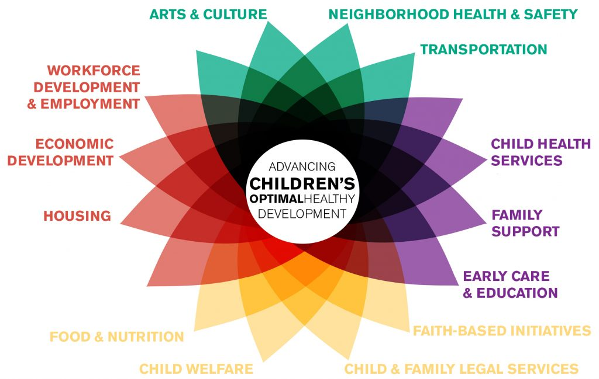
What is an early childhood system?
Interdependent policies, programs, services, and infrastructure
Inclusive of all child- and family-serving systems
The system is a sum of its parts– it’s how all of the gears work together

Slide 7
Early Childhood System Building Guided by Families, Advanced by Help Me Grow
Notes:
Both prior to and as a result of the pandemic, it has been increasingly recognized that the existing system designed to ensure early detection of and support for vulnerable children and families is fragmented and exceedingly difficult to navigate.
HMG is a solution for aligning disparate efforts and investments in early childhood which are the result of isolated initiatives and agencies that arise from siloed, inconsistent, and transient funding streams as well as policies that are uninformed by family voice and lived experience.
To foster optimal short- and long-term outcomes for young children, it is necessary to systematically elicit parents’/caregivers’ goals and priorities and establish partnership with them in creating pathways toward achievement of health and developmental goals for their children.

Slide 8
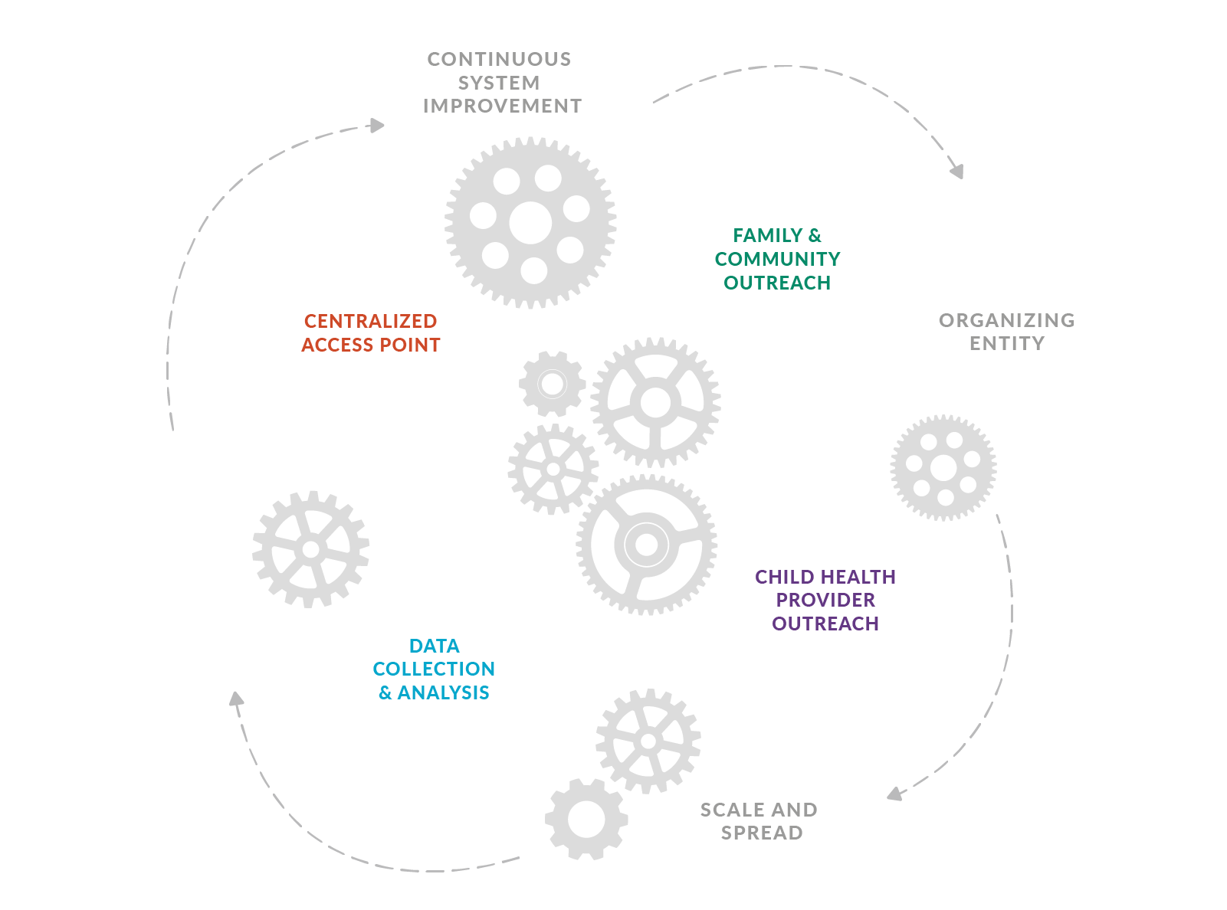
THE HELP ME GROW MODEL

Slide 9
What’s your context? Poll Answers
How would you describe your field of work?
What do you think of when you hear the term “goal concordant?”

Slide 10
What is Goal Concordant Care?

Slide 11
History of Goal Concordant Care
From palliative care
Identifies what a patient wants for their care in the context of their clinical situation
Involves shared decision-making between patient and provider

Slide 12
Goal Concordant Care in Multiple Contexts
Focusing on the end goals of users
Distinguish between needs (deficit) and wants (asset)-> can open up important conversations and ultimately put power back in the hands of the end user

Slide 13
Help Me Grow Model Progression Advancing Goal Concordant Care via Help Me Grow
Family engagement
Voice of the Family
Family Co-Production
Goal Concordant Care
Goal Concordant Care:
Engagement of those targeted by our programs, services, and systems to define the goals, efforts, and meaningful measures and metrics for our work.

Slide 14
Goal Concordant Care in the context of Help Me Grow
A strength-based approach to eliciting parents’ goals for their child’s well-being that ensures parents’ goals drive the process of developmental promotion, early identification of concern and need, referral and linkage
GCC offers the opportunity for HMG to advance a paradigm shift where parents and caregivers are partners in decision-making, and resources provided are in concordance with the goals, aspirations, and values of the family
Talking to parents about goals matters:
Helps shift power dynamics
Leading with priorities improves satisfaction, adherence and outcomes
Notes:
MELISSA

Slide 15
GCC PILLARS for Help Me Grow
Trust: respect parent’s expertise of their child’s development and utilize their goals for their family in prioritizing resources and referral.
Agency: parent’s knowledge, skills, and resources are equal inputs into the goal identification and prioritization process.
Partnership: a shared approach among multiple child-serving sectors that elicits and values parent’s goals as a key driver for resource identification and allocation.
Communicate: parent’s goals are shared among partners when closing the feedback loop and in linking to community-based resources and services.
Notes:
JACQUELYN (replace if there are other better slides)

Slide 16
Goal Concordant Care Practices for Help Me Grow
Individual
Elicit parent goals at the onset of engagement
Validate parent goals
Negotiate and align parent goals with provider priorities, if needed.
Document parent goals and next steps.
Communicate parent goals when making referrals and closing the feedback loop
Monitor and ensure resources and linkage are aligned with parent goals and provider priorities
Organizational
Systematize individual approaches to goal concordant care through training, policies, and quality improvement
Engage team members in capacity building activities, such as training, coaching, and mentorship, to enhance their ability and skills to implement GCC practices and document their efforts
Provide the infrastructure necessary, such as data collection systems, to support implementation of GCC practices
System
Maintain a coalition that champions parent’s goals and needs to guide developmental promotion, early identification, referral and linkage to community based services
Document and share at an aggregate parent’s goals
Ensure universal and equitable access to early childhood services and resources that address parent’s goals
Set community goals that are reflective of families priorities and needs
Notes:
JACQUELYN (replace if there are other better slides)

Slide 17
Advancing Goal Concordant Care via Help Me Grow
The project seeks to study how the health, development, social, and well-being goals prioritized by parents/caregivers for their young children might be further advanced by applying a novel GCC framework within the context of the evidence-based HMG early childhood system model.
Adapting and Adopting the Term Goal-Concordant Care for HMG
High quality support for families is:
Guided by families’ goals and values.
Respectful of families’ preferences and boundaries.
Dependent on open, continuous communication and asking meaningful questions to elicit families’ points of view.
Dependent upon well-trained providers who understand why and how to work in a way that advances families' self-determined goals.
A shift in the power dynamic. It moves barriers out of the way and creates space for family autonomy and shared power where the provider role is to meet caregiver, versus clinical, priorities.

Slide 18
What would “Goal Concordant Care” mean in your context?
How do you center the voice of your end user as a driver of your work?
How do you focus service provision on assets, in addition to meeting needs?

Slide 19
The Help Me Grow Goal Concordant Care Project

Slide 20
The Help Me Grow Model
Core Components and Key Activities
Centralized Access Point
1. Specialized child development line
2. Linkage & follow-up
3. Researching Resources
4. Real-time Director Maintenance
Family & Community Outreach
1. Utilize community partners
2. Networking
3. Community events & trainings
4. Marketing
Child Health Care Provider Outreach
1. Physician Champion
2. Surveillance and screening
3. Physician training
4. Feedback loop
Data Collection and Analysis
1. Reporting
2. Sharing data across partners
3. Continuous system improvement
4. Community change through data
Structural requirements:
Organizing Entity
Continuous System Improvement
3. Scale and Spread

Slide 21
Goal Concordant Care Learning Community: Why are we here?
Within the context of HMG, goal concordant care is defined as a strength-based approach to eliciting parents’ goals for their child’s well-being that ensures parents’ goals drive the process of developmental promotion, early identification of concern and need, referral and linkage
Notes:
GCC offers the opportunity for HMG to advance a paradigm shift where parents and caregivers are partners in decision-making, and resources provided are in concordance with the goals, aspirations, and values of the family

Slide 22
The Help Me Grow Model with a Goal Concordant Framework
Goal Concordant Care
Centralized Access Point
1. Specialized child development line that utilizes a strength-based approach to eliciting parent’s goals for their child’s well-being
2. Linkage & follow-up includes the sharing of parent’s goals
3. Researching Resources
4. Real-time Director Maintenance
Family & Community Outreach
1. Utilize community partners
2. Networking events on the importance of eliciting and attending to parent’s goals
3. Community events & trainings that encourage and validate parents’ communication of their goals
4. Marketing that embraces parents’ goals when navigating resources and services
Child Health Care Provider Outreach
1. Physician Champion
2. Surveillance and screening
3. Physician training on eliciting and attending to parents’ goals as a key element in promoting children’s optimal healthy development
4. Feedback loop includes parents’ goals
Data Collection and Analysis
1. Reporting
2. Sharing data across partners includes parents’ goals
3. Continuous system improvement efforts are guided by data inclusive of providers’ and parents’ goals
4. Community change through data
Structural requirements:
Organizing Entity
Continuous System Improvement
3. Scale and Spread
Notes:
https://helpmegrownational.org/goal-concordant-care-family-community-outreach-be-strong-families-learning-community-branch/framework-for-advancing-goal-concordant-care-through-hmg-implementation_13april2022-2/

Slide 23
Project Design: Learning Community with 4 “Branches”
HMG GCC Learning Community
Child Health Care Provider Outreach
Partner: Healthy Outcomes from Positive Experiences (HOPE)
Strategy: a “moment of HOPE” (eliciting family goal + discussing HOPE Building blocks) during well visits, and referral to HMG
HMGs: Butte CA, Connecticut, Oakland MI
Centralized Access Point
Partner: University at Buffalo Motivational Interviewing Center
Strategy: Motivational Interviewing during CAP calls to elicit family goals
HMGs: Long Island NY, Orange County CA, Kansas
Family & Community Outreach
Partner: Be Strong Families
Strategy: Parent Cafes that encourage family goal setting
HMGs: DC, Northwest Florida, Marin County CA
Data Collection & Analysis
Partner: Center for the Study of Social Policy, All Good Consulting
Strategy: Continuous System Improvement & data sharing across sectors
HMGs: Alaska, Delaware, Utah

Slide 24
Uncharted Territory
North Star= How did our changes impact families?
How did our changes impact us as providers/systems?
Destination: Early childhood systems that center parents’ goals to drive the process of developmental promotion, early identification of concern and need, referral and linkage
Starting Point: Early childhood systems that serve parents around developmental promotion, early identification of concern and need, referral and linkage
Notes:
We know where we are headed, and we have a plan to get there based on our Framework and the ensuring Learning Community structure that is built upon it. We’re also well-prepared for the journey, as this way of thinking is not novel for HMG folks, and we have a great team with us in the form of our Capacity Building Partners. But as we move forward into uncharted territory, we are going to come up against unforeseen barriers and renavigate as needed.
Our North Star:
We’re also charting the map as we go so that we can establish a trail for future adventurers. This means we need to understand a lot about our process, how things that we’re not even thinking about might be impacted, what worked, and what DIDN’T work.

Slide 25
GCC Study: 4 Populations of Interest
12 HMG Systems
Individual HMG Team Members
Parents/Caregivers
Healthcare Providers & Referral Partners

Slide 26
GCC: Three Levels of Project Evaluation
(1)
HMG Model
Universal metrics--all 4 branches
Data collection methods determined locally
Document in HMG System-Specific Action Plan by 12/12/22
Report in Quarterly All-System Report (via link provided by HMG National Center)
Core Component (CC) level
Extent to which enhancements are implemented with integrity
How integration of strategies impacts HMG CC Key Activities
Measured by CBP’s existing forms of evaluation
Informed by Quality Improvement (QI)
Document in HMG System-Specific Action Plan by 1/31/22, with ways to capture and summarize on data
(2)
Branch
(3)
HMG System
Based on system-specific priorities
Indicators not captured at Model or Branch levels
Document in HMG System-Specific Action Plan by 1/31/22, with ways to capture and summarize data

Slide 27
Co-Design of Project
Initial trainings in evidence-based strategies to be tested
Co-designed application of strategies to HMG Model; iterative evaluation planning
Implementation & continuous quality improvement

Slide 28
Your Turn
Based on the project design presented, what questions or concerns would you have?
How would you go about understanding the impact of the work on the “end user” (in this case, young children and their families?)

Slide 29
Initial Findings and Lessons Learned (so far)

Slide 30
Family Input Session (near start of project)
Experiences of families with young children
What are they experiencing?
What would they like to experience?
Whether and why to talk to parents about goals
Do parents see goals as different than needs/ concerns? Why does it matter?
Implications for HMG
What opportunities, changes, or challenges might HMG systems want to consider?
What are potential implications for the HMG Model?
Why talk to parents about goals?
Notes:
12 Family Leaders (parents/caregivers) recruited from HMG systems: HMG Alaska; HMG Delaware; HMG of Marin County, California; HMG Utah
Similar to a focus group
Conducted virtually, via Zoom
Co-designed/moderated by All Good Consulting & Center for the Study of Social Policy
Zoom transcription and field notes used to chunk/code verbatim data into themes
Unique population of parents who have experience obtaining services from HMG, being part of HMG system teams, engaging regularly with other parents
Findings to be considered/contextualized within larger study findings

Slide 31
Key Takeaways
1 | Trusted, affirming environments and interactions are important to parents in their early childhood system experiences.
2 | Parents want to see balanced power dynamics among parents and medical, education, service providers.
3 | HMG Family Leaders believe that parents think of goals as different than needs, concerns, or priorities, with goals being aspirational, positive, and empowering.
4 | When early childhood providers recognize and respect family goals, parents sense a shift in power dynamics.
5 | Family Leaders find it desirable for HMG systems to discuss goals/aspirations with parents, in addition to needs/concerns. They see potential for HMG to lead in shifting power dynamics in early childhood systems.
6 | Families with young children would appreciate concrete tools/supports to identify and track progress toward their goals.

Slide 32
Parents See Goals as Different than Needs/Concerns
NEEDS | GOALS
Immediate/Short-term priority | Long-term
Essential for survival | Aspirational/visionary
Often concrete in nature | Often abstract in nature
Prerequisites to goal realization/”stepping stones” | Broader level
Deficit-driven | Strengths-aligned; value-based
Examples cited by participants: Food Shelter/housing Clothing Safety Health Care/medicine Speech therapy Basic human rights Transportation | Examples cited by participants: Being ready for kindergarten Healthy, thriving children prepared for life Financial security Comfortable lifestyle Obtaining a college degree Being a healthy individual Being productive in society Career or sports achievements
KEY QUOTES
“Needs are what we need to survive (food, shelter, safety, etc.). Goals are more of what we wish for our children.” “Needs are basic human rights; things like safety, health, food, and shelter. Once basic needs are met, humans can reach for and achieve goals, which are hopes and aspirations.” “You can have needs and goals simultaneously, but when the needs are met first, it’s easier to dream bigger for longer-term goals.”

Slide 33
What Matters Most to Families with Young Children
HMG Parent Leaders shared what they consider most important to families w/young children.
Health & Well-being of Their Children
“Their kids are safe, healthy, and protected”
“Basic needs covered”
Feeling Affirmed & Confident
“Knowing they are enough”
Relationships & Connection
“Knowing you are not alone; we’re all here together”
“Spending time with their children and nurturing them”
“Safety and growth of their children”
“Learning to listen to, develop, trust their own voices”
“Reassurance that they’re doing the right things as parents”
“Feeling like everything is possible”
Having a Sense of Power
“Connection to community peers”
“Good relationships”
“In control of their goals”
“Making a positive future”
“Dignity”
“Having choices”
“Being respected”
“Being supported by people who show compassion”

Slide 34
Challenges for Families in Progressing toward Goals
Parents frequently feel distressed about immediate concerns and short-term family needs. They need help resolving these so they can chart a pathway toward goals.
Feeling overwhelmed
Lack of knowledge of available resources and accessibility
Lack of resources
Language and cultural barriers
Technology access, technology “literacy”, other technology challenges
Parent literacy
Differing priorities between families and providers

Slide 35
The Importance of Relationship Building
Within early childhood systems, parents are looking for relationship-building and trust with those who provide support and services.
What does an effective, trusting relationship look and feel like for parents?
Common life experiences and/or shared cultures
Language(s) spoken
Mutual respect; no judgment or shaming
Recognize family’s strengths/things that are going well
Ask permission before sharing information or making suggestions
Two-way “information/knowledge sharing” versus “being educated by an expert”
Do what has been promised/agreed upon (“follow-through”)
Be “human” and show authentic care
Show empathy for challenges
Follow up regularly (as appropriate) to assess family’s well-being and help problem solve, provide additional assistance if needed
Remember/track personal details of family’s situation

Slide 36
Shifting the Balance of Power: A Parent-led Agenda
“It’s better to identify what parents need instead of providers being like, ’This is what you need.’”
“See the strengths [families] already have. Help them realize they’re already a leader.”
“Providers, don’t go in with your goals and your agenda; it’s an immediate shutdown [for parents].”
“Let parents lead, especially at the initial stages when you’re just building trust.”
“It just seems like a foolish plan [to lead with provider goals]. People are going to work toward what they feel is important, so you just have to go with what parents’ priorities are.”
“There should be information and education back and forth [between providers and parents]. People on both sides have a pretty good reason for that being their priority.”
“Your own values [as a provider] need to take a sidestep; you really need to put that in a compartment and guide the family and focus and facilitate.”

Slide 37
Initial Findings from Project
95%
Participating HMG system
team members “Strongly Agree/Agree” a goal-considerate approach has the potential to improve how they can serve their families
32%
Increased understanding of why and how to engage families in goal elicitation and discussion among HMG team members
1 → 11
11 out of 12 systems now inquire about parent goals when Family Support Specialists communicate with families.

Slide 38
Where Are We after Project Quarter 2?
Greater knowledge and confidence in understanding the “spirit” of GCC and branch enhancements
Exploring GCC feasibility and operationalizability within HMG Model, with full implementation of branch enhancements just beginning
Continued need to vet parent, provider, and service partner receptivity to a goal-concordant approach within different HMG communities
Assessing what a goal-concordant approach might actually mean for HMG and how that may impact the HMG mission and model
AUCD.ORG

Slide 39
HMG affiliate systems: Eliciting, documenting, and sharing parents’ goals provides promising opportunities:
A HMG-parent conversation around family goals can provide value to parents by being strengths-based and power-equalizing;
HMG systems can better match information, referrals, and follow-up activities to holistic intents of families, with the potential for greater follow-through;
Intentional consideration of goals enhances relationship-building and results in repeated, ongoing use of HMG services by families; and
Sharing and consideration of parents’ strengths, goals, priorities, and aspirations adds value to coordinated referral and follow-up with multiple sector partners.

Slide 40
The HMG GCC project: Themes
Responsibility: To what extent does asking about goals make HMG responsible to "deliver" on goal achievement?
Sustainability: How do we sustain practices that may require ongoing training, staff capacity, and supervision?
Ethical Concerns: How do we share goals with partners that may not be prepared to receive them?
Spirit of a Parent-led agenda: How do we make sure the spirit of elevating parent voice and family choice is not overshadowed?
Notes:
[introduce the above themes]
we validate all of the themes and questions coming up. we have the same questions, and we're going to come to these answers together. That’s why we’ve taken a learning community approach
HMG has always believed that parents know their children best. we’re looking at GCC to better center families as experts across the early childhood field
What is HMG’s responsibility now? When a parent or provider connects with HMG regarding a concern or need, we connect to CB services and supports. HMG is not responsible for remedying the concern or closing the developmental trajectory gap.
What practices do we want to sustain? Are there outcomes from some of our PDSA’s that garner better insight, access or approaches to supporting families?
What data and with whom do you currently share data with? How do you share that data? Potentially child development, health and wellbeing goals are categorized by type or domain and then reported out to partners in the aggregate.

Slide 41
Key Issue: “Measuring” goal concordance
Attempts to have a standardized question for families after receiving their respective intervention… did not work
Switched to two categories of questions that could be decided upon in each branch:
1. Family Satisfaction with Interaction: This question should be posed to parents at the end of each interaction with the HMG CAP*, regardless of the type or frequency of the interaction. The question to assess Family Satisfaction with an Interaction is, “Were you satisfied with the support I provided just now?”
2. Family Feelings about Interaction: This question should be posed to parents at the end of each interaction with the HMG system, regardless of the type or frequency of the interaction. The question to assess Family Feelings about an Interaction is, “Do you feel I addressed what mattered most to you?”
This still did not work for many! Because of the nature of the interaction with families, many HMGs felt that asking these questions was not garnering meaningful answers

Slide 42
Applying GCC To Your Work

Slide 43
Discussion
How might the activities and initial findings from Help Me Grow’s Goal Concordant Care project be relevant to your work?
What opportunities are there in your field to improve goal concordant practices?
How might you measure “goal concordance” in your work?

Slide 44
The Future: Transforming Systems to be Goal Concordant

Slide 45
Next Phases for Our Work
Finish project in October 2023
Review and publish results
Scale up any meaningful strategies across our Network
Identify key strategies and measures of goal concordance and update our Model and measurement accordingly
Build out capacity (skills, knowledge, etc.) of leaders and invest in community “infrastructure” to design and implement systems of care driven by family goals

Slide 46
A Vision for the Future
The “end user” (families) is the driving force in the care they receive
Shift in power dynamics among “providers” and “recipients” can advance equity and improve outcomes
What is your vision?

Slide 47
HELPMEGROWNATIONAL.ORG

