Slide 1
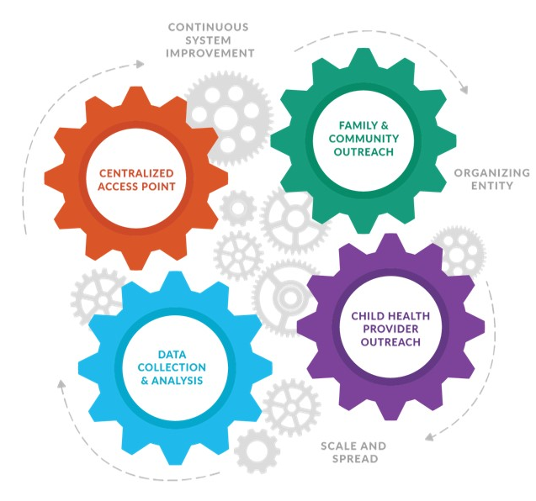
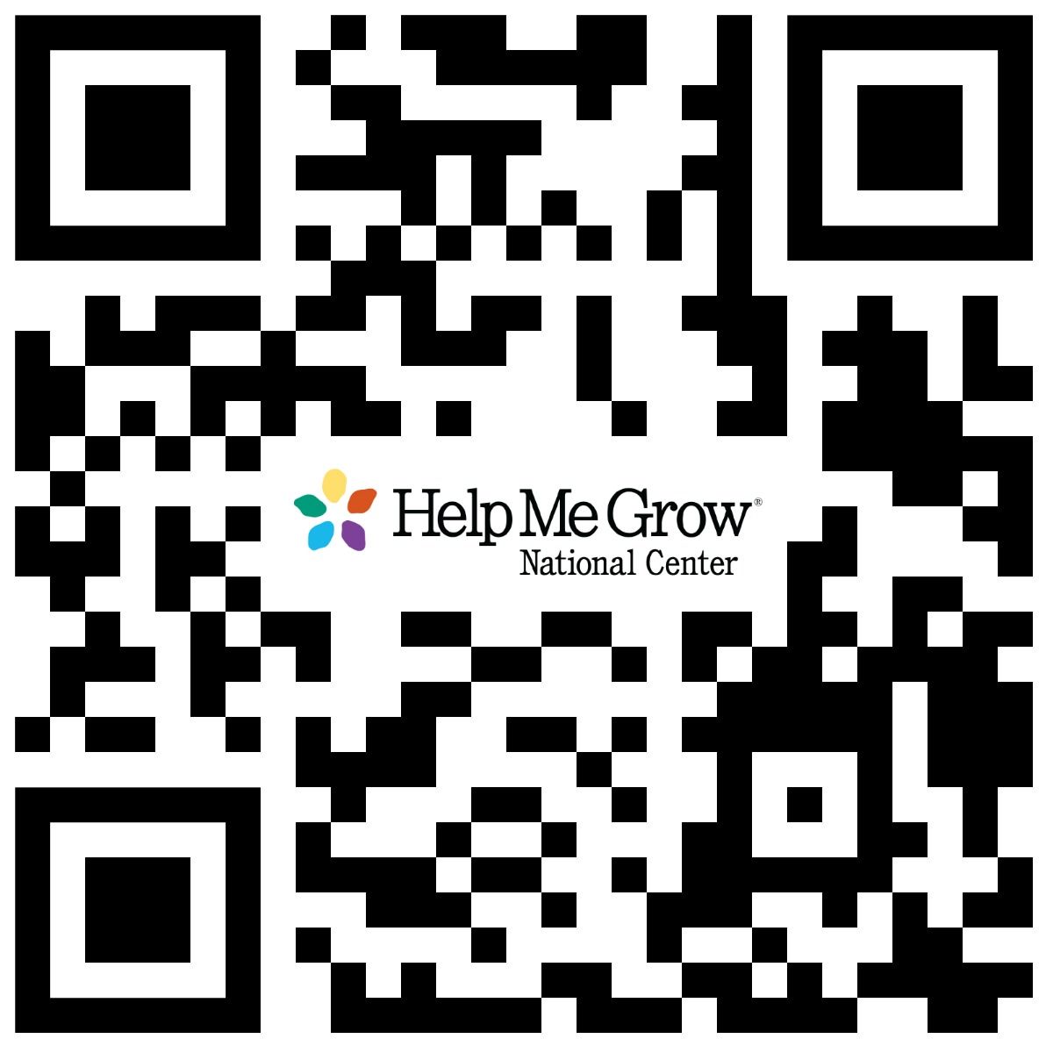
Expanding the Target Population for Early Detection Through Parent Engagement
Kimberly Martini-Carvell, MA, Executive Director, Help Me Grow National Center
THE HELP ME GROW SYSTEM MODEL
APPROACH
Four cooperative and interdependent Core Components characterize the Help Me Grow (HMG) Model:
Implemented as a Hybrid design:
Learning Community
12 diverse HMG affiliate systems, their healthcare and service agency partners, family leaders
4 expert capacity-building partners
HMG National Center
Exploratory Study
Tested enhancement strategies aligned with Core components of the HMG Model
ENHANCEMENT STRATEGIES
A Centralized Access Point assists families and professionals in connecting children to the grid of community resources that help them thrive.
Family & Community Outreach builds parent and provider understanding of healthy child development, supportive services available to families in the community, and how both are important to improving children’s outcomes. When potential concerns are spotted early on, they can be easier to address.
Motivational Interviewing
Centralized Access Point
University at Buffalo Motivational Interviewing Center
Healthy Outcomes from Positive Experiences (HOPE)
Child Health Care Provider Outreach
HOPE National Resource Center, Tufts University
Parent Cafés
Family & Community Outreach
Be Strong Families
Continuous System Improvement & Data Sharing Across Sectors
Data Collection & Analysis
Center for the Study of Social Policy; All Good Consulting
HMG CORE
COMPONENT
Data Collection & Analysis supports evaluation, helps identify systemic gaps, bolsters advocacy efforts, and guides quality improvement.
Child Health Care Provider Outreach supports early detection and intervention efforts and connects medical providers to the grid of community resources to best support families.
EXPERT PARTNERS
It is the cooperation of these four HMG Core Components that characterizes the HMG Model. HMG is a vehicle to achieve this cross-sector collaboration and increase a community’s opportunity to achieve positive child- and family-level outcomes. HMG, through its Model of four Core Components, serves as a novel approach as it goes beyond child health providers to include a variety of other community-based settings and sectors.
PRELIMINARY FINDINGS
BACKGROUND & RATIONALE
Family-Perspective: When parents/caregivers are engaged in discussion of their goals and priorities (in addition to their needs and concerns):
Families feel more heard, understood, and respected;
Families receive information and referrals from HMG that are better aligned with their families’ situations and aspirations;
Longer, trusted relationships can be built: less “transactional” and driven by short-term need resolution;
Power dynamics shifted to elevate parent voice, family choice, and merge parent and providers’ priorities; and
Parents’ and providers’ strengths and knowledge of children can be collaboratively applied to meet children’s needs and family aspirations.
HMG affiliate systems: Eliciting, documenting, and sharing parents’ goals provides promising opportunities:
A HMG-parent conversation around family goals can provide value to parents by being strengths-based and power-equalizing;
HMG systems can better match information, referrals, and follow-up activities to holistic intents of families, with the potential for greater follow-through;
Intentional consideration of goals enhances relationship-building and results in repeated, ongoing use of HMG services by families; and
Sharing and consideration of parents’ strengths, goals, priorities, and aspirations adds value to coordinated referral and follow-up with multiple sector partners.
95%
Participating HMG system
team members “Strongly Agree/Agree” a goal-considerate approach has the potential to improve how they can serve their families
In the United States, more than half of children who enter kindergarten are delayed in their health, social emotional, or cognitive development, despite widespread awareness that the early years of life have a significant and lasting impact on children’s learning, behavior, and health, which influences their readiness to succeed in school and achieve lifelong well-being [1,2]. Expanding the early identification process to include other child and family priorities and needs, such as resources like concrete and social supports, is a predictor of positive child outcomes. Eliciting family needs and priorities to support goal-making and service delivery is not only predictive of concerns, but honors the importance of the family’s values and perspective in decision-making. In this way, eliciting goals to drive care also shifts power dynamics back into the hands of families, a step necessary to advancing equity. Embedding family voice within a comprehensive and integrative process focusing on early identification can improve child and family well-being. Family well-being can lead to positive outcomes for all young children, especially those who experience social and environmental risk factors and identified delays and disorders [3]. Therefore, to foster positive short- and long-term outcomes for young children, it is necessary to systematically elicit parents’/caregivers’ goals and priorities and establish partnership with them in creating pathways toward achievement of health and developmental goals for their children.
It has been recognized that the existing system designed to ensure early detection of and support for the young children and families furthest from opportunity is fragmented and exceedingly difficult to navigate. Cross-sector collaboration and alignment, inherent in HMG, is necessary to strengthen capacity among communities to identify concerns and needs of children and families as early as possible. Multiple settings and sectors across the early childhood system, including child health care, child welfare, social services, education and care settings, home visiting, parent support, and many others must be engaged and active as authentic partners in early childhood system-building.
Goal Concordant Care, in the context of HMG, is a strength-based approach to eliciting parents’ goals for their child’s well-being that ensures those goals drive the process of developmental promotion, early identification of concern and need, referral, and linkage. Typically used in palliative care and those with complex medical needs, it has the potential to be applied broadly [1]. It offers an opportunity to advance a paradigm shift where parents and caregivers are partners in decision-making, and resources provided are in concordance with goals, aspirations and values of the family. [4,5]
32%
Increased understanding of why and how to engage families in goal elicitation and discussion among HMG team members
1 → 11
11 out of 12 systems now inquire about parent goals when Family Support Specialists communicate with families.
LESSONS LEARNED
Initial findings from the current GCC project demonstrate the need for enhanced capacity to support sustainable early childhood systems driven by family goals.
Our country - including families with young children, the early childhood field at large, and the HMG Affiliate Network - is at an inflection point. The COVID-19 pandemic has highlighted the inequities and cracks inherent in the systems of care for families. This, along with rollbacks in Medicaid, changes to reproductive care, inflation, and unprecedented turnover across family-serving providers creates a necessity and opportunity for “building back better” to ensure that all families receive the support they need for their children to thrive. HMG affiliates across the country are leveraging existing resources to build an infrastructure to navigate this increased need, but are not immune to the realities of turnover and funding that can negatively affect their impact.
HYPOTHESIS
There is significant potential for Goal Concordant Care (GCC) to be an important driver for early childhood system transformation. Additionally, the HMG Model’s Key Activities provide multiple opportunities to integrate processes that can support parent/caregiver goal elicitation and identification, which then serve as the imperative for how HMG organizes its response and resources. Child health and well-being outcomes are strongly correlated to parents’ and caregivers’ capacity to strengthen their family’s protective factors and access appropriate resources and support when needed.
GCC STUDY FRAMEWORK
NEXT STEPS
PILLARS OF GOAL CONCORDANT CARE
Trust: Respect parents’ expertise of their child’s development and utilize their family goals in prioritizing resources and referral.
Agency: Parents’ knowledge, skills, and resources are equal inputs into the goal identification and prioritization process.
Partnership: A shared approach among multiple child-serving sectors that elicits and values parents’ goals as a key driver for resource identification and allocation.
Communication: Parents’ goals are shared among partners when closing the feedback loop and in linking to community-based resources and services.
GCC & the Well-Visit: Expanding to the primary care setting; a demonstration study to adapt, develop, and test clinical workflows and protocols to tailor and individualize the goals of pediatric primary care in partnership with parents and caregivers.
Expansion & Scale: The proposed next phase of the GCC project will build the capacity of the HMG National Affiliate Network to implement strong early childhood systems guided by family goals. To accomplish this, we will apply lessons learned from the current phase of the project to provide support to the HMG affiliate Network on three levels: universal (offerings that impact everyone, such as Model and Fidelity adaptations, webinars, toolkits, etc.), targeted (offerings focused on a small group of systems/professionals in an ongoing, sustainable way), and intensive (offerings that provide individualized coaching and capacity).
System
Maintain a coalition that champions goals, document goals and share in aggregate; ensure access to services that address parents’ goals
This framework was used to support HMG affiliate systems in leveraging existing HMG infrastructure in order to effectively elicit parents’ goals for their child’s well-being and ensure those goals drive resource allocation, decisions, referrals and priorities for service delivery by all community-based providers working with a given family.
REFERENCES
Organizational
Systematize approaches, engage teams, provide infrastructure
Williams PG, et al. (2019) School Readiness. Pediatrics. 144 (2): e20191766.
Isaacs J. (2012) Starting School at a Disadvantage: The School Readiness of Poor Children. Washington, DC: Center on Children and Families at Brookings.
Berger LM and Font SA. (2015) The Role of the Family and Family-Centered Programs and Policies. Future Child. 25(1): 155-176.
Harmon et al. (2023) Goal-Concordance in Children with Complex Chronic Conditions. J Pediatr. 253:278-285.e4.
Jonas D, Scanlon C. and Bogetz J. (2022) Parental Decision-Making for Children with Medical Complexity: An Integrated Literature Review. J Pain Symptom Manage. 63(1):e111-e123.
Help Me Grow National Center Goal Concordant Care website: Advancing Goal Concordant Care Through Help Me Grow Implementation - Information & Materials | Help Me Grow National Center
Individual
Elicit, validate, negotiate, document, communicate, monitor goals
Funder: This work was funded by The JPB Foundation: Embedding Goal-Concordant Care in HMG Affiliate Systems, November 1, 2022 – October 31, 2023

