Slide 1
From “Voice of the Family” to “Goal-Concordant Care” in Early Childhood System Building
Paul H. Dworkin, MD
Environmental and Social Determinants of Child Mental Health
The Picower Institute for Learning and Memory
May 11, 2023

Slide 2
“Humans are not ideally set up to understand logic; they are ideally set up to understand stories.” - Roger Schank, PhD, cognitive neuroscientist

Slide 3
The Journey to Goal-Concordant Care
Family Engagement
Voice of the Family
Co-Production
Goal-Concordant Care

Slide 4
The Question
“How do we best transform child health services to promote children’s optimal health, development, and well-being?”

Slide 5
Mission of Child Health Services

Slide 6
Phase 1: Strengthening the Content (1970’s-1980’s)
CHILD HEALTH
SERVICES

Slide 7
Child Health Supervision
History
Physical examination
Measurements
Sensory screening
Immunizations and procedures
Anticipatory guidance
Developmental and behavioral monitoring

Slide 8
Does developmental content influence effectiveness of anticipatory guidance?
Prospective, controlled study to evaluate the value of discussing developmental themes with mothers during health maintenance visits
Suggested Issues for Discussion During Health Maintenance Visits
Age of Infant | General Issues | Developmental Themes
2 weeks | Feeding, sleeping, elimination patterns | State organization, attachment, temperament

Slide 9
Does developmental content influence effectiveness of anticipatory guidance?
Implications from research
Anticipatory guidance should continue to be emphasized as a means to promote children’s development
Need to individualize the content: discuss matters at level of parents’ cognitive, cultural, psychological readiness
Open-ended, parent-led agenda may be preferable
Dworkin P, Allen D, Geertsma A, Solkoske L, Cullina J. Does developmental content influence the effectiveness of anticipatory guidance? Pediatrics 1987;80:196-202.

Slide 11
Recommendations for developmental monitoring
Criteria for judging conditions appropriate for the screening process:
Must have significant morbidity or mortality and be sufficiently prevalent
Screening program must include entire population
Diagnostic tests must distinguish affected from non-affected persons
Condition must treatable or controllable
Detection and treatment during asymptomatic stage much improve prognosis
Adequate resources must be available for definitive diagnosis and treatment
Cost of screening must be outweighed by savings in suffering and alternative expenditures

Slide 12
Recommendations for developmental monitoring
Criteria by which specific tests are judged appropriate for use in screening programs:
Simple, convenient, acceptable
Reliable, valid (sensitive and specific)
Economical
Lend themselves to easy interpretation

Slide 13
Recommendations for developmental monitoring
Family Context: Validity of parent’s appraisals (opinions and concerns)
Glascoe FP, Dworkin PH. Obstacles to effective developmental surveillance: errors in clinical reasoning. J Dev Behav Pediatr 1993;14:344‑349.
Glascoe FP, Dworkin PH. The role of parents in the detection of developmental and behavioral problems. Pediatrics 1995;95:829‑836.
Glascoe FP, Oberklaid F, Dworkin PH, Trimm F. Brief approaches to educating patients and parents in primary care. Pediatrics 1998;101(16).

Slide 14
Developmental Surveillance and Screening
Flexible, longitudinal, continuous process in which knowledgeable practitioners perform skilled observations during child health encounters
Components:
eliciting/attending to parents’ concerns
obtaining a relevant developmental history
making accurate observations of children
identifying risk and resiliency factors
sharing opinions with other professionals
periodic administration of formal screening tools
View child within context of overall well-being
Dworkin PH. British and American recommendations for developmental monitoring: The role of surveillance. Pediatrics 1989;84:1000-1010.

Slide 15
Developmental Surveillance and Screening
Caveat
Detection without referral/intervention is ineffective and may be judged unethical
Perrin E. Ethical questions about screening. J Dev Behav Pediatr 1998;19:350-352.

Slide 16
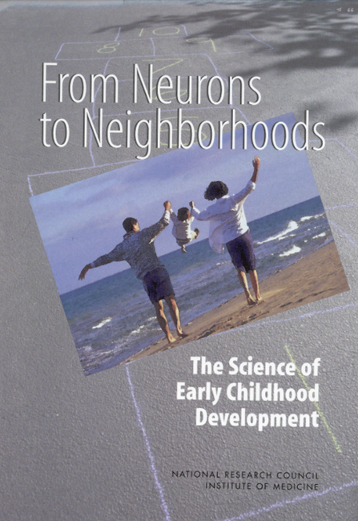
Phase 2: “Decade of the Brain” (1990’s)

Slide 17
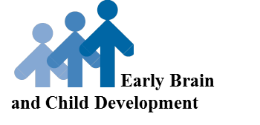
Phase 2: “Decade of the Brain” (1990’s)
Proportional brain growth
Neural plasticity
Critical periods
Sequential development
Role of experience

Slide 18
Developmental Trajectories
Domestic violence
Inaccessible health services
“Healthy” trajectory
Socioeconomic disparities
“At Risk” trajectory
Neighborhood safety and support
Quality ECE
“Ready to Learn”
“Delayed/Disordered” trajectory
Medical home
Protective home environment
Parent education
Emotional health
Health literacy
Prenatal 6 months 12 months 18 months 24 months 3 years 5 yrs
Birth
Early Infancy
Late Infancy
Early Toddler
Late Toddler
Early Preschool
Late Preschool
Graphic Concept Adapted from Neal Halfon , UCLA Center for Healthier Children, Families, and Communities

Slide 19
“The most effective long-term strategy appears to be the development of a comprehensive, coordinated, community-wide approach focused on preventing low- and medium-risk families from becoming high-risk, as well as providing intensive services to those who already have reached a high-risk status.”
Chamberlin RW. Preventing low birth weight, child abuse, and school failure: the need for comprehensive, community-wide approaches. Pediatrics in Review 1992;13(2):64-71.

Slide 21
Hartford, Connecticut

Slide 22
Shared Assumptions
Children with developmental/behavioral problems are eluding early detection
Many initiatives exist to provide services to young children, their families
A gap exists between child health and child development/early childhood education programs
Children and their families would benefit from a coordinated, region-wide system of early detection, intervention for children at developmental and behavioral risk

Slide 23
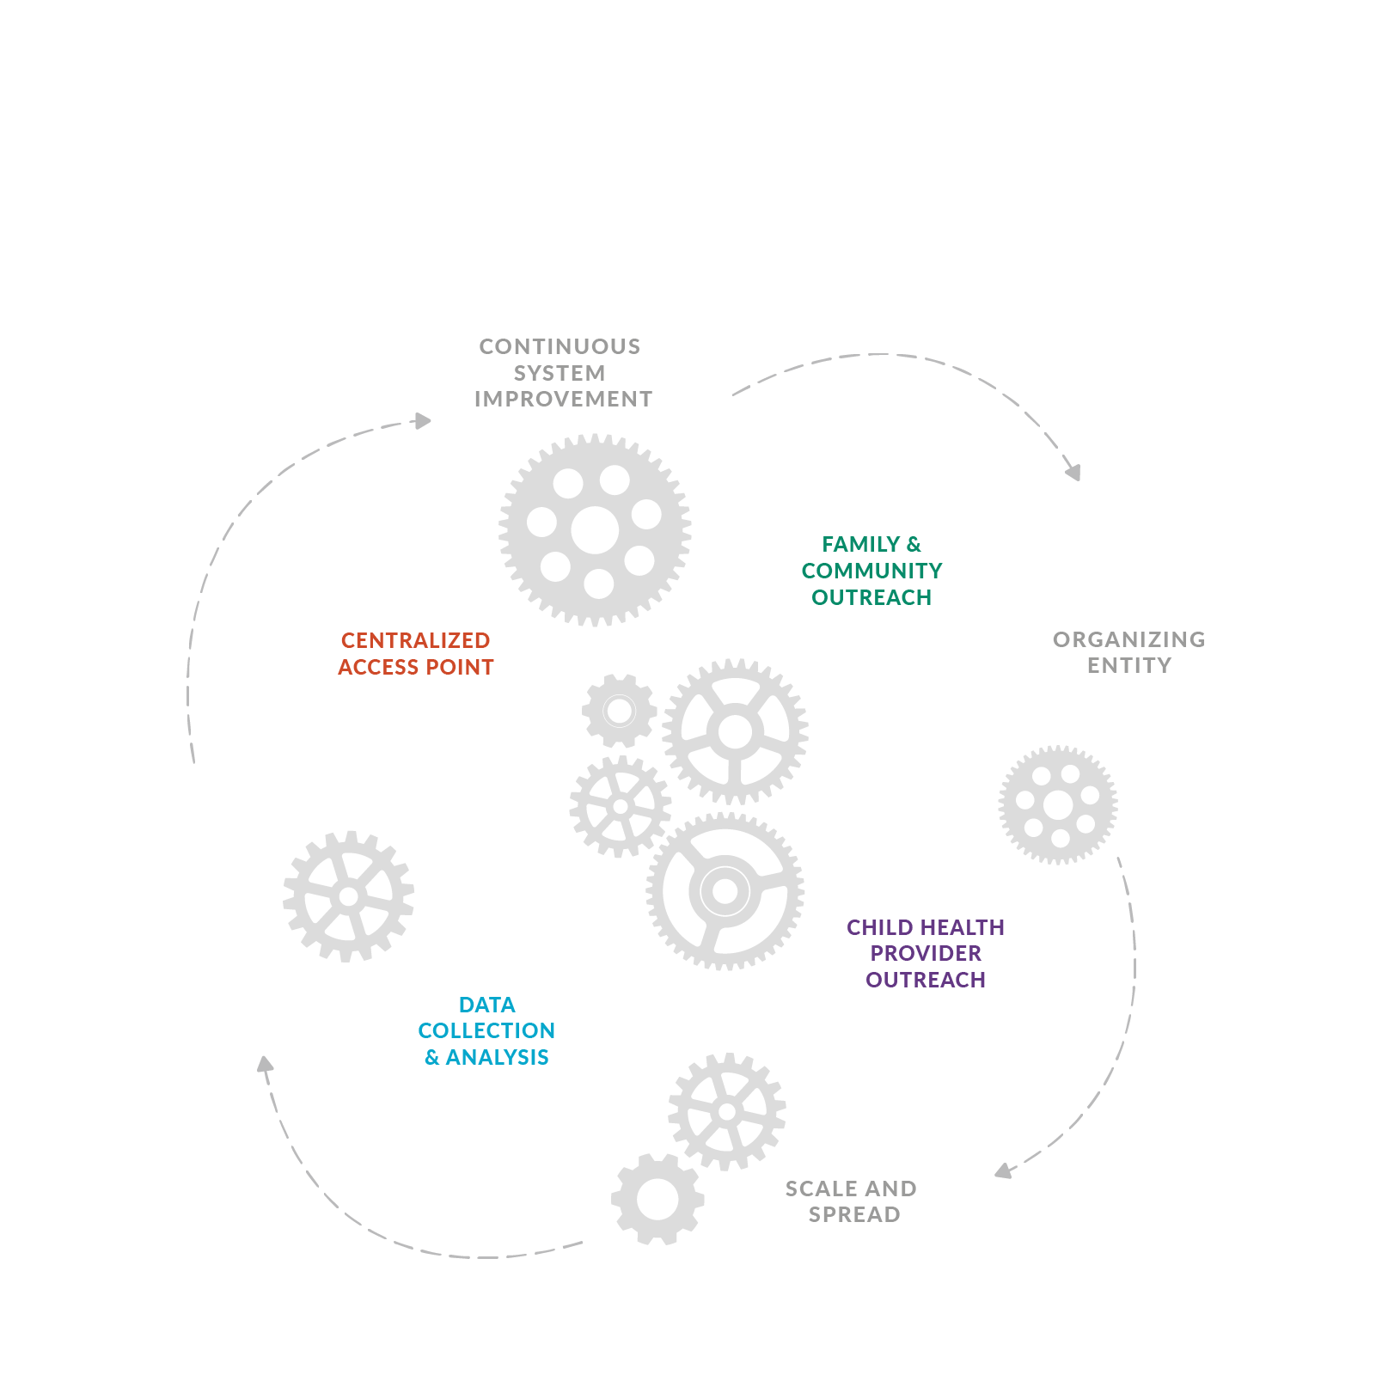
Help Me Grow Model
26

Slide 24
Evolution of Help Me Grow
1997-2004
HMG Pilot and early growth in Connecticut
2005
First HMG replication in Orange County, California
2008-2010
Replication spread to 5 states
2010-2013
Development of the HMG National Center
2014-2023
>140 HMG systems across 31 states and the District of Columbia
24

Slide 26
Phase 3: New Millennium
and the “Biology of Adversity”

Slide 28
Website: https://www.connecticutchildrens.org/community-child-health/
Co-Management
Children’s Center
on Family Violence
(CCFV)
Hartford Youth HIV Identification and Linkage (HYHIL) Program
Injury Prevention Center
Healthy Homes
Easy Breathing
Educating Practices (EP)
North Hartford Ascend Pipeline (Ascend)
Person-Centered Medical Home
Resident Education in Advocacy and Community Health (REACH)
Care Coordination Collaborative Model
Help Me Grow National Center
Center for Care Coordination
(CCC)
Center for Global Health
Connecticut Newborn Diagnosis & Treatment Network
Childhood Prosperity Lab
Start Childhood Off Right (SCOR)

Slide 29
Where Do We Go From Here? Goal-Concordant Care
What? A strength-based approach to eliciting parents’ goals for their child’s well-being that ensures that families drive the process of developmental promotion, early identification of concern and need, referral and linkage.
How? Study the impact of expanding a focus on parent-identified goals through the HMG Model to advance family engagement, family satisfaction, and achievement of parent/caregiver goals for child health, development, and well-being.

Slide 30
How will we determine impact?
Ultimate influence on children’s optimal health, development, well-being
Proximate impact on children and families’ protective factors*
Capture return-on-investment, cost savings, cost benefit to ensure sustainability
*Hughes M, Joslyn A, Wojton MM, O'Reilly M, Dworkin PH. Connecting vulnerable children and families to community-based programs strengthens parents’ perceptions of protective factors. Infants Young Child 2016; 29(2): 114–127. doi:10.1097/IYC.0000000000000059.

Slide 31
The Original Question
“How do we best transform child health services to promote children’s optimal health, development, and well-being?”

Slide 32
The Right Question
“How do we best build comprehensive early childhood systems to strengthen families to promote children’s optimal health, development, and well-being?”

