Slide 1
Title
Help Me Grow: So All Children Can Shine
Meeting Name/Venue
Additional Text
Date
Presenter Name
Title
Affiliation
Part of Connecticut Children’s Office for Community Child Health
www.helpmegrownational.org

Slide 2
What if our goal for early childhood health and development services is not ‘merely’ to treat or even prevent childhood diseases and disorders, but is also to promote optimal healthy development for all children?
www.helpmegrownational.org

Slide 3
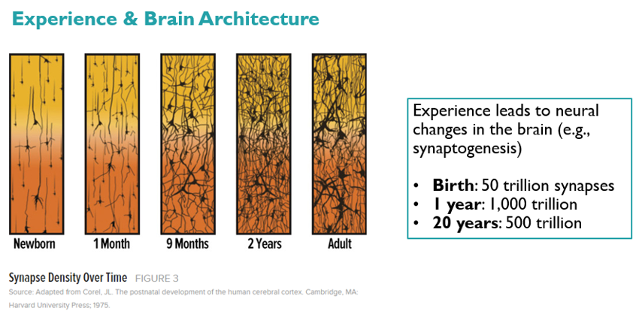
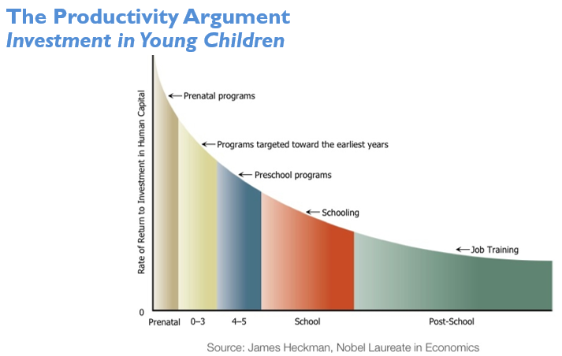
An Opportunity to Maximize Young Children’s Potential
Notes:
The early years present incredible opportunity to build a strong foundation as the brain rapidly develops during the first five years of life.
“A child's brain undergoes an amazing period of development from birth to three—producing more than a million neural connections each second. The development of the brain is influenced by many factors, including a child's relationships, experiences and environment.” – Zero to Three
It is critically important to address health disparities early in life: “Many disparities in health and well-being have roots that can be traced to stressors in early childhood, such as poverty, neighborhood safety and a lack of access to early childhood education. If unaddressed, such stressors can have detrimental effects on children and lead to them being on an “at-risk or vulnerable” trajectory or even a “delayed or disordered” trajectory.” - Dworkin. Addressing Health Disparities Early in Life, Advancing Kids Blog (2016).
The highest rate of economic returns comes from the earliest investments in children, providing an eye-opening understanding that society invests too much money on later development when it is often too late to provide great value. There are huge economic benefits from investing early and building skill upon skill to provide greater success to more children and greater productivity and reduce social spending for society. – Heckman Equation
A better future starts with Help Me Grow. By supporting our young children today, we promote healthier and more prosperous communities tomorrow. – HMG National Center
All children benefit from an organized system of community resources to help them thrive, like health care, quality early learning experiences, healthy nutrition, and parent support. However, when the system is not well organized, it can be challenging for families to access the resources their children need, which can have long-lasting consequences on health and well-being.

Slide 4
What We Know
Children with developmental/behavioral concerns are eluding early detection
Many initiatives exist to provide services to young children, their families
A gap exists between child health, child development, and early childhood education programs
Children and their families would benefit from a coordinated, region-wide system of early detection, intervention for children at developmental risk

Slide 5
What We Know
“The most effective long-term strategy appears to be the development of a comprehensive, coordinated, community-wide approach focused on preventing low- and medium-risk families from becoming high-risk, as well as providing intensive services to those who already have reached a high-risk status.”
- Chamberlin RW. Preventing low birth weight, child abuse, and school failure: the need for comprehensive, community-wide approaches. Pediatrics in Review 1992;13(2):64-71

Slide 6
Help Me Grow
A Solution for All Young Children to Shine

Slide 7
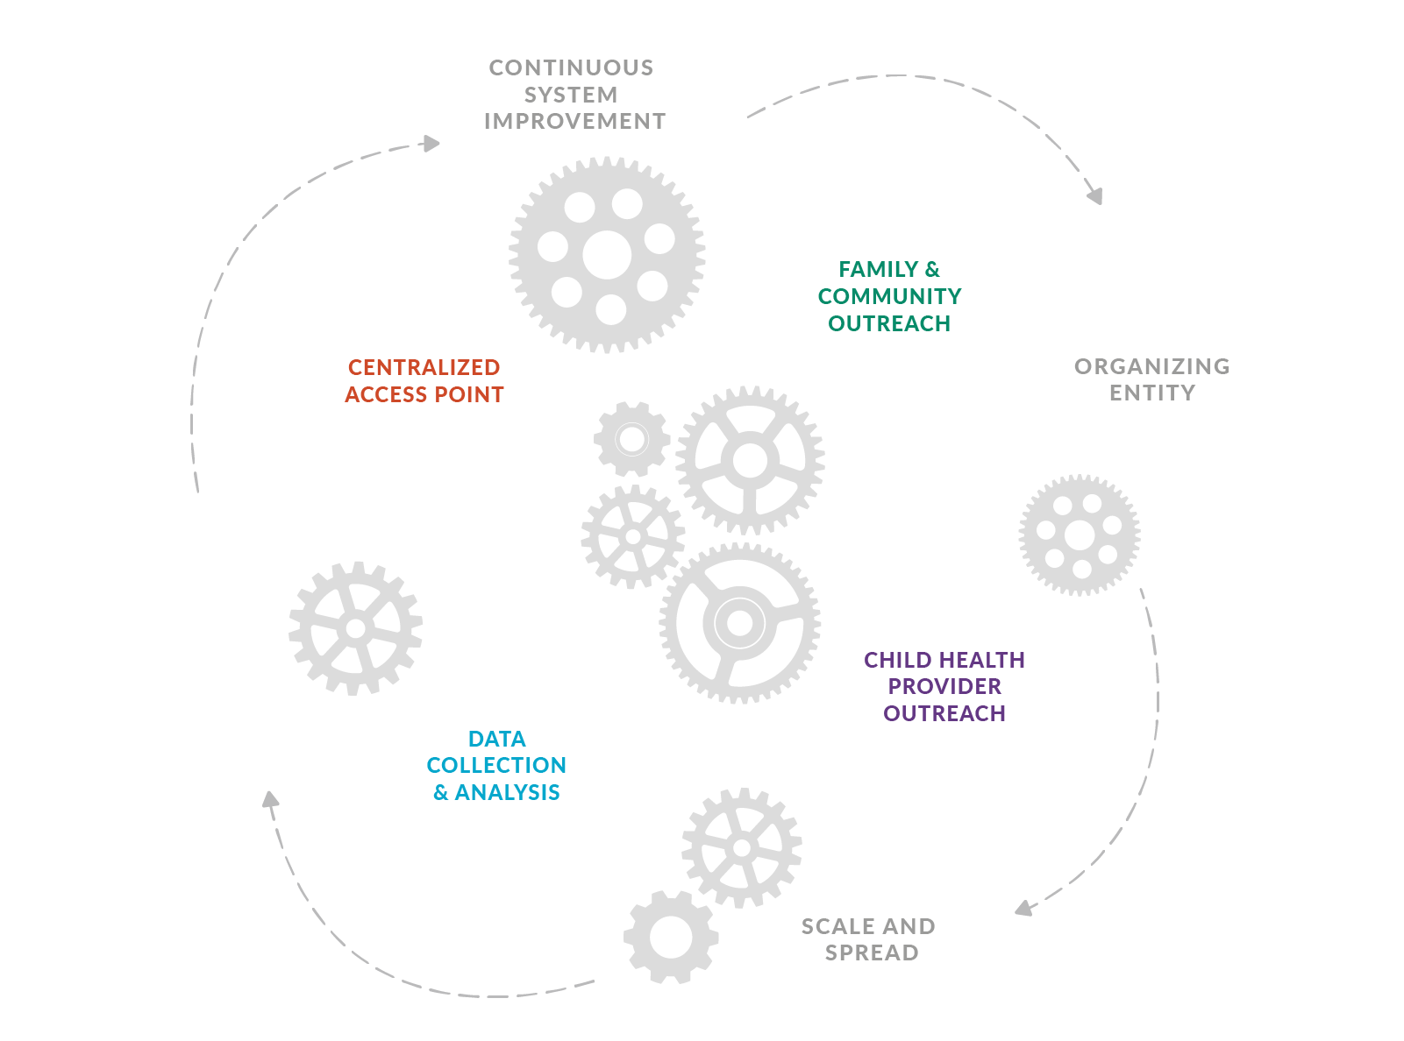
Help Me Grow: Strengthens System Infrastructure
WE BELIEVE THAT ALL CHILDREN SHOULD BE
ABLE TO GROW, DEVELOP, AND THRIVE TO
REACH THEIR FULL POTENTIAL.
The Help Me Grow Model is the only evidence-based early childhood system model existing nationwide.
It provides a unique framework to implement comprehensive, cross-sector, coordinated, effective early childhood systems that promote equity and strengthen family resilience and protective factors.
When all of the organizations working on behalf of young children work together, we can:
Better prevent or reduce the impact that stress or adversity may have on children and families
Increase protective factors that can maximize the well-being of children and families
Advance equity for families with young children

Slide 8
The Help Me Grow Model’s
Core Components & Key Activities

Slide 9
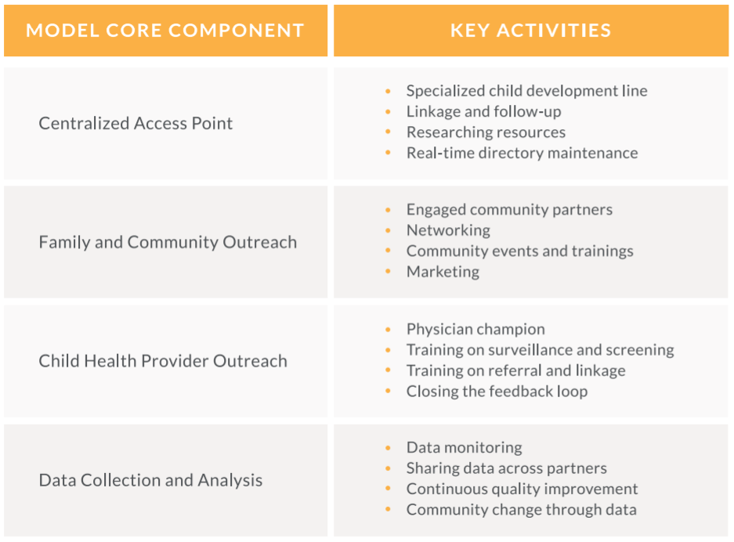
Help Me Grow Core Components & Key Activities

Slide 10
HMG CORE COMPONENT
CENTRALIZED ACCESS POINT
FAMILY & COMMUNITY OUTREACH
Four Key Activities
Specialized child development line
Linkage to service & follow-up with callers and providers
Resources are researched for families
Real-time maintenance of early childhood HMG Resource Directory
CHILD HEALTH PROVIDER OUTREACH
DATA COLLECTION & ANALYSIS
Notes:
The Centralized Access Point typically takes the form of a call center and in more recent years, an accompanying virtual service, that serves as the “go-to” place for family members, child health care providers, and other professionals seeking information, support, and referrals for children. Telephone and web-based services have proven to be effective primary points of access to community resources. They are cost-effective, easy to promote, efficient in identifying needs, and effective in supporting callers and triaging to appropriate services.
The Centralized Access Point connects children and their families to services they need through the efforts of HMG Care Coordinators, Centralized Access Point staff who work to provide education and support to families around specific developmental or behavioral concerns or questions, help families recognize typical developmental milestones, provide referrals to community-based supports, empower families overcome barriers to services, and follow up with them to make sure linkages are successful.
To ensure that callers feel safe, respected, and heard, the Centralized Access Point must be adequately staffed with individuals who are trained in telephone casework and cultural proficiency, and have backgrounds in child development.

Slide 11
HMG CORE COMPONENT
FAMILY & COMMUNITY OUTREACH
CENTRALIZED ACCESS POINT
Four Key Activities
Engage community partners
Host or participate in networking events for community-based providers
Community events and trainings
Marketing
CHILD HEALTH PROVIDER OUTREACH
DATA COLLECTION & ANALYSIS
Notes:
Family and Community Outreach promotes HMG, facilitates provider networking, and bolsters children’s healthy development through families.
Family and Community Outreach is key to promoting the use of HMG and providing networking opportunities among families and community-based service providers.
Family and Community Outreach staff work to engage families by participating in community meetings, forums, public events, fairs, and facilitating sessions that help families learn about child development and the role of HMG. These staff also establish and maintain relationships with community-based service providers.
A community presence encourages support for and participation in the HMG system and helps to market the service. It also facilitates efforts to gather and update information to include in a local early childhood resource directory.

Slide 12
HMG CORE COMPONENT
CHILD HEALTH CARE PROVIDER OUTREACH
FAMILY & COMMUNITY OUTREACH
CENTRALIZED ACCESS POINT
Four Key Activities
Physician Champion
Training on developmental surveillance and screening
Training referral and linkage through HMG
Closing the feedback loop
DATA COLLECTION & ANALYSIS
Notes:
Child health care providers are uniquely positioned to identify developmentally vulnerable children. However, child health care providers often face challenges in identifying early signs of developmental or behavioral concerns, and even when needs are recognized, keeping comprehensive and updated information on community-facing services is difficult. Also, ensuring successful connection to those programs is time-consuming.
Help Me Grow supports community-based pediatricians by enhancing their effective developmental promotion and early detection activities for all children and families. This support is provided in the form of outreach to providers to promote systematic surveillance and screening of young children, as well as providing community-based pediatricians with access to a centralized access point that can serve as a care coordination arm for busy pediatric primary care practices.
The Help Me Grow National Center provides technical support to states and communities to operationalize efforts to plan, build, and enhance a comprehensive and integrated Statewide Help Me Grow system, ensuring the development of robust, effective early childhood systems that promote the healthy development of every child.
To access in-office trainings and integrate Help Me Grow and its care coordination services into your daily work to better support your patient families, discover if your state is a Help Me Grow affiliate and connect with Help Me Grow leaders in your area. Have a question for the Help Me Grow National team? Email to speak with the National Center.

Slide 13
HMG CORE COMPONENT
DATA COLLECTION & ANALYSIS
FAMILY & COMMUNITY OUTREACH
Four Key Activities
Annual reporting to National Center
Data sharing across partners
Continuous quality improvement
Community change through data
CENTRALIZED ACCESS POINT
CHILD HEALTH PROVIDER OUTREACH
Notes:
Data collection and analysis ensure ongoing capacity for continuous system improvement, a key structural requirement of HMG. Data is collected throughout all components of the HMG system, including child health provider outreach, family and community outreach, and within the centralized access point.
The collection of a set of shared metrics across the HMG National Affiliate Network advances understanding of collective impact, informing the national narrative regarding the impact of HMG on children and families across the country. The collection of locally-sourced metrics enable HMG affiliates to benchmark progress, identify areas of opportunity and systemic gaps, determine potentially advantageous partnerships, and guide strategic quality improvement projects.

Slide 14
The Help Me Grow Model’s Structural Requirements

Slide 15
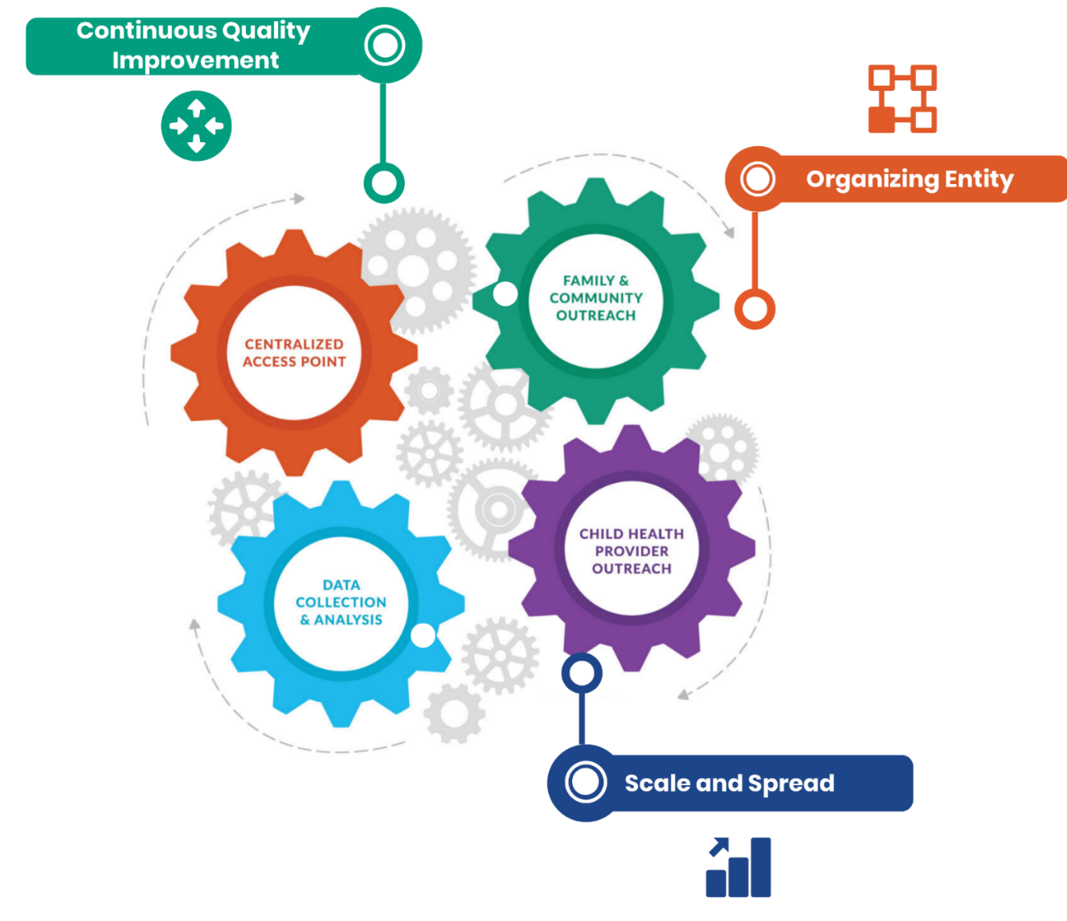
Help Me Grow Model
Structural Requirements
Organizing Entity
Guides vision and strategy at the state and local levels
Supports alignment of activities across local systems
Facilitates shared measurement practices
Advances policy through identification of gaps & barriers
Continuous System Improvement
Emphasizes improvements over time that continue to produce the best outcomes for children and families, maximize efficiency, and yield best practices
Spread & Scale
Deliberate efforts to increase impact of HMG efforts
Systems are unique, but aligned and coordinated
Leverages lessons learned through previous efforts
Ensures all families with young children have access to HMG

Slide 16
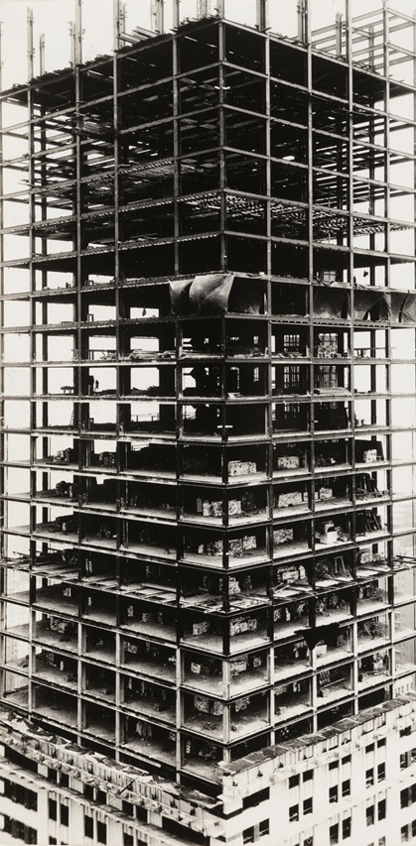
Help Me Grow Structural Requirements
ORGANIZING ENTITY
Guides vision and strategy at the state and local levels
Supports alignment of activities across local systems
Facilitates shared measurement practices
Increases and leverages political will
Advances policy through identification of gaps and barriers
Mobilizes funding

Slide 17
Help Me Grow Structural Requirements
SPREAD AND SCALE
Deliberate efforts to increase impact of successfully-tested HMG efforts
Systems are unique, but aligned and coordinated
Leverages lessons learned through previous implementation efforts
Enhances collective power and momentum
Ensures all families with young children have access to HMG

Slide 18
Help Me Grow Structural Requirements
CONTINUOUS SYSTEM IMPROVEMENT
Emphasizes incremental improvements over time that continue to produce the best outcomes for children and families, maximize efficiency, and yield best practices that can be applied across the state

Slide 19
What Can Help Me Grow Mean for Us?

Slide 20
Help Me Grow’s Unique Value
HMG is a cross-sector, systems-based approach that connects families to the resources they need to help all children thrive.
HMG builds and maintains a network of community resources across sectors and coordinates services across the network.
HMG engages in effective outreach to ensure a consistent and best practice approach among child health providers and community-based organizations.
HMG supports children in their early years, which have the longest-lasting consequences on children’s health and well-being.
HMG services and resources are flexible, data driven and targeted to each community and individual family served.
HMG builds relationships with families over time and serves as a trusted resource as children’s needs evolve.
Notes:
Affiliates may update/reframe based on target audience, as needed.

Slide 21
Help Me Grow’s Unique Value
Maintains low cost by leveraging existing services and making optimal use of existing resources – demonstrated return on investment
Facilitates cross-sector integration
Promotes a shared vision
Builds strong evidence base and use data most effectively
Provides care coordination, referral, linkage, and follow-up for all families
Supports early childhood providers in developmental monitoring and screening
Advances equity through Targeted Universalism, promoting the healthy development of all children, including targeted strategies for specific populations
01

Slide 22
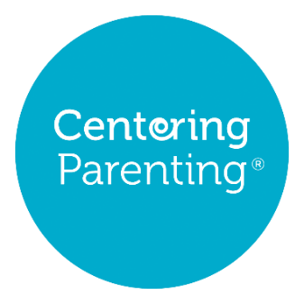
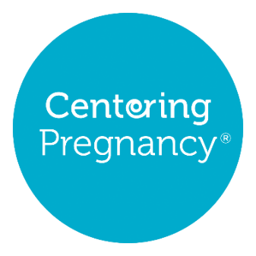
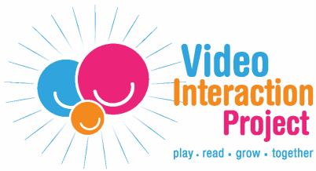
Strengthens developmental promotion through embedding in child health and other child service sectors such efficacious models as Healthy Steps, Medical-Legal Partnership Program, Project DULCE, Reach Out and Read, Video Interaction Project, group well-child care (e.g., Centering Parenting), and apps and other digital tools (e.g., Sparkler and Vroom);
As a system-building model, HMG helps integrate evidence-based programs and promising innovations into state maternal-early childhood sectors to make the best use of existing resources, diffuse best practices, and foster optimal child and family outcomes.

Slide 23
A network of community resources works like a power grid
Yet, the grid is not always set up in a way that allows these resources to run evenly throughout a community.
For some families, the grid functions well – these families can plug in and the resources flow consistently and reliably so they get what they need to succeed.
For others, the grid is patchy – the resource flow is weak and unreliable; families either can’t plug in or when they do, they don’t get what they need.
Notes:
When the services that touch families’ lives work together to make the most of every resource and opportunity, we get better outcomes. The agencies that provide things like health care, home visiting, and early learning opportunities recognize that we share a responsibility to ensure all children develop to reach their full potential. However, it is both challenging and duplicative for these agencies to identify all of the current available services for young children in their community. Help Me Grow provides support to service providers by ensuring the grid of resources is connected by maintaining an accurate, wide-ranging listing of early childhood resources. Rather than taking on the task of forging connections to all other existing services, agencies working to support children and families can contact the Help Me Grow Centralized Access Point to access the full grid of resources on behalf of their clients.
HMG strengthens the resource grid by connecting service providers to each other to create a reliable, interconnected system that best serves families. HMG affiliates identify existing resources and build a collaborative coalition that creates a well-functioning grid so that families can access resources when they need them. The work of HMG’s Centralized Access Point helps families plug into the grid, connects them to services, and provides ongoing support to help them achieve their goals. By creating a reliable grid, one in which all families are equally plugged in, we will help to ensure that all children have what they need to thrive.

Slide 24
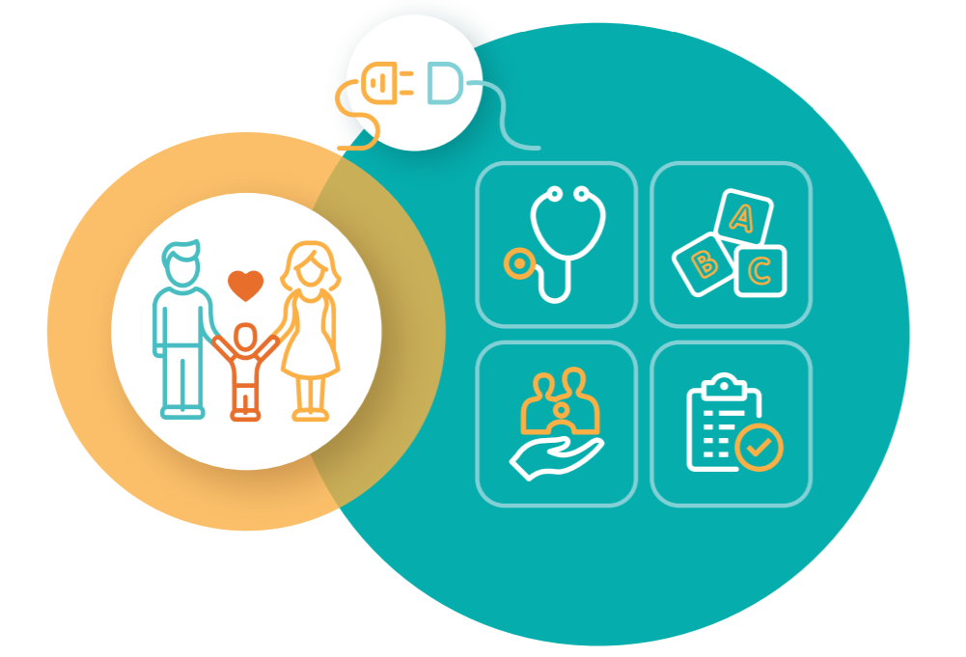
Help Me Grow Engineering a Powerful Resource Grid
Families benefit as Help Me Grow strengthens the resource grid by maintaining a current directory of available services and connecting service providers to each other to create an interconnected system. Families can easily plug in from wherever there are and access what they want and need.

Slide 25
Help Me Grow’s Impact

Slide 26
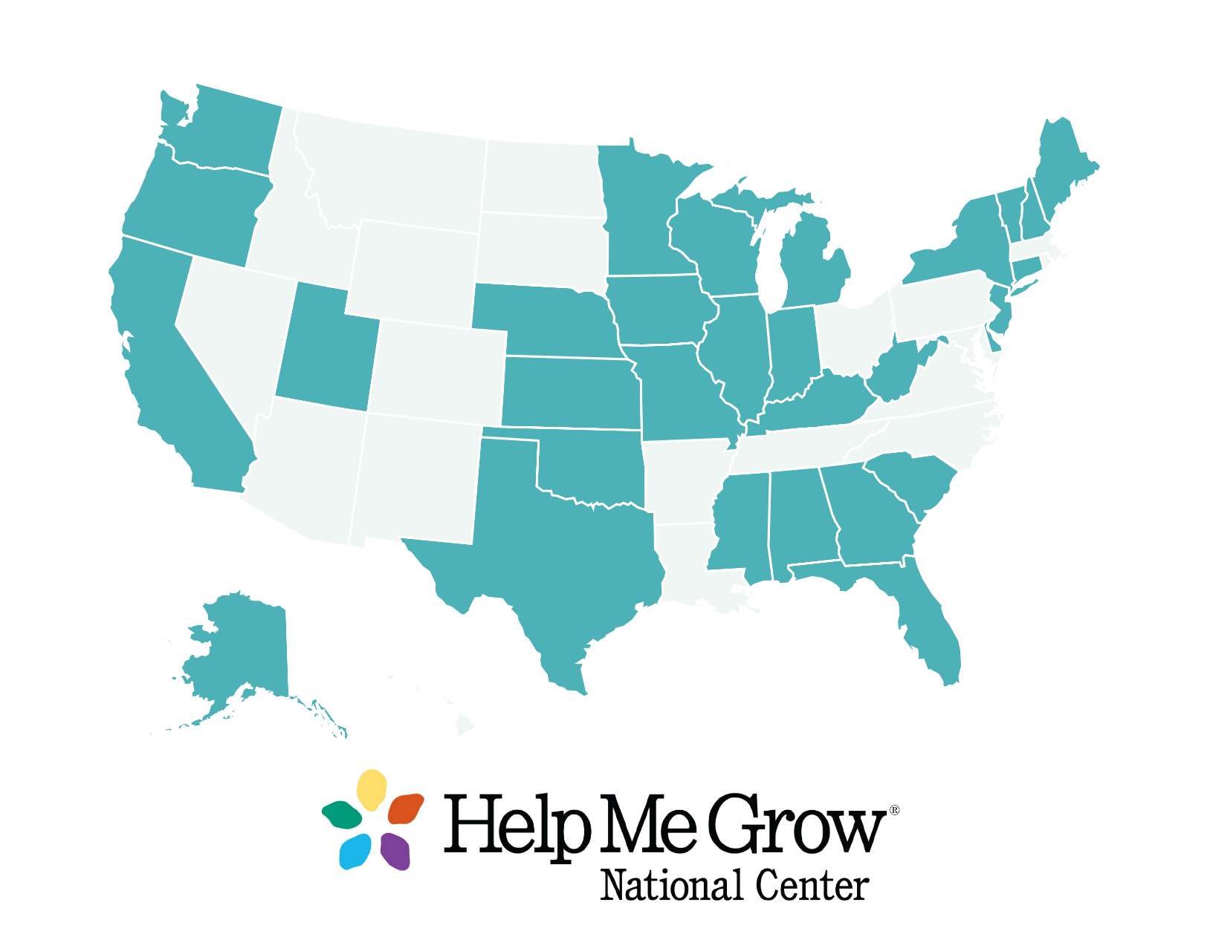
Help Me Grow National Affiliate Network
30 States and the District of Columbia together operating over 130 HMG systems

Slide 27
Help Me Grow Value Proposition Fidelity to a National, Evidence-Based Model
Centralized Access Point | Specialized child development line Linkage and follow-up Researching resources Real-time directory maintenance
Family & and Community Outreach | Engaged community partners Networking Community events and trainings Marketing
Child Health Care Provider Outreach | Physician champion Training on surveillance and screening Training on referral and linkage Closing the feedback loop
Data Collection & Analysis | Data monitoring Sharing data across partners Continuous quality improvement Community change through data
Average linkage rate for HMG affiliates (2020): 74%, an increase of 9% over 2019
Networking and community engagement activities increased 14% (virtually and in person) from 2019 to 2020.
Physician and medical staff trainings rose 9% between 2019 and 2020.
66% of HMG systems reporting closing the feedback loop at least 75% of the time (2020).
Half of HMG systems achieved community change through use of their data in 2020.
Source: 2019 and 2020 Fidelity Assessments. Help Me Grow National Center.

Slide 28
Right-Size Child Serving System
Children Linked
88%
Children Served
764,978
Help Me Grow’s Reach
2,642,207
Return on Investment
Centralized, scalable, up-to-date resource, referral & follow-up to services such as:
Home Visiting
Pediatrics/Child Health
Early Care & Learning
Child Welfare
Social Services
Promotes system efficiencies:
Decreased administrative burden for families
Increased access & enrollment in entitlement programs
Increased enrollment in family support services
Decreased wait time for developmental evaluations
Increased & earlier access to early intervention services
Population-level reach:
Increased understanding of child development among families
Enhanced capacity of child-serving sectors to implement best practice and influence system change
For every $1 invested in HMG, there is a $7-$15 return. Returns are short term (< 1 year), long term (>1 year) and multi-sector.
Intensive support for families that need it most
Increase
Children’s cognitive, behavioral & social-emotional development
Educational performance & graduation rates
Parenting ability & confidence
Workplace productivity & earning
Physical & mental health
Decrease
Targeted support for those with needs and concerns
Children with developmental delays
Special education
Cases of child abuse & neglect
Domestic violence
Welfare dependency
Juvenile & adult crimes

Slide 29
Help Me Grow’s Vision for a Brighter Future
Flourishing communities depend on the well-being of all members. By providing families with equitable access to the resources they need when they need them, Help Me Grow works to ensure we all enjoy more vibrant years ahead.

Slide 30
HELPMEGROWNATIONAL.ORG

