Slide 1
Title
Help Me Grow: So All Children Can Shine
Collaborating Equitably with Families of Young Children
Institutionalizing Transformative Partnerships
Thursday July 13th, 2023
Melissa Passarelli, MA
Associate Director of Implementation & System Building, Help Me Grow National Center
Part of Connecticut Children’s Office for Community Child Health
www.helpmegrownational.org

Slide 2
The Early Years Matter Most
90% of brain development in first 5 years
The first years of life set the foundation
A lot of factors can impact development
If there are concerns, the earlier they are addressed, the better!
Notes:
90% of your brain was developed in the earliest years of life
The early years are well known to set a foundation that impacts the trajectory of lifelong individual and societal outcomes, including for health, education, and economic prosperity
There’s so much that can impact child development, including parenting skills, interpersonal relationships, genetics, and access to basic needs
We also know that if there are concerns in the early years of life, they can often be ameliorated if addressed early. But that’s a big if!

Slide 3
Cultural Context
Most underfunded period of life span
Many stakeholders in “early childhood field”
No comprehensive system of care
Cultural context: individualism, paternalism, institutionalized racism
Notes:
Despite this, at least in my home country of the United States of America, it remains the most underfunded time period of the entire lifespan
Early childhood field= all those that work to support young children and their families, inclusive of health care providers, child care providers, social services, community-based organizations, family leaders, etc.
Yet no single comprehensive system exists in America to reach families before a child reaches kindergarten; instead, the players that serve families with young children have to compete for the same limited resources, existing programming operates in silos, and families must navigate for themselves a complicated and disorganized landscape of services and supports.
This means that most families are left scrambling
U.S. cultural context:
Culture of individualism and capitalism
History of “power over” and paternalism
History of institutionalized racism that has led to:
Inequitable access to resources
Implicit bias in the provision of services
Shame and fear around children being “tracked”

Slide 4
History of early identification
Focus on finding the problem
Misses risk
Causes fear and shame
Discourage engagement
Notes:
Historically, the focus of early identification was on detecting developmental delay or disability.
However, this deficit-based focus does a disservice in more ways than one.
It misses children that are at risk for delay
It can cause fear that something is wrong with the child and, therefore, the family; this perpetuates shame and makes it less likely for families to seek support
It can discourage families from engaging in their child’s development for fear of finding something wrong

Slide 5
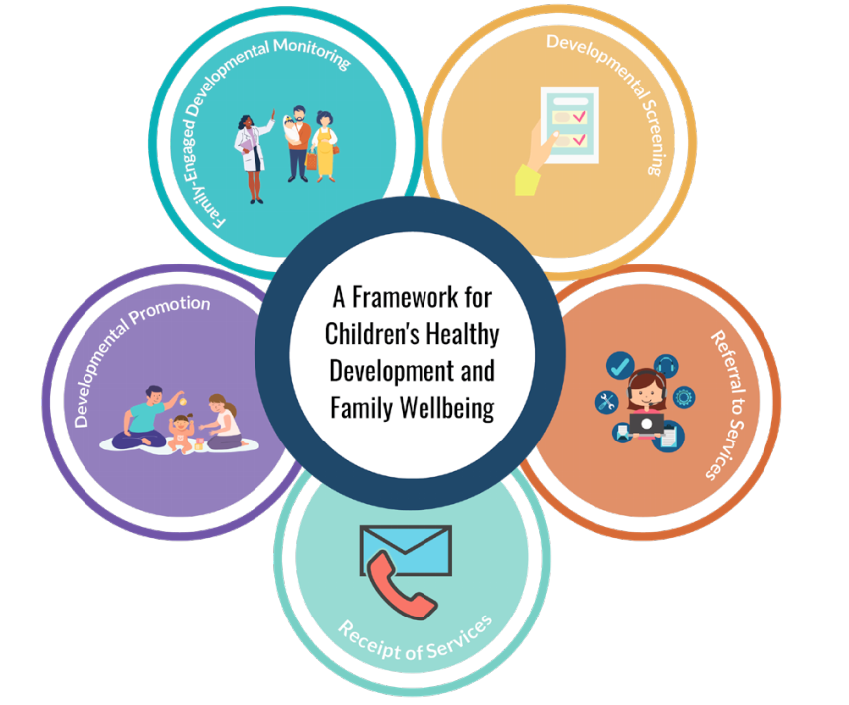
Centering Wellbeing
Notes:
In the U.S., we are far behind on other countries and cultures in practicing what has proven time and again to be true: an ounce of prevention is worth a pound of cure, and focusing on wellbeing is far better than waiting until there is a problem to address it
That’s why we’ve conceptualized a new framework for thinking about the early years that focuses on centering the wellbeing of children and families rather than finding problems to fix. In the process of promoting and celebrating what is going well, we will also identify when there are concerns and can connect families to services that can help

Slide 6
Parents as Experts
Family-engaged developmental monitoring: an intentional partnership of families and providers combining their knowledge to better understand a child’s developmental path, including celebrating progress and identifying opportunities for support and education.
3 Attributes:
Families are regarded as the expert on their child’s development
Information is gathered to inform a holistic approach to the child’s development
Developmental progress and needs are discussed over time
Notes:
A main focus of this framework is family-engaged developmental monitoring, an intentional partnership of families and providers combining their knowledge to better understand a child’s developmental path, including celebrating progress and identifying opportunities for support and education. In FEDM:
Families are regarded as the expert on their child’s development
Information is gathered to inform a holistic approach to the child’s development
Developmental progress and needs are discussed over time
FEDM can be practiced one on one between families and any type of provider that serves them, such as doctors, child care providers, and social service providers
The case for doing so includes:
Improving developmental outcomes
Supporting early identification
Accessibility across different systems and providers
Advancing equity by re-centering power in the hands of families and being less fear-inducing than screening and formal evaluation to root out concerns

Slide 7
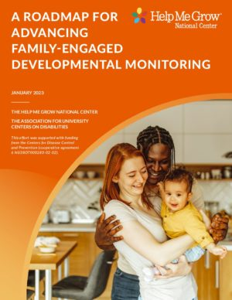
The future
Make best practice everyday practice
Promote positive outcomes for all young children and their families
Notes:
While a lot of the concepts in FEDM are now well known to be best practice, our landscape scanning of the literature and key informant interviews indicated that they are not every day practice
That’s why my organization, Help Me Grow National Center, in partnership with key early childhood organizations in the U.S., released A Roadmap for Advancing Family Engaged Developmental Monitoring that includes self-assessments at both the programmatic and systems levels to help institutionalize this practice and highlight the importance of equal partnership between families and the providers that serve them
By spreading FEDM across different types of systems and supporting families to recognize their power in their child’s development, we can promote positive outcomes for all young children and their families

Slide 8
HELPMEGROWNATIONAL.ORG

