Slide 1
Help Me Grow State Lead Network
Using Medicaid Funding to Support Help Me Grow
June 8, 2023
Part of Connecticut Children’s Office for Community Child Health
www.helpmegrownational.org

Slide 2
Help Me Grow State Lead Network
Hosted by the HMG National Center
Part of our broader Building Connections initiative to convene individuals across the HMG National Affiliate Network around commonalities
To learn from each other, share tools and resources, jointly address common challenges, and strengthen our collective approaches and impact
Guided by state lead priorities gathered from the December 2022 report, Exploring Help Me Grow at the State-Level: An Exploration of Roles, Responsibilities, Strategies & Approaches and a Learning Interest Assessment completed by members
Today’s session informed by member priority #1 – building capacity to fund, enhance, and sustain HMG

Slide 3
Other Opportunities & Capacity-Building Resources
HMG National Forum Week 2023
Introducing HMG National Forum Week 2023 including two exciting offerings:
In-Person Summit | October 11-13 | Fort Worth, Texas
Virtual Event | October 17 | Virtual Attendee Hub
Call for affiliate presentation proposals now open for the Virtual Event (closes June 15)
(NOTE: there will be no call for proposals for the In-Person Summit – the format is new this year)
We are seeking presentations about the ways in which HMG systems are operating the Core Components of the HMG Model. This is an opportunity to share the way their HMG looks.
The way each system runs HMG is different, and sharing what may seem like “business as usual”, could be a huge help and offer a new set of ideas for many other affiliates across the country.

Slide 4
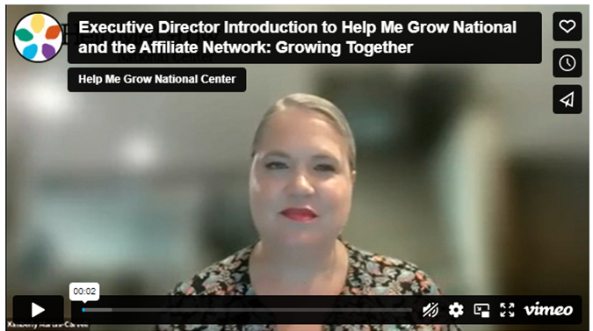
Other Opportunities & Capacity-Building Resources
Help Me Grow National and the Affiliate Network Growing Together
Use this link to register to attend a roundtable discussion with new HMG leaders on the direction of the Network and to drop into listening sessions with each new branch leader

Slide 5
Other Opportunities & Capacity-Building Resources
We Need Your Input What Makes You Most Engaged as a Member of the Help Me Grow National Affiliate Network?
HMG National Network Relations
How easy is it to access support and information?
How connected do you feel to other affiliates, National Center staff, and the HMG Network as a whole?
How included do you feel as part of the HMG Network?
How do you feel your voice and expertise are heard and valued?
You can participate in any or all of the following ways:
Schedule a 30-minute conversation Take this survey for state leads Register for a Listening Session (make sure to pick the one that’s right for you) State leads of single-system states option 1 - June 15 State leads of single-system states option 2 - June 19 State leads of single-System states option 3 - June 21 *Listening session date for multi-system state leads is being determined by Doodle poll
All anonymous, no HMG National Center staff present, all data comes to us in the aggregate!

Slide 6
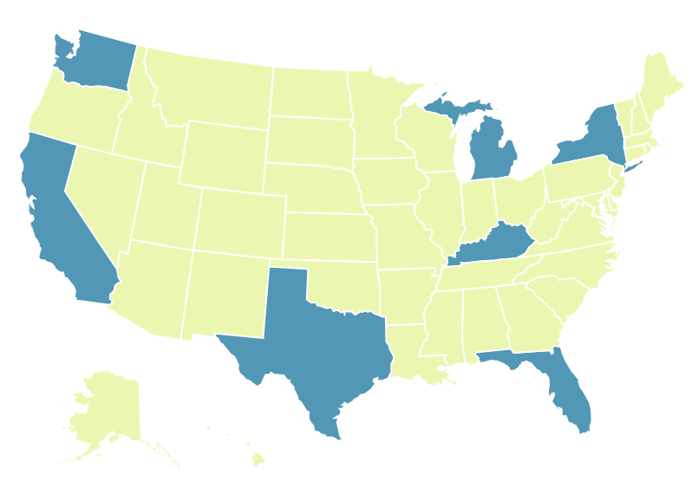
Other Opportunities & Capacity-Building Resources
Multi-System State Lead Match Group Meeting Save the Date – July 25 • 2:00pm Eastern
Join Lark Kesterke from HMG Washington and Courtney Gupta from HMG Michigan for an hour-long conversation about issues, challenges, and priorities specific to state leads heading up multi-system HMG states. Keep your eye out for an invitation at the end of June!

Slide 7
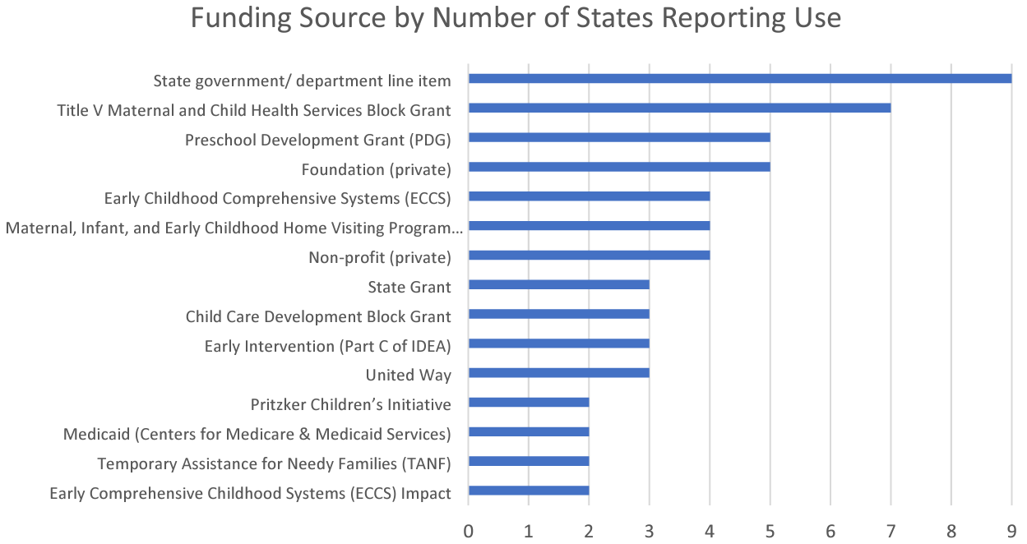
Medicaid (Centers for Medicare & Medicaid Services)
Notes:
When we took a deeper dive into the funding sources state leads were asked to share, we got a better picture of the specific streams of funding used for HMG. We only had two states report using Medicaid funds to support their HMG, even though it could be a unique opportunity for funding to support child health care provider outreach efforts.
Headlines:
The most commonly reported source of funding was state government/department line item (39%, n=9), followed by Title V Maternal and Child Health Services Block Grant (MCHB, HRSA) (30%, n=7).
Foundation (private) and Preschool Development Grant (PDG) (DOE & HHS) tied for third most commonly-reported funding source (22%, n=5).
Nonprofit (private), MIECHV, and Early Childhood Comprehensive Systems (ECCS) tied for fourth most commonly reported (17%, n=4) funding source.

Slide 8
Poll Questions
How familiar are you with Medicaid Concepts
How would you rate the strength of your HMG with the relationship you have with Medicaid?
Have you ever explored formal funding partnership with Medicaid
How aware are you of Medicaid’s goals in your state?
How synergistic do you see the goals of HMG align with Medicaid goals?

Slide 9
National Association of Medicaid Directors (NAMD)

Slide 10
Lindsey Browning Director of Medicaid Programming National Association of Medicaid Directors

Slide 11
Overview
About the National Association of Medicaid Directors
The nuts and bolts of Medicaid
Building an effective partnership with Medicaid
Q&A

Slide 12
Modern Annual Report
About the National Association of Medicaid Directors
______
2020

Slide 13
About NAMD
NAMD is the non-profit association for the 56 state and territorial Medicaid leaders
Mission: help Medicaid leaders deliver high value services to millions served by the program
Core strategies:
Be a thought leader and convener to improve Medicaid and CHIP
Build a strong state/federal partnership
Provide connection and program management assistance to Medicaid leaders
Support the development of state and territorial Medicaid leaders

Slide 14
Modern Annual Report
The nuts and bolts of Medicaid
______
2020

Slide 15
Medicaid overview
What is Medicaid?
A public health insurance program that provides comprehensive coverage to millions of Americans. A KFF Health Tracking Poll found in 2019 that 75% of the public has a favorable view of Medicaid.
Who does Medicaid cover?
Medicaid is currently serving almost 90 million people (by comparison, Medicare covers about 65 million people).
Enrollment in Medicaid grew 11.2% in 2021 and 8.4% in FY 2022, but is expected to decline in 2023, due to the sunset of the federal continuous coverage requirement
Medicaid covers 4 in 10 births, 27 million children, and 2/3 of older adults and people with disabilities.

Slide 16
Medicaid costs
How much does Medicaid cost?
Total Medicaid spend exceeded $728 billion in FY 2021, with 31% of costs covered by states and the remaining 69% provided by the federal government
Medicaid reflects nearly 1 in 6 dollars spent on health care and 1 in 2 dollars spent on long-term services and supports
Medicaid is often a state’s largest budget item. Health care cost growth continues to crowd out other state spending, like education.
MACPAC: Distribution of Medicaid, Education, and All Other Spending from Total State Budgets versus State-Funded State Budgets, SFY 2016

Slide 17
Medicaid delivery models
How are Medicaid services delivered?
Medicaid pays for covered services delivered to eligible & enrolled members. Services must be delivered by eligible providers to individuals who qualify for and are enrolled in Medicaid coverage. Medicaid does not generally make grants or pay for capacity.
Most states contract with health plans to deliver care. More than 2/3 of Medicaid enrollees receive services through risk-based managed care. The state contracts with health plans to deliver covered services. The health plan creates its own provider network and pays providers for those services delivered to enrollees.
Examples of covered services:
Doctors’ visits
Inpatient hospital care
Specialists
Targeted case management
Pharmacy services
Early periodic screening, diagnosis, and treatment (EPSDT) for children

Slide 18
Federal role
What’s the role of the federal government?
They set the rules of the road. State and territory Medicaid operate within federal guidelines and typically need federal approval to make program changes.
They jointly finance the program with states. State funds are matched by the federal government.

Slide 19
Modern Annual Report
Building an effective partnership with Medicaid
______
2020

Slide 20
Three pieces of advice
Start with shared goals, not the money.
Do your homework. Understand Medicaid’s priorities.
Acknowledge Medicaid’s constraints.

Slide 21
Start with shared goals, not the money
Medicaid leaders are approached daily by partners inside and outside state government to fund their priorities.
This can be incredibly challenging for Medicaid as these requests often fail to recognize the immense pressure Medicaid is under to manage their budgets.
A more effective strategy is to start with shared goals:
What are the strategic objectives of my Medicaid program and how can HMG partner with Medicaid to achieve those goals?
Come prepared for a give and take. Explore how you can help Medicaid.

Slide 22
Do your homework. Understand Medicaid’s priorities.
This is essential to figure out where there are shared goals between Medicaid and HMG.
Places to look:
Medicaid agency’s strategic plan
Presentations and webinars from Medicaid
Agency website
National organizations, like NAMD

Slide 23
Key priorities for many Medicaid programs
Unwinding from the public health emergency’s continuous coverage requirement
Meeting the behavioral health needs of members
Advancing health equity and reducing disparities, especially in maternal health
Addressing the health-related social needs of Medicaid members

Slide 24
Understand and acknowledge Medicaid’s constraints
Some of these constraints include:
Staff capacity
Funding
Federal rules of the road
IT systems
Many competing priorities
Explore how navigate these constraints in partnership with Medicaid, and recognize that “no” might actually mean, “we are prohibited from doing it like that.”

Slide 25
Modern Annual Report
Questions and Answers
______
2020

Slide 26
Help Me Grow Iowa

Slide 27
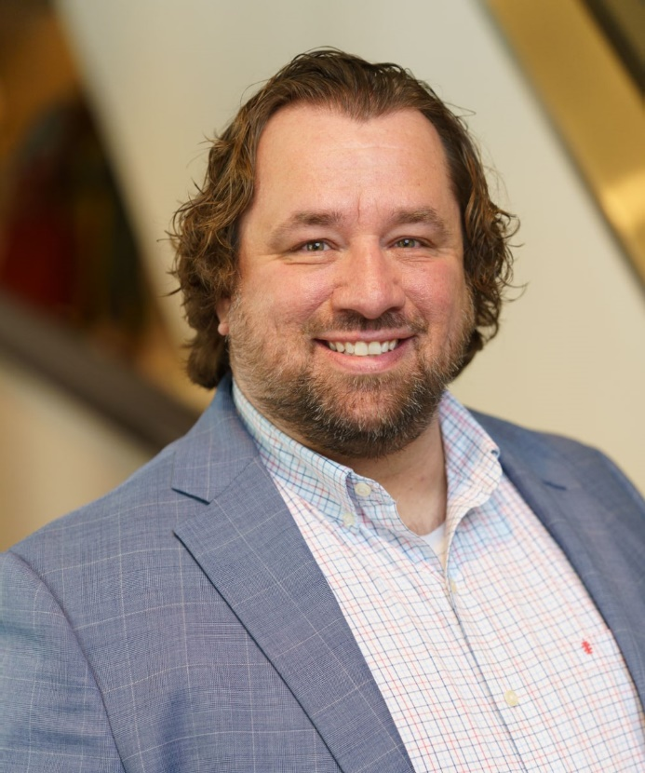
HMG Iowa Presenters
Michelle Holst State Coordinator, 1st Five Bureau of Family Health
Iowa Department of Health and Human Services
Marcus Johnson-Miller Title V MCH Director Chief, Family Health Bureau
Iowa Department of Health and Human Services

Slide 28
Iowa HMG
1st Five Healthy Mental Development Initiative
Children birth to age five (time of rapid brain development)
Increases use of developmental screening in primary care
Provides a one-step referral resource for primary care providers
Connects children (and their parents/caregivers) to existing services in their local communities
Keeps primary care providers informed about children’s progress
Supports health social, emotional and cognitive development

Slide 29
Connection
Iowa’s Title V National Performance Measures
NPM # | Data Source | Performance Measure 2021-2026 | MCH Population Domain
PM 14 | National Vital Statistic System | Percent of Women who smoke during pregnancy | Women/Maternal
PM 4B | National Immunization Survey | Percent of infants breastfed exclusively through 6 months | Perinatal/Infant
PM 5 | PRAMS | Percent of infants placed to sleep on their backs B) Percent of infants placed to sleep on a separate approved sleep surface Percent of infants placed to sleep without soft objects or loose bedding | Perinatal/Infant
PM 6 | National Survey of Children's Health(NSCH) – revised | Percent of children, ages 9 through 35 months, who received a developmental screening using a parent-completed screening tool in the past year | Child Health
PM 10 | NSCH – revised | Percent of adolescents, ages 12 through 17, with a with a preventive medical visit in the past year | Adolescent Health
PM 13 | A) PRAMS B) NSCH-revised | Percent of women who had a dental visit during pregnancy and Percent of infants and children, ages 1-17 years, who had a preventive dental visit in the last year | Cross-cutting
Iowa’s HMG & Title V

Slide 30
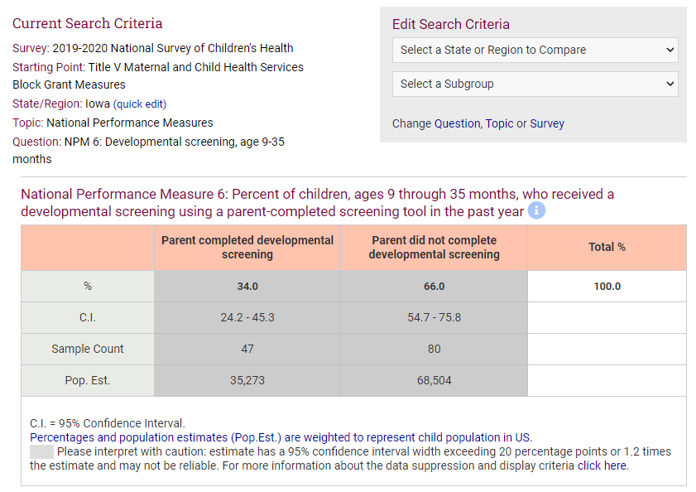
Connection
Iowa’s HMG & Title V
https://www.childhealthdata.org/

Slide 31
Connection
Iowa’s HMG & Medicaid

Slide 32
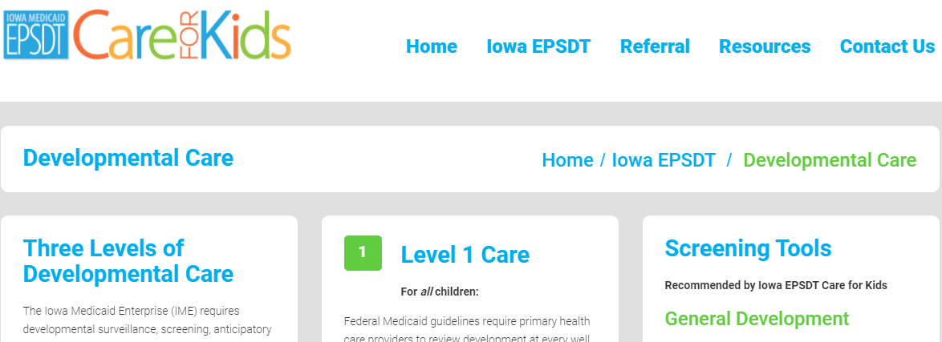
Connection
Iowa’s HMG & Medicaid

Slide 33
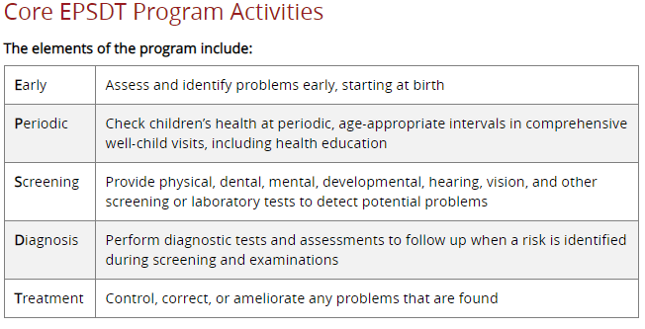
Connection
Iowa’s HMG & Medicaid

Slide 34
History
Began as the ABCD II Project, 2004-2006 (evidence informed)
Grant funded by the Commonwealth Fund and administered by the National Academy for State Health Policy
Focused on Medicaid children birth to age three
Iowa Medicaid was the grantee
Partnership with Iowa Title V (Public Health and Child Health Specialty Clinics)
Focus on public-private partnerships
local child health agencies & primary care providers
Aimed to increase use of developmental surveillance at well-child exams
Also included referral & follow up to local child health agency
Prevent the need for more intensive and expensive care at a later age (prevention)
Iowa HMG’s Foundation

Slide 35
History
ABCD II Lessons & Take-Aways
The primary care practice/provider is where to start
Parents and caregivers view health care providers as a credible source of information
In Iowa, nearly all parents take their child to the doctor before age 5, making this a nearly universal access point
Standardized surveillance makes a difference
Iowa’s CHDR was developed and promoted during this time
9, 12, 18, 24/30 month screening timeline established
Policy change initiative enacted: allow providers to bill for screening on same day as well-child visits
Providers need a one-call referral source
Must have a way to address identified concerns
Value in identification of community-based intervention services
Good relationships pave the way to good service
1st Five is a child-find service for many community organizations that provide direct service to families in need
Iowa HMG’s Foundation

Slide 36
“Why?”
Developmental Screening
Usage of screening tools among pediatricians is still lagging
Despite recommendations from the American Academy of Pediatrics, only 63% of pediatricians are screening all children at recommended time frames (AAP, 2020)
for children living in urban areas the prevalence of developmental delay is 17.4% of the population (CDC, 2020)
for children living in rural areas the prevalence of developmental delay is 19. 8% (CDC, 2020)
1st Five promotes standardized validated reliable screening tools such as – ASQ, ASQ:SE, M-CHAT/R-F
At intervals recommended by the American Academy of Pediatrics and following Iowa’s EPSDT Periodicity Schedule
1st Five HMDI

Slide 37
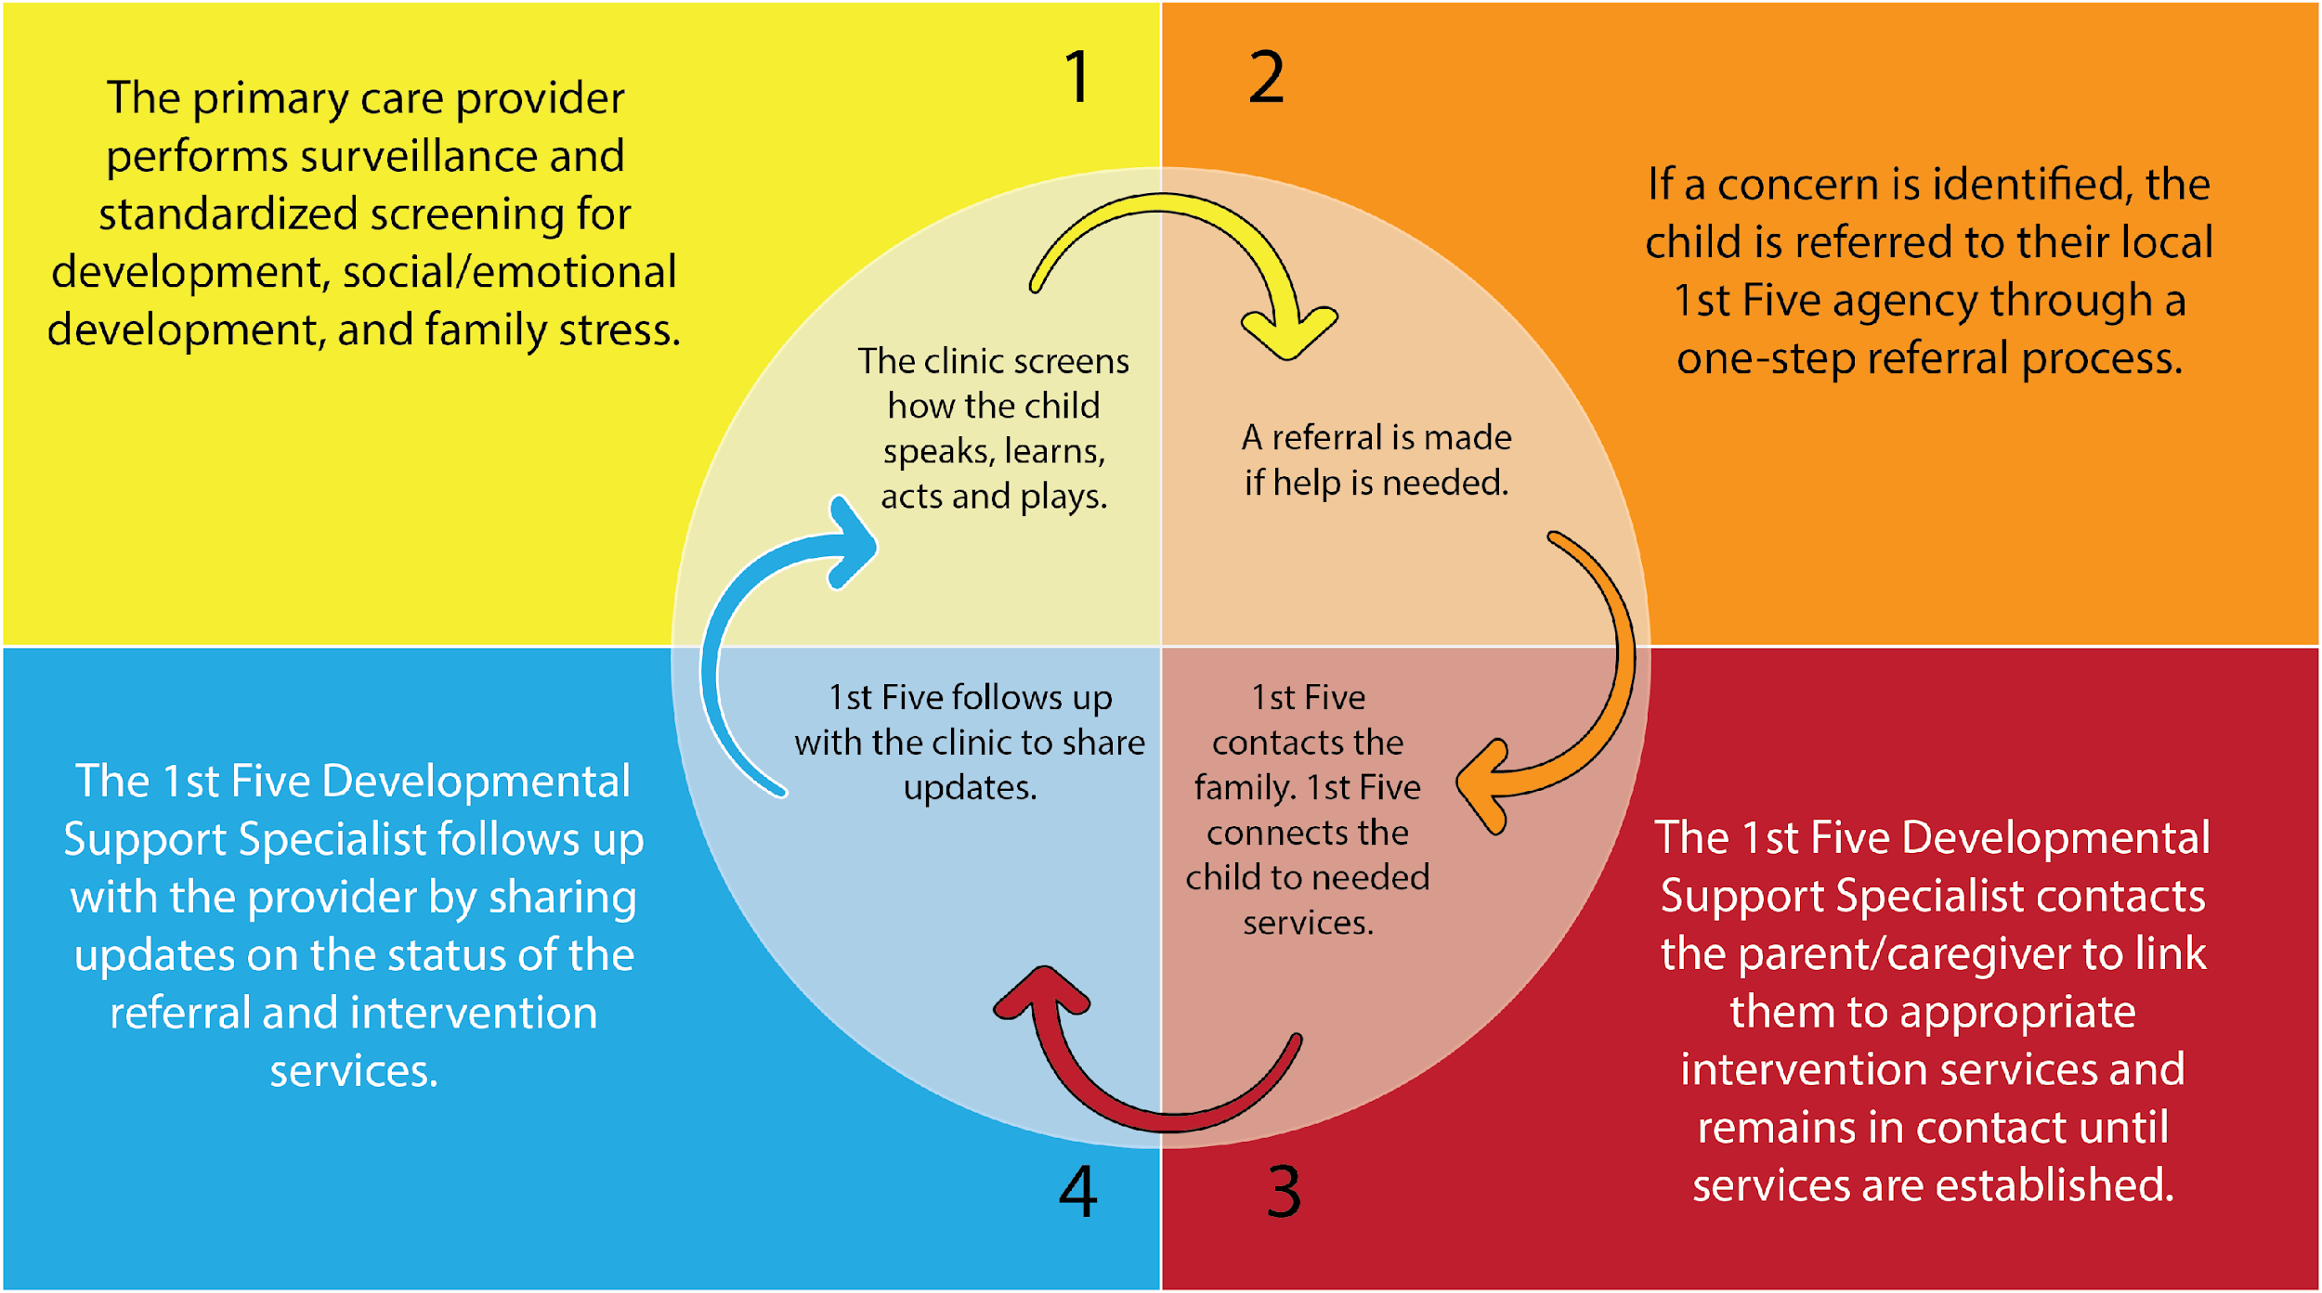
The 1st Five Model

Slide 38
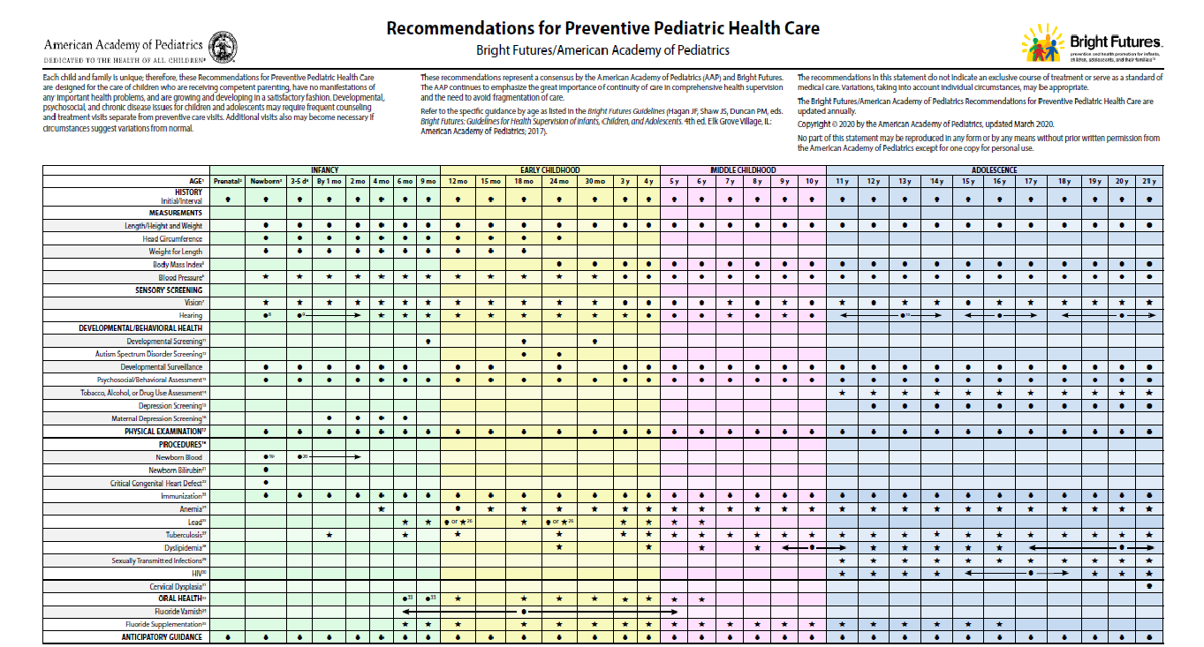
EPSDT
Early Development

Slide 39
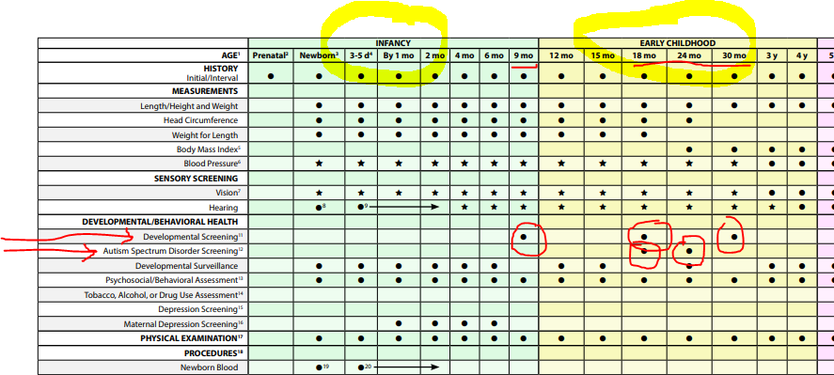
The 1st Five Model

Slide 40
1st Five Local Service Delivery
(includes 1st Five)
Instead of Title V funds, 1st Five is a state of Iowa general fund appropriation
1st Five Contract

Slide 41
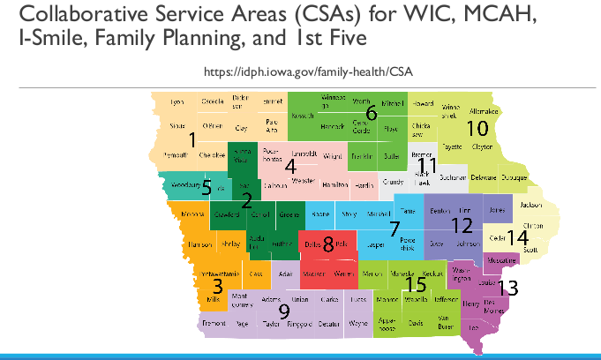
1st Five Local Service Delivery

Slide 42
Partnerships with Public Health and Title V
What is Title V?
Title V of the Social Security Act of 1935
The only federal legislation dedicated to promoting and improving the health of all of our nation's mothers and children
Promotes the development of community-based systems of medical and oral health care for pregnant women and children
Strives to serve all children - to develop standards of care and protection which gives every child a fair chance in this world
Promotes the health of pregnant women and children by facilitating access to preventive health services, especially for low-income families or families with limited access to health services
Federal mandates require an interagency agreement to coordinate activities

Slide 43
Title V / Medicaid Required Interagency Agreement
As required by Federal mandate the IAAs must
(1) utilize Title V agencies (or their grantees) who can furnish care and service to Medicaid beneficiaries,
(2) make “appropriate” provisions to reimburse Title V agencies (or their grantees) for covered services provided, and
(3) provide for sharing of information and education on pediatric vaccinations and delivery of immunization services.

Slide 44
Iowa’s Interagency Agreement
Examples of language
Assure local delivery of 1st Five services to implement the 1st Five Healthy Mental Development Initiative that promotes high quality well-child care in primary care clinics, which support the healthy mental development of all children ages zero (0) to five (5) years. Operate and continuously improve the 1st Five model as demonstrated by the Assuring Better Child Health and Development (ABCD II) project.
Assure local delivery of 1st Five services to provide EPSDT medical primary care provider consultation by contracting with local 1st Five sites to deliver services that include:
Develop strategic support to assess or increase the capacity for medical and mental health assessment by conducting training sessions and convening individual practice consultations with Iowa EPSDT primary care providers to implement the developmental identification guidelines and referral process promoted by the current edition of Bright Futures.
Provide training about early developmental identification guidelines for developmental surveillance and standardized developmental screening, as well as other topics as assigned by the Contractor to current and potential 1st Five medical practice partners through presentations, meetings, or individual practice consultations.
Provide training to other appropriate primary care practice staff, including allied health providers, clinic nursing staff, office managers, social workers, and mental health providers.
Assist practices and providers to identify resources for children with risk factors for child behavioral and mental health problems, as per Bright Futures, and as identified through surveillance and standardized developmental screening.
Establishes Medicaid provider status to Title V grantees
Screening Centers
Provides Funding for select services, such as informing and care coordination
Provides Medicaid Administrative Funding to support EPSDT providers (50/50 match)
Could philanthropic $$ be used?

Slide 45
ABCD II - Pilot Project
Assuring Better Child Development (ABCD) II - Funded by National Association of State Health Policy and Commonwealth Fund
Iowa Medicaid was the grantee - contacted with Public Health to administer, based on Title V relationship
2 pilot sites (1 rural, 1 urban)
Focus: Increased developmental surveillance and screening in PCP
Major result: Unbundled developmental screening from well-child billing

Slide 46
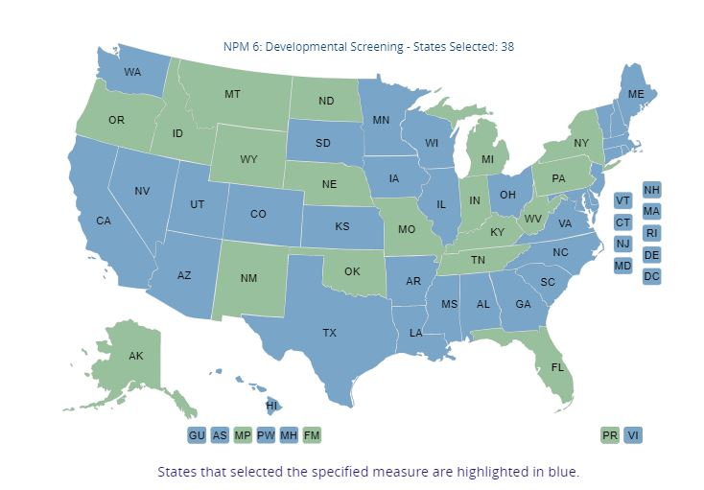
Title V: National Performance Measure 6
38 states focused on NPM 6 - Developmental Screening
States have flexibility in addressing chosen NPMs
Activities included in 3 levels:
Public Health Services and Systems
Enabling Services
Direct Health Care Services
**HMG/1st Five covers all 3 levels

Slide 47
Help Me Grow Vermont

Slide 48
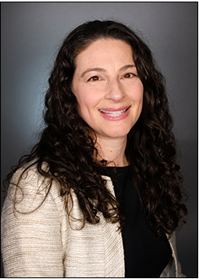
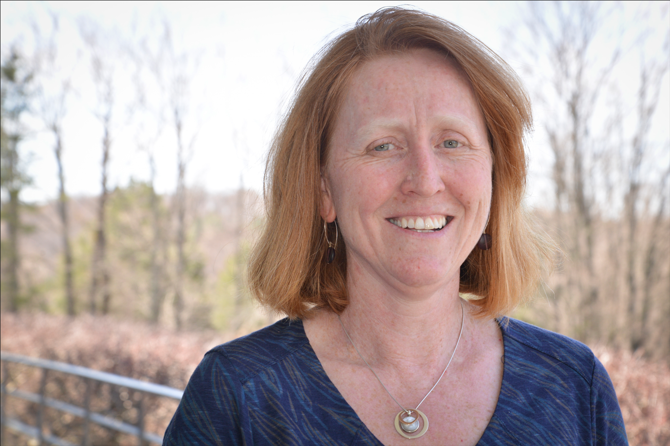
HMG Vermont Presenters
Breena Holmes, MD, FAAP Senior Pediatrician at Vermont Child Health
Improvement Program at Larner College of Medicine University of Vermont
Rachel Garfield, PhD Executive Director, Vermont Child Health Improvement Program Associate Professor, Department of Pediatrics
University of Vermont, Larner College of Medicine

Slide 49
Vermont’s Story
Review Improvement Partnerships (IPs, National Improvement Partnership Network, and VCHIP general approach
Discuss Roles and Value of IPs for:
Family and Child Health public health divisions and human service agencies
Medicaid and other insurers
American Academy of Pediatrics state chapter and other professional organizations) leadership
Academic medical center / children’s hospitals
Provide Examples of our Work with Help Me Grow

Slide 50
Vermont’s Story
Review Improvement Partnerships (IPs, National Improvement Partnership Network, and VCHIP general approach
Discuss Roles and Value of IPs for:
Family and Child Health public health divisions and human service agencies
Medicaid and other insurers
American Academy of Pediatrics state chapter and other professional organizations) leadership
Academic medical center / children’s hospitals
Provide Examples of our Work with Help Me Grow

Slide 51
What is an Improvement Partnership?
“…A durable, state or regional collaboration of public and private partners that uses measurement-based efforts and a systems approach to improve the quality of children’s health care…”
Partners include:
State Medicaid agency;
State health department;
Local chapter of the American Academy of Pediatrics (AAP) and
At least one of the following:
Academic institution
Children’s hospital
Healthcare delivery institution
Structure includes dedicated staff (e.g., QI coaches and measurement experts) who use rigorous, data-driven QI approaches

Slide 52
What do Improvement Partnerships do?
At the practice/clinician level
Coach clinicians and practice teams in measuring and improving care
Develop, test, and share tools, measures, and strategies
Connect clinicians with academic and systems experts
Support practices/clinicians in meeting regulatory and certification requirements
At the state and system levels
Provide access to clinical practices; engage clinicians in public health aims
Serve as a convener and “honest broker” for interested organizations and entities; engage reluctant stakeholders
Spread successful approaches statewide
Inform policy

Slide 53
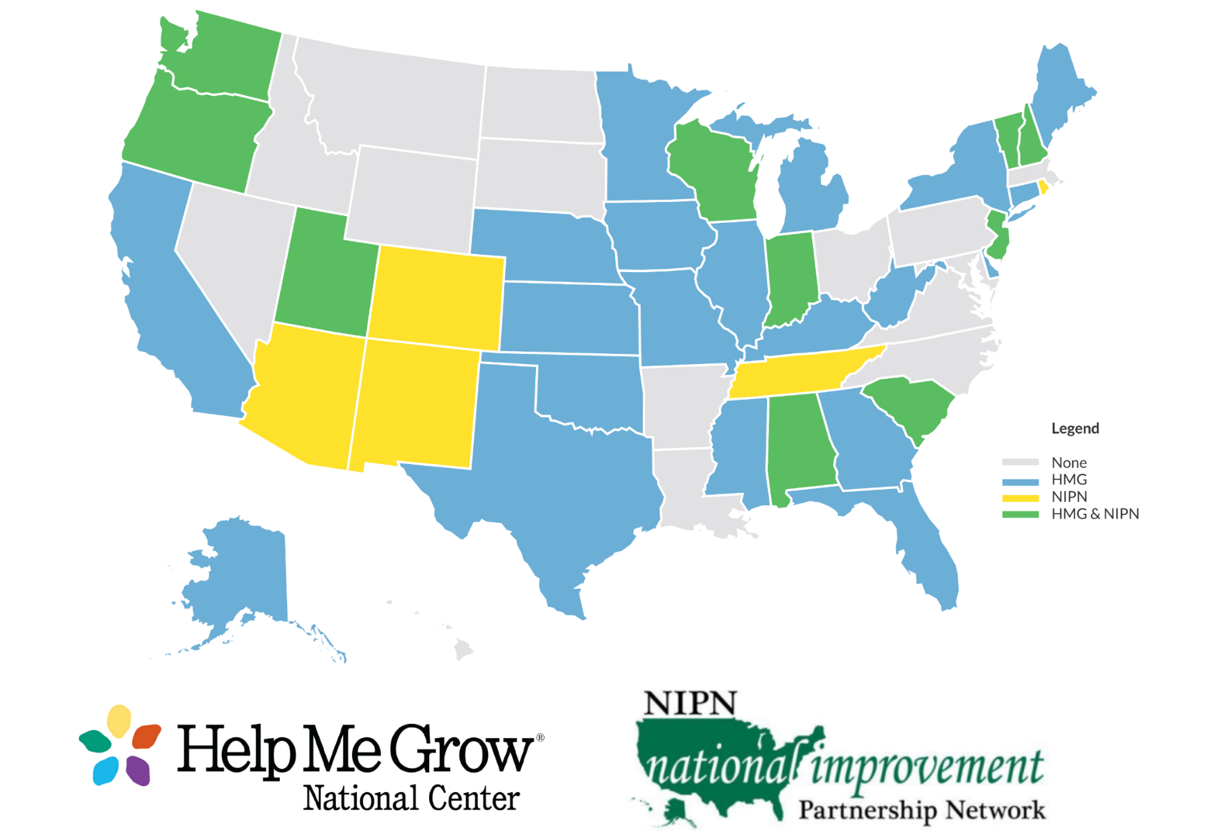
Many HMG states are involved with NIPN.

Slide 54
What is the Vermont Child Health Improvement Program (VCHIP)?
VCHIP, Vermont’s IP, is a population-based maternal and child health services research and quality improvement program of the University of Vermont that:
Integrates clinical practice and public health
Provides clinical and QI expertise to engage teams from multiple sites in structured activities around a focused topic
Serves as seat of National Improvement Partnership Network (NIPN) and other cross-state quality collaboratives
Conducts research and evaluation to inform future efforts

Slide 55
What is the VCHIP-VT Medicaid Partnership?
Supports improvement of health services and outcomes for children covered by Medicaid in Vermont
Funding draws from administrative funds to support EPSDT
Promotes Title V/public health policy priorities
Integrates clinical and public health systems
Relies on proven QI techniques
Works toward measurable goals

Slide 56
Medicaid and Other Insurers’ Goals
Improve access to high-quality health care services for covered children
Disseminate and implement standards, best practices
Improve measures (HEDIS, CHIPRA)
Be cost-effective and cost-efficient

Slide 57
Maternal and Child Health and Human Service Agency Partnership Goals
Efficient, effective, and lower cost delivery system performance
Accountability – value for public funds
Focus on underserved populations
Coordination of services
Improved outcomes for citizens – link to state results and priorities

Slide 58
Health Care Professionals as Partners
Want to improve care delivery but lack time, expertise, resources
Need tools, materials, curricula, and methodology
Want to partner with community organizations to coordinate care and reduce redundancies
Need to meet certification requirements (e.g., MOC, CME)
Need to respond to regulatory/reimbursement mandates (e.g., PCMH, HIT, meaningful use)

Slide 59
VCHIP is a Key Partner for Help Me Grow-Vermont
State funds and Medicaid EPSDT administrative funds enable VCHIP early childhood systems team to provide operational and structural support to HMG
Partnership draws on ongoing VCHIP projects to improve child health outcomes, including
Child Health Advances Measured in Practice (CHAMP): Network of 50 pediatric and family medicine practices that engage in quality improvement projects
Perinatal Quality Collaborative- Vermont: Coordinated activities across OB, NICU, and pediatrics to improve health care for pregnant people and infants in Vermont
Early Childhood-QI: Early childhood systems efforts including developmental screening

Slide 60
VCHIP and Help Me Grow Systems Efforts
Help Me Grow physician outreach, training and QI activities
Increase provider use of HMGVT’s Resource Hub to better connect families to services
perinatal, pediatric and family practice settings
Increase developmental screening and use of HMG’s ASQ Online platform through outreach and training
Build system integration and foster practice efficiencies between medical practices and HMGVT
CQI/data collection/evaluation

Slide 61
Contact Information
We are happy to talk further with states about Vermont’s experience
Be in touch!
Janet.kilburn@vermont.gov
Breena.holmes@med.uvm.edu
Rachel.garfield@med.uvm.edu

Slide 62
Panel Discussion

Slide 63
Panel Discussion
What advice would you have for a HMG affiliate looking to partner with Medicaid?
How do you see the current Medicaid rollback impacting the relationship between Medicaid and HMG?
How do you think it will affect the opportunities to tap into Medicaid funding?
What barriers do you see when tapping into Medicaid funding?

Slide 64
Full Group Open Forum

Slide 65
Questions
What is the HMG relationship with Medicaid in your state?
Do you know what your state’s Medicaid priorities are?
How do you think HMG can help towards those goals?
Has your state considered/pursued Medicaid funding for HMG?
What barriers have you faced in efforts to partner with Medicaid?

Slide 66
Wrapping Up
What did you think of today’s session? Take the poll!
Coming up for HMG State Lead Network
Multi-system state match group meeting July 25 led by HMG Washington and HMG Michigan
Third quarterly mini-retreat
Connect and continue the conversation with someone you met, heard from, or spoke to during today’s session
Visit the HMG State Lead Network resource page for all session recordings, slides, and the state lead report
Have suggestions for the HMG State Lead Network? Reach out to Sarah Zucker, szucker@connecticutchildrens.org

Slide 67
HELPMEGROWNATIONAL.ORG

