Slide 1
Title
A Roadmap to Advance Family-Engaged Developmental Monitoring
Part of Connecticut Children’s Office for Community Child Health
www.helpmegrownational.org

Slide 2
The Framework for Children’s Healthy Development and Well-Being

Slide 3
Terminology
Within A Roadmap to Advance Family-Engaged Developmental Monitoring and this presentation:
Provider refers to all those who interact with young children and their families, inclusive of medical, education, social service, community-based, faith-based, and other child serving sectors.
Family refers to the people with whom the child has a close personal relationship and who are responsible for the well-being and development of the child.
Early Identification means the timely detection of concern for developmental delay or disability.
Child development requires a holistic approach that considers multiple factors across the social ecology that may contribute to overall health and well-being, inclusive of social drivers of health (i.e. community and societal factors that can impact health outcomes).
Notes:
References page 11 of the ROadmap

Slide 4
The Evolution of Early Identification
Historically, the focus of early identification has been on detecting the presence of a developmental delay or disability. This attends to only a subset of children and misses those vulnerable to adverse outcomes.
The process should be universal for all children, and therefore needs to include the input of parent opinions and concerns.
Centering the family voice and experience is an evolution away from focusing on the identification of disorders.
Switching to a focus on family well-being, inclusive of family priorities and needs such as concrete and social supports, can lead to positive outcomes for all young children.
Notes:
References pages 10-11 in the Roadmap

Slide 5
Early Identification Process
A Framework for Early Identification
A Framework for Children’s Healthy Development & Family Well-Being
Broader conceptualization of the process
Asset-based approach with overall goal of promoting positive outcomes
Recognizes families as leaders in their child’s development

Slide 6
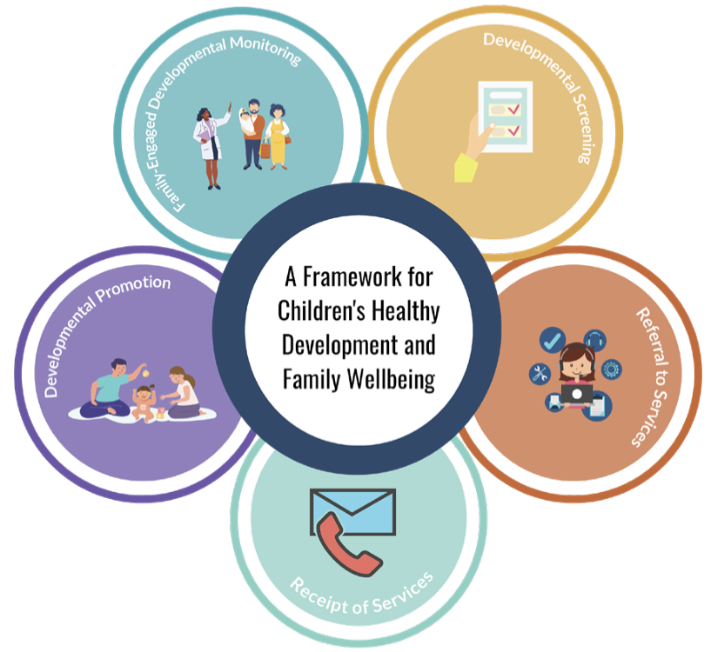
A Framework for Children’s Healthy Development & Family Well-Being
Offers a conceptual model that supports positive developmental outcomes for all children and promotes identification of developmental delays or disabilities at the youngest age possible.
Five components each articulate an active approach to support family’s priorities, celebrate progress, and enable conditions for early identification:
Universal strategies (done with all children and families):
Developmental promotion (ongoing)
Family-engaged developmental monitoring (ongoing)
Screening (at recommended ages)
Targeted strategies (as needed):
Referral to services
Receipt of services
Notes:
References page 25 of the ROadmap

Slide 7
Family-Engaged Developmental Monitoring:
A Key Component of A Framework for Children’s Healthy Development & Family Well-Being

Slide 8
Family-Engaged Developmental Monitoring (FEDM)
An intentional partnership of families and providers combining their knowledge to recognize a child’s developmental milestones and identify opportunities for support and education.
Three Essential Attributes
Families are the experts
Holistic picture of child’s development
Development is discussed longitudinally
Notes:
References page 12 of the Roadmap

Slide 9
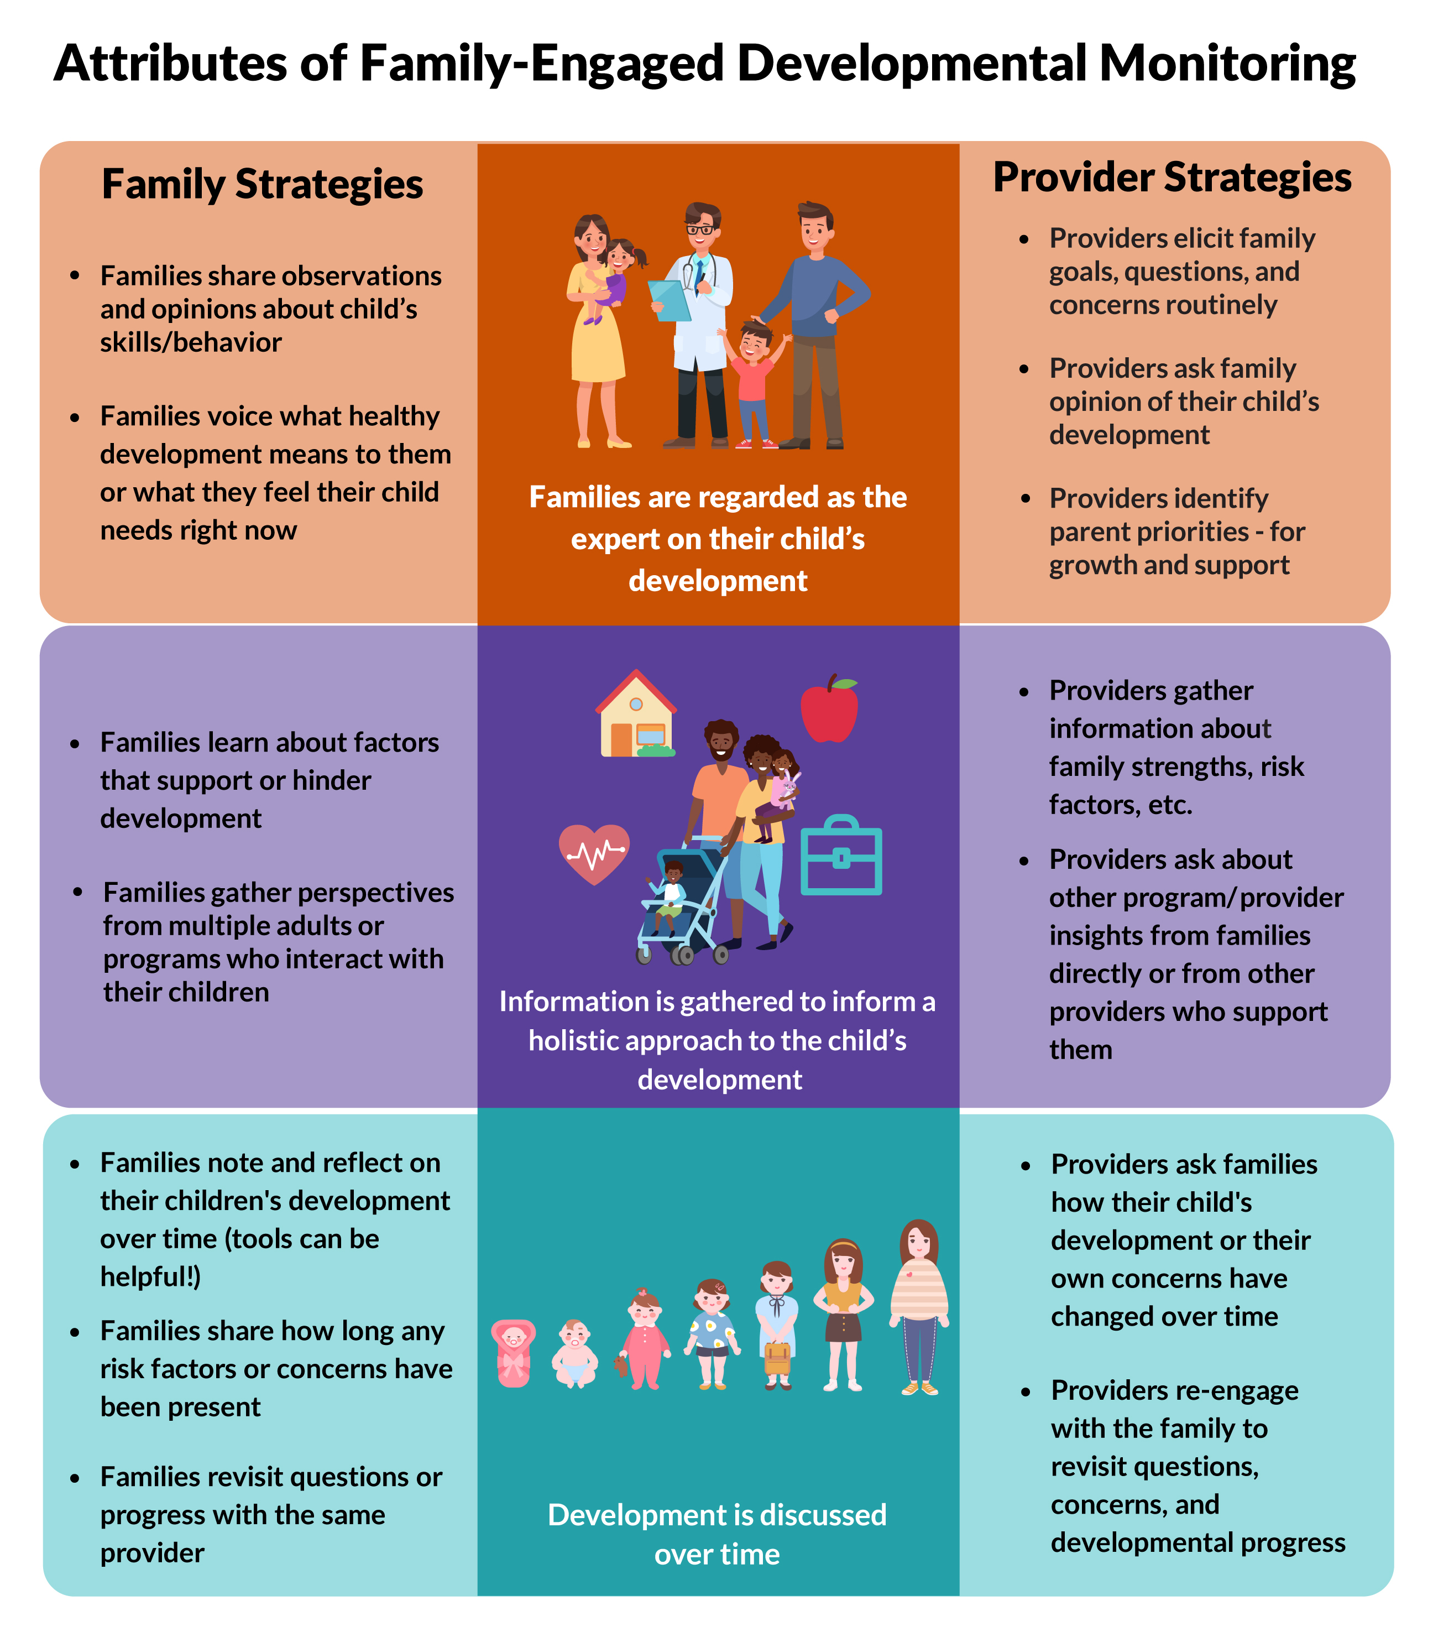
Notes:
References page 16 of the Roadmap

Slide 10
Is FEDM Different Than Developmental Monitoring or Surveillance?
Developmental surveillance is a term long-used by the medical community to describe eliciting and attending to families’ opinions and concerns about their child’s development as part of their ongoing interactions during service delivery.
The term developmental monitoring is more common in non-clinical early childhood settings, referring generally to the observation and tracking of developmental milestones as a child grows.
Family-engaged developmental monitoring (FEDM) utilizes concepts from developmental surveillance and more familiar and parent-appropriate terminology of “monitoring” while intentionally including the phrase “family-engaged” to center families as key partners in the process.
Notes:
Reference: Page 13 of Roadmap

Slide 11
FEDM: Distinct from Developmental Promotion
Developmental promotion is the provision of information, materials, and tools, for families to learn what to expect as their child grows so that they can engage their child in age-appropriate activities, celebrate milestones, and recognize when there are concerns.
Examples:
Providing Learn the Signs. Act Early materials
Promoting the use of developmental support app/messaging services such as Vroom, Bright By Text, The Basics, and the CDC Milestone Tracker App
Developmental health events such as Help ME Grow’s Books, Balls and Blocks
FEDM requires the intentional partnership of parent and provider to discuss the specifics of the child and family.
Developmental promotion can be used as a way to foster FEDM conversations.
Notes:
Reference: page 27 of Roadmap

Slide 12
FEDM: Distinct from Screening
Family-Engaged Developmental Monitoring | Screening
Providers can use monitoring tools, such as “Learn the Signs. Act Early.” milestone checklists. | Screening relies on the use of standardized and validated measures.
FEDM occurs in a regular, ongoing manner. | As per guidelines from the American Academy of Pediatrics, screening should occur at (minimum) 9, 18, and 30 months and when there is a concern.
FEDM provides a longitudinal view of development. | Screening provides a snapshot in time.
Notes:
Reference: page 28 of Roadmap

Slide 13
FEDM: An Approach to Advancing Equity
Practicing FEDM can support shifting the power dynamic back into the hands of families.
Developmental screening and evaluation may not be the best method of early identification for all families, due to historical institutionalized and structural racism.
FEDM is more accessible than components like screening, lending itself to broad utilization and acting as a strategy for targeted universalism.
When families are centered in the prioritization, decision-making, and selection of services for their children, this expands early identification to be more inclusive and culturally appropriate.
Notes:
Reference: page 23-24 of Roadmap

Slide 14
Am I Practicing FEDM?
Use the FEDM Self-Assessments!
To assist programs and systems in identifying where their existing service delivery aligns with FEDM and where practice could be strengthened as part of a larger framework of children’s healthy development and family well-being.
Program/Provider-Level Assessment
System-Level Assessment
The Self-Assessments are a part of the Roadmap for Advancing Family-Engaged Developmental Monitoring document and are also available as stand-alone, fillable PDFs on Help Me Grow’s FEDM webpage
Notes:
Reference: page 17 of Roadmap

Slide 15
A Family-Engaged Developmental Monitoring Self-Assessment for:
Early Childhood Programs and Providers
Notes:
Found on page 18 of Roadmap AND available as a stand-alone fillable PDF on the FEDM page on HMG’s website

Slide 16
Families are regarded as the expert on their child’s development
Do you celebrate milestones with families as they share their child’s strengths?
Do you directly and routinely elicit parent priorities, concerns, and questions?
Do you allow information provided by the family to shape your view of the child?
If a family’s views of the child’s development does not align with your own, do you ask clarifying questions to better understand factors that may contribute to the difference?
Does a family’s priority for concerns or support shape your considerations for future support?

Slide 17
Information is compiled to inform a holistic approach to the child’s development Depending upon your professional or programmatic scope, do you gather information about the child’s:
Family-level support network, such as family or community members who interact positively with the child, who support the family in times of need?
Community-level support network, such as faith-based organizations?
Involvement in other programs or services, such as: early care and education programs, parent education or support groups, food banks?
Family-level risk factors, such as a child’s underlying health conditions, family-level trauma, parental mental health, or substance use?
Community -level risk factors, such as neighborhood violence, discrimination in service access or delivery, poverty?
Positive parenting practices, such as reading together, serve-and-return interactions, creating rich opportunities for play?
Basic needs, such as food insecurity, access to medical care, unemployment, and housing?

Slide 18
Development is discussed over time
Do you routinely elicit information on progress and concerns?
Do you ask families how they have seen their child progress over time?
Do you ask families how long a concern has been present or if it has changed over time?

Slide 19
A Family-Engaged Developmental Monitoring Self-Assessment for:
Early Childhood Systems
Notes:
Found on page 19 of Roadmap AND available as a stand-alone fillable PDF on the FEDM page on HMG’s website

Slide 20
Families are regarded as the expert on their child’s development
Are families’ priorities, concerns, questions, and feedback on programs used to inform systems design and improvement?
Are families included in advocacy and policy work?
Are families represented on your leadership or decision-making teams?
Are partners trained on how to elicit parent priorities, concerns, and questions directly and routinely?
When partners elicit parent priorities, concerns, and questions, are they shared alongside other contextual information and referrals?

Slide 21
Information is compiled to inform a holistic approach to the child’s development
Are families’ culture, language, and lived experience incorporated into decision-making?
Are partnerships reflective of the priorities and needs of families in the community or state?
Does your system have the ability to collect, monitor, and analyze information about:
Family-level support network, such as family or community members who interact positively with the child, who support the family in times of need?
Community-level support network, such as faith-based organizations?
Involvement in other program or services, such as: early care and education programs, parent education or support groups, food banks?
Family-level risk factors, such as a child’s underlying health conditions, family-level trauma, parental mental health, or substance abuse?
Community or societal-level risk factors, such as neighborhood violence, discrimination in service access or delivery, poverty?
Positive parenting practices, such as reading together, serve-and-return interactions, creating rich opportunities for play?
Basic needs, such as food insecurity, access to medical care, unemployment, and housing?

Slide 22
Development is discussed over time
Does your system have the ability to document, monitor, and analyze family responses longitudinally to questions such as:
Family-level goals and priorities?
Information on progress or concerns at every interaction/visit?
What risk factors or assets are present?
How long a concern has been present?
Is data collected over time and used to inform the community about gaps, barriers, challenges, and opportunities to strengthen the early childhood system and advocate for community change?

Slide 23
Using “A Roadmap for Family-Engaged Developmental Monitoring”
Visit the Family-Engaged Developmental Monitoring Resource Page on Help Me Grow National’s Website to find:
The Roadmap
Fillable PDF versions of the Program and System-Level Self-Assessments
“What is Family-Engaged Developmental Monitoring?” one pager
Family-Engaged Developmental Monitoring brief

Slide 24
Questions and Discussion

Slide 25
WWW.HELPMEGROWNATIONAL.ORG

