Slide 1
Title
Help Me Grow: So All Children Can Shine
Targeted Universalism for Help Me Grow Exploration Project Introduction
April 18, 2024
Sarah Zucker
Help Me Grow National Center
Dr. Nina Moreno
Seed Collaborative
Evan Holland
Seed Collaborative
Part of Connecticut Children’s Office for Community Child Health
www.helpmegrownational.org

Slide 2
Welcome and Introductions
Opening
Sarah Zucker
SZucker@connecticutchildrens.org

Slide 3
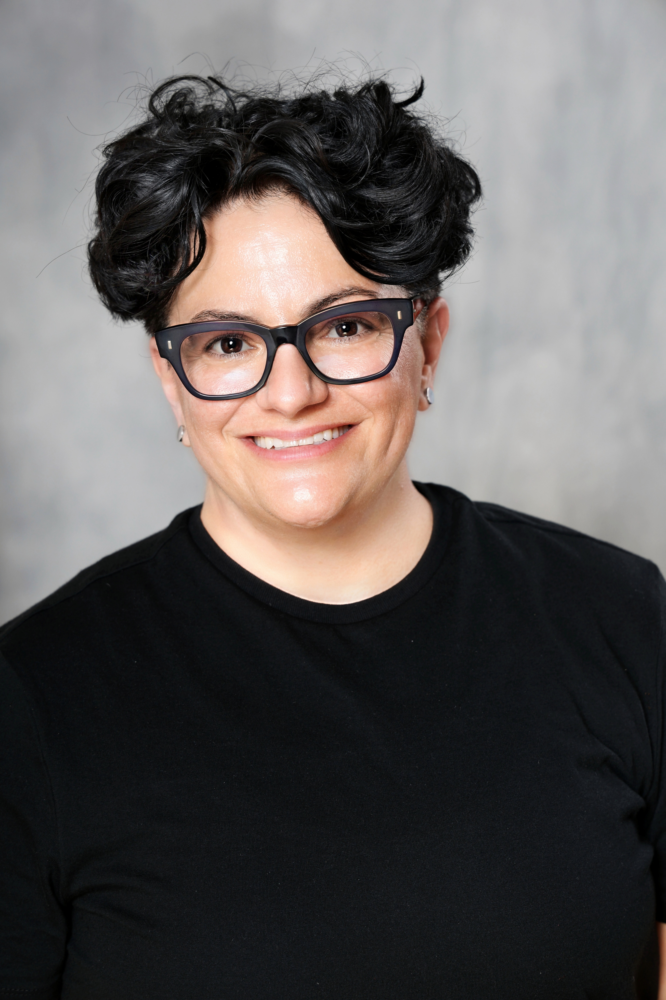
Welcome and Introductions
Meet the Seed Collaborative Team
Evan Holland
evan@seedcollab.com
Dr. Nina Moreno
nina@seedcollab.com

Slide 4
Agenda
1 | Welcome & Opening
2 | Introduction to the Seed Team
3 | TU Exploration Outline
4 | Clarifying Questions
5 | Targeted Universalism Overview
6 | Closing and Next Steps

Slide 5
Why Are You Here
To learn about what Help Me Grow National’s Targeted Universalism exploration entails
To learn about what this exploration means for your HMG system
To receive an introduction to Targeted Universalism
To learn about how to get involved with this exploration
SEED COLLABORATIVE

Slide 6
What This Exploration Entails
Through virtual interviews, focus groups, and a survey with affiliates, this exploration will build on existing data and assess affiliate experiences, preferences, and priorities in promoting equity through HMG. Specifically, Seed will assess affiliates’:
Understanding of Targeted Universalism among the Network,
Types of strategies HMG systems are using to advance equity,
Data affiliates are using to assess and meet the needs of all families,
Interest in integrating the steps of Targeted Universalism into HMG work, and
TA and resources affiliates want and need to advance their equity work
SEED COLLABORATIVE

Slide 7
What This Exploration Entails
This exploration will answer the following questions:
1-What initiatives are affiliates currently pursuing to advance equity?
2-To what extent do affiliates view the HMG Model as a vehicle/ infrastructure to advance equity?
3-What is the range/stratification of familiarity with TU across the National Affiliate Network?
4-To what extent are affiliates interested in using TU as a framework to advance equity?
5-To what extent do affiliates feel the principles/steps of TU relate to the Core Components and Structural Requirements of the HMG Model?
6-To what extent are affiliates ready to apply TU using HMG infrastructure?
SEED COLLABORATIVE

Slide 8
The Opportunity This Exploration Creates for HMG Systems
Opportunity to provide input on how to bring about greater access and equitable outcomes to the young children and families HMG serves
Why HMG stakeholders should engage?
You have the most familiarity with the planning, implementation, and evaluation of your HMG system’s equity work
SEED COLLABORATIVE

Slide 9
Which HMG Stakeholders Should Engage
You decide who engages. Please ensure it is individuals who are most aware and involved in promoting equity through HMG. This could include but is not limited to:
HMG leads
HMG Core Component staff
Family and community advisory groups or stakeholders who have experienced and interacted with HMG
HMG system partners
Diversity, equity, inclusion, and belonging leads for HMG
HMG data collection leads
Elected officials/HMG advocates/ambassadors
Key partners whose buy-in is critical to the success of equity work
SEED COLLABORATIVE

Slide 10
TU Exploration Outline
Tentative Timeline
April 2024- Introductory Meeting
May 2024- Schedule and conduct interviews and focus groups
August 2024- Launch survey
September 2024- Close survey
October 2024- Finalize Assessment Report

Slide 11
Clarifying Questions

Slide 12
TU Exploration Outline
How To get Involved
If you are interested in participating in this exploration, please complete this form: https://seed.qualtrics.com/jfe/form/SV_9HA1yj75nLwZKSy

Slide 13
Brief Overview of Definitions & Targeted Universalism

Slide 14
Equity
Doing what is fair or just
Addressing disparities and oppression
Challenging forms of othering
Considering people’s needs and circumstances
Equity ≠ Equality
SEED COLLABORATIVE

Slide 15
Inclusion
Inviting different people
Having a seat at the table
Playing by the rules of the game
Presence is especially important for those who have been excluded
Inclusion ≠ Belonging
SEED COLLABORATIVE
This Photo by Unknown Author is licensed under CC BY-NC-ND

Slide 16
Belonging
Inclusion + meaningful participation + co-creation.
Having voice.
Being able to be yourself.
Creating the rules of the game together.
SEED COLLABORATIVE

Slide 17
What is Targeted Universalism
Targeted Universalism means setting universal goals pursued by targeted strategies and approaches.
Universal goals are established for all groups concerned.
The strategies developed to achieve those goals are targeted, based upon how different groups are situated within structures, cultures, and across geographies to smooth the path to the universal goal.
SEED COLLABORATIVE

Slide 18
Why Targeted Universalism?
Targeted Universalism (TU) recognizes:
That lasting systemic, structural, and cultural change comes from the implementation of this framework.
That this (TU) is the pathway to co-creation, inclusion, equity, and belonging.
That different groups are situated differently.
That these differences can create a variety of barriers and needs.
That these barriers and needs must be met with a variety of strategies to smooth and advance the journey to the universal goal.
SEED COLLABORATIVE

Slide 19
Closing and Next Steps
Meetings to Come
Thank you for participating!
If you are interested in participating in this exploration, please complete this form: https://seed.qualtrics.com/jfe/form/SV_9HA1yj75nLwZKSy
If you have any questions, please do not hesitate to contact Dr. Nina Moreno at nina@seedcollab.com.

Slide 20
Closing and Next Steps
Interested in learning more about TU?
TU Policy & Practice primer:
https://belonging.berkeley.edu/targeted-universalism
TU Snapshot videos:
https://www.youtube.com/watch?v=a0At2xbQB7w
https://www.youtube.com/watch?v=a0At2xbQB7w
Podcast on TU:
https://belonging.berkeley.edu/podcast-targeted-universalism-john-powell
The Problem of Othering- Shifting to Inclusiveness and Belonging:
https://www.otheringandbelonging.org/the-problem-of-othering/

Slide 21
Thank You!
Evan Holland
evan@seedcollab.com
Nina Moreno
nina@seedcollab.com
Skylar Hall
skylar@seedcollab.com

