Slide 1
Continuing Collaboration for Statewide Expansion

Slide 2
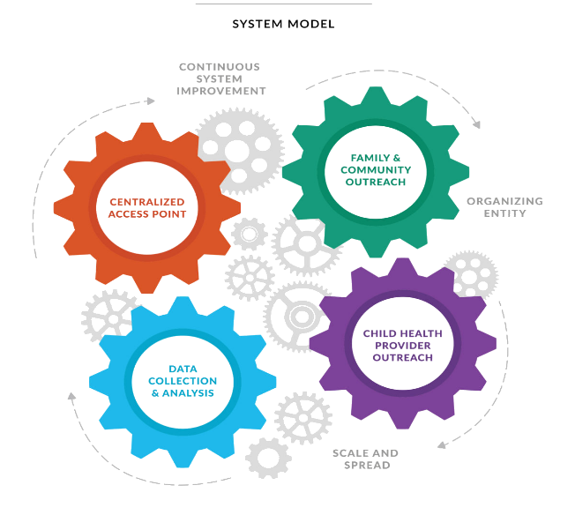
How did we get started?
Indiana State Agency Collaboration
Indiana Department of Health and Department of Child Services
Funding
MIECHV (DCS) –determined the 9 counties HMG IN were implemented in
ECCS (IDOH)– allowed HMG IN to collaborate with our local community center and WIC clinic
Marketing and Outreach
CDC-Learn the Signs Act Early Collaboration

Slide 3
How did we serve our families pre-pandemic?
Statewide
Community Outreach through-out the state
Roadshows to implementing counties
Locally
Referrals from local WIC clinic
In-person Books, Balls & Blocks events
Physician referrals via fax
These in-person connections , resulted in referrals and follow-up care coordination with Help Me Grow Indiana families

Slide 4
How did the pandemic effect how we served our families?
Local WIC clinic had to close = No referrals via Brooks ASQ API
Community outreach was put on hold = No statewide in-person connection to families or providers
Physician referrals were collected on a weekly basis instead of daily
Surveying new counties for expansion had to pause

Slide 5
How did we continue connecting with families?
Communication
Maintaining communication with families we were currently serving
Ensuring our physician referrals and feedback maintained a timely response
Leveraged programs within the centralized access point, to receive referrals
Technology
Call center software and a web-based database , provided access to care coordinate from a remote space
Processes
Revising standard operating procedures to accommodate remote work
Creating new processes to sustain remote work

Slide 6
Reviving Our Impact

Slide 7
How did HMG Indiana revive our impact?
HMG-IN and CDC-LTSAE , created virtual roadshow to refresh existing HMG counties about developmental screening & resources
Virtual roadshows have been extended to new counties
New connection with Spark Early Learning, to provide funding for HMG IN training and technology
State
Key Purpose
Statewide Expansion

Slide 8
How did HMG Indiana revive our impact?
Local WIC clinic has re-opened and ASQ’s
In-person Books, Balls and Blocks events
Physician referrals and feedback are maintained daily
Local
Key Purpose
Re-establish successful connections

Slide 9
How did HMG Indiana revive our impact?
In-person Community Outreach
Key Purpose
Connect with families and providers through promotional items and brochures

Slide 10
What will HMG IN do with these revived connections?
Apply new funding to improved training for staff and remote technology
Provide in-person developmental screenings at community events
Improve marketing materials and presence
Embed a developmental screening process for EC providers in new counties , to connect with HMG IN

Slide 11
Key Takeaways
Maintaining Partnerships
Leveraging Existing Resources
Adaptable Technology
Re-establishing Predetermined Goals

Slide 12
Questions?
Stephanie Beverly, Director of Community Engagement and Systems Building
Indiana Department of Health, Maternal and Child Health
SBeverly@isdh.in.gov

