Slide 1
An Introduction to Help Me Grow
Your Partner in Promoting Optimal Early Childhood Health & Development

Slide 2
What is Help Me Grow?
Help Me Grow (HMG) provides families, early childhood educators, daycare centers, and healthcare providers the tools they need to help young children (ages 0-5y) reach their full potential.
HMG does not charge for services or materials.
While HMG does not provide services, it connects families to appropriate community resources and checks in with them to monitor progress and follow through.
It relies on a comprehensive, up-to-date directory of local services and programs that focus on the needs of children.
HMG is funded by Onondaga County, the Health Foundation for Western and Central New York, and the Sisters of Saint Francis of the Neumann Communities.

Slide 3
HMG National Affiliate Network
28 States*, 100+ Systems
HMG
Onondaga
Alabama
Alaska
California
Connecticut
Delaware
Florida
Georgia
Indiana
Iowa
Kansas
Kentucky
Michigan
Minnesota
Mississippi
Missouri
Nebraska
New Jersey
New York
Oklahoma
Oregon
South Carolina
Texas
Utah
Vermont
Virginia
Washington
West Virginia
Wisconsin
*The District of Columbia also has a campaign

Slide 4
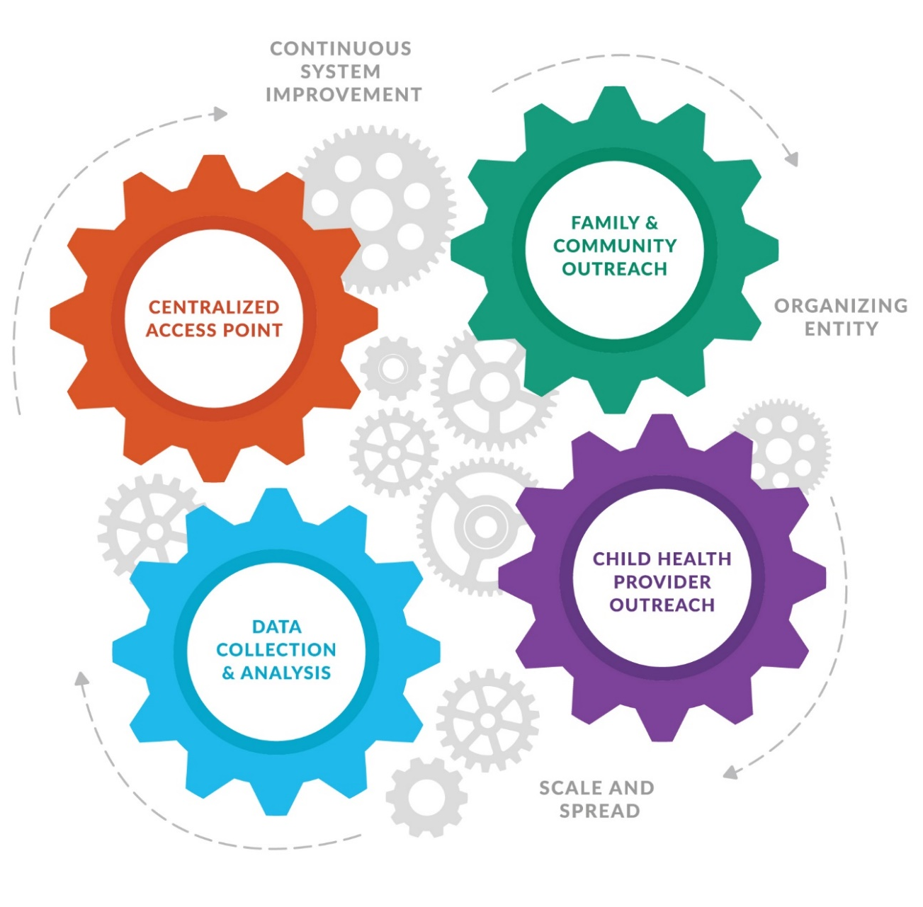
Key Components of HMG
HMG has four essential, coordinated components that drive its operation:
Child Health Provider Outreach - You!
Centralized Access Point - 2-1-1 community resource and referral hotline.
Family & Community Outreach - Increasing awareness and understanding of healthy early childhood development.
Data Collection - Identifying our community’s needs and advocating for additional services and increased funding.

Slide 5
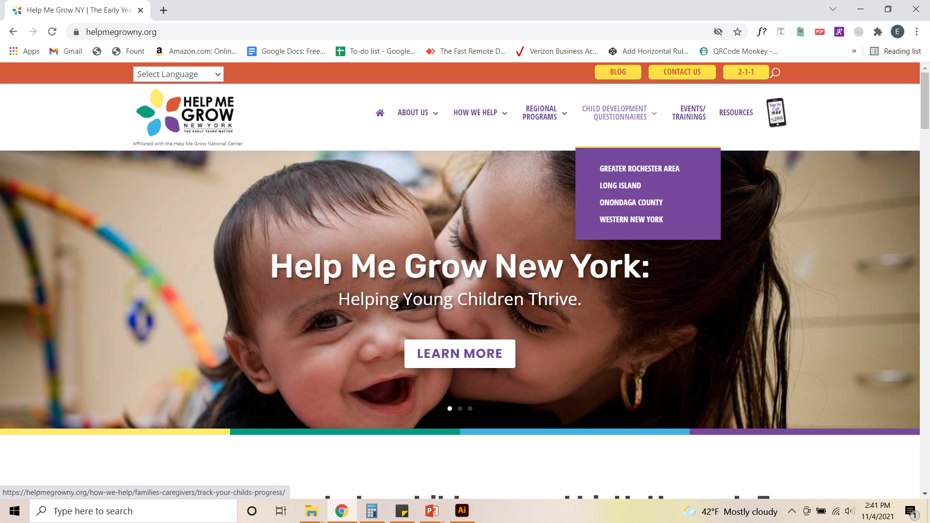

Slide 6
What Can HMG Do for Primary Care Offices?
Help healthcare providers plan and implement a successful developmental screening and follow-up program.
Providers may choose to direct their patients, prior to a well child visit, to be screened on the HMG website using a practice specific, HIPPA compliant platform.
Provide handouts of age specific activities that help families encourage skill development.
Help families engage and follow-up with Early Intervention and Special Education programs.

Slide 7
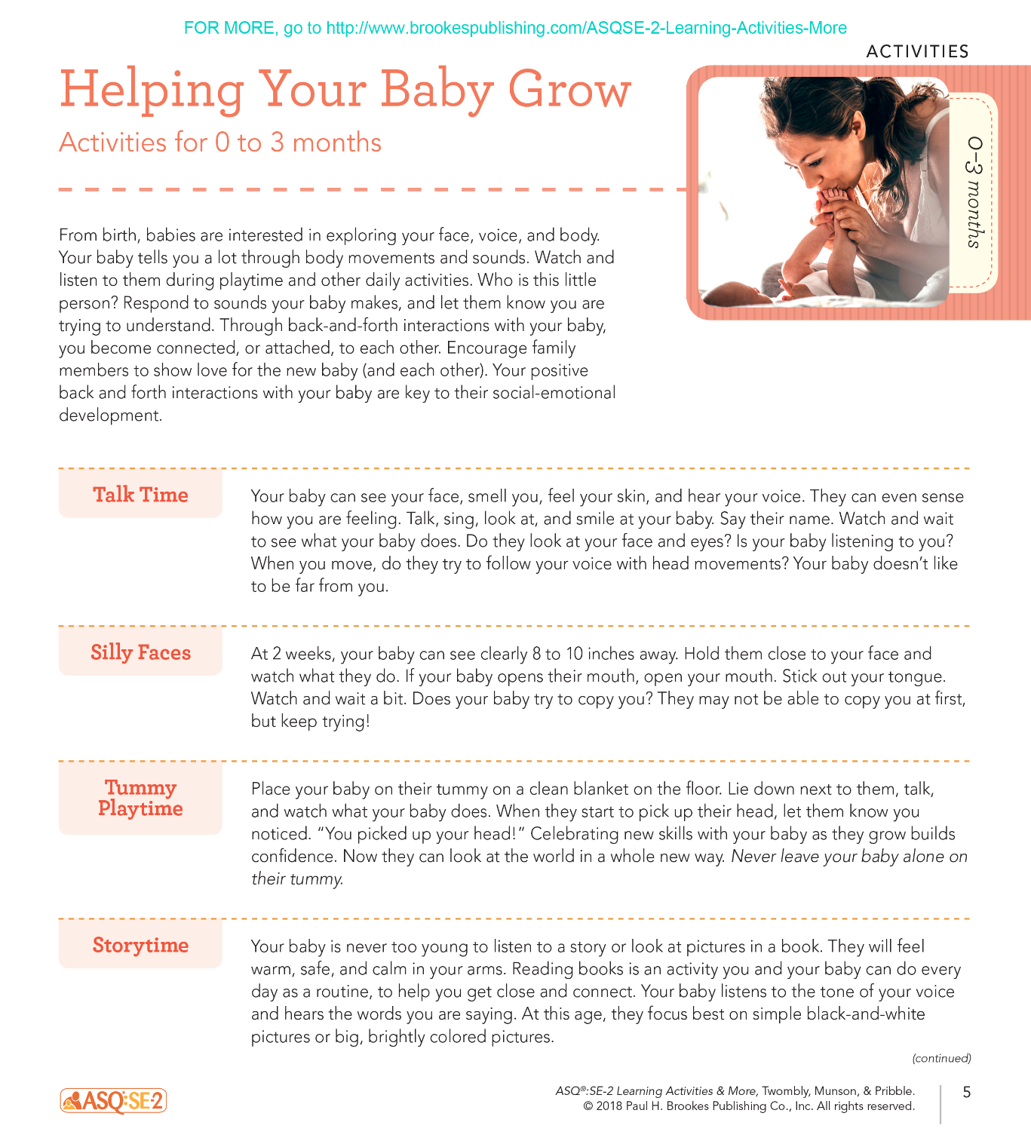
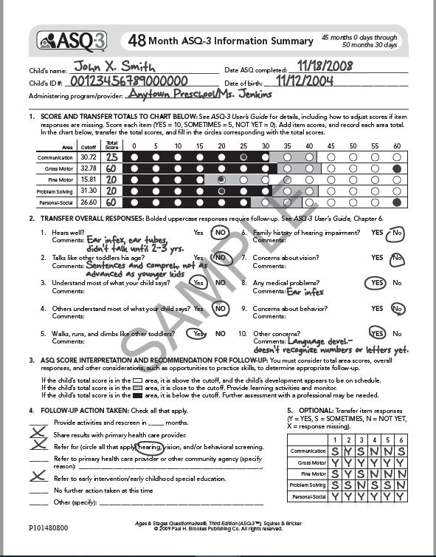

Slide 8
Why Should Primary Care Offices Do Developmental Screenings?
1-in-4 children are at risk for developmental delays. (Birth to Five: Watch Me Thrive, HHS, 2014)
Universal early childhood screening is critical in identifying delays and intervening at the most opportune period. HMG endorses the Ages and Stages Questionnaire, a standardized screening tool that is easy for parents to complete.
The AAP recommends developmental screenings at 9 months, 18 months, and 24 or 30 months.
New York State ranks second-to-last in the percentage of children receiving developmental screenings, with only 17.5% of children having a formal developmental screening before entering school. (JAMA Pediatrics, 2018)

Slide 9
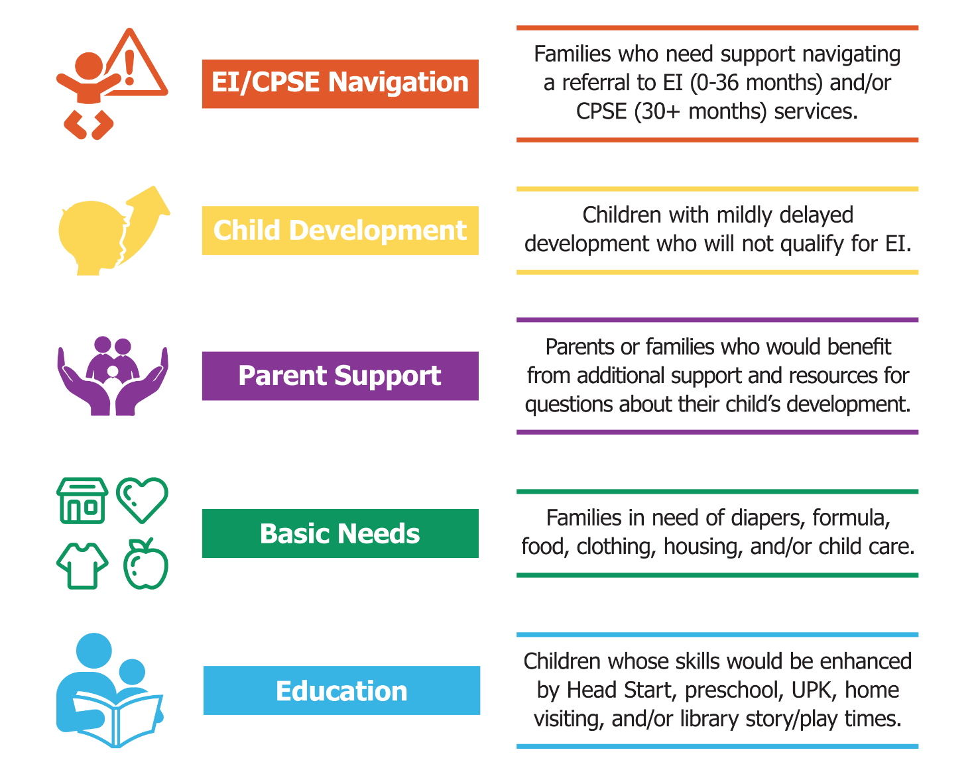
When to Refer to HMG
To make a referral, please contact Pediatric Resource Specialist
Kerrie Wenham at (315) 944-2054 or kwenham@hmgonondaga.org.
Notes:
There are 21 ASQ-3 intervals. Note that intervals are spaced 2 months apart until 24 months, 3 months apart from 24-36 months, and 6 months apart from 36-60 months.
The 9 month interval was designed for health care providers who do 9 month well baby check-ups. It has the same items as the 10 month questionnaire (would recommend only using this interval in health settings to coordinate with well child check-ups).
If a child falls in between an age then there are “window’s” listed at the top of each ASQ

Slide 10
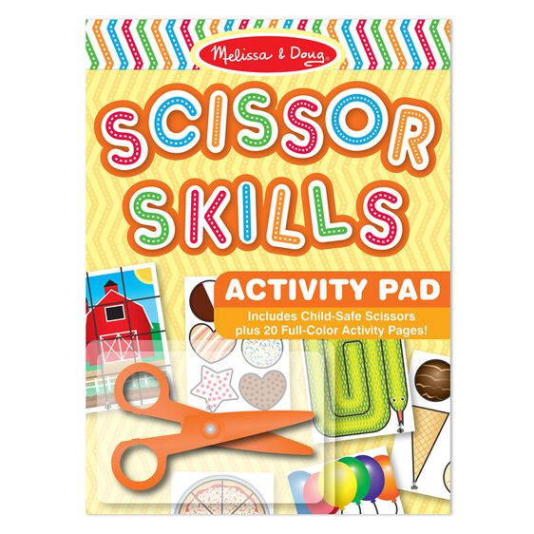
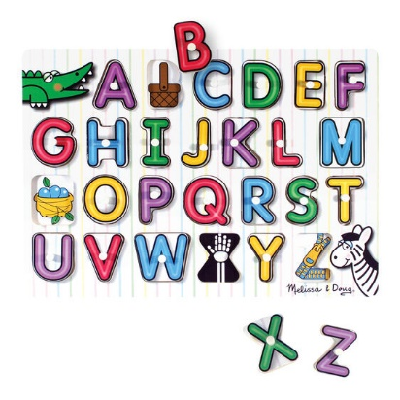
What Other Services Can HMG Offer to Primary Care Offices?
Supply offices with colorful posters from the Talking is Teaching campaign that offer simple prompts parents can use with their children to encourage early literacy.
Provide offices age appropriate developmental books and toys for their patients.
Advocate with insurance companies and Medicaid programs to increase reimbursements for developmental screenings.

Slide 11
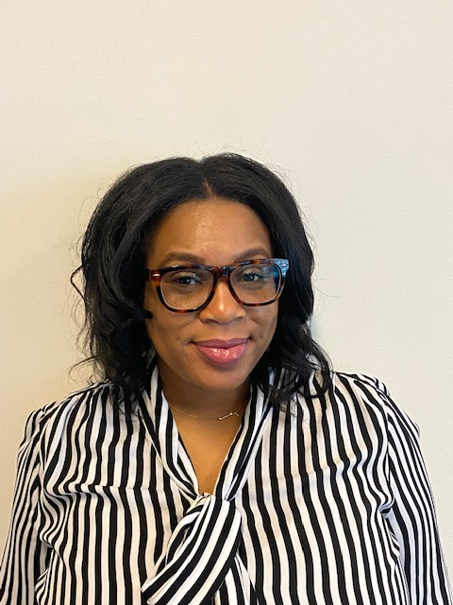
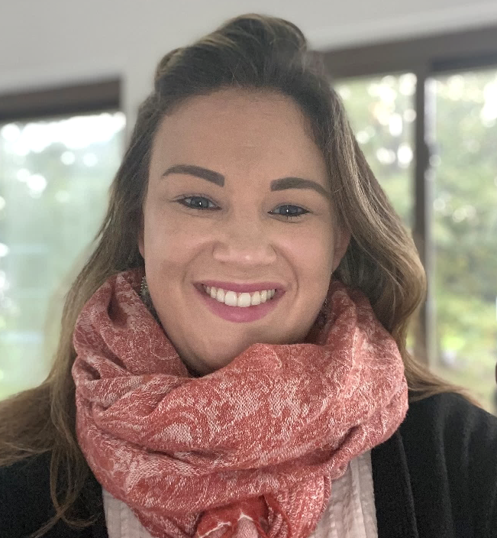
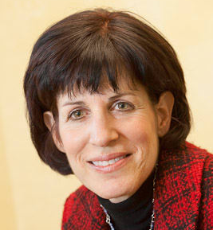
Who Is On the HMG Team?
Summer Merrick
Program Director
(315) 218-1938
smerrick@hmgonondaga.org
Kerrie Wenham
Pediatric Resource Specialist
(315) 944-2054
kwenham@hmgonondaga.org
Dr. Cynthia Bright
Physician Liaison
(315) 416-4041
cbright1@gmail.com

Slide 12
Discussion Thoughts? Questions?
We look forward to creating new partnerships and to working together to benefit the families in Onondaga County!

