Slide 1
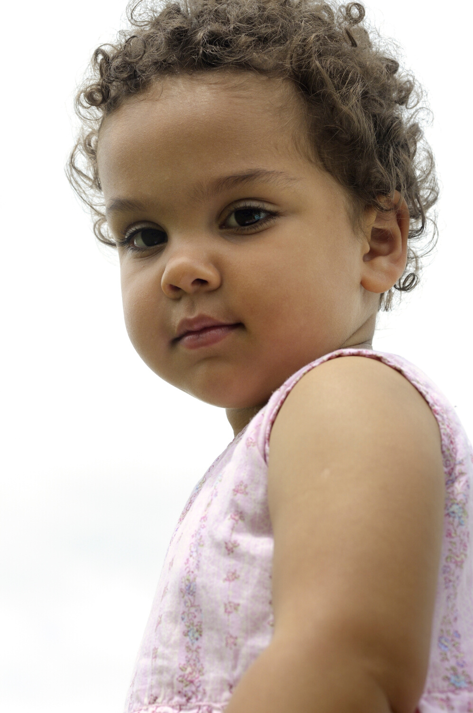
Network Partner
Grants

Slide 2
Network Partner Grants
Help Me Grow SC and the SC Infant Mental Health Association are seeking partners interested in working to promote the healthy development of children birth through age 5.
The 3rd Network Partner funding opportunity will award four grants in April 2023.
Partners will join a growing statewide network working to improve universal developmental screening access and strengthen connections to community-based programs and services that promote child health and family well-being.
Grantees will receive training, ongoing technical assistance, professional development opportunities, and a $10,000 award.
Any non-profit agency serving young children and their families is eligible to apply.

Slide 3
Why Network Partner Grants Are Effective
Allows scale and spread of HMG South Carolina across the state especially in areas where HMG has little or no presence (*rural areas)
HMG South Carolina is introduced to families/communities by an organization or agency in that community
Promote healthy child development in partnership with HMG SC
Connect families to developmental screening through HMG SC
Lead community screening events (Read Rattle & Roll)
Identify resources in their community that serve young children for the HMG SC Resource Directory
Network Partners can easily incorporate Help Me Grow into the outreach they are already doing in their community. (Example: Orangeburg County Library conducts Read Rattle & Roll during their story times for children.)

Slide 4
Agenda
Welcome
Network Partner Grant Opportunity
Mission and History of Help Me Grow
Help Me Grow Core Components
Funding Opportunity
Review Application & Key Dates
Sharing from 2022 Network Partner
Questions & Answers
Attendance at an informational webinar is required to apply for the Network Partner Grants.
Notes:
Walk through agenda

Slide 5
Four awards during third round
Each award is $10,000
Applications open February 17, 2023 and close at 5 pm on March, 17, 2023
Awards to be announced April 2023
Required virtual orientation for awardees: HMG SC overview/how to talk about HMG, STAR training to enter outreach, how to conduct screening events – Read Rattle & Roll
Project period: May 1, 2023 – April 30, 2024
Eligible applicants: any SC 501©3 nonprofit organization that serves children B-5 and their families
Single county minimum/ multi-county preferred
Grant
Details

Slide 6
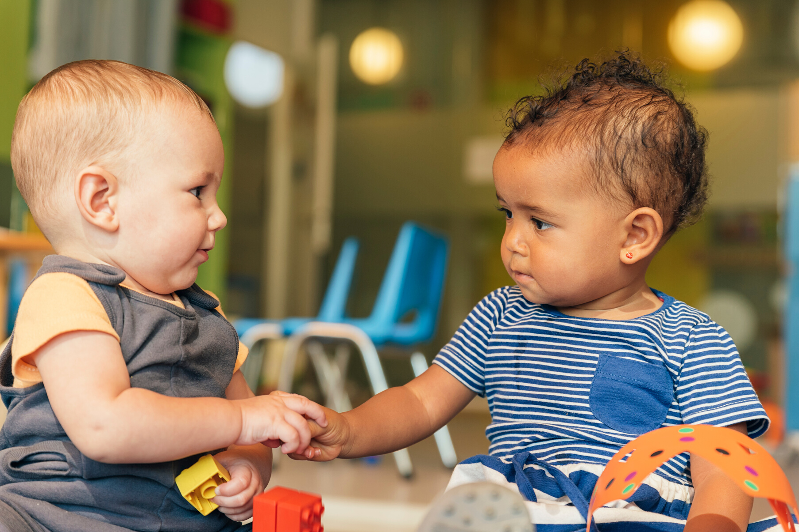
How Can the Money Be Used?
Supplies to support Outreach
Printed materials (co-branded with HMG SC/ SCIMHA
Equipment to support Outreach activities ($1,500 or less)
Membership fees related to Outreach work
Materials for hosting community screening events (Read Rattle & Roll)
Salary support for site coordinator (existing staff)
Non-allowable expenses:
Travel
Food
Capital Improvements
* Awards made possible through funding from the Preschool Development Grant (PDG) awarded to South Carolina by the Administration for Children and Families

Slide 7
Co
Co

Slide 8
Network Partners
Shifa Clinic
Calhoun County First Steps
Georgetown/Williamsburg County First Steps
Orangeburg County Library/Friends of the Library
The Champions Center (formerly Developmental Center for Exceptional Children)
Chester County First Steps

Slide 9
Network Partner Grant Application

Slide 10
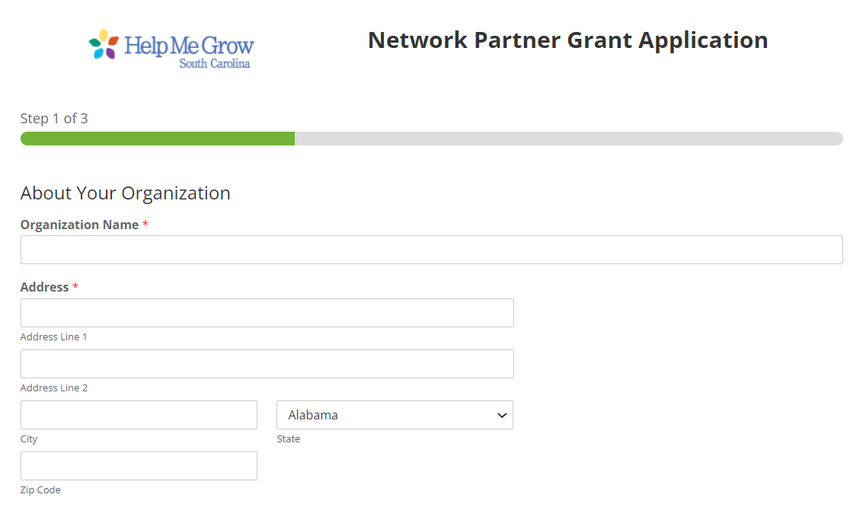

Slide 11
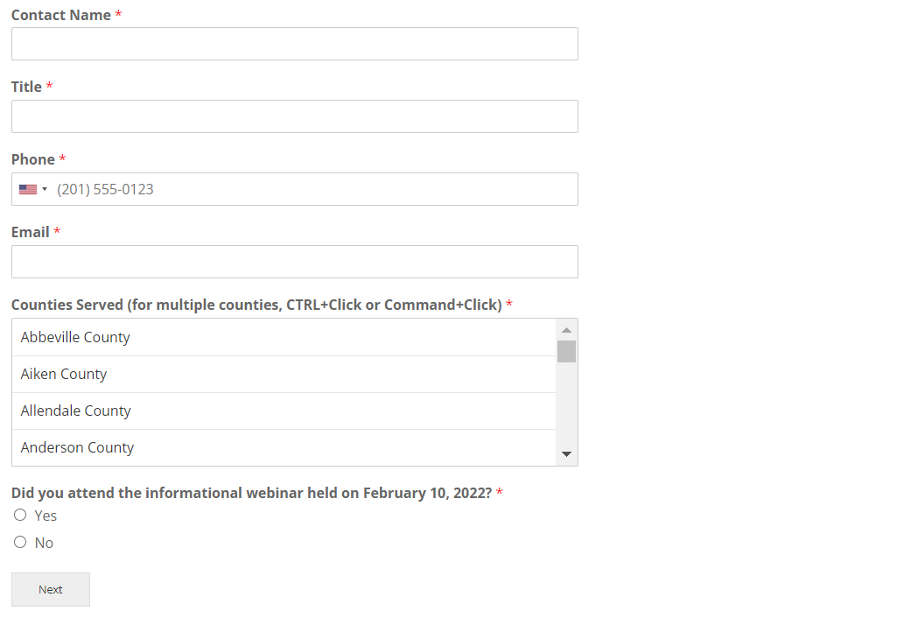

Slide 12
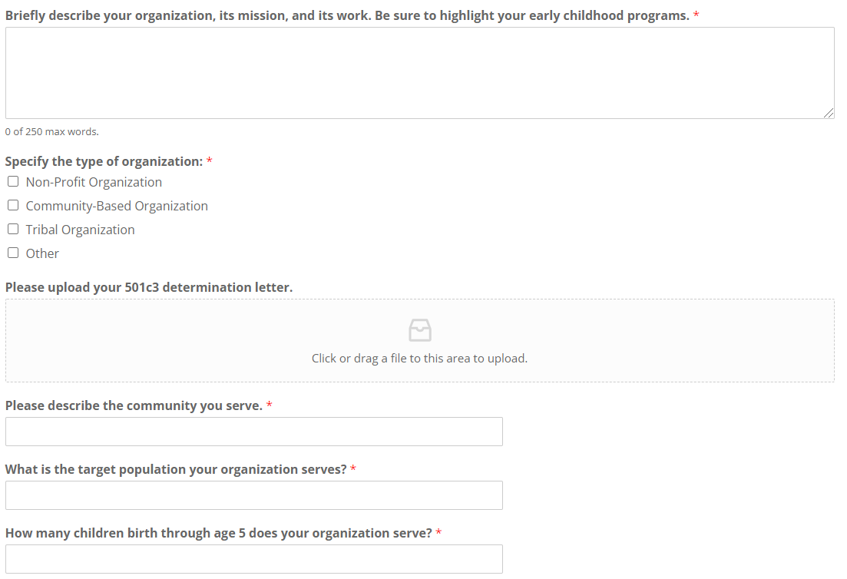

Slide 13
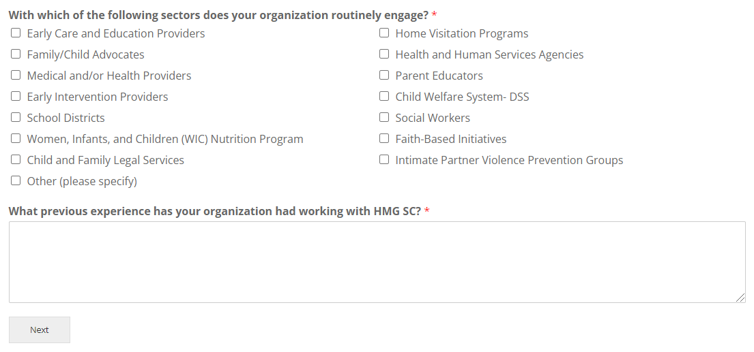

Slide 14
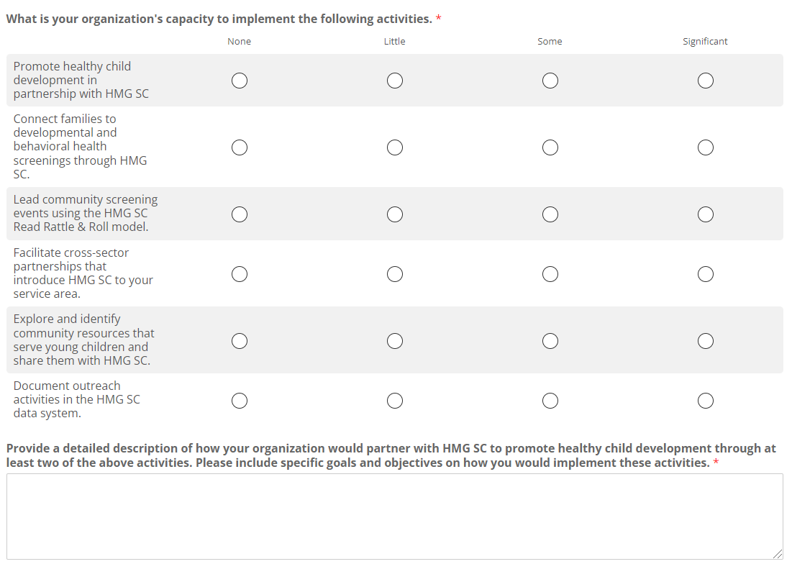

Slide 15
