Slide 1
Family Engaged Developmental Monitoring and Screening in Alaska
Emily Urlacher
Women’s, Children’s, & Family Health
Early Childhood Systems and Parents as Teachers Program Manager
Notes:
Note HMG-AK as lead, and we partner closely.

Slide 2
Presentation objectives
Share our current projects that highlight FEDM activities in Alaska
Share future planned projects that support FEDM in Alaska
Highlight the importance of accessibility and cultural relevance when promoting FEDM

Slide 3
State of Alaska Universal Developmental Screening Advisory Committee (UDSAC)
Alaska LTSAE Team and CDC LTSAE State Ambassador – Help Me Grow Alaska
Department of Education and Early Development
Alaska MIECHV and PAT Home Visiting
Alaska Mental Health Trust Authority
All Alaska Pediatric Partnership
State of Alaska Early Intervention/Infant Learning Program

Slide 4
Alaska Learn the signs. Act early. (LTSAE) team projects
Amazing Book Series - Adaptations, accessibility, and promotion
CDC LTSAE Milestone Moments Booklets – Adaptation, accessibility and promotion
Regional updates of the LTSAE developmental checklists (pre-LTSAE team)
ASQ Companion Document – an ongoing journey!
Head Start developmental screening toolkit project

Slide 5
Keep in mind….
A large goal of the UDSAC currently is to provide opportunities to introduce developmental monitoring and screening to Alaska families. At a baseline, we want them to be exposed to these terms so that when they hear the words monitoring, screening or surveillance, they do not have a negative association that would stop them from engaging. This is especially important when working with populations where colonization has occurred.
We want all projects and messaging to be as culturally relevant to Alaska families as possible.

Slide 6
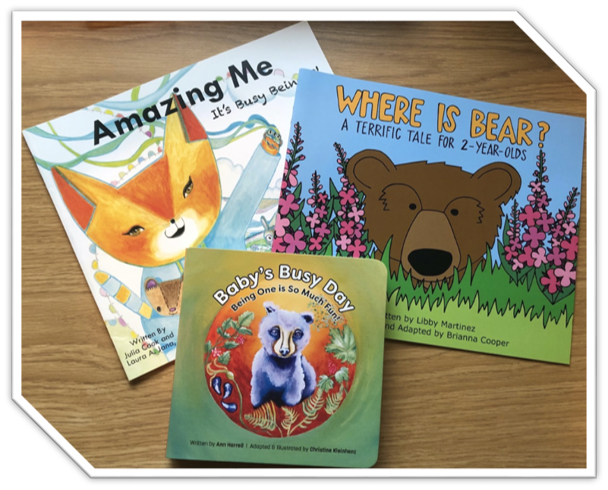
Notes:
Updated both the narration and illustrations to better reflect where we live. Ex. Alaska animals, not animals that aren’t present here. OR, in Amazing Me, It’s Busy Being Three, the occupations listed reflect ones that are more common here such as pilots or working on a commercial fishing vessel. The illustrations were all done by Alaska artists who have experience working in early childhood, from three different regions of the state. These are available FREE to all provider types who serve young children. They can order online through HMG-AK. We ‘ve also been able to update and print Where is Bear is Tagalog to reflect the large Filipino population in some regions of Alaska. To promote and support families in using these books, the LTSAE team created three videos – one for each book, that discusses the importance of monitoring milestones, and shows real Alaska families reading the book to their young children. Moving forward, with funding from the Preschool Development Grant Renewal and our partners from the Alaska Mental Health Trust Authority, we are hoping to provide more of these books in other languages, including traditional languages from Alaska Native tribes, as well as launch a large campaign to promote the materials (social media, community events, etc. – TBD)

Slide 7
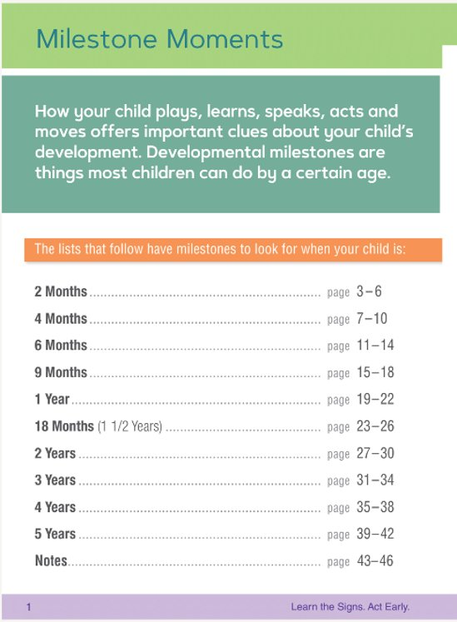
Notes:
The second things the LTSAE team did was update the CDC LTSAE Milestone Moments Booklets to better reflect Alaska family language and culture. Colloquially we call this “Alaska-fying” the project. This allows families to feel more comfortable understand and using the materials. These are also available on the HMG-AK website for free to providers. We expect to print more (and possibly update?) with Preschool Development Grant Renewal funds.

Slide 8
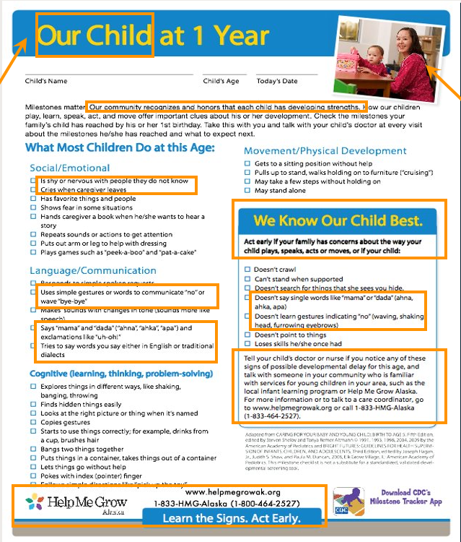
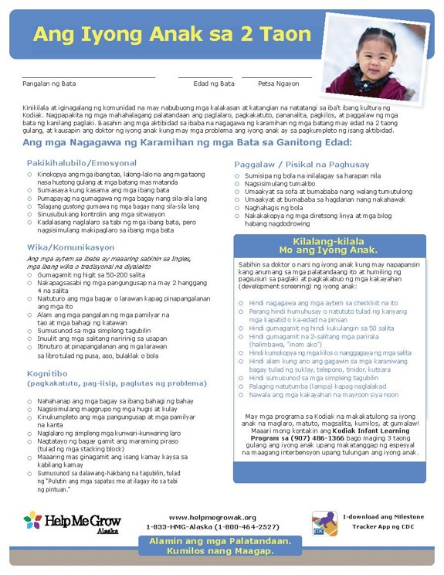
Notes:
Similar to the Milestone Moments booklets updates, but more region and language specific.

Slide 9
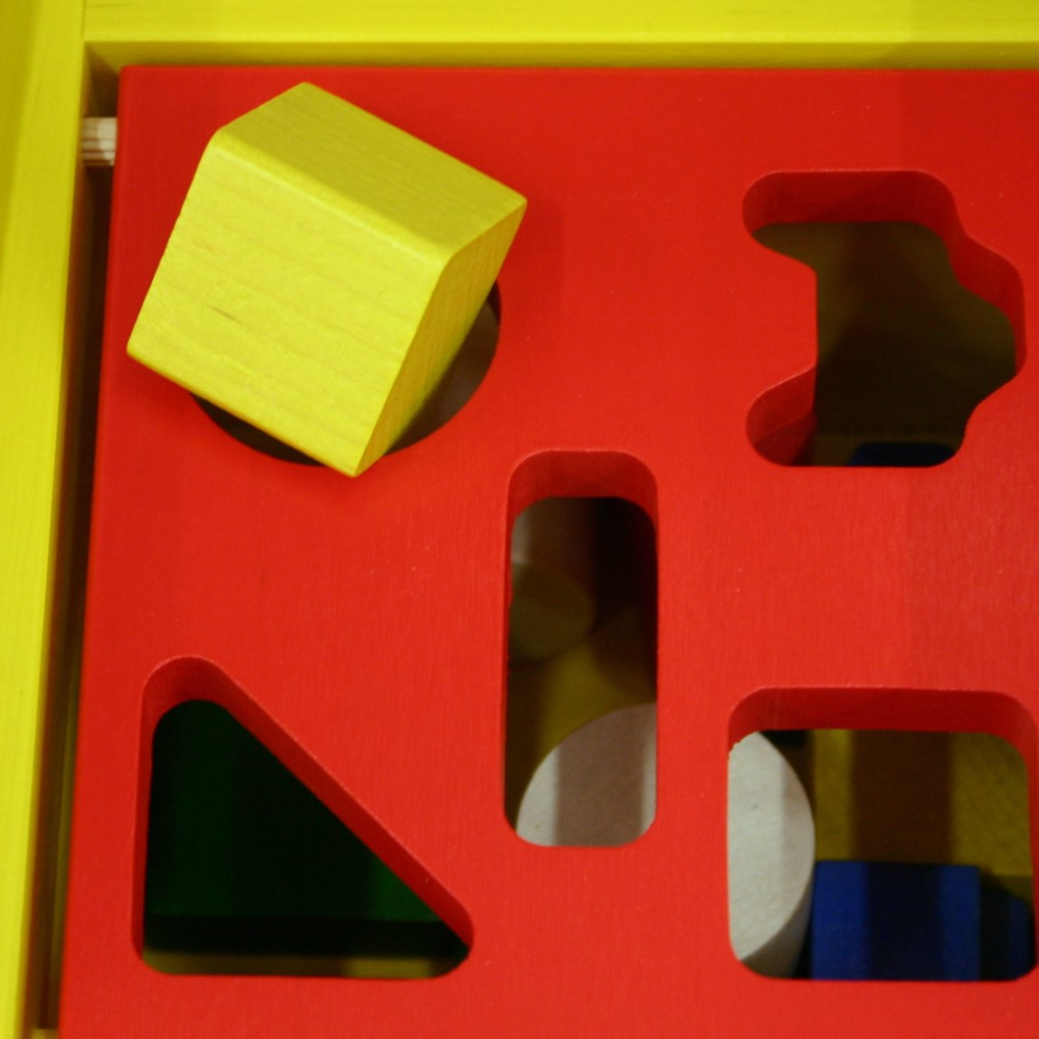
ASQ Companion Document
ASQ Companion Document
ASQ
Sits alongside the ASQ to provide cultural context specific to the region
Draft documents were created in both the Norton Sound and Southeast regions of Alaska
Must have dedicated community partners
Must have a way to gather community feedback
Notes:
Sits alongside the ASQ to provide cultural context specific to the region, so that scores are more accurate and families feel more supported while engaging in developmental screening.
Creation includes dedicated partners from the area to provide feedback and guidance in creating the document.
Community outreach for feedback must be conducted by a trusted provider/consultant/group to ensure the ASQ Companion Document meets the needs of the families in the community and will be utilized appropriately.
This project was started when a specific region of the state wanted an updated version of the ASQ, but they didn’t have a large enough population size for Brookes Publishing to take on the project. This was an alternate to that identified need.
*There’s a hope that PDG renewal funding could go towards the creation of more ASQ companion documents in partnership with other Alaska communities*

Slide 10
Head Start Developmental Screening toolkit
Created to provide guidance specific to Alaska Head Start agencies on how to provide a developmental screening event for families with young children in the program.
Needs to be piloted by Head Start agencies for feedback
The toolkit will assist Head Start agencies in hosting something very similar to a Books, Balls and Blocks event, but in a way that also meetings Head Start National Standards.
Notes:
Would love to create large event kits that agencies could rent out to host an event like this.

Slide 11
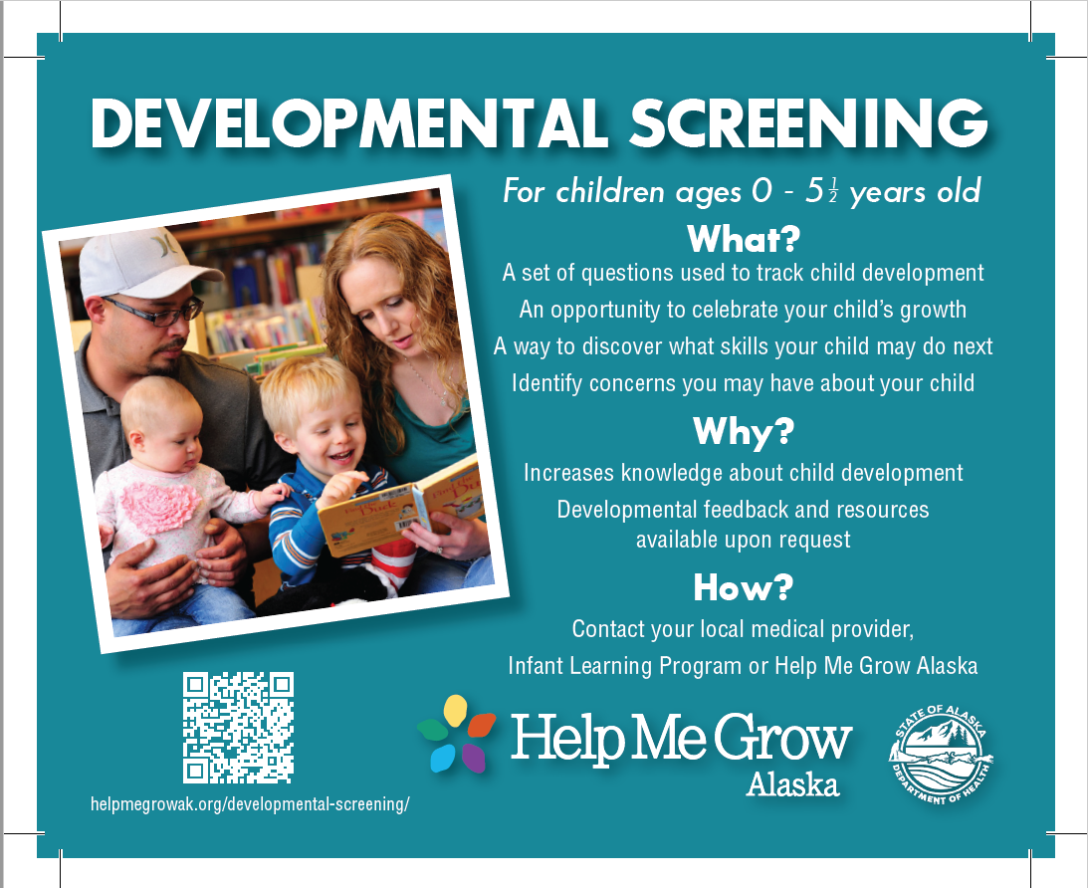
Notes:
To make developmental screening less scary and more know to the public. Social media, radio, posters and magnets. To increase family engaged developmental monitoring and screening, we have to promote knowledge of it and make it less scary for families first.

Slide 12
Thank you!
Emily Urlacher at emily.urlacher@alaska.gov
Carmen Wenger with Help Me Grow Alaska at carmen@a2p2.com

