Slide 1
Strengthening Early Childhood Policy, Programs, and Advocacy Using a Child Rights-Based Approach
Sherri L. Alderman, MD, MPH, IMH-E Mentor Clinical & Policy, FAAP
Help Me Grow National Forum
September 22, 2021
Copyright © 2021 by Alderman Boreal Consulting®, LLC. All rights reserved

Slide 2
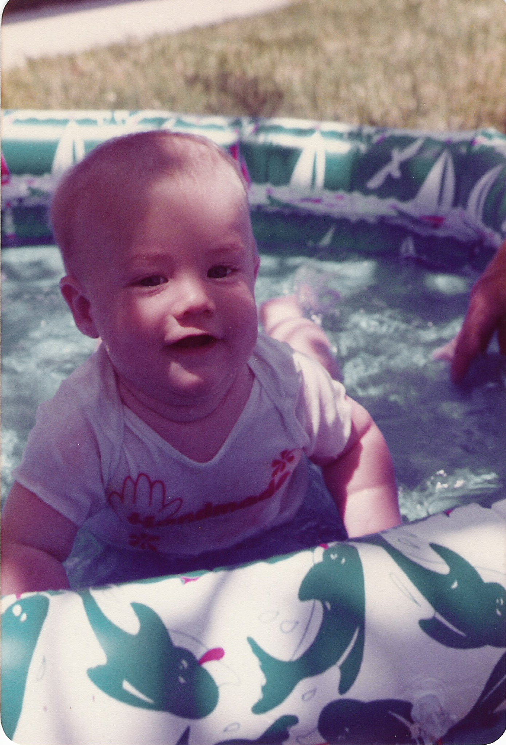
Disclaimer
Neither I nor my immediate family have any financial interests to disclose.
I do not intend to discuss any unapproved or investigative use of commerical products or devices.
Reasonable attempts have been made to provide accurate and complete information.
The practitioner or provider is responsible for use of this educational material; any information provided should not be a substitution for the professional judgement of the practitioner or provider.
Copyright © 2021 by Alderman Boreal Consulting®, LLC. All rights reserved

Slide 3
Goals & Objectives
Name three benefits of a child rights-based approach to policy and program development that elevate early childhood services to basic human rights.
Experience applying a child rights-based mechanism of framing a proposal, program, or initiative using provided tools.
Copyright © 2021 by Alderman Boreal Consulting®, LLC. All rights reserved

Slide 4
Agenda
Human Rights Basics
Child Rights
Rights-Based Approach to Development
Child Rights Programming
Practical Applications
Copyright © 2021 by Alderman Boreal Consulting®, LLC. All rights reserved

Slide 5
Infant Mental Heath Endorsement Core Competency
Advocacy
Copyright © 2021 by Alderman Boreal Consulting®, LLC. All rights reserved

Slide 6
How we care for our children is how, at last, we take charge of our destiny.
Laurence Frank, 1939
Copyright © 2021 by Alderman Boreal Consulting®, LLC. All rights reserved

Slide 7
I.
Human Rights Basics
Copyright © 2021 by Alderman Boreal Consulting®, LLC. All rights reserved

Slide 8
Human Rights
Standards that recognize and protect the dignity of all human beings
Copyright © 2021 by Alderman Boreal Consulting®, LLC. All rights reserved

Slide 9
Human Rights
Values that can be found in all cultures and all religious, moral, and ethical traditions
Common standards of conduct
Create a normative framework and common goals universally applicable
Save the Children (2005). Child Rights Programming, 2nd Edition
Copyright © 2021 by Alderman Boreal Consulting®, LLC. All rights reserved

Slide 10
Human Rights Documents are:
A clear vision of what humans need in order to survive and to live a life of dignity and fulfillment
Protections from violence and discrimination
Opportunity to:
    Adequate standard of living
    Access to basic services
    Participate in decision-making
Save the Children (2005). Child Rights Programming, 2nd Edition
Copyright © 2021 by Alderman Boreal Consulting®, LLC. All rights reserved

Slide 11
Human Rights Principles
Universal
Indivisible
Interdependent
Interrelated
Inalienable
Hold rights-holder and duty-bearer accountable
Participation is fundamental
Save the Children (2005). Child Rights Programming, 2nd Edition
Copyright © 2021 by Alderman Boreal Consulting®, LLC. All rights reserved
Notes:
Indivisible: non-hierachal, equal status as rights
Inalienable: unable to be taken away from or given away by the possessor
Rights-holder: who has the right
Duty-bearer: entity with obligation to fulfill the right

Slide 12
Brief History of Human Rights
Universal Declaration of Human Rights (1948)
Convention on the Elimination of all Forms of Racial Discrimination (1965)
Convention on the elimination of all Forms of Discrimination of Against Women (1979)
Convention on the Rights of the Child (1989)
Save the Children (2005). Child Rights Programming, 2nd Edition
Copyright © 2021 by Alderman Boreal Consulting®, LLC. All rights reserved
Notes:
Indivisible: non-hierachal, equal status as rights
Rights-holder: who has the right
Duty-bearer: entity with obligation to fulfill the right

Slide 13
II.
Child Rights
Copyright © 2020 by Alderman Boreal Consulting®, LLC. All rights reserved

Slide 14
Why Child Rights?
Children are individuals
Children start life as totally dependent beings
Government actions and inactions impact children more strongly than other groups
Children’s views should be heard and considered in the political and social processes
Child Rights and Why They Matter;
www.unicef.org/child-rights-convention/child-rights-why-they-matter
Copyright © 2021 by Alderman Boreal Consulting®, LLC. All rights reserved

Slide 15
Why Child Rights?
Many changes in society are having a disproportionate, and often negative, impact on children
Healthy development of children is crucial to the future well-being of any society
Costs to society of failing its children are huge
Child Rights and Why They Matter;
www.unicef.org/child-rights-convention/child-rights-why-they-matter
Copyright © 2021 by Alderman Boreal Consulting®, LLC. All rights reserved
Notes:
Examples:
Child welfare
Divorce
Environmental toxins
Lead in drinking water
Separation at the border

Slide 16
Child Rights
Same general human rights as adults
AND
Rights recognizing special needs
Child Rights and Why They Matter;
www.unicef.org/child-rights-convention/child-rights-why-they-matter
Copyright © 2021 by Alderman Boreal Consulting®, LLC. All rights reserved

Slide 17
History of Child Rights Documents
Geneva Declaration on the Rights of the Child (League of Nations, 1924)
Rights to:
Means for their development
Special help in times of need
Priority for relief
Economic freedom & protection from exploitation
Upbringing that instills social consciousness & duty
History of Child Rights;
www.unicef.org/child-rights-convention/history-child-rights
Copyright © 2021 by Alderman Boreal Consulting®, LLC. All rights reserved

Slide 18
History of Child Rights Documents
Universal Declaration of Human Rights (1948)
Article 25
entitles mothers and children to ‘special care and assistance’
Declaration on the Rights of the Child (1959)
Convention on the Rights of the Child (1989)
History of Child Rights;
www.unicef.org/child-rights-convention/history-child-rights
Copyright © 2021 by Alderman Boreal Consulting®, LLC. All rights reserved

Slide 19
Convention on the Rights of the Child (CRC)
Most widely adopted human rights document in history
Ratified by 196 of 197 UN States
Save the Children (2005). Child Rights Programming, 2nd Edition
Copyright © 2021 by Alderman Boreal Consulting®, LLC. All rights reserved

Slide 20
Convention on the Rights of the Child (CRC)
Most comprehensive human rights treaty
Humanitarian law
Civil
Political
Economic
Social & cultural
Culturally sensitive & responsive
Save the Children (2005). Child Rights Programming, 2nd Edition
Copyright © 2021 by Alderman Boreal Consulting®, LLC. All rights reserved

Slide 21
4 Basic CRC Principles
Non-discrimination
Best interests of the child
Rights to life, survival, and development
Respect for the views of the child
Save the Children (2005). Child Rights Programming, 2nd Edition
Copyright © 2021 by Alderman Boreal Consulting®, LLC. All rights reserved

Slide 22
4 Basic CRC Principles
Save the Children (2005). Child Rights Programming, 2nd Edition
Copyright © 2021 by Alderman Boreal Consulting®, LLC. All rights reserved
Notes:
Interdependent
Interrelated
Inalienable
3 Pillars (non-discrimination, best interest of the child, child participation in society and decision-making)
Contribute and assure survival and development

Slide 23
CRC protects and promotes the rights of all children to:
Participate in family, cultural, and social aspects of life
Right to survival, development, and protection against abuse, neglect, and exploitation
Right to education, health care, juvenile justice
Rights for children with disabilities
Save the Children (2005). Child Rights Programming, 2nd Edition
Copyright © 2021 by Alderman Boreal Consulting®, LLC. All rights reserved
Notes:
Positive rights
Negative rights (protections)

Slide 24
Child Participation
Transforms the power relations between children and adults
Challenges authoritarian structures
Supports children’s capacity to influence families, communities, and institutions
Save the Children (2005). Child Rights Programming, 2nd Edition
Copyright © 2021 by Alderman Boreal Consulting®, LLC. All rights reserved

Slide 25
Child Participation
Builds new relationships between children and adults
Promotes development of communication skills and civic responsibility
Improves adult understanding of children’s situations and recognition of their contributions to family and society
Save the Children (2005). Child Rights Programming, 2nd Edition
Copyright © 2021 by Alderman Boreal Consulting®, LLC. All rights reserved

Slide 26
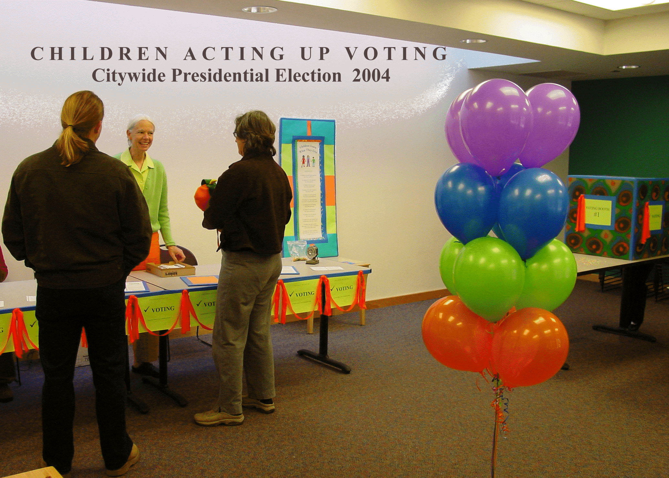
Takes only 5 minutes/Lasts a lifetime
Copyright © 2021 by Alderman Boreal Consulting®, LLC. All rights reserved
Notes:
1st Children’s Presidential Election in 2004
Voting is a basic civic responsibility
Children learn by doing

Slide 27
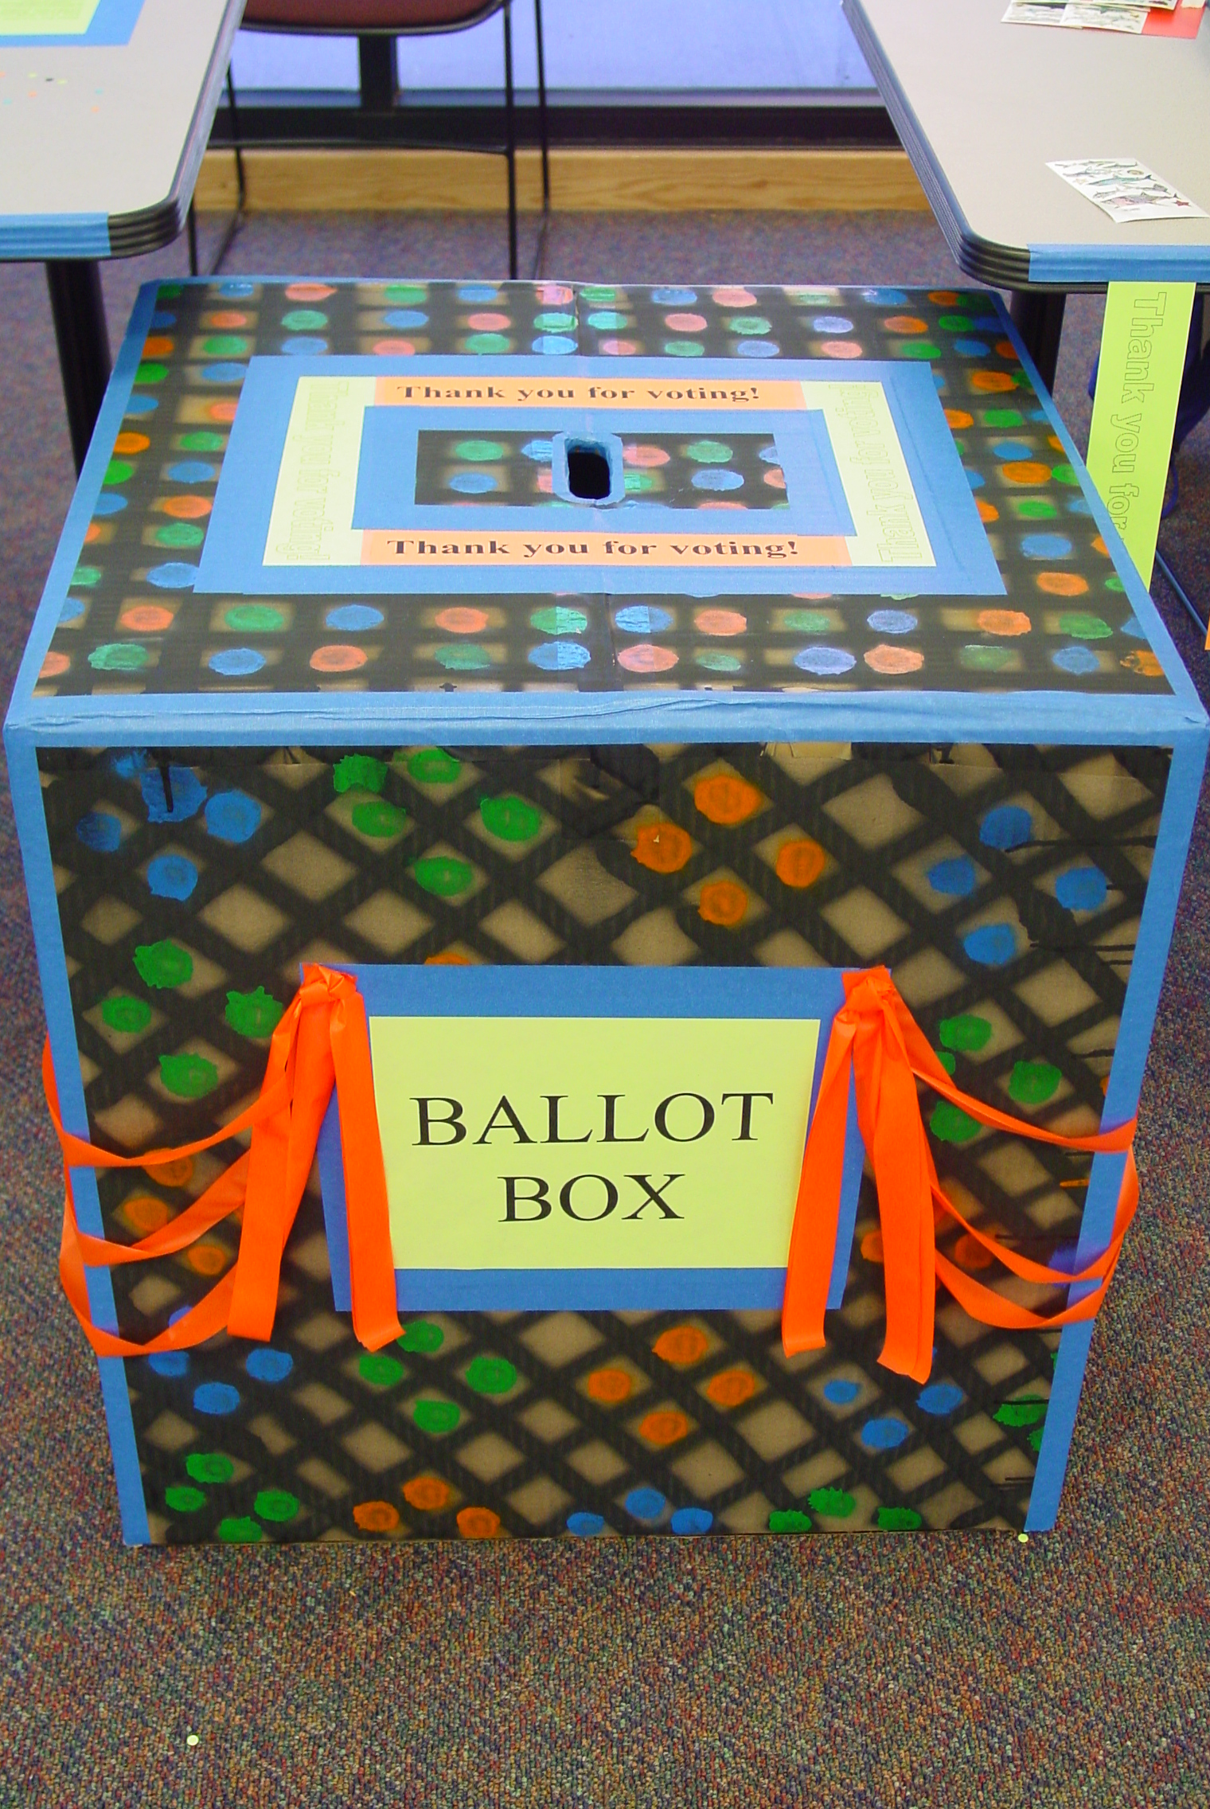
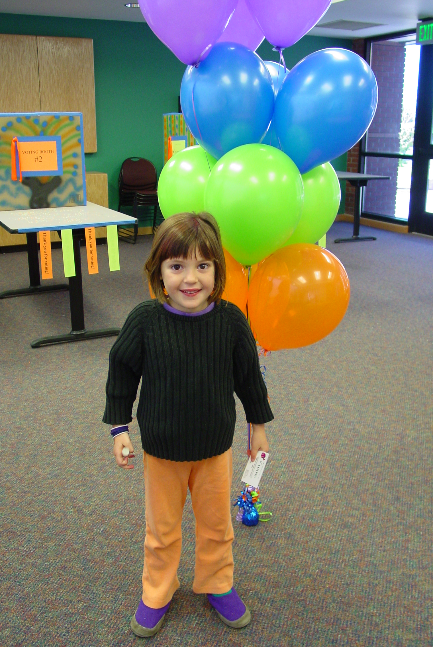
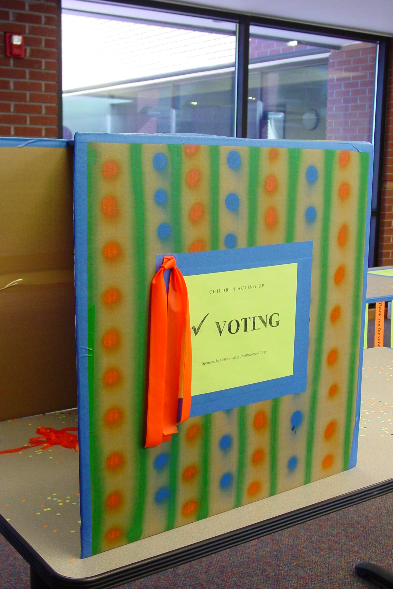
Copyright © 2021 by Alderman Boreal Consulting®, LLC. All rights reserved
Notes:
Children’s Presidential Election
Encouraged development of communication skills
Built new relationships btw child and parent
Example:
7 yo boy coming in with his mother, marched over to the voting booth with determination
Mother waited and shared that he was voting for a candidate different from hers

Slide 28
Rights of Infants
The Infant by reason of his/her physical and mental immaturity and absolute dependence needs special safeguards and care, including appropriate legal protections.
Miri Keren
World Association of Infant Mental Health (2017). Perspectives
Copyright © 2021 by Alderman Boreal Consulting®, LLC. All rights reserved

Slide 29
III.
Rights-Based Approach to Program Development
Copyright © 2020 by Alderman Boreal Consulting®, LLC. All rights reserved

Slide 30
Rights-Based Approach to
Program Development
Brings together the best of previously separate perspectives:
Relief and program development professionals
Human rights
Save the Children (2005). Child Rights Programming, 2nd Edition
Copyright © 2021 by Alderman Boreal Consulting®, LLC. All rights reserved

Slide 31
Rights-Based Approach to
Program Development
Fulfillment of everyone’s human rights as the end goal of development
Application of human rights principles as constituting good practice in achieving lasting change
Save the Children (2005). Child Rights Programming, 2nd Edition
Copyright © 2021 by Alderman Boreal Consulting®, LLC. All rights reserved

Slide 32
Rights-Based Approach to
Program Development
3 defining characteristics
People centered
Empowering
Participatory
Save the Children (2005). Child Rights Programming, 2nd Edition
Copyright © 2021 by Alderman Boreal Consulting®, LLC. All rights reserved

Slide 33
Rights-Based Approach to
Program Development
Equitable
Gives voice to “rights-holders” especially poor, marginalized, powerless, and discriminated against
Empowering
To claim their rights
Addresses root cause of disparities
Violation of human rights
Sustainable change
Rights-informed policies & practices
Save the Children (2005). Child Rights Programming, 2nd Edition
Copyright © 2021 by Alderman Boreal Consulting®, LLC. All rights reserved

Slide 34
Rights-Based Approach to
Program Development Benefits
Clear shared long-term goals
Accountability
Empowerment
Equity
Greater impact and effectiveness
Integrated
Save the Children (2005). Child Rights Programming, 2nd Edition
Copyright © 2021 by Alderman Boreal Consulting®, LLC. All rights reserved
Notes:
Pg 24
Rights-holders and duty-bearers
Integrated:
interdependent,
Interrelated

Slide 35
Rights-Based Approach vs. Other Approaches
Other Approaches | Rights-based Approaches
Action is voluntary | Action is mandatory
People have needs | People have claims and entitlement
Poor people deserve help | Poor people are entitled to rights
Some may be left out | All people have the same rights
People invited as passive beneficiaries | People are active participants
Some cultures do not recognize some needs | Rights are universal and inalienable
Need to be pragmatic and work within the power structure | Power structures that block realizing rights must be changed
Development is technocratic, led by “experts” | Development process must empower rights-holders and involve them in public decision-making
Hierarchy of needs | Rights are indivisible and interdependent
Save the Children (2005). Child Rights Programming, 2nd Edition
Copyright © 2021 by Alderman Boreal Consulting®, LLC. All rights reserved
Notes:
Pg 24

Slide 36
IV.
Child Rights Programming
Copyright © 2021 by Alderman Boreal Consulting®, LLC. All rights reserved

Slide 37
Child Rights Programming
Using the principles of child rights to plan, implement, and monitor programs
With the overall goal of improving the position of children
So that all children can fully enjoy their rights
And can live in societies that acknowledge and respect children’s rights
Copyright © 2021 by Alderman Boreal Consulting®, LLC. All rights reserved

Slide 38
Child Rights Programming Aim
Address gaps and violations of rights
Strengthen physical structures or mechanisms/systems
Strengthen communities and civil societies capable of supporting children’s rights
Save the Children (2005). Child Rights Programming, 2nd Edition
Copyright © 2021 by Alderman Boreal Consulting®, LLC. All rights reserved
Notes:
Pg 42:
A mix of activities that aim to…
Address gaps and violations of rights
(food aid, reunification of separated children, sexual exploitation
2. Strengthen physical structures or mechanisms
(access, political, legislative, judicial)
Remember 4 principles (or specific Articles) of CRC
freedom from discrimination, Non-discrimination
Best interests of the child
Rights to life, survival, and development
Respect for the views of the child

Slide 39
Child Rights Programming Key Components
Focus on children
Holistic view of children
Accountability
Supporting duty-bearers
Advocacy
Participation
Save the Children (2005). Child Rights Programming, 2nd Edition
Copyright © 2021 by Alderman Boreal Consulting®, LLC. All rights reserved
Notes:
Pg 26-27
Holistic: Remember rights are inalienable, inter-dependent and inter-related
Accountability: holding duty-bearers accountable
Advocacy: public education, awareness, reframing
Participation: aliened with child’s evolving capacity

Slide 40
Child Rights Programming Key Components
Non-discrimination
Best interest of children
Survival and development
Children as part of a community
Root causes
Partnerships
Information and knowledge
Save the Children (2005). Child Rights Programming, 2nd Edition
Copyright © 2021 by Alderman Boreal Consulting®, LLC. All rights reserved
Notes:
Pg 26-27
Negative Rights: non-discrimination
Positive Rights: inclusion for ALL (including most marginalized)
Survival in the immediate sense AND development of their full potential in the longer-term
Community—family, school, community, and society—
and the role that parents and other adults have in defending child rights
Root causes of adverse experiences and outcomes: immediate violations and structurally embedded root causes
Such as racism
Partnerships: and alliances with shared vision and goals defined by child rights
Information & Knowledge of child rights: government, duty bearers, communities and children (CANADA study)
Can be an effective way of approaching and addressing bullying

Slide 41
Child Rights Programming Mechanism
Make integrating child rights into all aspects of program development the norm
Consider the 4 general principles at every juncture
Identify, engage, support, and hold accountable duty bearers
Apply to all levels of society and use as linkages to levels
Save the Children (2005). Child Rights Programming, 2nd Edition
Copyright © 2021 by Alderman Boreal Consulting®, LLC. All rights reserved
Notes:
Page 41
Non-discrimination
Best interests of the child
Rights to life, survival, and development
Respect for the views of the child

Slide 42
Child Rights Programming Mechanism
Make participation an essential component
Define measurable outcomes through child rights lens
Discuss short- and long-term goals in terms of child rights
Be an early adopter and mentor others
Build and embrace diverse forms of partners sharing the same child rights programming approach
Save the Children (2005). Child Rights Programming, 2nd Edition
Copyright © 2021 by Alderman Boreal Consulting®, LLC. All rights reserved
Notes:
Page 41

Slide 43
Child Rights Programming Partnerships:
Dynamic & Growth-Promoting
Shared vision, values (e.g., 4 Principles)
Common, measurable objectives
Mutual learning and recognition
Mutual respect for differing cultural perspectives
Mutual empowerment
Mutual accountability
Transparency and trust
Save the Children (2005). Child Rights Programming, 2nd Edition
Copyright © 2021 by Alderman Boreal Consulting®, LLC. All rights reserved
Notes:
Page 46
4 Principles
freedom from discrimination, Non-discrimination
Best interests of the child
Rights to life, survival, and development
Respect for the views of the child

Slide 44
Program perspective of children ensures that children are recognized as whole people with dignity and evolving capacities and that they are empowered to speak out, be heard, and become an integral part of society.
Copyright © 2021 by Alderman Boreal Consulting®, LLC. All rights reserved

Slide 45
V.
Practical Applications
Copyright © 2021 by Alderman Boreal Consulting®, LLC. All rights reserved

Slide 46
Copyright © 2021 by Alderman Boreal Consulting®, LLC. All rights reserved
TOOL #1: Your Agency through a Child Rights Lens
CRC = Convention on the Rights of the Child
4 Basic CRC Principles
Non-discrimination
Best interests of the child
Rights to life, survival, and development
Respect for the views of the child
CRC protects and promotes the rights of all children to:
Participate in family, cultural, and social aspects of life
Right to survival, development, and protection against abuse, neglect, and exploitation
Right to education, health care, juvenile justice
Rights for children with disabilities
Agency Name | Mission, Vision, and/or Goal(s) | Relevant CRC Principle, Protection/Pro-motion, or Article | Top 1-3 CRC Priorities | Top 1 or 2 CRC Gap or Opportunity (Principle, Protection/Pro-motion, or Article

Slide 47
Copyright © 2021 by Alderman Boreal Consulting®, LLC. All rights reserved
TOOL #2: Program or Proposal Development through a Child Rights Lens
CRC = Convention on the Rights of the Child
4 Basic CRC Principles
Non-discrimination
Best interests of the child
Rights to life, survival, and development
Respect for the views of the child
CRC protects and promotes the rights of all children to:
Participate in family, cultural, and social aspects of life
Right to survival, development, and protection against abuse, neglect, and exploitation
Right to education, health care, juvenile justice
Rights for children with disabilities
Program or Proposal (hypothetical or real) | Gap or opportunity addressed by program or proposal | Relevant CRC Principle, Protection, Promotion, or Article | Partner(s) (hypothetical or real) | Shared Vision, Value, or Goal (Principle or Right)

Slide 48
Copyright © 2021 by Alderman Boreal Consulting®, LLC. All rights reserved
EXAMPLE: Children’s Presidential Election
TOOL #2: Program or Proposal Development through a Child Rights Lens
CRC = Convention on the Rights of the Child
4 Basic CRC Principles
Non-discrimination
Best interests of the child
Rights to life, survival, and development
Respect for the views of the child
CRC protects and promotes the rights of all children to:
Participate in family, cultural, and social aspects of life
Right to survival, development, and protection against abuse, neglect, and exploitation
Right to education, health care, juvenile justice
Rights for children with disabilities
Program or Proposal (hypothetical or real) | Gap or opportunity addressed by program or proposal | Relevant CRC Principle, Protection, Promotion, or Article | Partner(s) (hypothetical or real) | Shared Vision, Value, or Goal (Principle or Right)
Children shall have the opportunity to vote in the presidential election | Children lack opportunity to participate in social aspects of life Children lack opportunities to develop skills and experience in civic responsibility | Respect for the views of the children Right to education in civics Article 6: ensure the maximum extent possible the development of child Article 12: right of child to express their views | League of Women Voters Early Learning Hubs State’s Association of the Education of Young Children | Children have a right to access to education and experiences to achieve their full potential including civic participation

Slide 49
Summary
Children are human beings with vulnerabilities who must have basic human rights afforded adults AND rights that recognize their special needs
CRC is the most comprehensive, most widely adopted human rights treaty in history, and cross-cultural
Assuring children’s rights to non-discrimination, societal commitment to the best interests of the child, and opportunities to participate in society and decision-making assure their survival and optimal development
Rights-based approaches to planning and program development unite and coordinate funding streams and initiatives, build synergism, and promote innovative partnerships
Copyright © 2021 by Alderman Boreal Consulting®, LLC. All rights reserved

Slide 50
Thank you!
Questions: aldermanborealconsulting@gmail.com
Copyright © 2021 by Alderman Boreal Consulting®, LLC. All rights reserved

