Slide 1
Help Me Grow Building Connections Outreach Coordinator Network
April 19, 2023
Parents as Partners:
How HMG Outreach Coordinators Can Work with Families to Monitor Children's Development

Slide 2
Goals of the HMG Outreach Coordinator Network
Part of the HMG National Center’s Building Connections initiative, now in its second year
Mini retreats provide a space for peer-to-peer support, idea and resource sharing, collective problem solving, and relationship building
A resource available to any individual or organization that is conducting awareness, outreach, and engagement work for any and all HMG systems across the HMG National Affiliate Network
Co-chaired and co-led by Tiffany Howard (HMG South Carolina) and Summer Merrick (HMG Onondaga County, New York State) who do HMG outreach work themselves!
Topics and structure are selected and informed by the Outreach Coordinator Learning Interest Assessment
Webpage for recordings, slides, and resources
HMG Affiliate Connections Directory to keep in contact with folks you meet here

Slide 3
Today’s Agenda
Welcome
Presentation on Family Engaged Development Monitoring (FEDM)
Icebreakers and Full Group Discussion
Presentations from HMG Connecticut, Alaska Division of Public Health
Wrap-Up

Slide 4
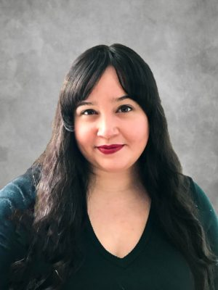
Family-Engaged Developmental Monitoring (FEDM)

Slide 5
Coordinated and Integrated Data Systems for Early Identification (CIDSEI)
Explore and enhance state and territory capacity to improve the collection, management, interpretation, and dissemination of data related to developmental advancement and early identification of young children with developmental delays or disabilities
Outgrowth of the CDC’s Act Early Response to COVID-19, a project of the Learn the Signs. Act Early program
Based on 4 steps of early identification:
Parent-engaged developmental monitoring
Screening
Referral
Receipt of services
Timeline: November 2021-December 2022

Slide 6
Redefining the Final Product
Could not share a toolkit for implementing a CIDSEI, because there are no current examples that could be replicated
Need for a clarification of what family-engaged developmental monitoring (FEDM) is, what it looks like, and why it’s important
Ensure a common understanding of FEDM and its importance
Standardize practice
Measure practice
Feed data into a CIDSEI/link to other components

Slide 7
A Roadmap for Advancing Family-Engaged Developmental Monitoring
The Roadmap introduces and describes family-engaged developmental monitoring as a key component of a framework for children’s healthy development and family well-being
Evidence-informed:
Literature
Phases 1 & 2 of the project
CIDSEI HMG Affiliate Work Group and CIDSEI Advisory Committee
Key definitions and concepts delineated
Program and Systems-level Self-Assessments

Slide 8
The Framework for Children’s Healthy Development and Well-being

Slide 9
Early Identification Process
A Framework for Early Identification
A Framework for Children’s Healthy Development & Family Well-Being
Broader conceptualization of the process
Asset-based approach with overall goal of promoting positive outcomes
Recognizes families as leaders in their child’s development

Slide 10
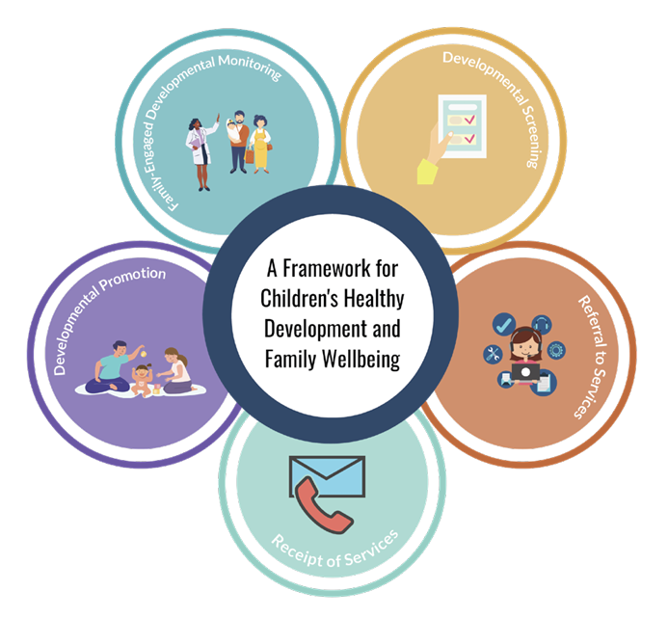
A Framework for Children’s Healthy Development & Family Well-Being
Framework describes the process needed to support child and family wellbeing, inclusive of early identification
Inclusive of ongoing monitoring of young children who are not in need of early intervention but have identified risk factors for developmental delay
Includes developmental promotion (re: education/interaction) activities as a discrete component
Universal strategies:
Developmental promotion (ongoing)
FEDM (ongoing)
Screening (at recommended ages)
Targeted strategies:
Referral to services
Receipt of services

Slide 11
Family-Engaged Developmental Monitoring (FEDM)
FEDM is an intentional partnership of families and providers combining their knowledge to recognize child’s developmental milestones and identify opportunities for support and education
Three essential attributes:
Families are the experts
Holistic picture of child’s development
Development is discussed longitudinally

Slide 12
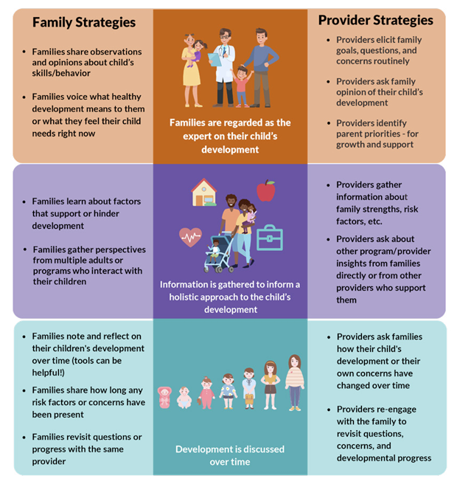
Family & Provider Strategies

Slide 13
FEDM: An Approach to Advancing Equity
Practicing FEDM can support shifting the power dynamic back into the hands of families
Developmental screening and evaluation may not be the best method of early identification for all families, due to historical institutionalized and structural racism
FEDM is more accessible than components like screening, lending itself to broad utilization and acting as a strategy for targeted universalism

Slide 14
Distinguishing between Developmental Promotion and FEDM
Developmental Promotion
FEDM
The Roadmap supports a clearer delineation between developmental promotion and FEDM
Developmental promotion promotes child development and shared knowledge between provider and family

Slide 15
Difference between FEDM and screening
As part of FEDM providers can use monitoring tools, such as “Learn the Signs. Act Early.” milestone checklists
Using tools such as milestone checklists is different than general developmental screening
Screening relies on the use of standardized and validated measures
Many screening instruments also rely on parental report

Slide 16
A Family-Engaged Developmental Monitoring
Self-Assessment for Early Childhood
Programs and Providers

Slide 17
Families are regarded as the expert on their child’s development
 | Do you celebrate milestones with families as they share their child’s strengths?
 | Do you directly and routinely elicit parent priorities, concerns, and questions?
 | Do you allow information provided by the family to shape your view of the child?
 | If a family’s views of the child’s development does not align with your own, do you ask clarifying questions to better understand factors that may contribute to the difference?
 | Does a family’s priority for concerns or support shape your considerations for future support?

Slide 18
Information is compiled to inform a holistic approach to the child’s development
Depending upon your professional or programmatic scope, do you gather information about the child’s:
 | Family-level support network, such as family or community members who interact positively with the child, who support the family in times of need?
 | Community-level support network, such as faith-based organizations?
 | Involvement in other programs or services, such as: early care and education programs, parent education or support groups, food banks?
 | Family-level risk factors, such as a child’s underlying health conditions, family-level trauma, parental mental health, or substance use?
 | Community -level risk factors, such as neighborhood violence, discrimination in service access or delivery, poverty?
 | Positive parenting practices, such as reading together, serve-and-return interactions, creating rich opportunities for play?
 | Basic needs, such as food insecurity, access to medical care, unemployment, and housing?

Slide 19
Development is discussed over time
 | Do you routinely elicit information on progress and concerns?
 | Do you ask families how they have seen their child progress over time?
 | Do you ask families how long a concern has been present or if it has changed over time?

Slide 20
Full Group Chat

Slide 21
How do you currently partner with families, parents, and caregivers in your outreach and engagement work?
What piece of the FEDM presentation stood out to you or resonated with you most?
What part of FEDM feels like this could be challenging?

Slide 22
In what ways are monitoring, surveillance, and screening, surveillance part of your work currently?
How are families, parents, and caregivers currently serving as partners in following their child’s growth and development trajectory?
What providers do you have a relationship with to implement developmental monitoring & screening?

Slide 23
HMG Connecticut

Slide 24
Breakout Room Questions
How is HMG where you are promoting developmental monitoring and screening with early childhood providers and families?
Is it an aligned message across all programs and materials disseminated?
Are you able to respond effectively to the cultural and linguistic needs brought by families when concerned about their child’s development?

Slide 25
Alaska Division of Public Health
Emily Urlacher
Public Health Specialist II
State of Alaska | Department of Health
Early Childhood Systems & PAT Home Visiting Program Manager

Slide 26
Alaska Breakout Room Questions
How is HMG where you are supporting providers in developmental monitoring and screening in strength-based, culturally appropriate ways? What are you already doing that is working?
Do you feel like you have materials that are culturally appropriate?

Slide 27
Closing Discussion
What’s one thing someone said today that really resonated with you?
What is one thing you feel you could bring back to your work? Or a potentially actionable idea that was sparked for you today?

Slide 28
Wrap-Up Thank you for attending the April 2023 OCN Retreat!
Keep an eye out for email communications around our next session
Visit the website for session recordings and resources
HMG Outreach Coordinator Network webpage
HMG Affiliate Connections Directory

Slide 29
HELPMEGROWNATIONAL.ORG

