Slide 1
Going Virtual with Help Me Grow Outreach
Virtual Books, Balls & Blocks
Featuring Help Me Grow Onondaga County
April 7, 2021
Summer Merrick
Director
Help Me Grow Onondaga County, New York

Slide 2
Objectives
Get the lay of the land in Onondaga County, New York
Get the basics of Books, Balls, and Blocks as HMG outreach
Hear how COVID impacted the strategy
Learn about HMG Onondaga’s pivot to a virtual approach to Books, Balls, & Blocks
Find out how initial data helped inform improvements and an evolution
Hear how HMG Onondaga regards this virtual approach as important even after social distancing restrictions are lifted

Slide 3
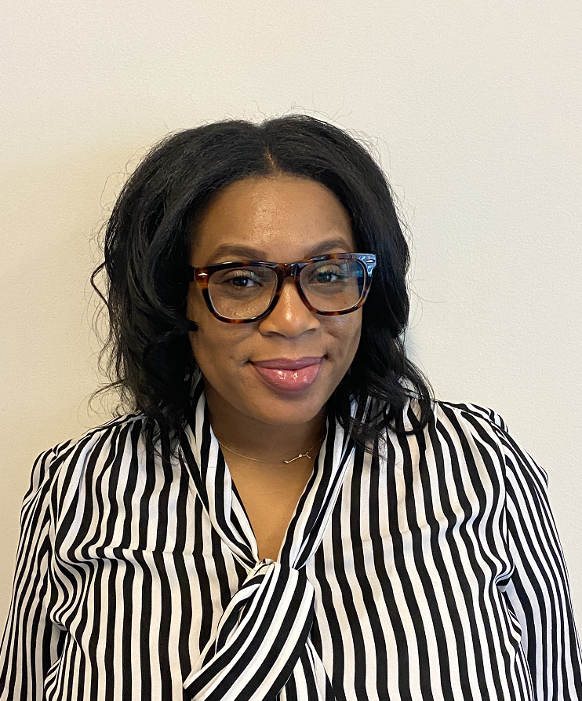
Introductions
Summer Merrick
Director
Help Me Grow Onondaga
Notes:
Summer Merrick is the Director of Help Me Grow Onondaga (HMG), an initiative of the Early Childhood Alliance, that works with children ages 0-5 their caregivers and the community by teaching them about developmental milestones and screenings and making connections to local community resources.
Summer has spent the last 14 years working in various aspects of the education field. She has received a Bachelor’s in Special Education and Sociology and a Master’s in Literacy from LeMoyne College. After graduating from college Summer, worked with two community action agencies as an Early Head Start Home Visitor for eight years. Prior to Summer working at HMG, she worked for 4 years as a Family Support Specialist at Frazer and Dr King Elementary in the Syracuse City School District. Through the past year with Help Me Grow, Summer has partner with WIC, the Department of Social Services, Syracuse Community Connections, Catholic Charities, and the local libraries to bring developmental screening events to the public through Books, Balls, and Blocks event.

Slide 4
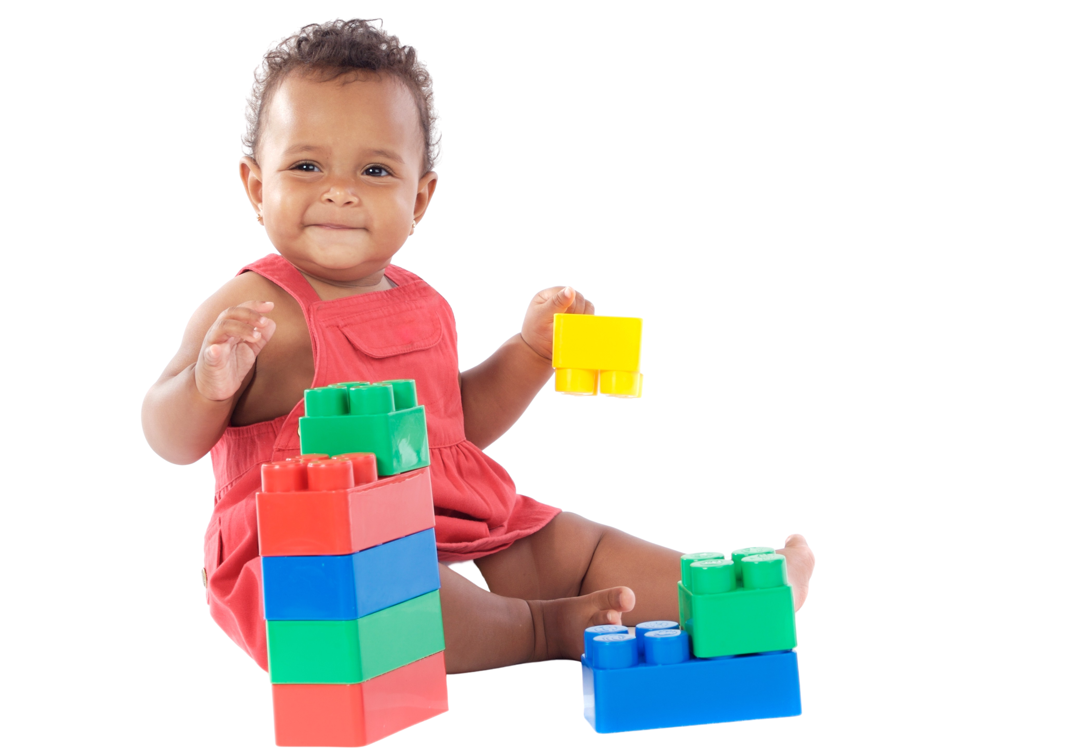
Virtual Books,
Balls & Blocks

Slide 5
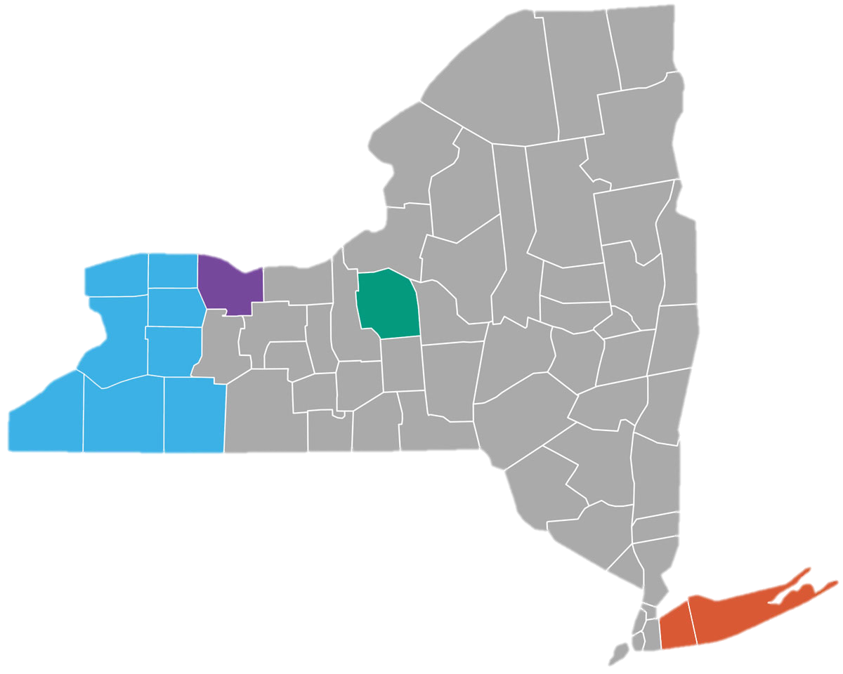
Help Me Grow Onondaga
4 Help Me Grow Affiliates in New York State
HMG Long Island
HMG Western New York
GROW Rochester
HMG Onondaga
HMG Onondaga is in Central New York
(Green county in the middle of the State)
Manageable population size – 1 County
470,000 residents in Onondaga County
5,200 children born per year
31,200 children birth-through-five
Significant levels of child poverty
1-in-2 children in Syracuse (ranked 5th nationally)
1-in-5 children in Onondaga County
HMG Onondaga launched in 2019 with 1 employee. In August 2020, we expanded to 4 employees.

Slide 6
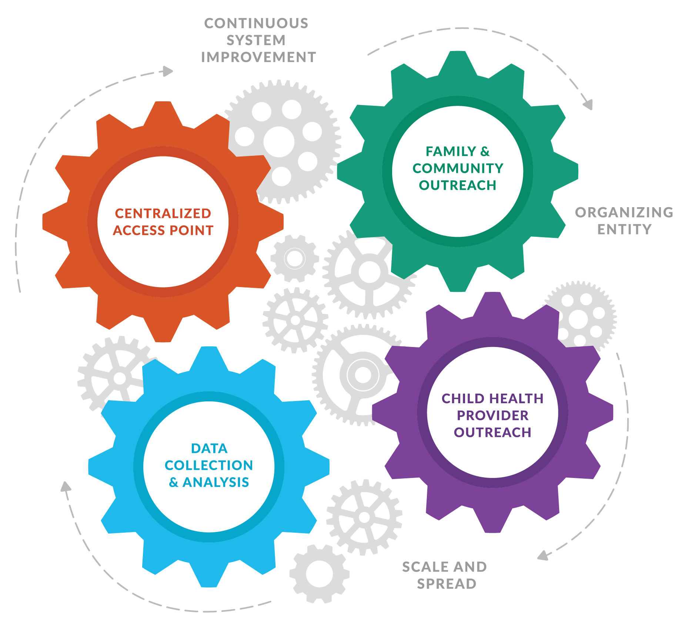
Program Structure System Model
Help Me Grow Leadership Team
Help Me Grow
Work Team
Program Director
Summer Merrick
Centralized Access Point & Family & Comm. Outreach Work Group
Family Resource Specialist
Miranda Walker
Data Collection
& Analysis
Work Group
Pediatric Resource Specialist
Phyllis Koester
Child Health Provider Outreach Work Group
Early Learning Resource Spec.
Kayla Delaney

Slide 7
Books, Balls & Blocks Overview
Interactive: Explain, Show, Review
Community Partners: Libraries, Community Agencies, Head Starts
Time of the Day
Registering for Event

Slide 8
Event Results
6 Events – 75 People
Tote Bag Pick Up at Local Library Building local community connection
2-1-1 Call Center Connecting back to other community resources and awareness

Slide 9
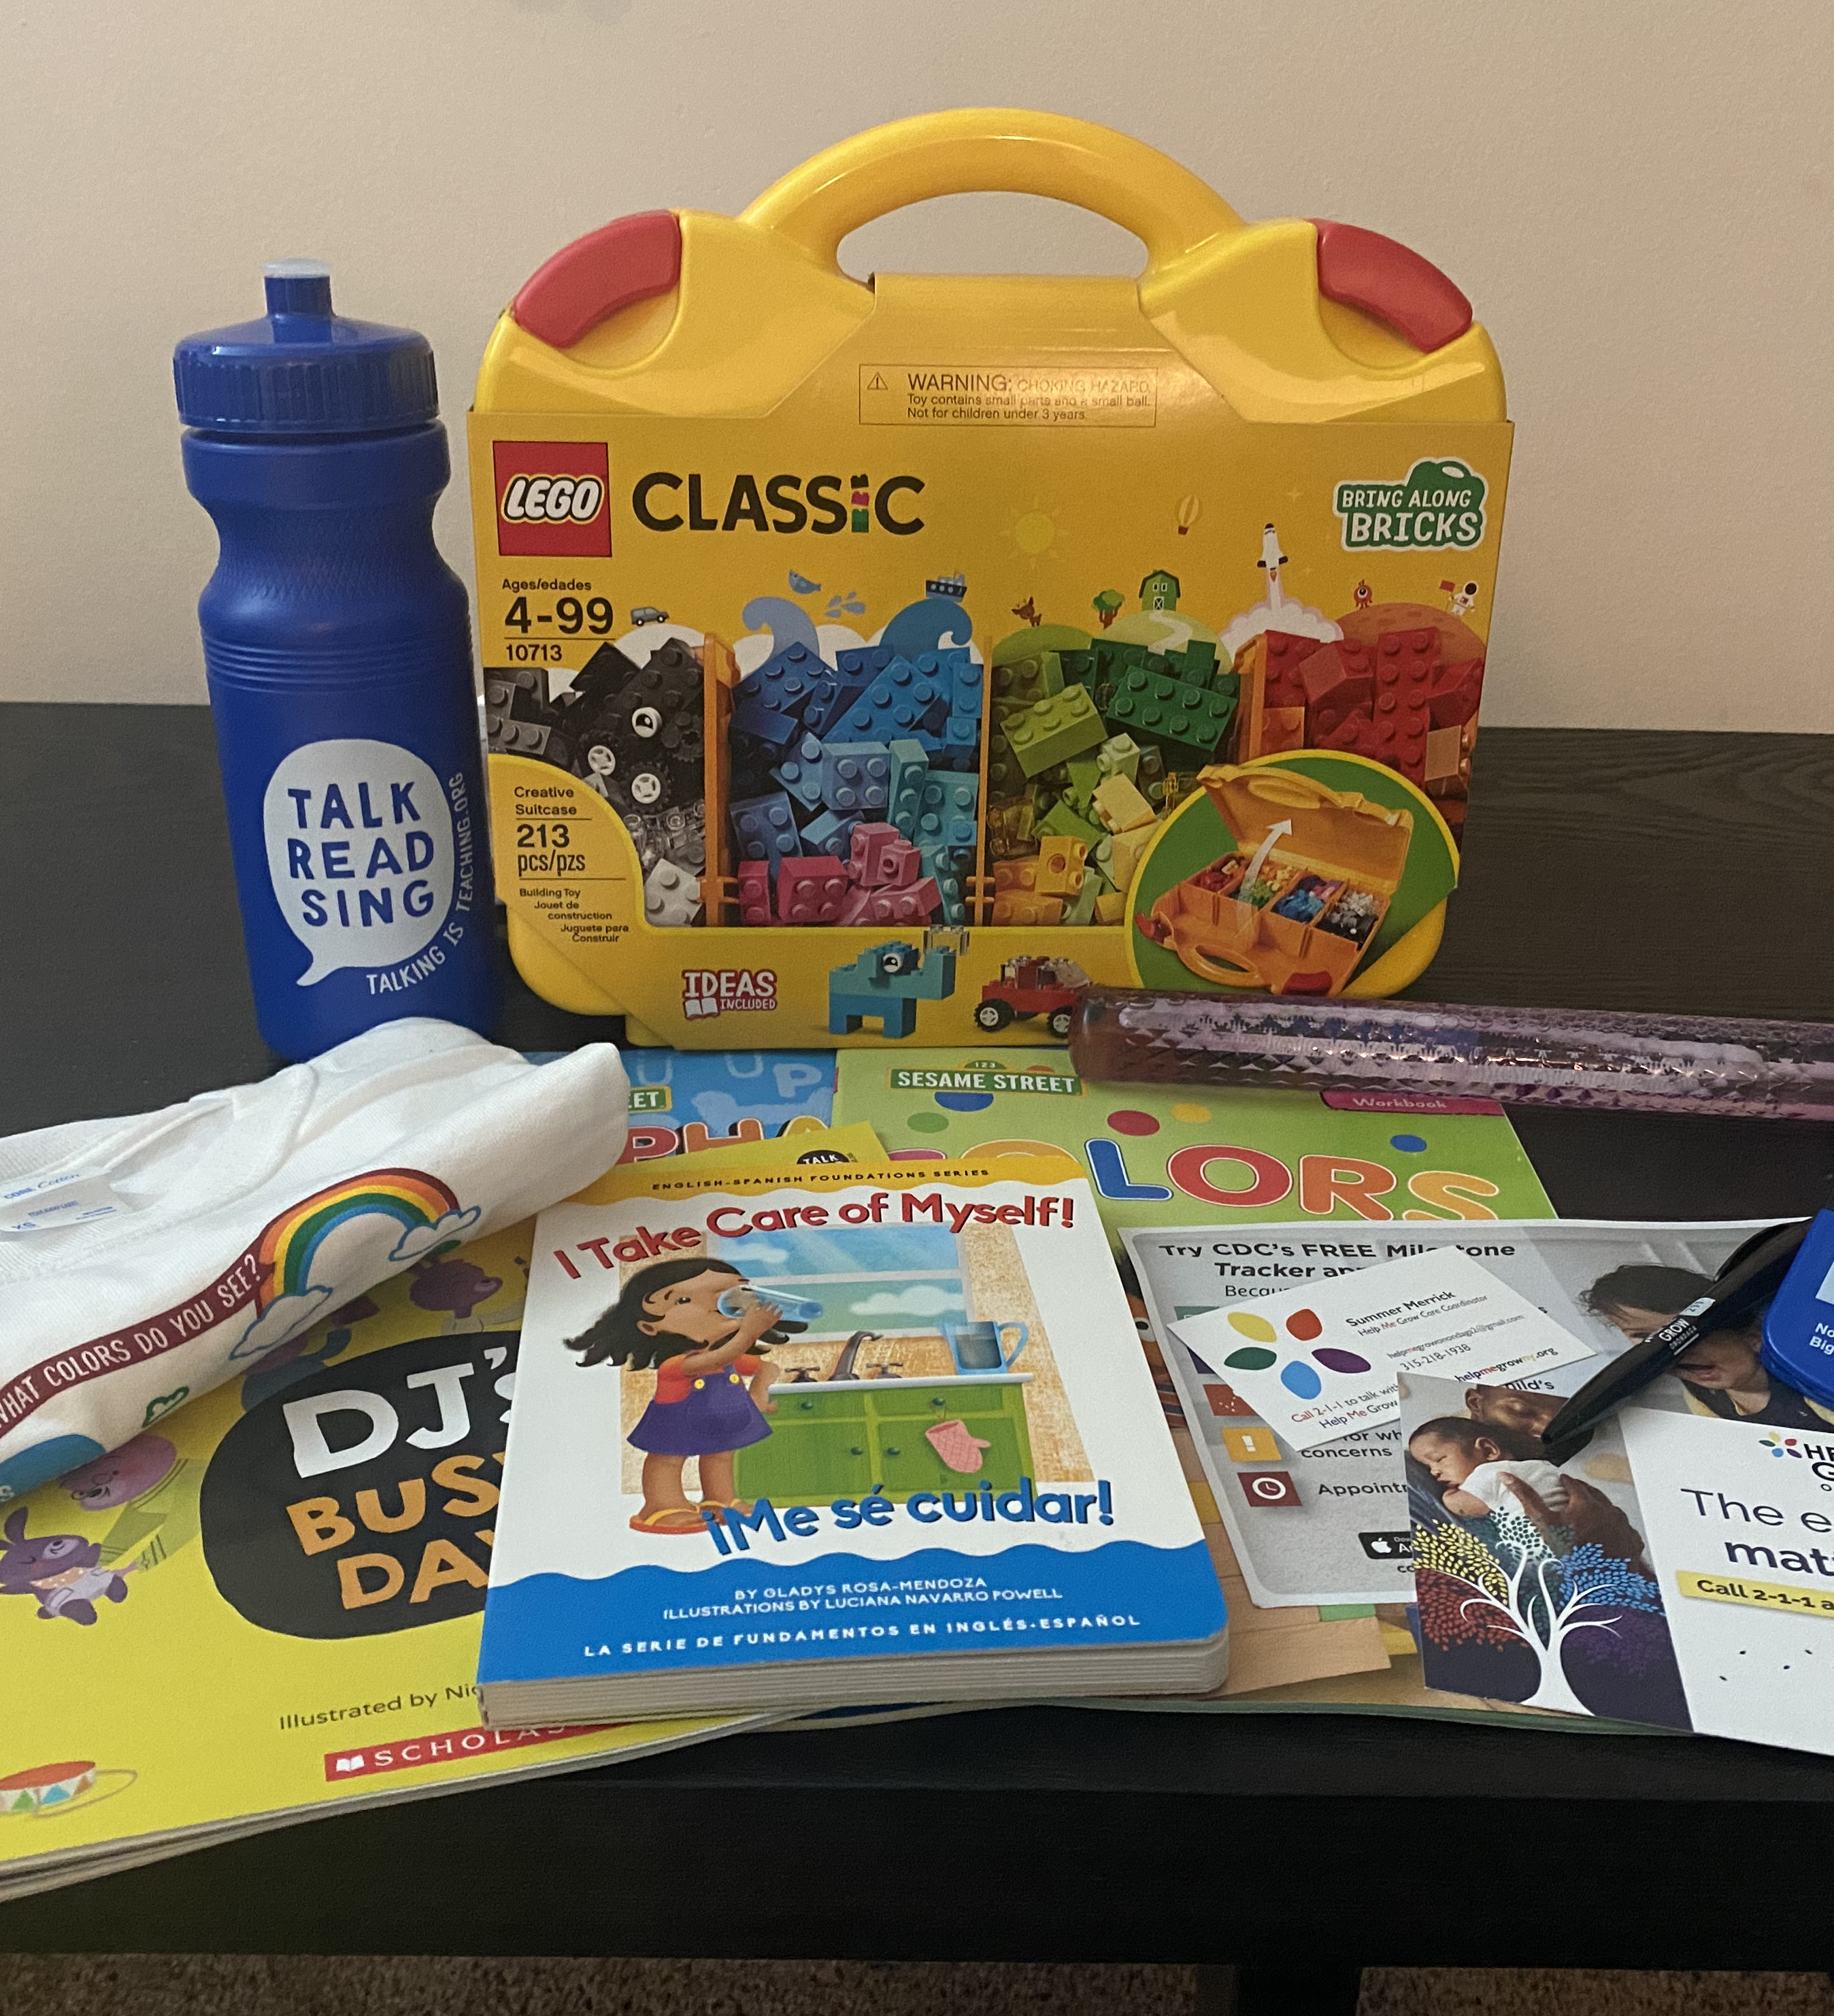
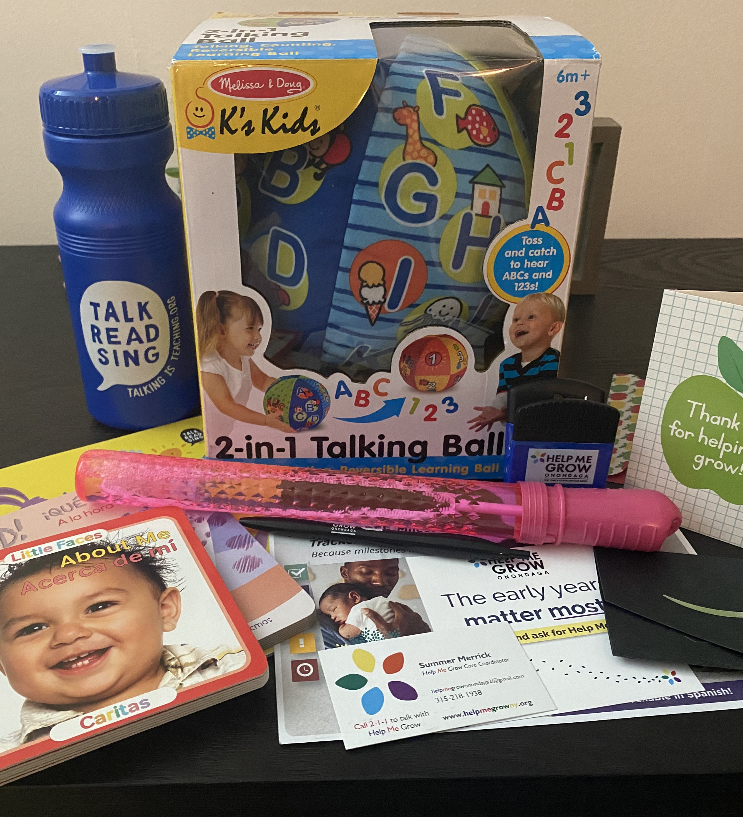
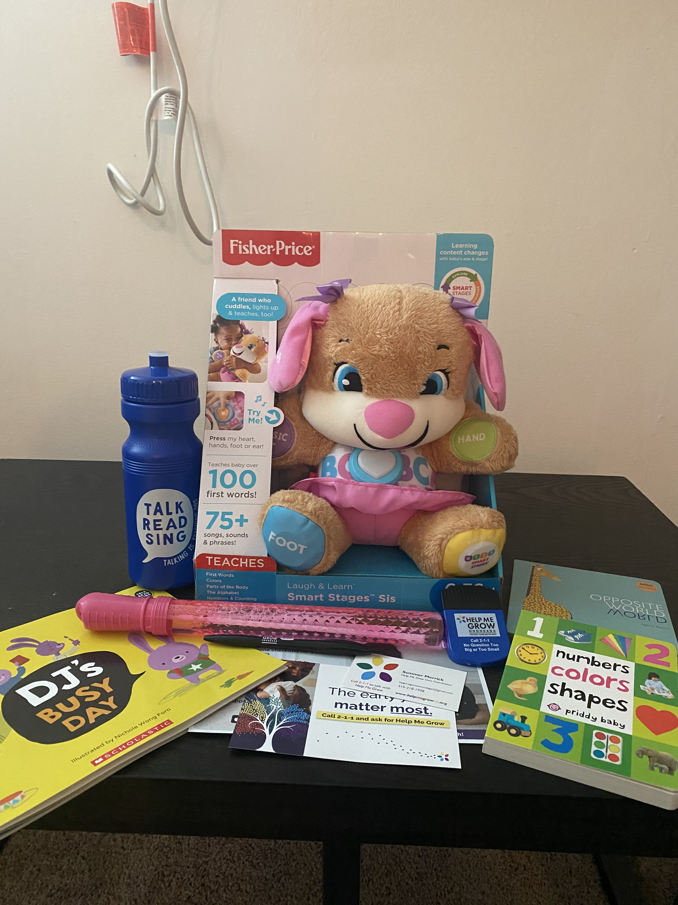
Developmental Tote Bags
* Funding for tote bags provided by a grant from Excellus BlueCross BlueShield

Slide 10
Parent Testimonials
“I learned that some of the things my daughter does that drive me crazy (like climbing on the furniture and jumping off of everything) are ways that she is learning!”
“I came away with a greater appreciation of some of the basic stuff we already have. For instance, I hate Play-Doh, but after last night, I'm more willing to break it out so they can work on their fine motor skills.”
“I have never heard of Help Me Grow. I learned about the new resource and how to get help on development if I need it. I stay at home with Logan, and he has never been enrolled in daycare or any sort of school. It's great to know about resources I can use if needed.”
“I learned about the services offered by Help Me Grow Onondaga and will absolutely share with others! I also learned a few new developmental activities to help my kids - I will be saving empty food boxes for my kids to play with and will try to make a photo book as well.”
“I learned some new activities to help entertain/teach the kids. I like the idea of using the mirror and teaching emotions/faces.”

Slide 11
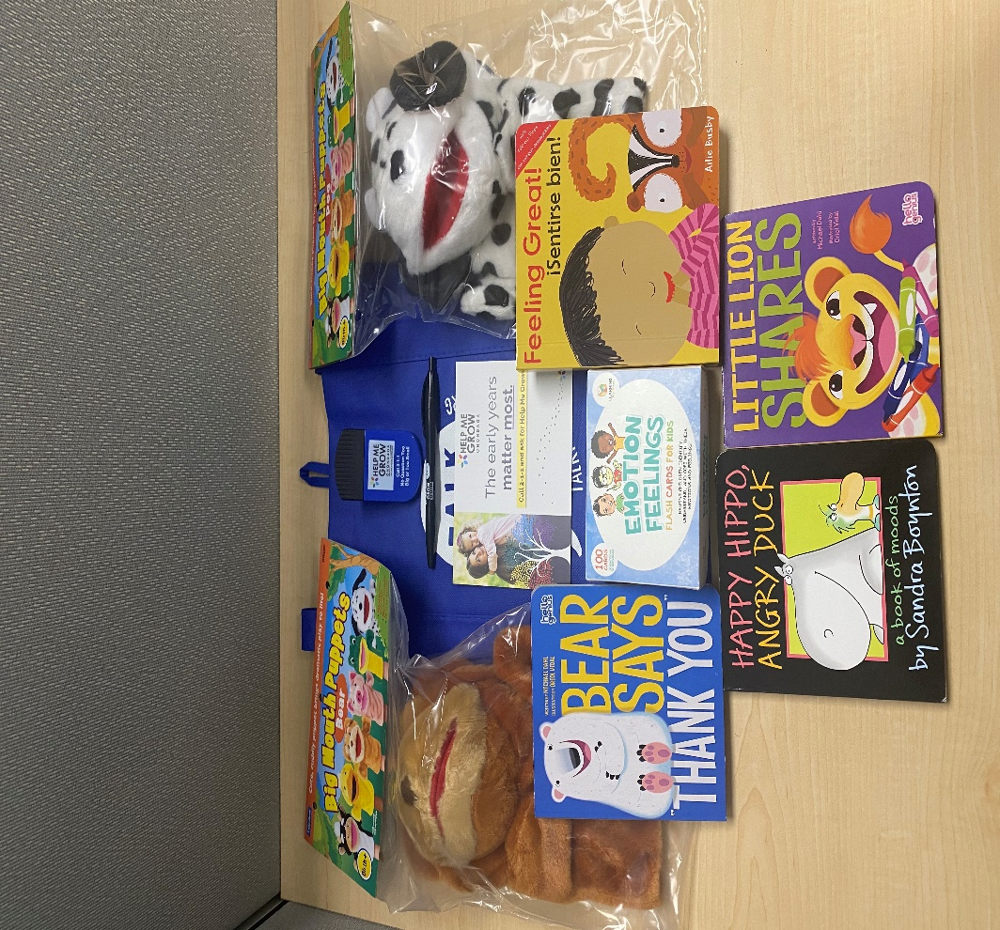
Books, Balls & Blocks: ASQ-SE
Developed in response to COVID and social isolation
Parents’ comments about social-emotional concerns
Highlight resources in the community for parents and kids with simple tips

Slide 12
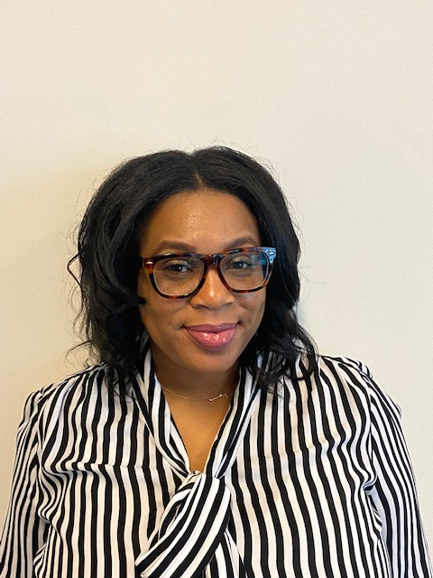
Discussion Thoughts? Questions?
Summer Merrick
Program Director
helpmegrowonondaga2@gmail.com
helpmegrowonondaga
@helpmegrowoc

Slide 13
Going Virtual with Help Me Grow Outreach
Register for the rest of the Going Virtual series:
April 14, 1:00-1:30pm EST: Using Technology to Connect with Child Health Care Providers featuring HMG Iowa
April 21, 1:00-1:30pm EST: Text Messaging to Connect with Families featuring HMG New Jersey
April 28, 1:00-1:30pm EST: Using Social Media to Reach Families featuring HMG Brevard County, Florida
HMG-COVID Contact Directory
To be located on the HMG affiliate dashboard
Intended to facilitate direct peer-to-peer connection opportunities and strategy sharing
Contact Sarah Zucker at szucker@connecticutchildrens.org to be included
Visit our Going Virtual with Help Me Grow Outreach web page (requires affiliate login) to register for the rest of the series and access recordings and slides following each presentation.

