Slide 1
Growing Together:
Listening Session
Implementation and System-Building
August 22, 2023
Melissa Passarelli
Nadia King
Help Me Grow National Center
Office for Community Child Health
Connecticut Children’s Medical Center

Slide 2
Today’s Session
Introduction to HMG National Implementation & System-Building
Current affiliate input we’re reflecting on
Facilitated discussion
Wrap-up

Slide 3
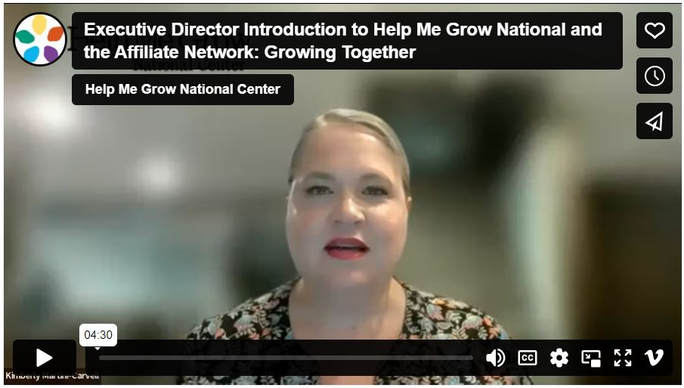
Where We Are in Our Evolution
Released strategic growth plan in 2021
Held affiliate listening sessions
Pursued growth goals via initiatives such as: goal concordant care study, Family-Engaged Developmental Monitoring, return on investment tools, state lead exploration/network, and:
Expanded National Center team to institute five branches:
Implementation & System Building, led by Melissa Passarelli.
Impact & Network Performance, led by Melissa Miller.
Policy & Community Change, led by Chelsea Neelon.
Communications & Network Relations, led by Sarah Zucker.
And Business Development & Operations, led by Sara Sibley.
Published video and blogs introducing the National Center and opportunities to contribute/co-produce
HMG Roundtable

Slide 4
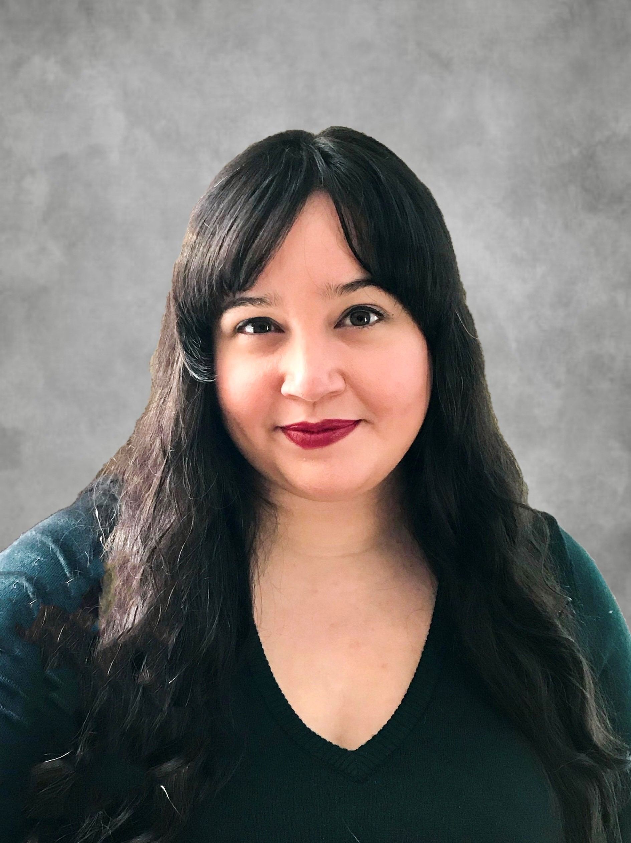
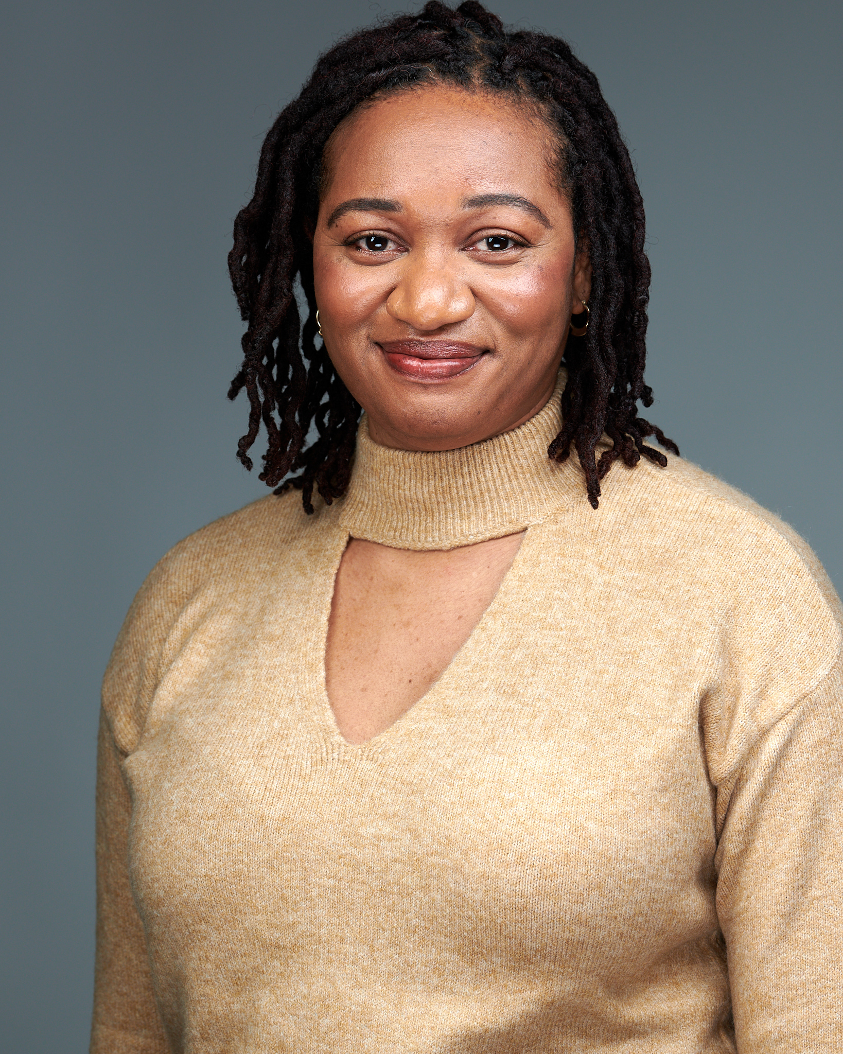
Implementation & System-Building
Our Purpose - Support states and communities in implementing the HMG Model according to their local context. This includes technical assistance through our universal, targeted and intensive offerings:
Universal: Offerings available to all affiliates as a benefit of affiliation, such as webinars, toolkits, etc.
Targeted: Offerings focused on a small group of systems/professionals in an ongoing, sustainable way, such as Communities of Practice and Learning Communities.
Intensive: Offerings that provide individualized coaching and capacity.
Our Vision - By connecting with our affiliates we aim to create strong system foundations through direct support
Our Commitment to the Network - We have grown and gained so much and want to apply these learnings in new ways; from improved onboarding process to new TA offerings. We want the next phase to truly reflect HMG.

Slide 5
Themes from the Growing Together Roundtable
Identifying and sustaining funding, and balancing funder needs with HMG/community needs
The benefits of communities of practices, learning communities, group TA, etc.
The challenge of gaining buy-in
Strategies for true “co-creation”/”co-leadership”
Opportunities to connect with other affiliates
Standardized trainings

Slide 6
Facilitated Questions
What technical assistance do you currently need to implement a successful HMG?
What resources would be helpful to you as you onboard new members or start a HMG?
What are you looking to have standardized for implementation?
What information do you wish you had or knew before starting your HMG journey?

Slide 7
Facilitated Questions
What do you see as benefits of affiliation?
How important is your HMG implementation status (i.e. as reported after the annual Fidelity Assessment) to your HMG system, and how do you use that information?
When do you reach to the HMG National Center for support?
What types of support do you NOT reach out to HMG National for?

Slide 8
Universal Offerings
Building Capacity webinars/webinar series
Tools/manuals/resources
Office hours
Roundtables
Of the above what have you found helpful or not helpful?
What other ways of delivering information do you find helpful?
What would you like to see more of?

Slide 9
Targeted Offerings
Building Connection Series (e.g. Outreach Coordinator Network & State Lead Network)
How has the series impacted your implementation?
Communities of Practice & Learning Communities
For those who participated in a CoP, are you still implementing the strategies/innovations? Can you please share why or why not?
Work Groups
Group TA (Building Expertise in HMG Model Implementation)

Slide 10
Intensive Offerings
Which of the following topics would be of interest and worthwhile for potential group TA:
Data Collection & Analysis (including Fidelity alignment and other measures)
Strategic planning
Marketing/branding/messaging
Funding and sustainability
Policy & Community Change
Other?
Are there any barriers other than cost which would prevent you from signing up for group or individual TA?

Slide 11
What’s Next in Our Evolution
Will be greatly shaped and influenced by what we learn from you
Remaining listening sessions
Surveys
Office hours
One-on-one interviews
Advisory opportunities
Comment periods
The more input we have from you, the more our work will reflect the values and priorities of your communities.

Slide 12
Wrap-Up & Next in the Evolution
Poll
We invite you on the journey to co-create
Next Up: Listening Sessions
Policy & Community Change (AUGUST 29, 2-3PM ET)
Register for HMG National Forum Week

Slide 13
Communications & Network Relations
Network connections and crafting messaging
Sarah Zucker
szucker@connecticutchildrens.org
Morgan Reiss
mreiss01@connecticutchildrens.org
Impact & Network Performance
Metrics and evaluation
Melissa Miller
mmiller02@connecticutchildrens.org
Noshin Ahmed
nahmed@connecticutchildrens.org
Implementation & System Building
Implementation and special projects
Melissa Passarelli
mpassarelli@connecticutchildrens.org
Nadia King
nking01@connecticutchildrens.org
Policy & Community Change
Policy and advocacy efforts
Chelsea Neelon
cneelon@connecticutchildrens.org
Morgan Reiss
mreiss01@connecticutchildrens.org
Business Development & Operations
Contracts and payments/invoicing
Sara Sibley
ssibley@connecticutchildrens.org
Skyley Parizek
sparizek@connecticutchildrens.org

