Slide 1
Growing Together:
Listening Session
Impact & Network Performance
August 16, 2023
Melissa Miller
Noshin Ahmed
Help Me Grow National Center
Office for Community Child Health
Connecticut Children’s Medical Center
Notes:
Welcome to today’s listening session, where we will focus on one of the five branches of work at the HMG National Center: _________________
We are coming together today as part of what we’ve titled our Growing Together initiative, a campaign aiming for full-Network awareness of the National Center’s new design, capacities and expertise, and commitment to co-creating our direction forward with you.

Slide 2
Today’s Session
Welcome & National Center’s new design
Introduction to HMG National Impact & Network Performance
Current affiliate input we’re reflecting on
Focuses and a major initiative for the next year
Group discussion
Wrap-up
Poll
How you can help direct the path

Slide 3
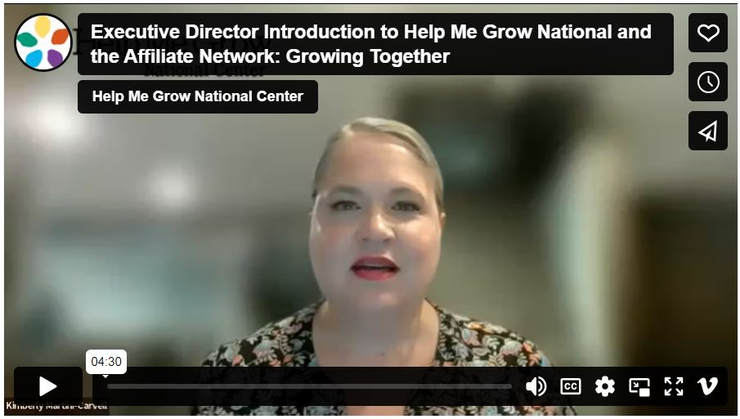
Where We Are in Our Evolution
Released strategic growth plan in 2021
Held affiliate listening sessions
Pursued growth goals via initiatives such as: goal concordant care study, Family-Engaged Developmental Monitoring, return on investment tools, state lead exploration/network, and:
Expanded National Center team to institute five branches:
Implementation & System Building, led by Melissa Passarelli;
Impact & Network Performance, led by Melissa Miller;
Policy & Community Change, led by Chelsea Neelon;
Communications & Network Relations, led by Sarah Zucker; and
Business Development & Operations, led by Sara Sibley.
Published video and blogs introducing the National Center and opportunities to contribute/co-produce
Held full-Network Roundtable discussion on July 26
Today’s listening session is the 2nd branch-specific rountable
Notes:
You may have recently seen a video message from the National Center’s executive director, Kimberly Martini-Carvell, which introduced the new design of the HMG National Center, as we are at an important moment of growth and opportunity. If you haven’t seen that video, we are dropping the link into the chat now. (https://vimeo.com/manage/videos/832388187)
The National Center and Affiliate Network have been working hard towards growth goals established in a 2021 strategic plan for HMG to achieve its fullest potential. One of the strides made by the National Center is in its efforts to strategically and intentionally build out the team and therefore the expertise, capabilities, and services we can provide to the Network towards those goals. The build-out was informed not just by the goals of the strategic plan, but by the goals, priorities, and needs of affiliates themselves.
The new, intentional design for the HMG National Center expands our capacity and skill-set behind all of these efforts, and ensures that five branches of work coordinate together in alignment to make a powerful machine of impact.
Today, we’re focusing on the _______________________ branch of HMG National.

Slide 4
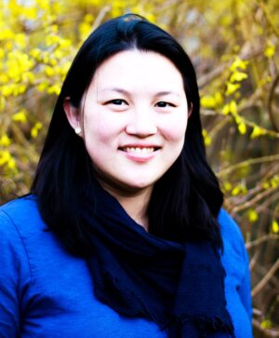
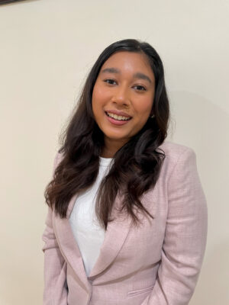
Impact & Network Performance Branch
Melissa Miller, MPH, PMP and Noshin Ahmed, MPH
Our goal & responsibilities
Oversee the strategic development and implementation of a measurement framework to:
Further validate the HMG Model
Measure the impact and performance of the HMG Network
Lead HMG’s measurement and evaluation efforts across projects/ initiatives
Maintain, administer, and analyze Fidelity/ Sustainability Assessment data
How we hope to achieve this
Meaningful Measurement & Minimize Burden
Leveraging Data to Accelerate Change
Streamlining Data Collection
Applying mixed method evaluation techniques to ensure a complete picture
Incorporating feedback and co-creating changes with the Network
Our approach and values
For all data we request and decisions we make, we promise to be:
Mindful of your constraints
Thoughtful in our requests
Collaborative in our processes
Mission-driven to produce findings that are actionable and maximally beneficial to the Affiliate Network
Notes:
Leaving branch slides in if you’d like to re-use (if so, keep your slide and delete the others)

Slide 5
Impact & Network Performance Branch: Summary of Changes to Date
In the past couple of months, we have already made the following changes:
Draft Report “Preview Period”: New this year, we conducted a preview period for systems to review their draft Assessment report and provide edits to ensure we have high-quality data and that the data submitted is accurate.
Enhanced Reports: Our system-level reports have been “refreshed” and enhanced with additional data and features, such as: a customized resource list to support systems not in full implementation of a Core Component; Impact Indicator data; and SMART Aim & Trends.
Analysis Approach: New this year, we have applied more rigorous analytic methods to our analysis. We have included an additional quality check step where we validate the responses received, flag inconsistencies, errors, and data issues. We have also set up internal tools and queries to streamline and automate data analysis.
Your Feedback: Your feedback from the Assessment Experience Survey will help inform Assessment changes. We want to better understand experiences in aggregating data and submitting results to improve our future data collection efforts.
Mini-Assessment Data Collection Pause: We paused Mini Assessment this year to give us additional time to incorporate feedback we have received from the Network in the recent Assessment Experience Survey.
Notes:
Leaving branch slides in if you’d like to re-use (if so, keep your slide and delete the others)

Slide 6
Meeting Norms, Open Floor
Meeting Norms:
Safe Space
Facilitation features we will utilize: Jam Board, Chat, Raise Hand
Quick Open Floor:
Any initial comments? Questions.
Notes:
Fill in your branch content

Slide 7
Fidelity and Sustainability Assessment
At Present:
What currently works well?
What should we improve?
What challenges with regards to the assessment data collection process do you currently have and need met?
What would you most immediately like to see in the analysis of the data?
In the Future:
Long term, what would you like to see in the future with regards to the assessments (e.g. next 5 years or more)?
What challenges do you foresee?
Notes:
Fill in your branch content

Slide 8
Leveraging Data for Actionable Change
At Present:
How might the HMG National Center best support your system in leveraging data for actionable change?
How do you currently use the data and reports we collect?
What works well/what should we keep?
What needs improvement?
In the Future:
How might the HMG National Center best support your system in leveraging data for actionable change in the future?
What measurement tools, reports should we create?
Notes:
Fill in your branch content

Slide 9
Our Support, Your Involvement
At Present:
How does the HMG National Center best support your system’s measurement and evaluation needs and challenges right now?
How would you like to be included in decision-making process?
In the Future:
How might the HMG National Center best support your system in providing technical assistance on measurement and evaluation in the future?
Notes:
Fill in your branch content

Slide 10
Quality Improvement Efforts within your System
At Present:
How might the HMG National Center best support your quality improvement efforts within your system now?
In the Future:
How might the HMG National Center best support your quality improvement efforts within your system in the future?
Notes:
Fill in your branch content

Slide 11
Advancing Equity
At Present:
With respect to advancing equity within your system’s population what are your biggest needs related to data, measurement and evaluation right now?
In the Future:
With respect to advancing equity within your system’s population what are your biggest needs related to data, measurement and evaluation in the future?
Notes:
Fill in your branch content

Slide 12
What’s Next in Our Branch’s Evolution
Will be greatly shaped and influenced by what we learn from you
Publications in medical journals
Clarified and updated assessments
Measurement and Evaluation Technical Assistance
Upcoming Learning Intensive on Measuring's Disparities and Gaps at this year’s In-Person Forum
The more input we have from you, the more our work will reflect the values and priorities of your communities.
Notes:
These reflect the potential upcoming opportunities across our branch!

Slide 13
What’s Next in the HMG National Center’s Evolution
Will be greatly shaped and influenced by what we learn from you
Remaining listening sessions
Surveys
Office hours
One-on-one interviews
Advisory opportunities
Comment periods
The more input we have from you, the more our work will reflect the values and priorities of your communities.
Notes:
These reflect the potential upcoming opportunities across the entire National Center (not just your branch). Leaving in if you want to share this as part of your wrap-up – remove if not

Slide 14
Communications & Network Relations
Network connections and crafting messaging
Sarah Zucker
szucker@connecticutchildrens.org
Morgan Reiss
mreiss01@connecticutchildrens.org
Impact & Network Performance
Mmeasurement and evaluation
Melissa Miller
mmiller02@connecticutchildrens.org
Noshin Ahmed
nahmed@connecticutchildrens.org
Implementation & System Building
Implementation and special projects
Melissa Passarelli
mpassarelli@connecticutchildrens.org
Nadia King
nking01@connecticutchildrens.org
Policy & Community Change
Policy and advocacy efforts
Chelsea Neelon
cneelon@connecticutchildrens.org
Morgan Reiss
mreiss01@connecticutchildrens.org
Business Development & Operations
Contracts and payments/invoicing
Sara Sibley
ssibley@connecticutchildrens.org
Skyley Parizek
sparizek@connecticutchildrens.org
Notes:
Please leave in – you don’t have to speak to this slide in your session, but it will be nice to include in all the decks that then get saved to the webpage.

Slide 15
Wrap-Up & Next in the Evolution
Poll
We invite you on the journey to co-create
Next Up: Listening Sessions
Implementation & System-Building (AUGUST 22, 2-3PM ET)
Policy & Community Change (AUGUST 29, 2-3PM ET)
Register for HMG National Forum Week
Notes:
Add any upcoming news, opportunities, events led by your branch
Add any planned input-collection initiatives your branch might have coming up
Please remove the details on your listening session and the ones that preceded it and promote the remaining ones (if any)
Drop the link to Forum registration (https://web.cvent.com/event/6e9b8e22-52fb-473e-8163-ee2c829c4946/summary)
Important Registration-Related Dates:
Early Bird registration ends Tuesday, August 15 (note: all listening sessions other than CNR happen after early bird closes)
In-Person Summit registration closes Friday, September 15
Room block reservations for In-Person Summit attendees must be made by Wednesday, September 20
Virtual Event registration remains open through Tuesday, October 17

