Slide 1
HMG Maternal and
Early Childhood Systems-Building Opportunities
January 28, 2021
Presented by:
Kimberly Martini-Carvell, Executive Director,
Help Me Grow National Center
Lynn Pullano.
Help Me Grow Implementation Expert

Slide 2
Opening Remarks
Kimberly Martini-Carvell
Executive Director, Help Me Grow National Center
Notes:
Kimberly provides welcome and opening remarks as desired.
(Background) The overarching goal of today’s session and the Community of Practice that will follow is to support affiliates and their partners in leveraging the ECC Prenatal-to-Three program to advance use of the evidence-based Help Me Grow model as an optimal builder of state-level maternal/early childhood systems of care. Using the HMG Model as a framework, mutual ECCS-HMG can be achieved in promoting early developmental health and family well-being while increasing family-centered access to care and engagement of the prenatal-to-3 population during a critical period of early child development and parental challenge. Common aims include equity, sustainability, comprehensiveness, and inclusion of the health system—with a focus on expanding state capacity to reach and engage families during their children’s important early years.

Slide 3
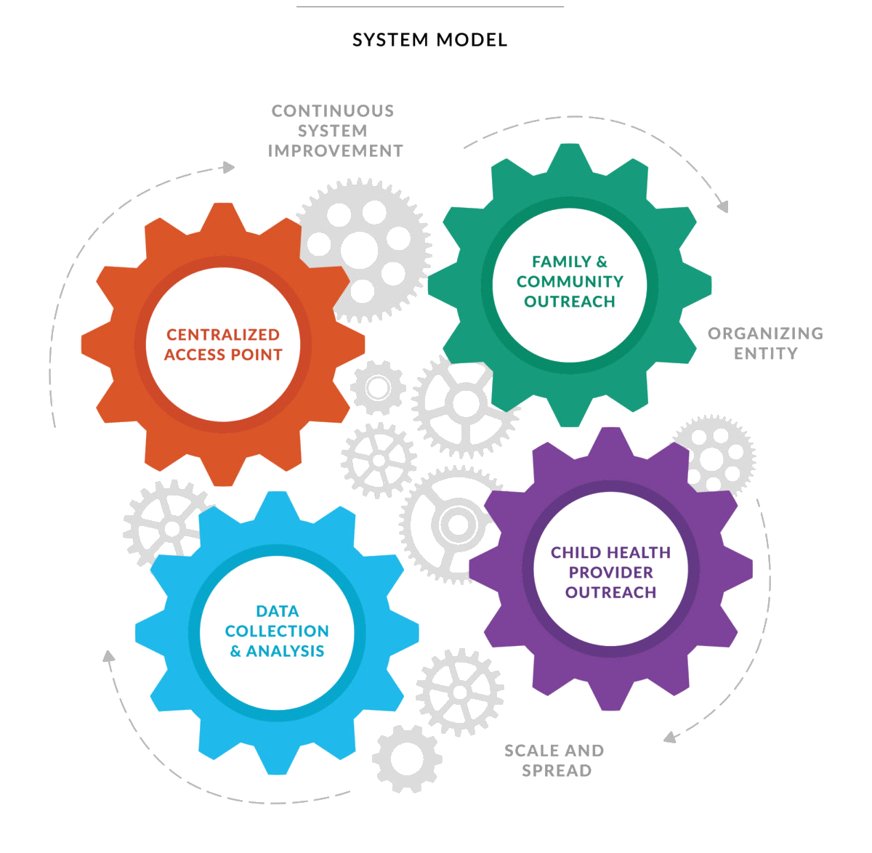
HMG Model: A Vehicle for Comprehensive Systems Building
Notes:
Kimberly.

Slide 4
Vision Alignment:
Maternal-Child Health Bureau and HMG
Accelerate Progress and Impact
Focus on health systems integration into early childhood systems, equity, policy and financing strategies.
Scale family-centered, multi-generational interventions and supports.
Notes:
Kimberly. MCHB definition/vision of ECCS systems-building and HMG vision and missions. Brief review of ECCS evolution and HMGNC input and feedback on the initiative’s evolution.

Slide 5
Vision Alignment:
Maternal-Child Health Bureau and HMG
Move Upstream
Focus on the prenatal-to-3 period.
Shift state systems toward universal, multigenerational promotion of early development and family well-being.
Notes:
Kimberly. MCHB definition/vision of ECCS systems-building and HMG vision and missions. Brief review of ECCS evolution and HMGNC input and feedback on the initiative’s evolution.

Slide 6
Vision Alignment:
Maternal-Child Health Bureau and HMG
Bring Systems Together
Emphasize intentional, goal-oriented partnerships.
Promote greater coordination among initiatives.
Foster a stronger connection of the health care system to broader early childhood systems.
Embed family and community leadership and partnership as a foundation of achieving health equity.
Notes:
Kimberly. MCHB definition/vision of ECCS systems-building and HMG vision and missions. Brief review of ECCS evolution and HMGNC input and feedback on the initiative’s evolution.

Slide 7



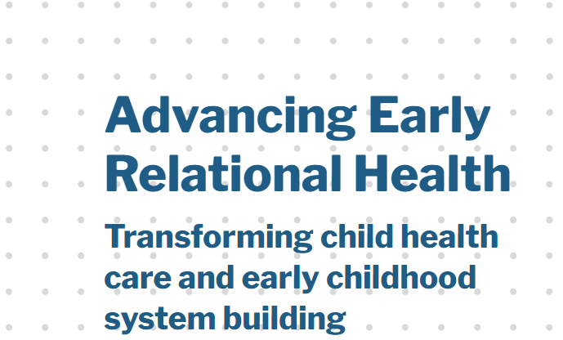



ECCS Evolution:
A Developing Partnership with HMG National Center
Notes:
Slide objectives: Kimberly. MCHB definition/vision of ECCS systems-building and HMG vision and missions. Brief review of ECCS evolution and HMGNC input and feedback on the initiative’s evolution.
Suggested talking points:
Our longstanding and evolving collaboration with federal and state leaders in placing screening/early detection within the context of a comprehensive approach to developmental promotion, early detection, referral & linkage.
We have been privileged to engage with MCHB in their strategic planning efforts, national funders and collaborative funding efforts in support of child health services transformation and strengthening families to enhance children's developmental outcomes (e.g., PSP, ERH), system transformation at the state level (e.g., MS THRIVE!), and many crucial dialogues that have yielded implications for placing efforts in the context of system building with "all sectors in" and "cross-sector collaboration." Select examples include our engagements with the CDC, DOE, HRSA/MCHB, ACF, and SAMHSA.
We are inspired by the evolution of such federal initiatives as the MIECHV CoIIN, the CDC's LTS.AE, and MCHB's EECS CoIIN and the HRSA/MCHB strategic plan which all embrace this integrated approach. Similarly, we applaud the efforts of state and county initiatives that have evolved from an initial focus on screening to a broader, more comprehensive approach, as illustrated by the recent launch of HMG-LA (county).

Slide 8

InCK Marks:
State of the Field for Child Health Care Transformation
HMGNC Partner and Affiliate Resource
Resources to help leaders advance child health care transformation
InCK Marks has released a new Working Paper 5 in its series outlining the state-of-the-field for different aspects of child health care transformation – focused specifically on the role of state managed care contracting under Medicaid.
Johnson, K & Bruner C (January 2021). Medicaid Managed Care: Transformation to Accelerate Use of High Performing Medical Homes for Young Children.
Kay Johnson will provide an overview of Working Paper 5 as the first part of the February 3rd Zoom Meeting and Dialogue with InCK Marks National Resource Network partners.
To register for this first in a series of meetings and dialogues on child health care transformation:
https://us02web.zoom.us/meeting/register/tZAtcO6urDkrH92ijMq09eOUeVbqn-tVc3Gq
Notes:
Kimberly. This working paper summarizes state Medicaid managed care contract provisions related specifically to children, from a review conducted by George Washington University for InCK Marks employing its overall managed care contract data base. While states generally have limited contractual language specific to children and the elements of child health care transformation and none have a comprehensive, child-specific approach, states have developed language, particularly with respect to children with special health care needs, that can be built upon in doing so. The working paper categorizes these different efforts as starting points for developing Medicaid managed care contract language to advance high performing medical homes and child health transformation.

Slide 9
Webinar Objectives
Lynn Pullano,
HMG Implementation Expert and ECCS P-3 Advisor
Notes:
Lynn.

Slide 10
Objectives
Articulate synergies between HMG Strategic Growth Plan, HMG Model, ECCS P-3, and other systems-building opportunities
Explore affiliates’ intentions to submit and/or partner in state ECCS P-3 applications
Identify HMG value proposition and outcomes as they relate to state-level maternal/early childhood systems-building
Share resources from the HMG National Center that may be helpful in funding applications
Discuss targeted ECCS Community of Practice and universal Bridgespan support of affiliates
Notes:
Lynn. Given the common aims and synergies between HMGNC Strategic Growth Plan, the ECCS P-3 Program—as well as the strength of the HMG model and the expertise of affiliates in systems-building—HMGNC wishes to support HMG state leads, affiliates, and their collaborating partners in creating compelling applications for the ECCS P-3 opportunity. Today’s objectives are…(listed on slide).

Slide 11
Support of Affiliates’
State Prenatal-Early Childhood Systems Building Efforts
Targeted:
ECCS P-3 Community of Practice (CoP) for qualifying HMG state leads and their collaborative partners applying for the ECCS P-3 opportunity.
Universal:
Bridgespan focus groups and office hours will be held for those affiliates who are not primary members of the ECCS P-3 CoP. The goal is to inform planning and implementation of the HMG Strategic Growth Plan with input from a wide range of the HMG affiliate network to support states’ and affiliates’ efforts in expanding and sustaining the reach and impact of the HMG Model.
For affiliates not included in the ECCS CoP who wish to advocate for use of the HMG Model as their state Maternal-Early Childhood model of choice, the HMG National Center will offer additional advisement opportunities.
Notes:
Lynn. Given the common aims and synergies between HMGNC Strategic Growth Plan, the ECCS P-3 Program—as well as the strength of the HMG model and the expertise of affiliates in systems-building—HMGNC wishes to support HMG state leads, affiliates, and their collaborating partners in creating compelling applications for the ECCS P-3 opportunity. Today’s objectives are…(listed on slide).

Slide 12
Synergies:
HMG, ECCS P-3,
Other State Systems-Building Opportunities
Notes:
WHO?

Slide 13
Synergies and Common Aims:
Promote early developmental health and family well-being.
Build state-level, comprehensive, integrated maternal/early childhood systems of care.
Expand states’ capacities to reach and engage families during the critical prenatal-to-three period.
Advance intergenerational health equity.
Enrich collaboration between health care, early care and education, child welfare, and other human and family support program partners and sectors to help children and their families thrive.
Authentically engage families, community partners, and other stakeholders in driving change.
Strengthen sustainability.
Notes:
LYNN. The overarching goal of today’s session and the Community of Practice that will follow is to support affiliates and their partners in leveraging the ECC Prenatal-to-Three program to advance use of the evidence-based Help Me Grow model as an optimal builder of state-level maternal/early childhood systems of care. Using the HMG Model as a framework, mutual ECCS-HMG can be achieved in promoting early developmental health and family well-being while increasing family-centered access to care and engagement of the prenatal-to-3 population during a critical period of early child development and parental challenge. Common aims include equity, sustainability, comprehensiveness, and inclusion of the health system—with a focus on expanding state capacity to reach and engage families during their children’s important early years.

Slide 14
Quick Poll: State-level Applications
Notes:
Lynn, assisted by Sarah/Cassie

Slide 15
In what way is your HMG affiliate currently involved in a state-level ECCS Prenatal-3 application?
A. Involved as an ECCS grant lead
B. Involved as an ECCS grant partner
C. Just exploring the state ECCS grant opportunity
D. Not considering ECCS/participating in webinar for other reasons
Notes:
Lynn, assisted by Sarah/Cassie

Slide 16
Help Me Grow Value Proposition
Notes:
Lynn.

Slide 17

47

Slide 18
HMG Value Proposition: Fidelity to a National, Evidence-Based Model
Centralized Access Point | Specialized child development line Linkage and follow-up Researching resources Real-time directory maintenance
Family and Community Outreach | Engaged community partners Networking Community events and trainings Marketing
Child Health Provider Outreach | Physician champion Training on surveillance and screening Training on referral and linkage Closing the feedback loop
Data Collection and Analysis | Data monitoring Sharing data across partners Continuous quality improvement Community change through data
Average linkage rate for HMG affiliates (2020): 74%, an increase of 9% over 2019
Networking and community engagement activities increased 14% (virtually and in person) from 2019 to 2020.
Physician and medical staff trainings rose 9% between 2019 and 2020.
66% of HMG systems reporting closing the feedback loop at least 75% of the time (2020).
Half of HMG systems achieved community change through use of their data in 2020.
Source: 2019 and 2020 Fidelity Assessments. Help Me Grow National Center.

Slide 19
HMG Value Proposition: Strong Multi-sector Relationships
HMG affiliate systems receive referrals from a wide range of community members and cross-sector partners (2019 data).
30% of HMG affiliates received referrals from Family Members & Caregivers
30% of HMG affiliates received referrals from Child Health Care Providers
30% of HMG affiliates received referrals from Early Care & Education Providers
15% of HMG affiliates received referrals from Early Intervention Providers
15% of HMG affiliates received referrals from School District Personnel
15% of HMG affiliates received referrals from Other Service Providers or
Community-Based Organizations
Source: 2019 Help Me Grow Building Impact Report. Help Me Grow National Center. 2020.

Slide 20
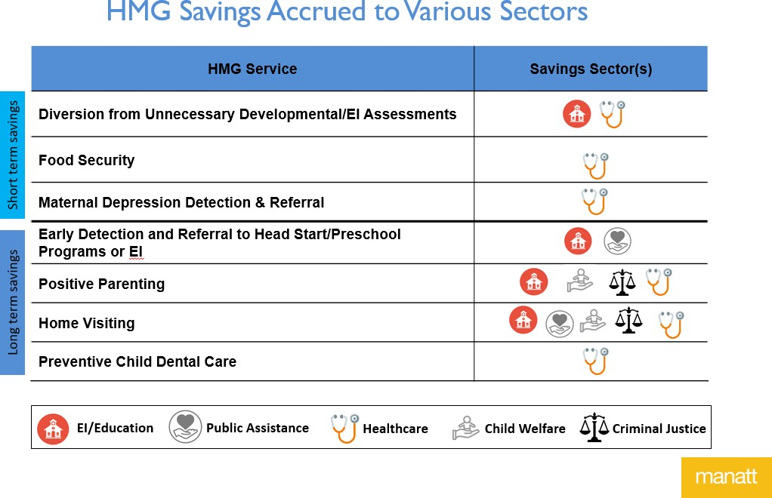
HMG Value Proposition
Return on Investment and Business Case

Slide 21
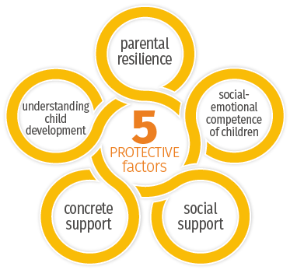
HMG Value Proposition
HMG strengthens family protective factors.
A 2018 Help Me Grow Utah study indicated statistically significant increases in the development of family protective factors among Help Me Grow users. One-on-one care coordination with families seemed particularly effective

Slide 22
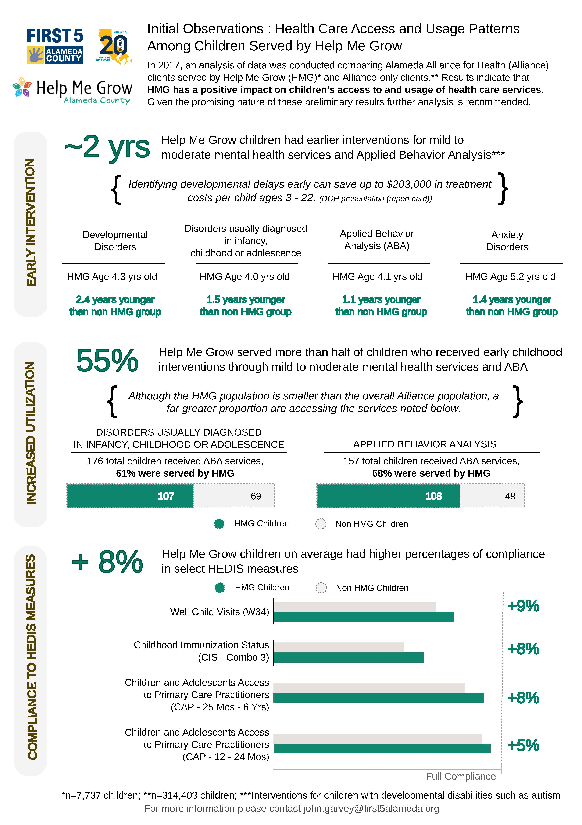
HMG Value Proposition
HMG increases access and usage of child health services
A 2017 Alameda County, CA study showed preliminary results indicating that HMG has a positive impact on children's access to and usage of health care services.

Slide 23

HMG Value Proposition
The HMG model advances racial equity through targeted universalism
HMG applies a “targeted universalism” approach, that is, while HMG is available universally to all families in a community, HMG should be documenting gaps in the grid of supports and barriers to accessing existing resources, and to leverage those data to develop targeted strategies aimed to reduce barriers in order to advance racial equity in access and benefits.
Standardize the collection of HMG outcomes disaggregated by race and ethnicity
Analyze HMG system access data, and implement targeted strategies to overcome barriers

Slide 24
HMG Value Proposition
Evidence in Support of HMG
HMG promotes early identification and intervention for children at risk for developmental delays through child health provider training and successful linkage to address child and family needs (1, 2).
Complex, often multiple social needs that impact child development are addressed by HMG’s approach that crosses systems and encourages collaboration outside the traditional context of child, maternal, and family health services. (1, 2)
Both in theory and practice, HMG serves as a mechanism of care coordination that fills a crucial gap between child health providers and service delivery regardless of child or family need(1, 2)
Children receiving developmental screening and care coordination through a centralized call center such as HMG’s are more likely to be referred and receive services than children who only receive usual care from their primary care providers (1,3)
Sources:
(1) Cornell, E.. (2020). Using the consolidated framework for implementation research to identify factors shared among positive deviants with respect to Help Me Grow implementation: A qualitative study. [Unpublished PhD dissertation]. University of Connecticut. .
(2) Hill, K.D. and Hill, B.J. (2018), "Help Me Grow Utah and the impact on family protective factors development", Journal of Children's Services, Vol. 13 No. 1, pp. 33-43. https://doi.org/10.1108/JCS-05-2017-0016
(3) Nelson BB, Thompson LR, Herrera P, Biely C, Arriola Zarate D, Aceves I, Estrada I, Chan V, Orantes C, Chung PJ. Telephone-Based Developmental Screening and Care Coordination Through 2-1-1: A Randomized Trial. Pediatrics. 2019 Apr;143(4):e20181064. doi: 10.1542/peds.2018-1064. PMID: 30894408; PMCID: PMC6564070.

Slide 25









HMG Value Proposition
As a systems-building model, HMG helps integrate evidence-based programs and promising innovations into state maternal-early childhood sectors to make the best use of existing resources, diffuse best practices, and foster optimal child and family outcomes.
Strengthens developmental promotion through embedding in child health and other child service sectors such efficacious models as Healthy Steps, Medical-Legal Partnership Program, Project DULCE, Reach Out and Read, Video Interaction Project, group well-child care (e.g., Centering Parenting), and apps and other digital tools (e.g., Sparkler and Vroom);

Slide 26
HMG Value Proposition as A Model for State Maternal & Early Childhood System Building
Resources
Protective Factors: Making the Link, Connecting HMG Affiliates and State Strengthening Families Efforts
HMG: A Nationwide Movement
HMG National Network: Enhancing-Developmental-Promotion-Early-Detection-Referral-and-Linkage-to-Services-within-Early-Learning
Defining Full Potential: HMGNC Strategic Growth Plan
Using Administrative Data to Demonstrate HMG Impact (Alameda)
Help Me Grow Utah Pediatrician Outreach Marketing Strategy
Enhancing developmental services in primary care: The Help Me Grow Experience
Connecting Vulnerable Children and Families to Community-based Programs Strengthens Parents' Perceptions of Protective Factors
Help Me Grow Utah and the Impact on Family Protective Factors

Slide 27
Crosswalk:
  Systems-building Criteria
    (matched to ECCS P-3 w/broader application)
  HMG Strategic Plan
  HMG Model
Notes:
LYNN

Slide 28
ECCS P-3:
Prioritized Application Criteria by Point Attribution
Goal Alignment, Methodology (40)
Evaluation, Measurement (15)
Capacity, Capability (15)
Support Requested (10)
Impact (10)
Need (10)
Notes:
LYNN

Slide 29
Goal Alignment & Methodology

Slide 30
Goal Alignment

Slide 31
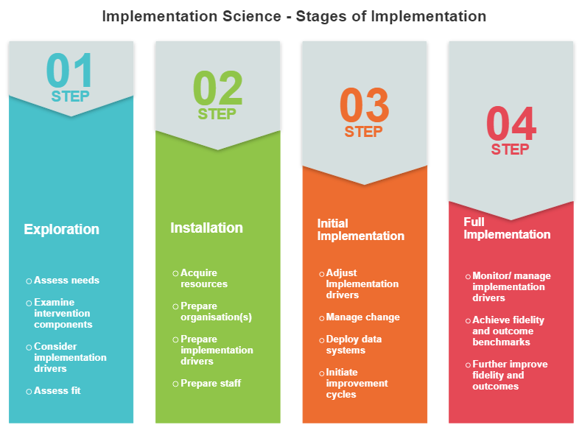
Methodology
The Help Me Grow Model uses a methodology based in Implementation Science to achieve statewide and community impact and sustainability.

Slide 32
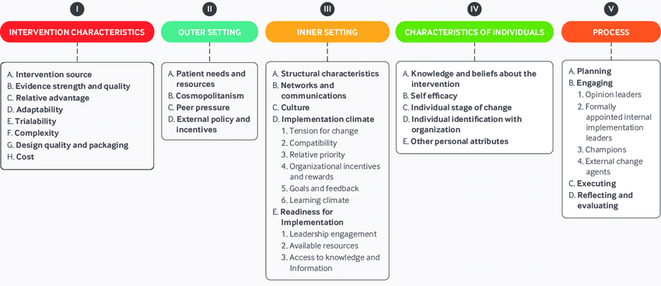
Methodology
Implementation Science provides a useful framework to explain the aspects of system building achieved through the Help Me Grow Model.
Click here for more information on implementation science and theory.

Slide 33
Methodology
Resources
Health system-based best practices, innovations, engagement of key partners
HMG National: Pediatrics Supporting Parents
HMG National: How Do We Decide What Works to Strengthen Child Health Services?
HMG National: System Enhancement and Innovations
HMG National: Child Health Care Provider Outreach Resources
HMG National: Collaboration to Enhance Family Engagement in Child Health
HMG National: Embedding Infant Mental Health Principles
HMG National: Engaging Child Health Care Providers
HMG National: WIC Community of Practice Resources
Embedding of equity through community and family leadership and engagement in decision making
HMG National: HMG Strategic Growth Plan 2021
HMG National: HMG, Health Equity and Young Children
HMG National: Family Leadership Resources
Family Voice in Early Relational Health
Berkley: Targeted Universalism Resources
CSSP: Advancing Early Relational Health and Equity Resources
HMG National & CSSP: Equity Resource Index

Slide 34
Methodology
Resources, continued
Well-aligned leadership and collaborative interagency and partner contributions to the ECCS strategic plan
HMG National: Collaboration to Improve Child Health Systems: A Toolkit for State Leaders
HMG National: BUILD Initiative Resources on State Leadership in Building MEC Systems
AMCHP Roadmap for Improved Collaboration: Accelerating Improvements in Early Childhood Systems Programs
Feasible, well-articulated approaches to financing and policy strategies that are likely to result in system improvements and sustainability
A Guide for Leveraging Opportunities between Title V and Medicaid to Promote Social Development
HMG National: California's EI System and the Role of HMG
First 5: Network Strategy for Impacting Policy
HMG National: Five Keys to Spreading, Scaling and Sustaining Innovation for Vulnerable Children
HMG National: Supporting Healthy Child Development through Medical Homes
HMG National: System Advocacy, Shared Policy Priorities
Resolution of challenges, including COVID-19 pandemic
HMG National: COVID-19 Response, A Network Discussion
HMG National: Affiliate Resources for Responding to COVID-19
HMG National: Central Referral Systems Reduce Contributors to Family Toxic Stress

Slide 35
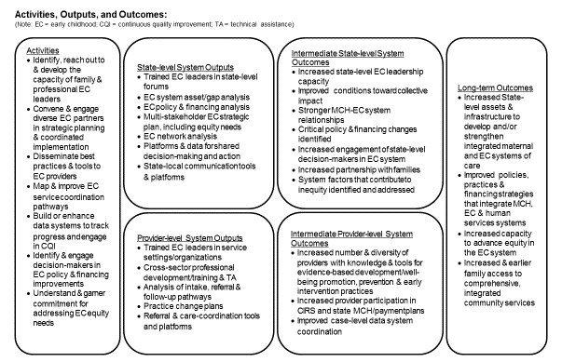
Methodology
State Maternal-Early Childhood Systems-Building Logic Model (ECCS P-3)

Slide 36
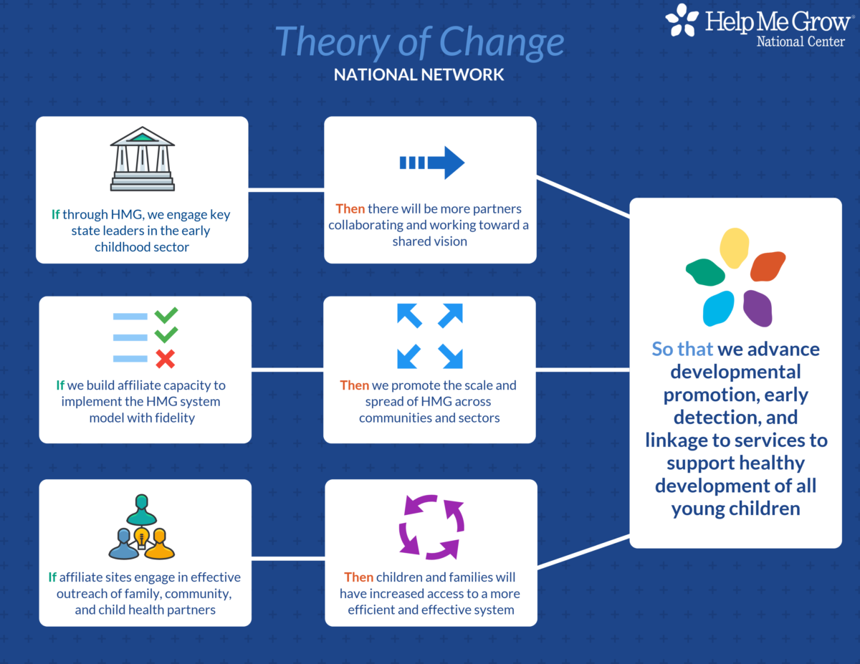
Methodology
HMG is an evidence-based, existing multigenerational model that can be used to advance state-level MCH-EC system infrastructure to increase coordinated access to services for young children and their families.

Slide 37
Evaluation & Measurement
Capacity & Capability

Slide 38
Evaluation & Measurement
Alignment of HMG State-Level Performance and Outcome Indicators*—Examples
*Refer to HMG State-level Indicator Sample Code Sheet to match potential indicators.

Slide 39
Evaluation & Measurement
Alignment of HMG State-Level Performance and Outcome Indicators
ECCS-HMG Code Sheet—Universally Applicable at the State Level
Click here to access code sheet through the ECCS CoP materials.

Slide 40
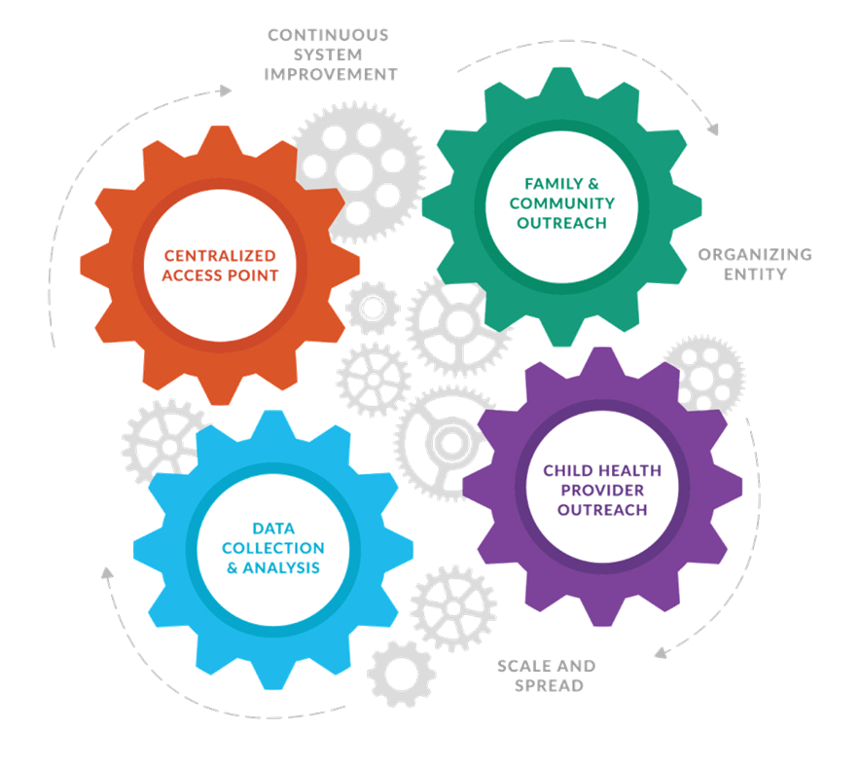
Capacity & Capability
Help Me Grow’s Structural Requirements and Core Components make state affiliates ideally positioned for ECCS in terms of capability and leveraged capacity.

Slide 41
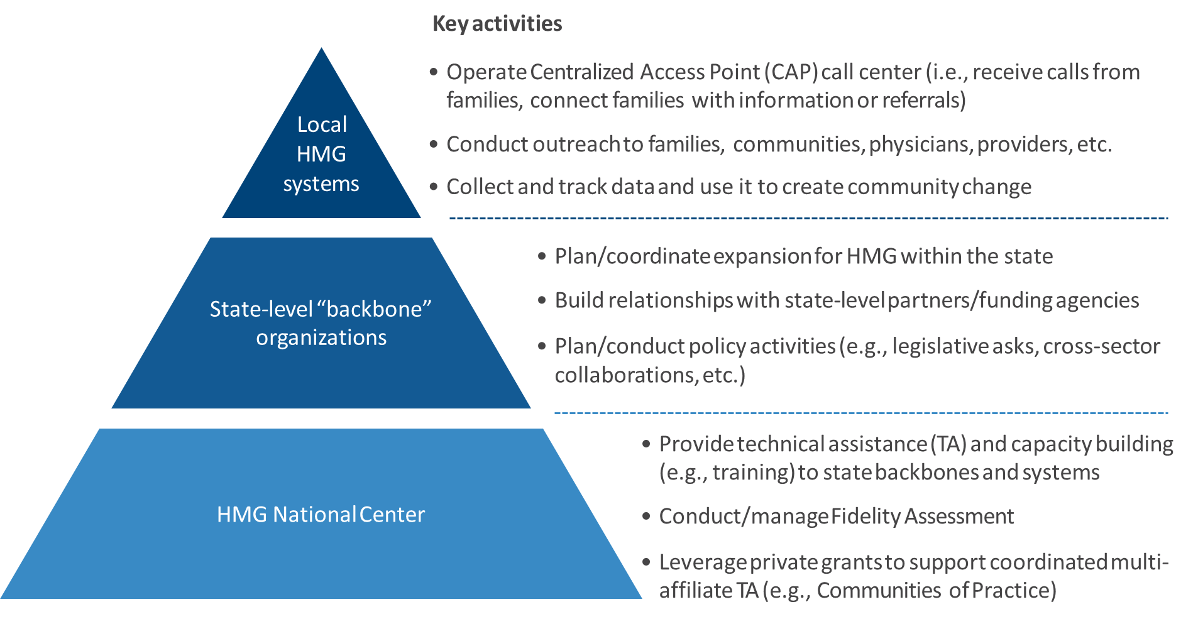
Capacity & Capability
Help Me Grow state leads are supported through the HMG National Center’s ongoing technical assistance and leverage a National Network of 29 state affiliates and 111 local systems engaged in continuous system improvement.

Slide 42
Articulation of Need
Impact
Support Requested/Budget Considerations

Slide 43
Articulation of Need
Resources
Resources on the Need for Integrated, Comprehensive Maternal-Early Childhood Systems of Care
HMG National: Tapping into the Untapped Potential of Help Me Grow
MIECHV Guide to Conducting Needs Assessments

Slide 44
Impact
Resources for HMG Impact Data
See HMG Value Proposition (slides 13-17)
2019 HMG Annual Building Impact Report
Data also available from state and local affiliate annual HMG Fidelity Assessment Impact Measures as well as other affiliate and partner data collection/analysis efforts.

Slide 45

Impact
Consider five key points of prevention and intervention for maternal-child systems of care.
Five Points of Prevention & Intervention*
Occur within Social Care & Health Sectors
* Based on SAMHSA’s: Five Points of Family Intervention

Slide 46
Support Requested/Budget Considerations
Additional information from the HMG National Center
Covered in subsequent ECCS CoP for lead ECCS applicants who are HMG state affiliates. HMG National Center dedicated technical assistance is available for ECCS grantees.
For other affiliates wishing to advocate for use of the HMG Model as their state Maternal-Early Childhood model of choice, the National Center will offer additional advisement opportunities.

Slide 47
ECCS P-3 Applications:
HMG Affiliate Community of Practice
Notes:
Lynn.

Slide 48
Community of Practice: ECCS P-3 Application
A targeted technical assistance support for qualifying state lead affiliates and their collaborative partners
CoP Applications due January 29
Webpage with all info on this CoP:
https://helpmegrownational.org/resources/eccs-hmg-community-of-practice-resources/

Slide 49
Community of Practice: ECCS P-3 Application
Timeline and Key Dates
January 29, 2021 CoP Request for Applications (RFA) due to HMG National Center
February 1, 2021 Notification of acceptance sent to CoP participants
HMG-ECCS CoP Sessions (Eastern Time)—Opportunities for co-learning among peers as well as HMG National Center support and technical assistance in preparation for grant applications.
  February 11, noon-1:00pm
  February 18, 3:00-4:00pm
  February 25, 3:00-4:00pm
  March 4, 3:00-4:00pm
  March 11, 3:00-4:00pm
March 15, 2021 applications due to HRSA

Slide 50
Discussion
Notes:
Lynn

Slide 51
Community of Practice: ECCS P-3 Applicants
Contact:
Lynn Pullano
HMG Implementation Expert lynndpullano@gmail.com

Slide 52

HELPMEGROWNATIONAL.ORG

