Slide 1
Welcome to WithinReach
Help Me Grow Forum Site Visit
José Villalobos
Stephanie Orrico

Slide 2
WE ARE:
A first stop for Washingtonians
to explore resources for health,
food, and child development.
A compassionate team equipped to discuss a variety of needs and use multiple modalities to serve the family.
Notes:
Who do we serve?
All ages
All state
What is our scope?
All direct-service staff can assist with a range of needs, from health insurance to food resources to immz
A subset of staff are trained to assist more deeply with ASQ and navigating early childhood systems
No crisis line, no mental health or legal counseling, no direct parent coaching, no housing, direct financial counseling/advising
What service do we provide?
Resource consultation and navigation using phone, email, and text
Online resource database to search for resources for themselves or others
In-person: resource support out in the community
We are largely government funded, blending contracts from several state agencies to stay current on their programming.
Shorter-term grants allows us to innovate, expand into new languages, service offerings, or outreach strategies.

Slide 3
COMMUNICATING WITH CLIENTS
Hotlines
Online portals –
Benefit Finder
ASQ Family Access
Texting platform
E-fax
Snail-mail
Notes:
We interact with client through many modalities. We receive and return calls by phone, using email and text as appropriate to follow up. Other clients come to us through the benefit finder or ASQ portal, or are referred by a provider via e-fax. Some clients prefer we mail them printed resource information, or an ASQ,

Slide 4
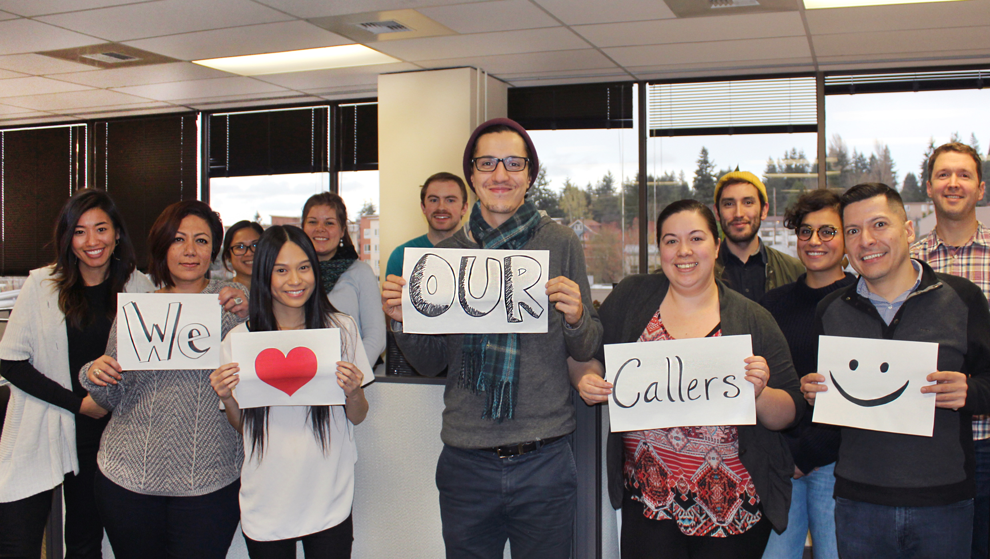
HOTLINES
Notes:
Name some partner agencies who contract us or list us as an information access point, e.g. WIC, Part C, Summer Meals, CHIP, etc.

Slide 5
Online Portal – Benefit Finder
Notes:
The Benefit Finder is a public-facing form that any individual can complete to a) get a rough sense of which state benefit programs they may be eligible for, b) request a call from WithinReach to explore their eligibility more deeply, and get assistance applying. Over the years, we’ve added child development and parenting resource needs to the list.

Slide 6
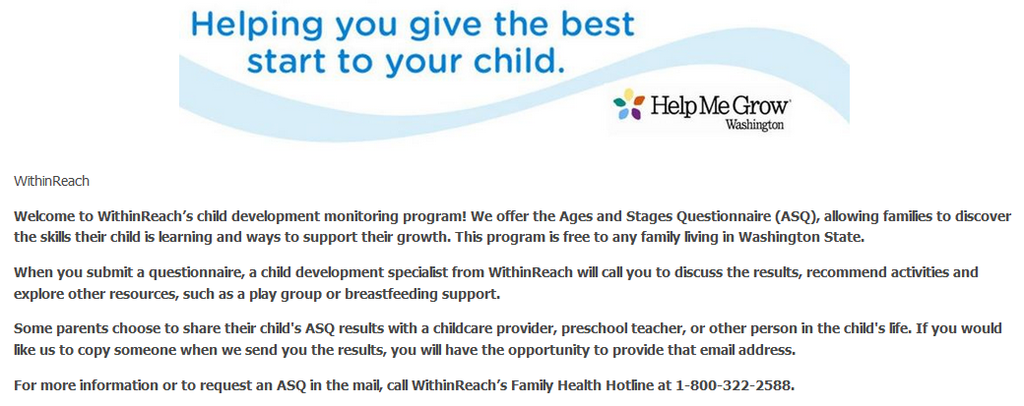
Online Portal – ASQ Family Access
Notes:
Families can complete an ASQ or ASQ:SE directly through our www.ParentHelp123.org website. If a hotline caller is interested in the ASQ, we send them a link to this portal.

Slide 7
TEXTING
Client follow-up
Resource information delivery
Campaigns, such as Summer
Meal sites
Notes:
Our Health Leads REACH database, where our general hotline staff track callers and follow-up, allows us to text resources at the end of the call or text to follow-up a few days later.
We use a different texting platform to conduct campaigns, to help a partner advertise a program like WIC or Summer Meals. In these campaigns, families text a key word to a given short code, and receive resource info for their nearest WIC clinic or Summer Meals site.

Slide 8
Self-guided Resource Search
www.ParentHelp123.org
Families can search by zip code to find local resources including:
Food banks
Summer meal sites
Low-cost medical/dental clinics
WIC Clinics
Immunizations
Development screenings
Parent support
Child care referrals
AND MORE!
Notes:
Visit the website for a comprehensive list of resources the hotlines and website provides to clients.
You can add resources you view to a “resource list” – like a cart, when online shopping. You can then send that list to yourself or someone else by email or text (or print it).
We offer this searchable resource directory to allow the public to explore the same resources our hotline gives out. Our hotline staff often have more detailed knowledge or notes on the program’s process or parameters, to assist clients with questions or experiencing barriers.

Slide 9
Profinder
System for Tracking Access
to Referrals
(STAR)
ASQonline.com
(w/ API function to STAR)
Health Leads REACH
(triaging, text, gaps, barriers)
TECH ASSETS
Notes:
Profinder was a proprietary system we developed many years ago to help us manage our resource database, track caller info, and deliver resources to the call electronically. We built it, because we could not find something off-the-shelf that met our needs.
We added ASQ Online (a subscription through Brookes Publishing) to hold our ASQ data and enable families to submit their results directly.
HMG National added the Common Indicators, which required child-centered data and resource connection data. Our hotline’s database was adult-centered, and could not capture referral outcomes. We purchased STAR to allow our ASQ staff to be aligned with the Common Indicators and the HMG best practice for follow-up. We recently paid for Brookes’ API, which ports the ASQ data families enter over to STAR.
To this day, we mainly use STAR to track ASQ-related communication and referrals. If a client originated with the hotline staff, they are likely in their client database also. While this is redundant in some ways, it is also quite a different dataset than our hotline collects.
In July, our hotline team switched to using REACH, a database developed by Health Leads USA. It adds social needs screening to the workflow, helping us document those needs and surfacing needs they didn’t call about. We are still getting the hang of it, but this format is certainly uncovering more families with child-related concerns.

Slide 10
10 Bilingual Specialists - care coordinators
(5 specialized for navigating early childhood systems)
1 Resource Database Specialist 3 Program Coordinators
Notes:
10 Bilingual Specialists (or care coordinators, as the HMG model calls them)
5 of the 10 are specialized for navigating early childhood systems
1 Resource Database Specialist
3 Program Coordinators

Slide 11
KNOWLEDGE
Training
Ongoing personal and professional development
Information access
Quality assurance
Cross-training
Notes:
Our staff undergo about a month of training before they answer a single hotline call. It includes information about the programs for we which screen or refer families, as well as the process for connecting them (getting certified as a health insurance exchange navigator, for instance). New and veteran staff are shadow periodically to identify additional training needs, and to assure consistent quality.
We maintain an internal Wiki that contains programmatic information, such as decision trees to help staff triage among similar programs, or obscure eligibility details to help them troubleshoot with clients.
Our most recent effort to produce well-rounded staff and a holistic experience for families is to develop HMG care coordinators from our existing hotline staff (instead of hiring directly for ASQ follow-up staff).
Regular team and staff meetings offer employees opportunity to delve into complex issues, to grow as people and to better relate to clients (e.g. transgender issues, homelessness, refugee experiences, etc)

Slide 12
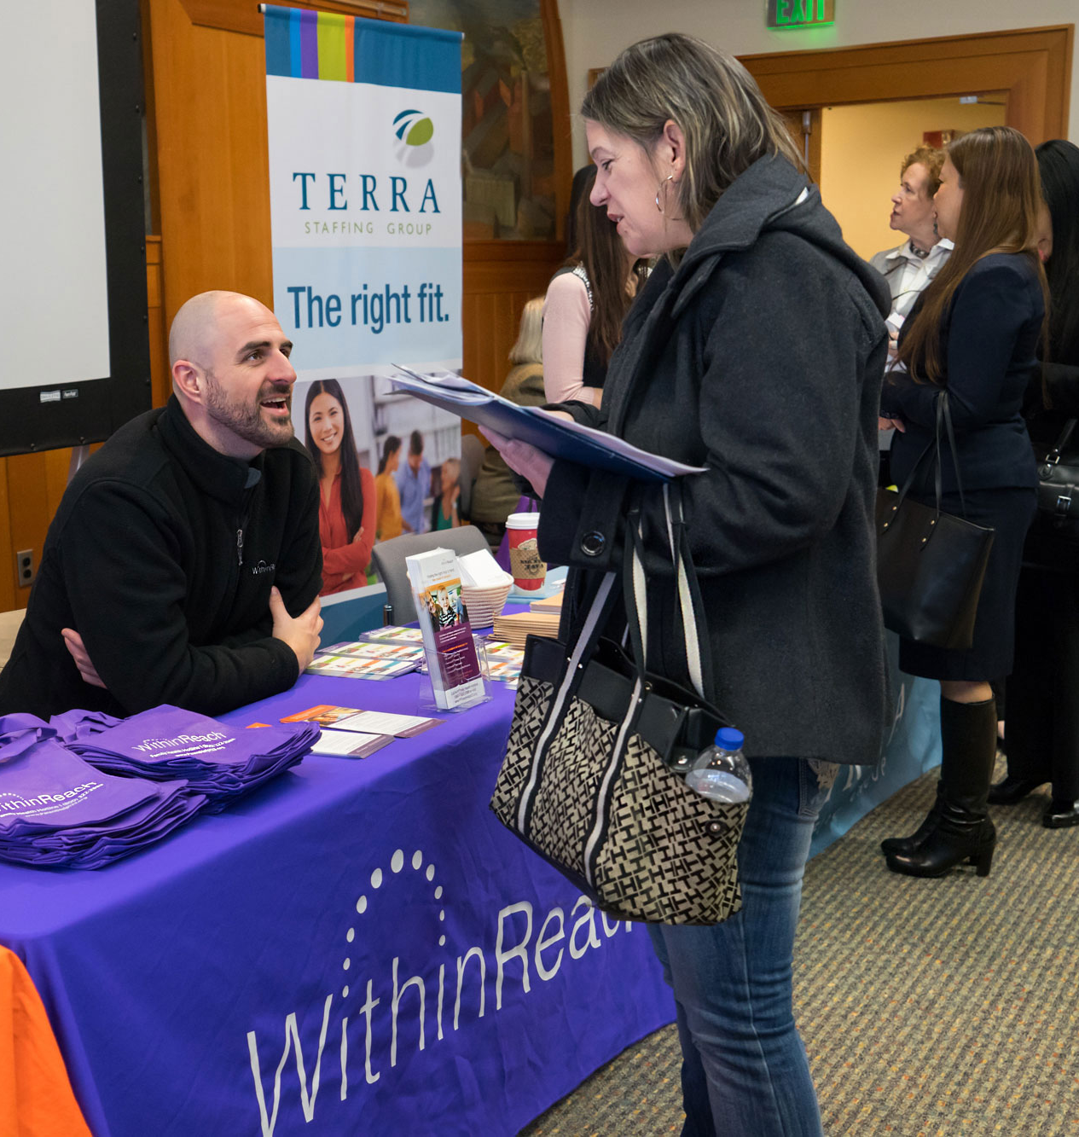
OUR INTERACTIONS
No time limit
Conversational
Culturally responsive
Awareness
Empowerment
Active listening
Non-judgmental
Notes:
We pride ourselves at being able to take calls, and assist clients in an unhurried, authentic, responsive way. We believe the client is the expert on their life and their child, and that their priorities must be our priorities.

Slide 13
Collaboration
Research
Did someone say FOOD?
Genuine interactions
ENVIRONMENT
Open door/cube
Professional development
Notes:
We asked our team what they like about working here:
Integrated chi dev question in our social needs screening --> driving traffic for ASQs, EI services, other referrals and parent supports
Comprehensive phone calls/interactions
We do research, find the best answer, provide good info to callers
Food! We like to eat!
Work environment: collaborative, shared ideas, problem solving, challenging client scenarios, low cubicles to see each other and chat
New learning opportunities, always adding resources (new categories), maintain up-to-date info and stay aware of changes
Excellent customer service, genuine interactions, detail oriented
Different modes of communication - walk up, Teams (instant messages)
Training: Able to shadow different people, Different styles, approachable team members and supervisor, open door environment, ability to watch the process and hear calls in action

Slide 14
A Hotline Interaction: Start to Finish
Call is answered
- Through the Family Health Hotline 1 (800) 322-2588
- Caller is interested in WIC
2. Demographics collected
3. Social needs screening (question 3)
Do you currently have any questions or concerns about
your child’s/children’s health or development (such as
speech, behavioral, or physical development)?
- Caller says “yes,” and opts-in to HMG
- Care coordinator addresses presenting need
(e.g. determines WIC eligibility → explains services →
delivers resource/site info)

Slide 15
An Interaction: Start to Finish (continued)
4. HMG: Explore family’s child development needs
Questions? ASQ
Concerns? Refer to Part C or Part B for evaluation
Early learning and parenting support options
5. Follow-up time-line depends on nature of resource
Note: If parent/caregiver completes ASQ online, our care coordinators score
it and follow-up after every ASQ to discuss results-additional resources.

Slide 16
OUR DATA
3,844 incoming calls this year so far!
~4,000 families enrolled in ASQ service by hotline since 2012
On average, ~90 ASQs per month
Coordinated parent support resources for 688 families referred by DSHS
Coordinated Part C intake for over 2,800 Children in King County since 2015
Total 6,500 resources in our database

Slide 17
Help Me Grow Projects and Areas of Growth
ASQ service
Part C/early intervention intake
Parenting support/home visiting triage
Children and Youth with Special Health
Care Needs (CYSHCN)
Enlace project – focus on teens, Spanish-speakers, rural areas
Notes:
We have developed our child-related resource expertise, partnerships, and service offering over time.
Our ASQ service was originally funded by Project LAUNCH in 2012, but has been funded by various DOH pots of money since then.
We have been the state’s Part C info line for about 15 years – light touch, giving people their county’s lead agency number. In recent years, we became our own county’s intake point, able to enter children to the state’s database and assign them to a provider. We are actively engaged in the early intervention provider network, which is doing wonderful work around racial equity, parent advocacy, etc.
The Dept of Health has contracted us to refer families to their local CYSHCN coordinator, through their health department. A D70 grant from HRSA allowed us to hire a CYSHCN-focused staff person who expanded our resource offering to include far more resources, especially around autism. She also trained us on key topics re: disability, like universal design or using person-first language.
With a constellation of state and regional partners, WithinReach used a federal grant for pregnant and parenting teens to focus ASQ and HMG support to young parents, Spanish-speakers, and those living in rural areas. It enabled us to build rapport (in-person!) with rural partners, experiment with different outreach strategies, and most of all, bolster our Spanish-language ASQ and HMG service delivery.

Slide 18
Stories from our Care Coordinators
Libby Wayss | Maritza Cazares
libbyw@withinreachwa.org | maritzac@withinreachwa.org
Chris Gray | Bradley Mills
christineg@withinreachwa.org | bradleym@withinreachwa.org
Notes:
Now we’ll hear from 4 of our care coordinators who have additional training in early childhood systems. They’ll each share a family story, to illustrate how families come to us, what types of things we do, and what stuck with them about the family.

Slide 19
Questions & Answers

Slide 20
OUR CONTACT INFORMATION:
If any of your questions were not answered during our Central Access Point Site Visit, please contact us:
José Villalobos | Stephanie Orrico
josev@withinreachwa.org | stephanieo@withinreachwa.org

Slide 21
OFFICE TOUR!
Notes:
Please collect your belongings, the shuttle back to The Westin is the last stop of our tour!

