Slide 1
Part of Connecticut Children’s Office for Community Child Health

Slide 2
JUST WHAT THE DOCTOR ORDERED:
HONING EXPERTISE IN HELP ME GROW
PHYSICIAN OUTREACH
January 9, 2018

Slide 3
OBJECTIVES
Delve into HMG Child Health Care Provider Outreach strategy
Articulate the value of HMG to physicians
Examine the role and responsibilities of the HMG physician outreach liaison
Hear how an affiliate leveraged HMG Maintenance of Certification to promote quality and engagement

Slide 4
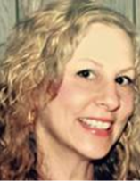
PRESENTERS
From HMG Connecticut
Abby Alter
Senior Associate for Early Childhood Initiatives
Child Health and Development Institute
aalter@uchc.edu
www.chdi.org
From Help Me Grow Ventura County, CA
Sharon T. Elmensdorp, Ph.D, BCBA-D Developmental Specialist Landon Pediatric Foundation
Help Me Grow Ventura County
sharon@helpmegrowvc.org
www.helpmegrowvc.org
From HMG National
Sarah Zucker
Program Specialist for Network Development
szucker@connecticutchildrens.org
www.helpmegrownational.org
Notes:
Abby Alter is the Senior Associate for Early Childhood Initiatives at the Child Health and Development Institute of CT. Abby has a Master's Degree in Public Administration (MPA) from New York University and has over 20 years of experience in the human service field, specifically in children's mental health, public health, child welfare and managed care. AT CHDI, she has worked on provider outreach for Help Me Grow through CHDI’s Educating Practice in the Communities Project and has also been the project coordinator for a national Help Me Grow project that includes 6 pediatric practices in CT, CA and VT. In addition to provider outreach work, Abby also works on the issue of early childhood obesity prevention
Sharon is a Developmental Specialist for Help Me Grow Ventura County. She received her Doctorate in Educational Psychology with an emphasis in Special Education, Disabilities and Risk Studies from the University of California, Santa Barbara. While at UCSB, Sharon conducted research on the early identification of autism and related disorders and training of healthcare providers to identify these disorders. She is a Board Certified Behavior Analyst- Doctoral Level and has worked in the field of naturalistic behavior intervention for over 12 years. She specializes in working with young children with autism, communication delays, behavioral concerns and related disorders as well as providing education and training to parents and professionals. Through her work with Help Me Grow Ventura County, Sharon develops training protocols for early identification with community-based and healthcare providers including a focus on the implementation of standardized developmental screening tools.

Slide 5
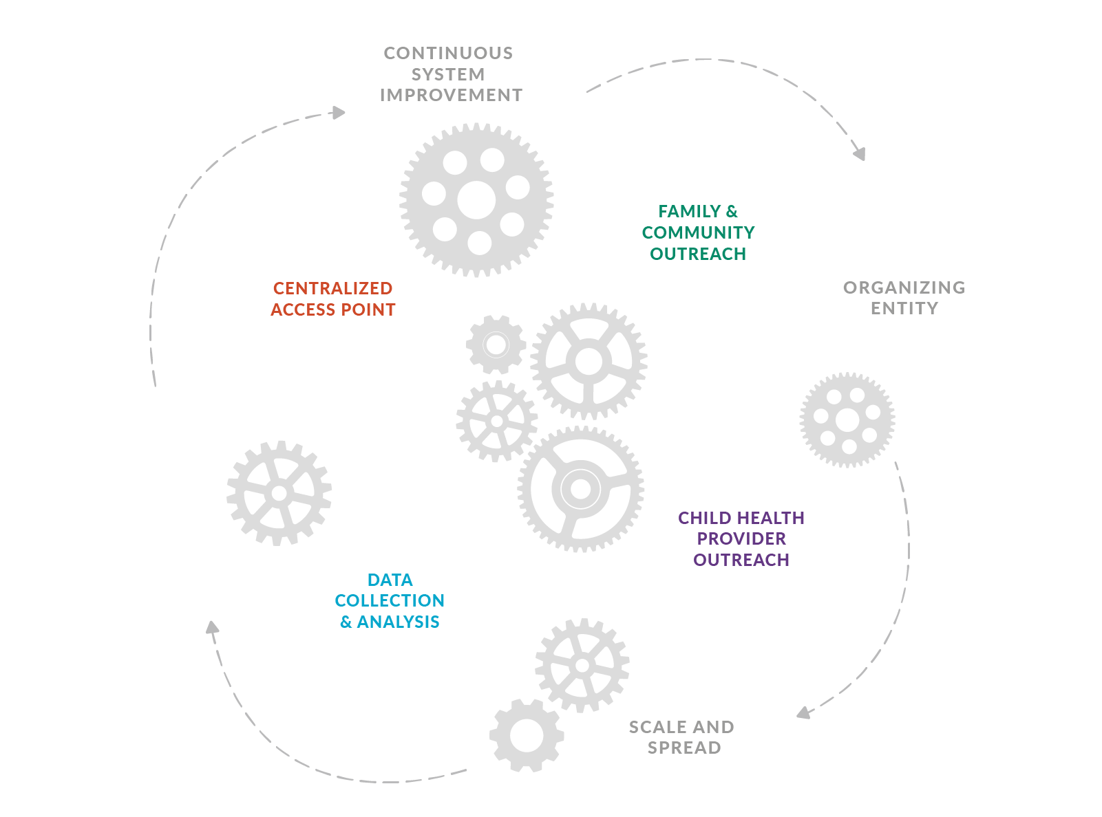
HELP ME GROW SYSTEM MODEL
DEFINED BY CORE COMPONENT COOPERATION
Child Health Care Provider Outreach
supports community-based pediatricians by enhancing their effective developmental promotion and early detection activities and offering a simple yet comprehensive solution through the centralized access point when concerns are identified.
The centralized access point offers care coordination support for busy pediatric practices and closes the loop with referring physicians so families are optimally supported, communication is streamlined, redundancies minimized, gaps identified, and children receive what they need, when they need it.

Slide 6
HELP ME GROW SYSTEM MODEL
CHILD HEALTH CARE PROVIDER OUTREACH
Perfectly positioned partners in early childhood system building efforts: Near universal access and uniquely positioned to identify developmentally vulnerable children.
However, early identification is challenging. And so is linkage.
The HMG system model supports child health care providers:
Outreach, trainings, workshops promoting systematic surveillance and screening of young children
Provides access to centralized access point that can serve as a care coordination arm for busy pediatric primary care practices
Child Health Care Provider Outreach

Slide 7
Help Me Grow Provider Outreach
Abby Alter, MPA
Senior Associate for Early Childhood Initiatives
Aalter@uchc.edu
860-679-8788

Slide 8
Child Health Provider Outreach
Approaches:
Identify an organization (AAP chapter, non-profit, training hospitals, community health centers (FQHC) or community orgs) that have established relationships with providers in the community you are trying to serve
Identify a Help Me Grow staff person as a physician outreach liaison
Be Creative: work with city/state government agencies if possible to help identify physician champions or an appropriate organization to help conduct outreach

Slide 9
Why focus on child health providers?
Near universal utilization of child health services
Near universal access to parents
Longitudinal relationship with families
Trusting relationship
Opportunity to connect with other services
Instead of the bullet button

Slide 10
Successful Provider Outreach Strategies
Obtain updated list of child health providers in your target community
Conduct a mailing/and or make calls to introduce HMG and the other services you offer. Usually ask for the office manager who might be in charge of physician education.
Follow up mailing and/or call with an offer to come in person. Make sure you offer the following:
bring a free meal
offer to come during lunchtime or be very flexible to meet their scheduling needs
bring promotional materials and resources
bring copies of screening tools (you can only bring the ones that are free)
PEDS AND ASQ ARE NOT FREE
explain the value you are bringing to their office
HMG centralized access point
Developmental monitoring training
Personal commitment of HMG staff to assist child health providers
Connections to state/local policies
Access to MOC/Quality Improvement projects
before you leave ask to set up another time to meet with physicians and other appropriate staff to introduce HMG to them

Slide 11
Other incentives to offer child health providers
Developmental Screening Incentives:
National Committee on Quality Assurance (NCQA) includes developmental screening with a formal tool according to AAP schedule in standards for achieving medical home recognition
Some state’s Medicaid and some private insurers are paying more for services delivered in NCQA recognized medical homes
Some state’s Medicaid medical home performance measures include developmental screening; adherence to schedules earns practice bonus payments
Quality Improvement Project participation-providers can participate in a Developmental Monitoring Quality Improvement Project and get MOC credits and/or CME credits – Affiliates can work with CT Children’s Medical Center’s Office for Community Child Health PQI office
Bring billing code information for public and private payers so provider’s offices can know how to bill for screening in their state
Bring resources-HMG is a great resource in itself, but there may be others in the community. Make sure to always leave materials
Remember that Help Me Grow adds value to the community and to play up that information when conducting outreach

Slide 12
Tips for Successful Outreach
Be persistent but affable
Do not take any rejection personally
Try and identify the right person in the office-sometimes you may not get the person that has influence in the office, so try and identify that person
Food goes a long way-always bring a meal and check for food allergies
Follow-up on any requests they may have given you. If you don’t know the answer to their questions offer to find out and make sure you get back to them on a timely basis.
Send a thank you note via email or card

Slide 13
Roles and Responsibilities of Provider Outreach Liaison
Work closely with provider outreach org (if that is your approach)
Offer to attend provider meetings with outreach org
Supply appropriate HMG materials for outreach org
Collect provider outreach data from outreach org
Follow up with child health providers to ensure satisfaction
Conduct provider outreach
Follow-up and maintain relationships with both child health provider office managers and/or physicians
Maintain data on all provider outreach activities
Offer MOC/QI projects through CT Children’s PQI program
Conduct satisfaction or solicit feedback from providers about your outreach efforts
Develop relationships with city/state agency leaders (Medicaid, PART C, Early Intervention Services) so you can be up to date on policy issues that affect child health provider reimbursement and/or quality

Slide 14
Example Provider Outreach Org
Educating Practices in the Community- EPIC Project
The Child Health and Development’s (CHDI) EPIC program includes 17 training topics that help pediatric and family medicine sites across Connecticut better meet the needs of children
Uses academic detailing model. Academic detailing involves educational outreach through a personal visit by a trained person to health professionals and their staff in their own settings
EPIC trainings are brief, free and offered in the comfort of the provider’s office over lunch or another convenient time to all practice staff
The trainings are tailored to connect practices in Connecticut to existing state and community resources and include up-to-date clinical information, helpful resources and office tools
Many of our trainings have a MOC/Quality Improvement Project that providers can sign up for.

Slide 15
Changing pediatric practice
Research supports Academic Detailing as an effective strategy for promoting practice change in several areas:
Pediatric pain management (Schechter, N. L., Bernstein, B. A., Zempsky, W. T., Bright, N. S., & Willard, A. K. (2010) Educational outreach to reduce immunization pain in office settings. Pediatrics, 126(6), e1514-1521.)
Autism screening (Honigfeld, L., Chandhok, L., & Spiegelman, K. (2011) Engaging pediatricians in developmental screening: The effectiveness of academic detailing. Journal of Autism and Dev Dis, (DOI) 10.1007/s10803-011-1344-4.)
Asthma management (Cloutier, M. M., & Wakefield, D. B. (2011) Translation of a pediatric asthma-management program into a community in Connecticut. Pediatrics, 127(1), 11-18.)

Slide 16
Key components of Academic Detailing
Knowledge of baseline behavioral and barriers to change
Clear educational and behavioral objectives
Credibility of sponsoring organization
Referencing authoritative and unbiased resources
Active participation from learners
Concise visual materials
Repetition of essential messages
Positive reinforcement for practice improvement through follow-up
Instead of the bullet button

Slide 17
EPIC: Core Components
Onsite visits to child health sites
Targeted presentations on topics that address practice change supported by community and state resources
Presentations that highlight the role of the entire practice team in delivering care
Feedback and follow up to monitor: 1) how much is done, 2) how well it is done, and 3) is anyone better off?

Slide 18
EPIC: Structural Requirements
Backbone organization to coordinate visits and ensure core components are present
Quality monitoring data system
Connection to state and community resources
Connection to pediatric primary care
**Bonus is to offer MOC/QI projects

Slide 19
Maintenance of Certification (MOC) Quality Improvement Projects
Through our partnership with CCMC Office of Community Child Health we have several MOC projects that go along with our EPIC modules
Help Me Grow Developmental Screening MOC
Practices will complete chart audits to assess their implementation of surveillance, screening, and connection to services at 9, 12, and 18 month old well child visits.
Before signing up for project providers must either have participated in the EPIC module or taken the HMG online module available on our website www.kidsmentalhealthinfo.com
Link: http://www.kidsmentalhealthinfo.com/providers/pediatric-providers/help-me-grow-developmental-monitoring-and-connecting-children-to-services-online-training/
Included in MOC/Quality Improvement Project:
Documentation that provider solicited parental concerns at 9, 12 and 18 month visits
Documentation that provider screened with a formal tool at 9 and 18 month visit
Documentation that provider connected parents to services if the child had concerns on formal tool or through solicitation of concerns

Slide 20
Summary
For more information
CHDI staff is available to answer questions
Abby Alter email: aalter@uchc.edu

Slide 21
Using the HMG QI/MOC Project to promote provider outreach: An Affiliate Example
Sharon Elmensdorp, Ph.D., BCBA-D Developmental Specialist Landon Pediatric Foundation
Help Me Grow Ventura County

Slide 22
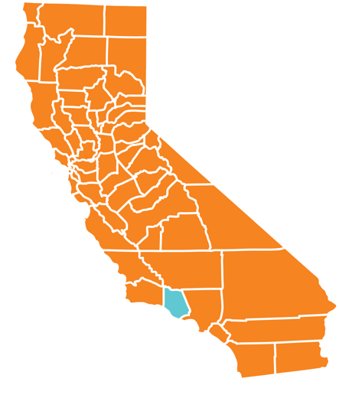
Ventura County
Population |  | 849,738
Under age 5 |  | 6.1%
Median household income |  | $78,593
Over age 25 with a college degree |  | 32.2%
Statistics from July 1, 2016.
From census.gov/quickfacts

Slide 23
Our Background
Gained affiliate status in 2013
4th county in California, 1st of the Learning Communities
Lead agency Landon Pediatric Foundation
Prior to 2013:
Funding from First 5 of Ventura County to focus on developmental screening
2011 formed Developmental Screening Collaborative with Tri-Counties Regional Center & Ventura County Public Health

Slide 24
Challenges
Successful Child Health Provider Outreach requires:
Getting your foot in the door
Keeping the experience meaningful
Using time efficiently
Working well with all levels of staff
Sustaining motivation and interest
Maintaining gains over time

Slide 25
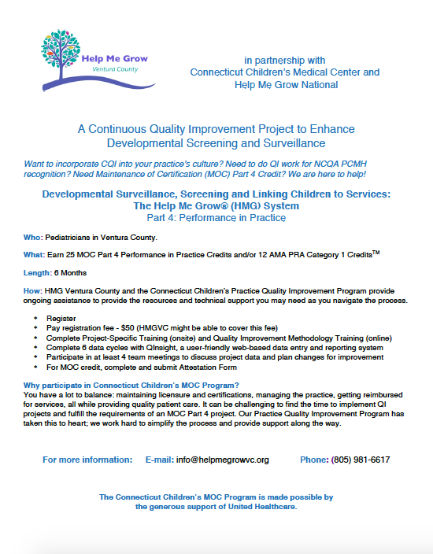

Slide 26
QI/MOC Steps
Register ($50 fee per participating physician)
Complete the following:
Project-specific training (on-site)
Quality Improvement Methodology Training (online)
6 data cycles with QInsight
Participate in … at least 4 team meetings to discuss
project data
plan changes for improvement
Complete an Attestation Form
25 MOC Part 4 Performance in Practice Credits and/or 12 AMA PRA Category 1 Credits

Slide 27
Leveraging Partnerships
Local Managed Care Plan
Gold Coast Health Plan Performance Improvement Project (PIP)
American Academy of Pediatrics - Chapter 2
Local health care systems
Ventura County Health Care Agency
Ventura County Public Health

Slide 28
Advantages of Partnering
At clinic level:
Provide layers of support
Efficient - completed 2 projects during 1 project timeline
Immediate benefit of supporting patients
Positive recognition from multiple agencies
At managed care level:
Helped focus in on PIP topic
MOC helped provide framework for intervention
Faster approval by Health Services Advisory Group
Filled a need
At HMG level:
Helped open door to providers
Legitimized work with providers
Leveraged resources with a willing partner

Slide 29
Joint MOC & PIP Project
Who?
Low-income family medical center in Ventura County
Part of larger health system
3 out of 3 pediatricians at practice
Also: office manager, front office manager, back office manager, health information specialist, medical assistants, front office staff, billing and records
Goals:
Improve developmental screening workflow
Increase screening at younger ages
Baseline- Jan 2017
Intervention- Feb 2017
Intervention- March 2017
Intervention- April 2017
Intervention- May 2017
Intervention & Closing- June 2017

Slide 30
Joint MOC & PIP Project
Methodology
Pre-meetings
On-site project specific training- pre-baseline (HMG)
Online Quality Improvement Methodology Training
Monthly in-person PDSA cycles (HMG & GCHP)
Monthly data entry (HMG)
Ongoing on-site and remote support (HMG)

Slide 31
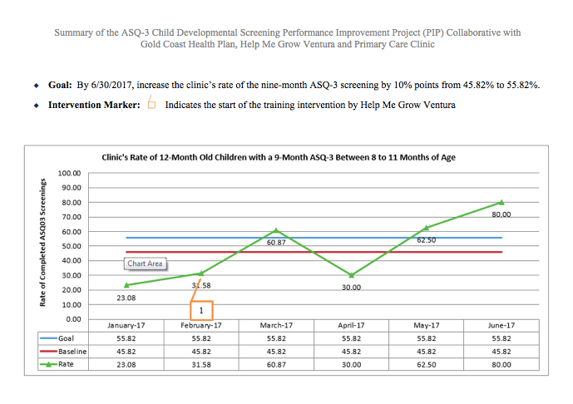

Slide 32
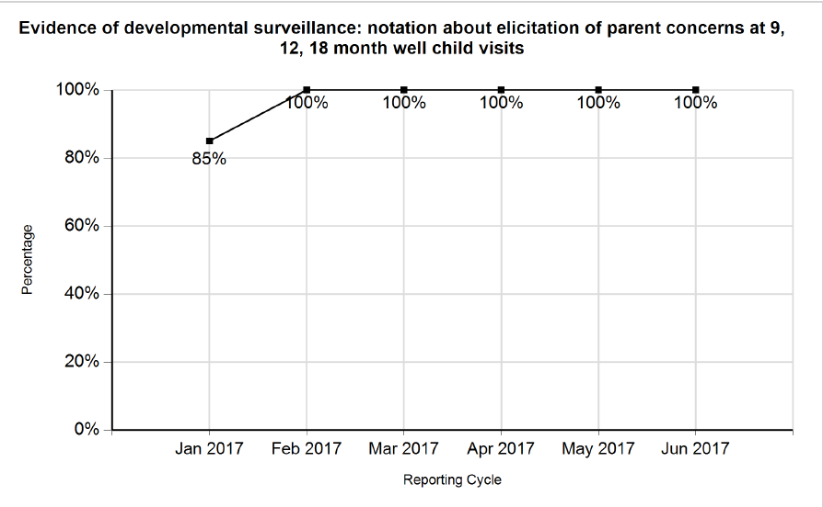

Slide 33
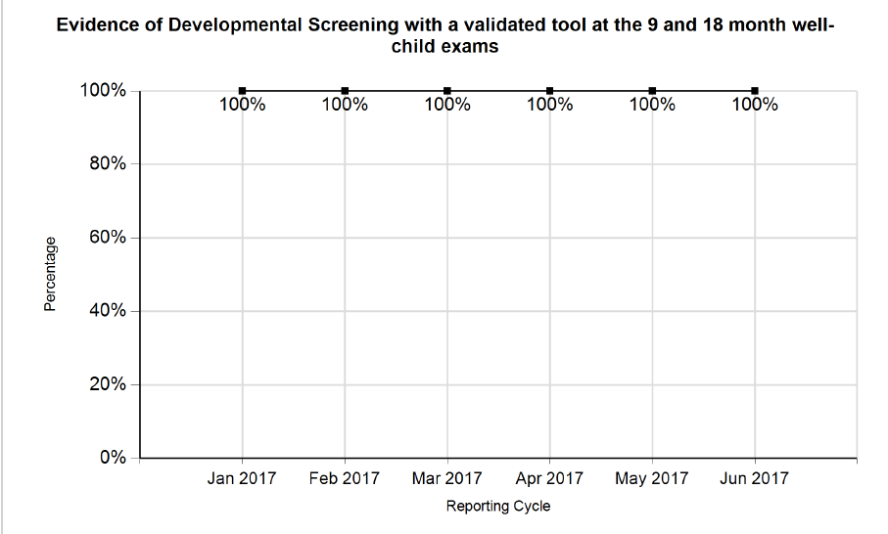

Slide 34
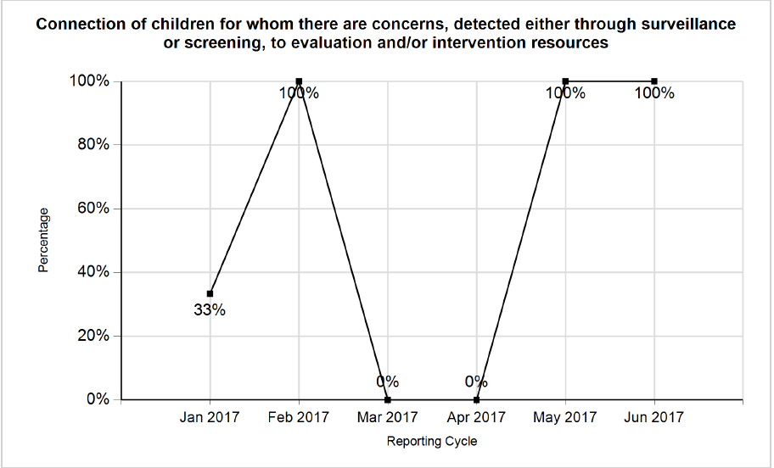

Slide 35
Lessons Learned
Collaborate with partners
Be flexible and creative!
Focus on the needs of the specific provider
Include as many people as possible
Be persistent!

Slide 36
Impact
“HMG has definitely helped me provide better care for my patients.”
- One of our participating pediatricians
Notes:
Part of MOC

Slide 37
One of our participating pediatricians shared the following about working with Help Me Grow Ventura County:
HMG has definitely helped me provide better care for my patients. Because I am aware of the safety net and services available to my young pediatric patients I am more able to react to small changes in development or behaviors. Before Help Me Grow reached out to our clinic and helped streamline our developmental screening process, I can honestly admit I was a "wait and see" proponent when it came to development. Now with more standardized screening, both my parent population and I more quickly move forward if there are any concerns. I've found that starting early with small interventions has a much bigger impact than waiting for more time consuming and comprehensive interventions down the line. If a child does not qualify, everyone is happy in my experience, there has been no frustration with the process especially in Ventura County.
Notes:
Part of MOC

Slide 38
Meet up on Slack with Dr. Dworkin
Friday, January 19
2pm EST
#DworkinDropin
Notes:
Meet up on Slack with Dr. Dworkin and other Network Affiliates to discuss Dr. Dworkin’s latest blog post on the roles and core capabilities for leaders in the formidable work that is systemic change.
To join, simply log onto the HMG Slack channel at 2pm EST on January 19. Bring your questions, reactions, and thoughts on your own experience leading early childhood system change through Help Me Grow! We will use the hashtag Dworkin Dropin during our conversation so its easily searchable and shareable later.

Slide 39
LET’S TALK
Q&A

