Slide 1
Part of Connecticut Children’s Office for Community Child Health

Slide 2
INTEGRATING PEDIATRICS INTO YOUR
EARLY CHILDHOOD SYSTEM BUILDING
November 14, 2017

Slide 3
OBJECTIVES
Define essential activities included HMG Child Health Care Provider Outreach
Describe various strategies to successfully carry out this core component, including the strategic identification of the best-suited partner organization to manage and coordinate
Highlight the strategic relationships between HMG Leads and the organizations responsible for coordinating and managing Child Health Care Provider Outreach activities

Slide 4
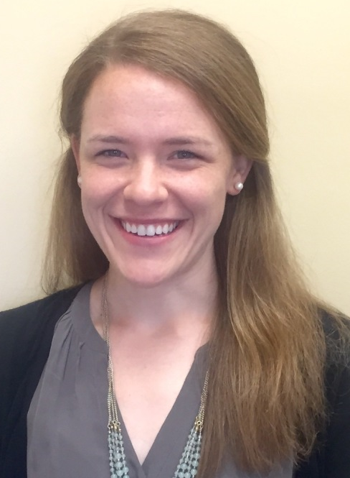
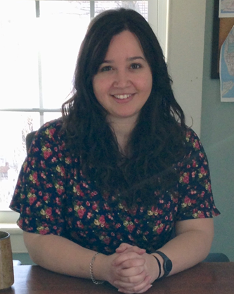
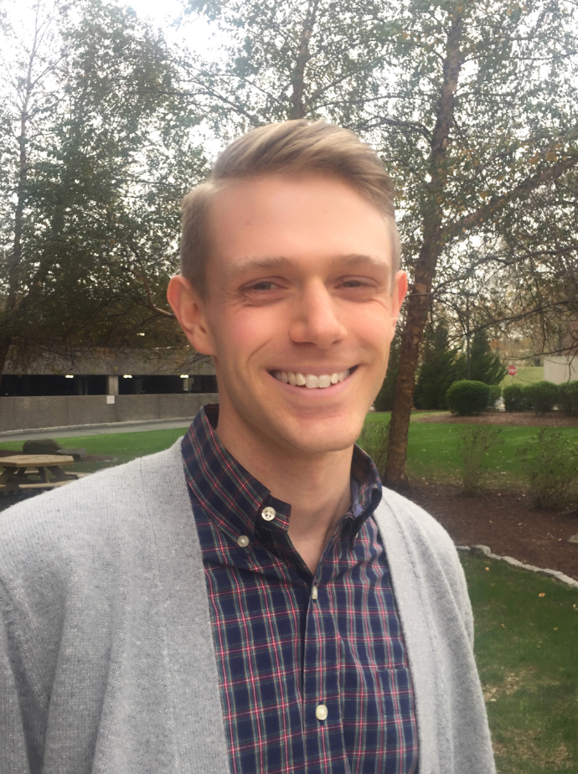
PRESENTERS
From HMG Long Island
Dr. Liz Isakson
Executive Director
Docs for Tots
liz@docsfortots.org
www.docsfortots.org
Melissa Passarelli
Director of Programs
Docs for Tots
melissa@docsfortots.org
From HMG Alabama
Katie Prince
Director
Help Me Grow Alabama
Alabama Partnership for Children
Kprince@smartstartalabama.org
www.helpmegrowalabama.org
From HMG National
Von Jessee
Program Specialist for Network Assessment
vjessee@connecticutchildrens.org
www.helpmegrownational.org
Notes:
Joining us from Help Me Grow Long Island today, we have Liz Isakson and Melissa Passarelli.
Dr. Liz Isakson is the Executive Director of Docs for Tots. She is a pediatrician and public health practitioner with 15 years of experience with Columbia-Presbyterian Medical Center, the National Center for Children in Poverty (NCCP) and the New York Zero-to-Three Network (NYZTT).
Melissa Passarelli is the Director of Programs at Docs for Tots, for which she oversees maternal depression screening and developmental screening initiatives, including coordinating Help Me Grow - Long Island.
Joining from Help Me Grow Alabama, is Katie Prince, who is the Help Me Grow Alabama Director at the Alabama Partnership for Children, where she provides coordination of nine Help Me Grow sites throughout the state. Prior to her current position, Katie worked with the Alabama Interagency Coordinating Council (AIACC) and the Autism Society of Alabama. Katie has a Bachelor of Science degree from Auburn University and a Master of Public Health, Maternal and Child Health Leadership and Policy from the University of Alabama at Birmingham.
From the National Center, we have Von Jesssee, who is our Specialist for Network Assessment and will be laying some groundwork for our discussion today, describing some of the specifics around HMG Child Health Care Provider Outreach and the key activities that are essential to carry out the core component.

Slide 5
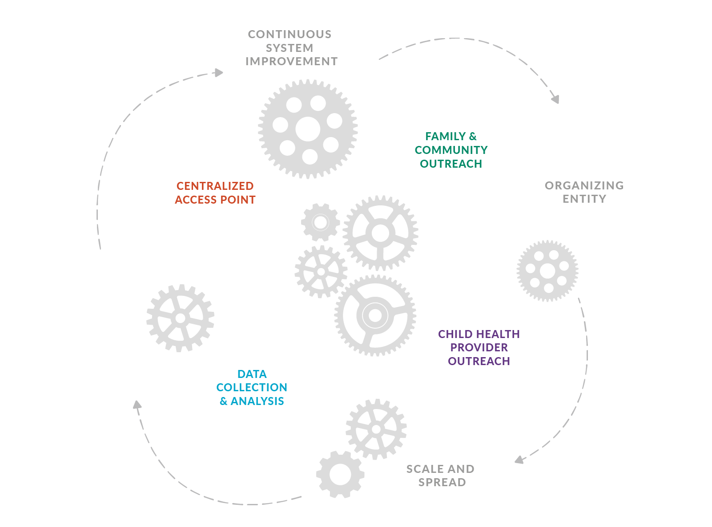
HELP ME GROW SYSTEM MODEL
DEFINED BY CORE COMPONENT COOPERATION
Child Health Care Provider Outreach
supports community-based pediatricians by enhancing their effective developmental promotion and early detection activities and offering a simple yet comprehensive solution through the centralized access point when concerns are identified.
The centralized access point offers care coordination support for busy pediatric practices and closes the loop with referring physicians so families are optimally supported, communication is streamlined, redundancies minimized, gaps identified, and children receive what they need, when they need it.

Slide 6
HELP ME GROW SYSTEM MODEL
CHILD HEALTH CARE PROVIDER OUTREACH
Perfectly positioned partners in early childhood system building efforts: Near universal access and uniquely positioned to identify developmentally vulnerable children.
However, early identification is challenging. And so is linkage.
The HMG system model supports child health care providers:
Outreach, trainings, workshops promoting systematic surveillance and screening of young children
Provides access to centralized access point that can serve as a care coordination arm for busy pediatric primary care practices
Child Health Care Provider Outreach

Slide 7
HELP ME GROW SYSTEM MODEL
CHILD HEALTH CARE PROVIDER OUTREACH
Key Activity #1
Identify a Physician Champion
HELP ME GROW HEADING
A program of Connecticut Children’s Office for Community Child Health.
01

Slide 8
HELP ME GROW SYSTEM MODEL
CHILD HEALTH CARE PROVIDER OUTREACH
Key Activity #2
Advance rates of developmental screening and surveillance

Slide 9
HELP ME GROW SYSTEM MODEL
CHILD HEALTH CARE PROVIDER OUTREACH
Key Activity #3
Conduct targeted outreach to child health care providers
01

Slide 10
HELP ME GROW SYSTEM MODEL
CHILD HEALTH CARE PROVIDER OUTREACH
Key Activity #4
Close the feedback loop with physicians
01

Slide 11
Finding and Engaging the Right Medical Partners

Slide 12
About Docs For Tots
Non-profit, non-partisan organization lead by pediatricians
Mission: Bring together children’s doctors and communities to promote practices, policies and investments in children from prenatal to five that foster children’s healthy development and future success.
Model: Intensive technical assistance using a quality improvement framework
Past success: Developmental Screening Project
Over 1000 screens given (and counting)
Over 100 referrals to EI
95-100% screening rates in all FQHCs

Slide 14
Help Me Grow – Long Island
Launching in January 2018
Natural outgrowth of developmental screening initiative and need for coordinated care for vulnerable children

Slide 15
Changing Health Care Practice
Quality Improvement
Competing initiatives
Time and funding
Health center/clinic capacity for change

Slide 16
Qualities and Characteristics of a CHCPO Champion
Champions serve to encourage staff members to:
serve as the main point of contact
implement screening
provide feedback about the process
help make improvements as needed.
Champions can and should represent the different parts of the practice: front desk, nursing, physician/provider level

Slide 18
The Role of Each Team Member in a Practice
Practice Change = Shared Process
Practice Administrator/Manager
Clerical
Assessment/Triage
Doctors/Providers

Slide 19
Making the Case: What can HMG offer?
Patient-centered Medical Home
Compliance with AAP screening recommendations
Referral coordination/expertise
“referred but not eligible”
Maintenance of Certification credits through the American Board of Pediatrics

Slide 20
Tips for Engagement
Don’t make assumptions
Make the case around local statistics and benefits for the health sector
Offer credit opportunities
Be mindful of meeting times/length

Slide 21
Where to Start
Training hospitals (residency programs)
Community pediatrics rotations
Community health centers (www.fqhc.org)
Local chapters of the AAP & AAFP
Medical Societies
Sub-committees of these groups
CATCH grant recipients

Slide 22
Thank You!
Dr. Liz Isakson, Executive Director
liz@docsfortots.org
Melissa Passarelli, Director of Programs
melissa@docsfortots.org
For more information regarding maternal depression and Docs For Tots, visit www.docsfortots.org

Slide 23
Child Health Care Provider Outreach
Katie prince, Help Me Grow Alabama Director, Alabama partnership for children

Slide 24
Help Me Grow Alabama
Alabama Partnership for Children
Organizing entity
Mission
To work in partnership with families and organizations to ensure that all Alabama children (birth to five) get everything they need to develop to their fullest potential.
Public-Private Partnership (10 agencies)
Board appointments by Governor, Speaker, Senate Pro Tem
Pediatrician and health care provider
Coordinate several multi-agency initiatives and programs
(3) HMG statewide staff
HMG Director, Community Liaison, and Professional
Development Coordinator

Slide 25
Centralized Telephone Access Point
Dial 2-1-1 and ask for Help Me Grow!
Centralized telephone access point
9 regions serving 67 counties
9 care coordinators located at each local 2-1-1 agency

Slide 26
HMG Alabama Leadership Team
2-1-1 Connects Alabama
Alabama Chapter-American Academy of Pediatrics
Alabama Department of Early Childhood Education
Alabama Department of Education-Special Education
Alabama Department of Mental Health
Alabama Department of Public Health
Alabama Department of Rehabilitation Services/Early Intervention
Alabama Interagency Autism Coordinating Council
Alabama Partnership for Children
Alabama Project LAUNCH
Childcare Resource Network
Parenting Assistance Line
Reach Out and Read-Alabama
United Way of Central Alabama/Success By 6
University of Alabama-Child Development Resources

Slide 27
Early Detection Becomes a Priority
AABCD grant targets policy barriers and physician outreach for screenings and referrals
Success in policy change to cover screenings at well- child visits through Medicaid and private insurance
Received grant from Community Foundation of Greater Birmingham to fully develop physician outreach for HMG Central Alabama through Reach Out and Read/AAP/Success By 6/United Way

Slide 28
Early Detection Becomes a Priority
Early Childhood Comprehensive Systems Blueprint for Zero to Five includes priority of regular developmental screening and referral as one of the major indicators to track
30% of parents in Alabama have concerns about their young child’s health and development
Ready Families in Ready Communities
Ready Services:
Health
Ready Services:
Early Education
Ready Children with Bright Futures
Ready Schools

Slide 29
Key Funding Milestones
2011: HMG National Network 2 year planning grant
2012: Community Foundation of Greater Birmingham 3 year grant
2014: Alabama Department of Mental Health through a Project LAUNCH grant from the Substance Abuse and Mental Health Services Association
2015: Alabama Department of Early Childhood Education through the Preschool Development Grant
2016: Alabama Department of Human Resources
Notes:
Contracting with AAP

Slide 30
Partnerships: American Academy of Pediatrics
Quality Improvement-Maintenance of Certification Project
2012: 5 practices (Central Alabama)
2015: 12 practices (statewide)
2016: 9 practices (statewide)
Amazing results!
Spring and Fall Meeting participation
Quarterly newsletter highlights
Website page inclusion (www.alaap.org/help-me-grow-new/)

Slide 31
Partnerships: American Academy of Pediatrics
APC Board of Directors established
AABCD Pilot Study
APC receives grant from HMG National-Leadership Team established
HMG participates in 3rd QI-MOC project
Community Foundation of Birmingham funding/ HMG Central Alabama established/1st QI-MOC project
Project LAUNCH grant established HMG West Alabama/ Contract with AAP/ROR for 2nd QI-MOC project and books
APC receives funding from ADECE to expand HMG statewide-contract with AAP/ROR for physician outreach
Partnership Timeline
2001
2008
2011
2012
2014
2015
2016

Slide 32
Partnerships: Reach Out and Read-Alabama
Access to pediatricians with a unified message about early childhood development
Streamlined partnership simplifies what we are both asking of health care providers--to prepare America’s youngest children to succeed in school
Prescription for Summer Reading events

Slide 33
Developmental Screening
Screen
Score
Share Results
Follow-Up
Report

Slide 34
ASQ Enterprise
ASQ Enterprise allows program to:
Create and manage child and program records
Store results and follow-up decisions in child records
Easily track when children need to be screened
Access activities parents can try at home to encourage child progress
Access automatic scoring and screening selection to help eliminate scoring errors and provide more accurate referral information
Analyze both child and program level data and track trends across time

Slide 35
Lessons Learned
Build on existing partnerships
Blueprint Committee →AABCD Stakeholder group →Help Me Grow Alabama Leadership Team →Young Child Wellness Council
Maintain record of decision making, milestones, successes, and challenges
Build from your state’s strengths (existing systems, strong partnerships)
Don’t make assumptions! (knowledge of HMG, knowledge between systems, services offered, etc.)
Key stakeholder buy-in every point along the way
Be willing to change and update as circumstances change
Don’t be afraid to ask for help! (materials adaptation, input from other states)
Fidelity to the model

Slide 36
Strategies
HMG and ASQ “Lunch and Learns”
Team approach!
ASQ Enterprise
Physician specific promotional materials
One-pager, referral card, bookmarks, talking points/FAQ’s, ASQ physician letter
Pediatrician/medical home intake question
Physician Champion or Office Manager/Referral Nurse/Coordinator Champion?
Continuous (sometimes repetitive) follow-up!
Well Visit Planner

Slide 37
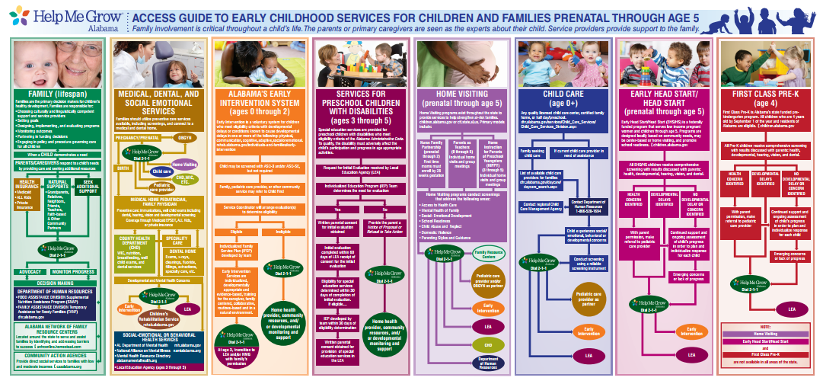
Alabama Access Guide

Slide 38
Challenges
Staff turnover
Geography
Messaging/overcoming misconceptions
Understanding what is care coordination

Slide 39
Thank You!
Katie Prince
Kprince@smartstartalabama.org
334-271-0304
www.helpmegrowalabama.org

Slide 40
Part of Connecticut Children’s Office for Community Child Health

Slide 41
LET’S TALK
Q&A on Slack
First-ever HMG Community Conversation
#pedspartners
Notes:
Invitation to HMG Slack Channel: http://bit.ly/2w61HE4

