Slide 1
Part of Connecticut Children’s Office for Community Child Health

Slide 2
IMPROVING EARLY CHILDHOOD SCREENING AND CARE THROUGH CLINICAL-COMMUNITY PARTNERSHIPS AND 2-1-1 TECHNOLOGY
November 30, 2017

Slide 3
HELP ME GROW SYSTEM MODEL
Advancing Developmental Promotion, Early Detection & Linkage to Services

Slide 4
HELP ME GROW SYSTEM
EVALUATION FRAMEWORK
System
Community
Family
HMG NATIONAL CENTER
Provides external support to implementers
HMG AFFILIATES
Implement system model within community

Slide 5
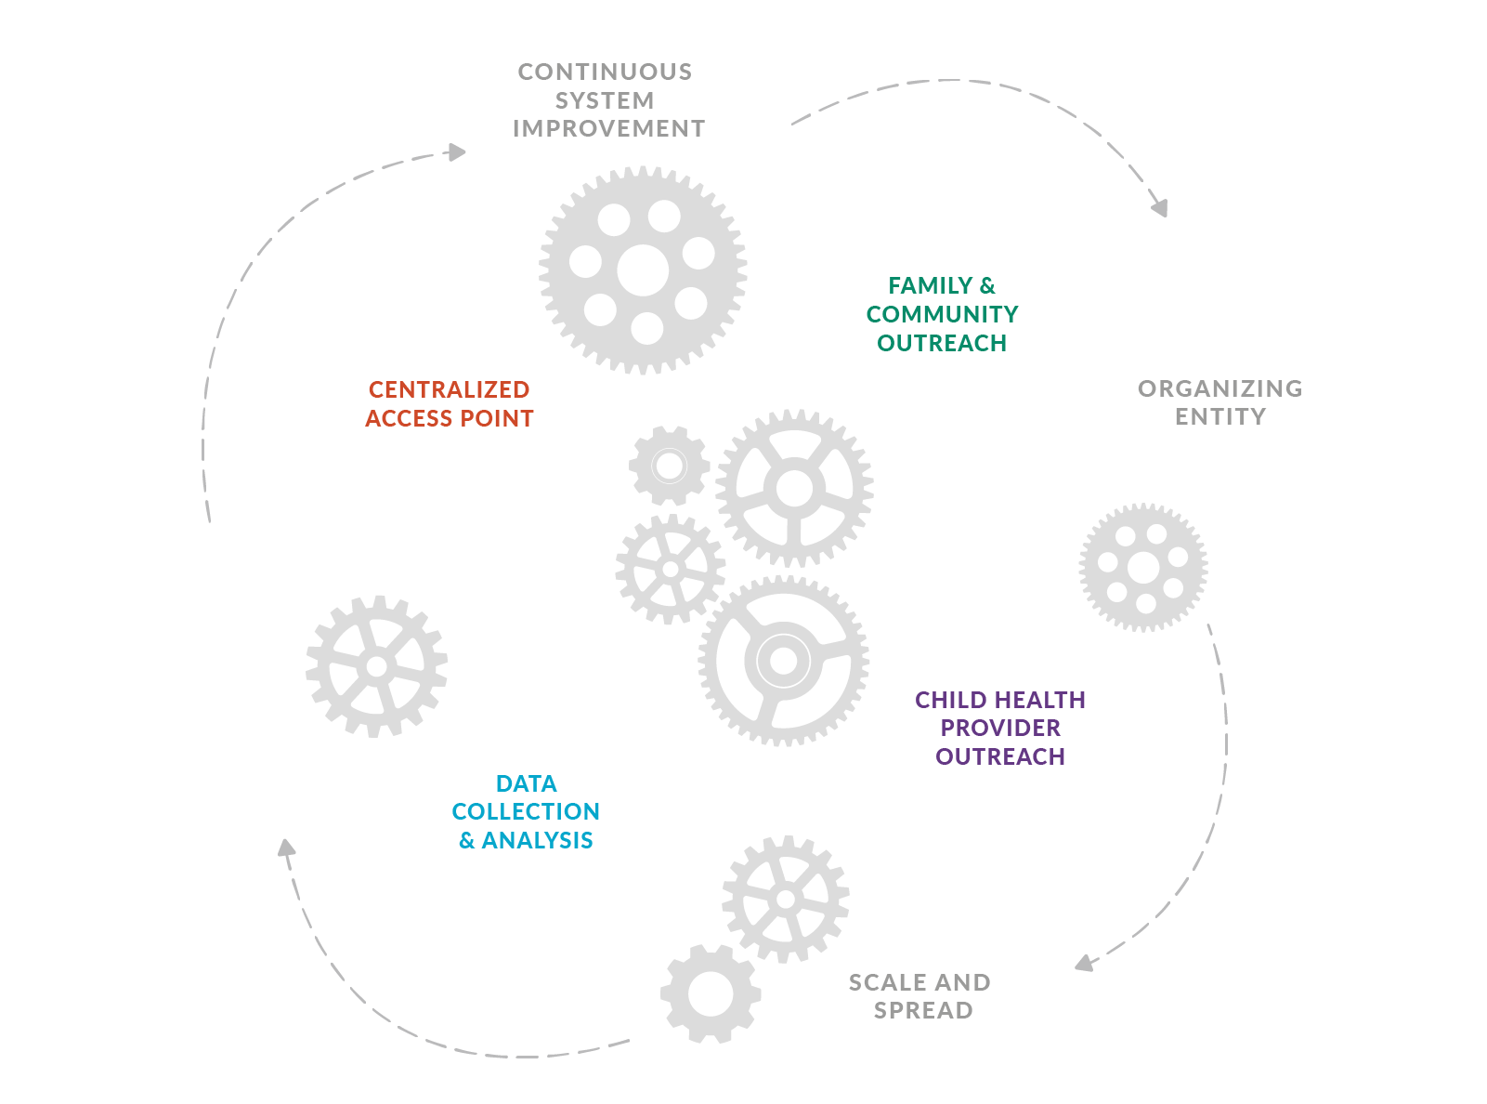
HELP ME GROW SYSTEM MODEL
COOPERATION OF FOUR CORE COMPONENTS
FAMILY &
COMMUNITY
OUTREACH
DATA COLLECTION & ANALYSIS

Slide 6
PRESESNTERS
Patricia Herrera, MS
Program Director
Developmental Screening and Care Coordination Program
211 Los Angeles
Bergen Nelson, MD, MS
Pediatrician
Assistant Professor
Children’s Hospital of Richmond at VCU
Paul Chung, MD, MS
Chief of General Pediatrics
Professor of pediatrics
David Geffen School of Medicine & Mattel Children's Hospital
UCLA

Slide 7
Improving Early Childhood Developmental
Screening and Care Coordination
through Partnership with 2-1-1
Bergen Nelson, MD, MS; VCU
Patricia Herrera, MS; 211 Los Angeles
Paul Chung, MD, MS; UCLA

Slide 8
The 211LA DSCC Story
Developmental Screening and Care Coordination at 211LA:
The vision
Initial funders
How it works

Slide 9
Am J Prev Med 2012;43(6S5):S457–S463

Slide 10
Methods and Procedures
211LA Information and Referral (I&R) Specialists offer screening to parents/caregivers with children 0-5 with stated and unstated concerns.
211LA I&R Specialists warm transfer all calls to a Care Coordinator Specialist that has been trained to conduct the screening and needed care coordination for a child at risk for a delay/disability.

Slide 11
Methods and Procedures
All screening results and essential demographic data were captured by the PEDS Online database and linked to the 211 LA database;
5. The status of 211 LA referrals and whether a referral resulted in delivery of services were tracked in 211 LA’s database.

Slide 12
Measurement
PEDS Online, which has automated scoring and report-writing, was used to support interview administration and referral decisions via:
Parents' Evaluation of Developmental Status (PEDS)
PEDS: Developmental Milestones (PEDS:DM)
The Modified Checklist of Autism in Toddlers (M-CHAT)
www.pedstest.com/online

Slide 13
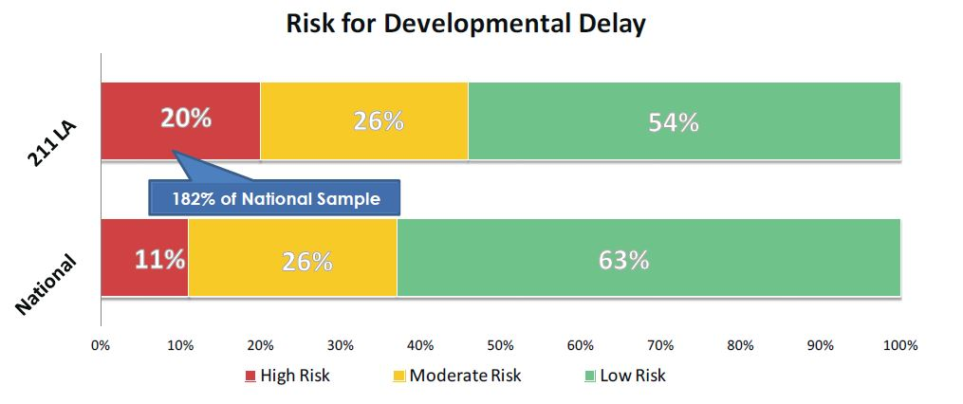
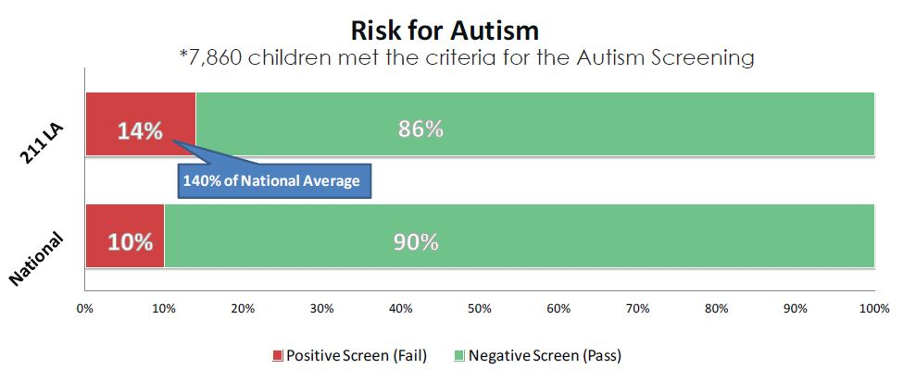
Program Impact: Risk
12,293 = number of children screened by 211 LA to date
46% = At risk for Developmental Delay
14% = At risk for Autism
That is 182% and 140% compared to a national sample, respectively

Slide 14
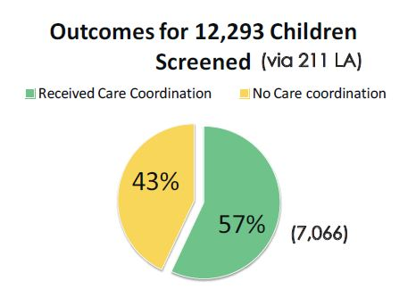
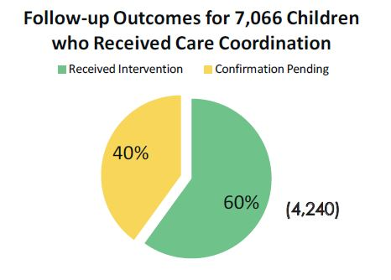
Program Impact: Outcomes
211 LA referred 100% of children who screened at-risk for delays, compared to 39% at general pediatric clinics*.
60% of 211 LA’s children received services (referral uptake), compared to about 20% at general pediatric clinics. * Guevara JP, Gerdes M, Localio R, et al. Effectiveness of Developmental Screening in an Urban Setting, Pediatrics, 2013; 131: 30-37

Slide 15
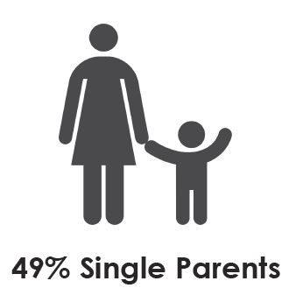
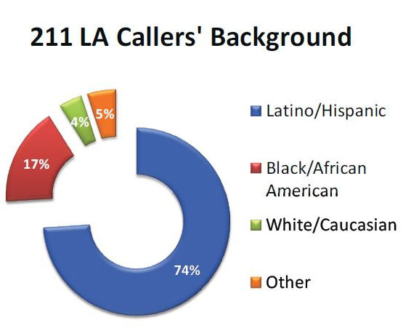
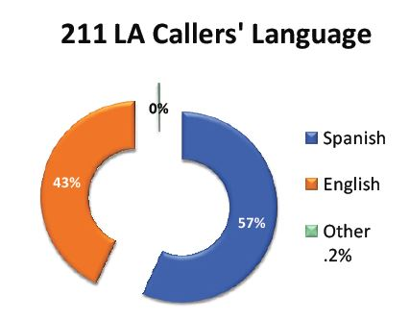
Program Impact: Demographics
Demographics of DSCC
Program Participants

Slide 16
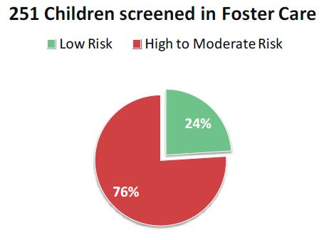
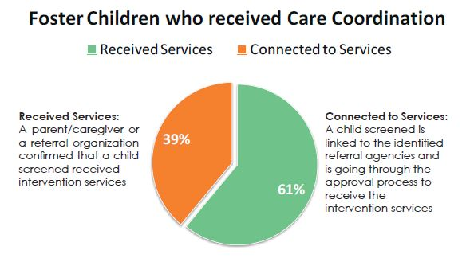
Program Impact: Foster Children
Outcome highlight: Foster Care, a hidden crisis
76% Screened at-risk for developmental delay

Slide 17
Conclusions
Parents, even in the midst of financial crises and stressful living situations, are willing to discuss worries about their children
Families with high rates of psychosocial risk have children with high rates of developmental-behavioral problems and health concerns
Live referrals to services have a high uptake rate as compared to other referral methods (e.g., fax, email, requiring parents to make their own appointments, etc.)
Conclusions
Parents, even in the midst of financial crises and stressful living situations are willing to discuss worries about their children;
Families with high rates of psychosocial risk have children with high rates of developmental-behavior problems and health concerns;
Live referrals to services have a high uptake rate as compared to other referral methods (e.g., fax, email, requiring parents to make their own appointments, etc.).

Slide 18
Trabajando Juntos por Nuestros Niños (Working Together for Our Kids)

Slide 19
Clinical Partnerships with 211 to Improve Developmental Screening and Care Coordination
Funded by the Robert Wood Johnson Foundation Public Health Systems and Services Research Program
Grant Period: Feb, 2015 – Jan, 2017
Team Members:
Bergen Nelson, Lindsey Thompson, Damaris Arriola Zarate, Paul Chung
Patricia Herrera, Irene Aceves, 211 LA
Ingrid Estrada, Clinica Msr. Oscar A. Romero

Slide 20
Background: Developmental Screening is a Recommended Preventive Service
The American Academy of Pediatrics (AAP) recommends universal screening and surveillance:
Ask about and document family concerns at every well visit
Use a validated screening tool at 9, 18 and 24-30 months
Use an autism-specific screening tool at 18 and 24-30 months
Refer promptly to evaluation and intervention services when concerns are detected
AAP Council on Children with Disabilities. Identifying Infants and Young Children with Developmental Disorders in the Medical Home: An Algorithm for Developmental Surveillance and Screening. Pediatrics. 2006;118 (1):405-420.

Slide 21
Background: Gaps in Evidence for Developmental Screening
Improved
Developmental, Social, Educational and Health Outcomes
Developmental
Screening
Early Detection
Early Intervention
?

Slide 22
Developmental Screening in Pediatrics
Need for Quality Improvement:
30-50% of parents with young children report having had a developmental assessment in primary care (Halfon, et al., 2004; Guerrero, et al., 2010)
Even with increased rates of screening:
Families often struggle with follow-up
(Jimenez, et al. 2012)
Few clinics have good systems for tracking outcomes (King, et al. 2010)

Slide 23
Developmental Screening in Pediatrics
Barriers to screening in clinical settings:
Lack of time
Lack of familiarity with validated screening tools/ widespread use of EHR milestones checklists
Challenges making referrals
Challenges to follow-up

Slide 24
Voltage Drops

Slide 25
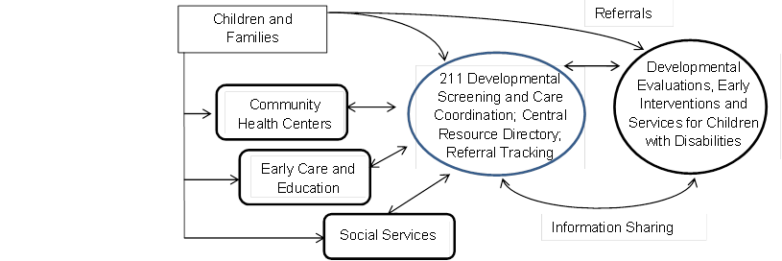
Research Question
Can a centralized, telephone-based model of early childhood developmental screening and care coordination improve quality of care for young children and their families?

Slide 26
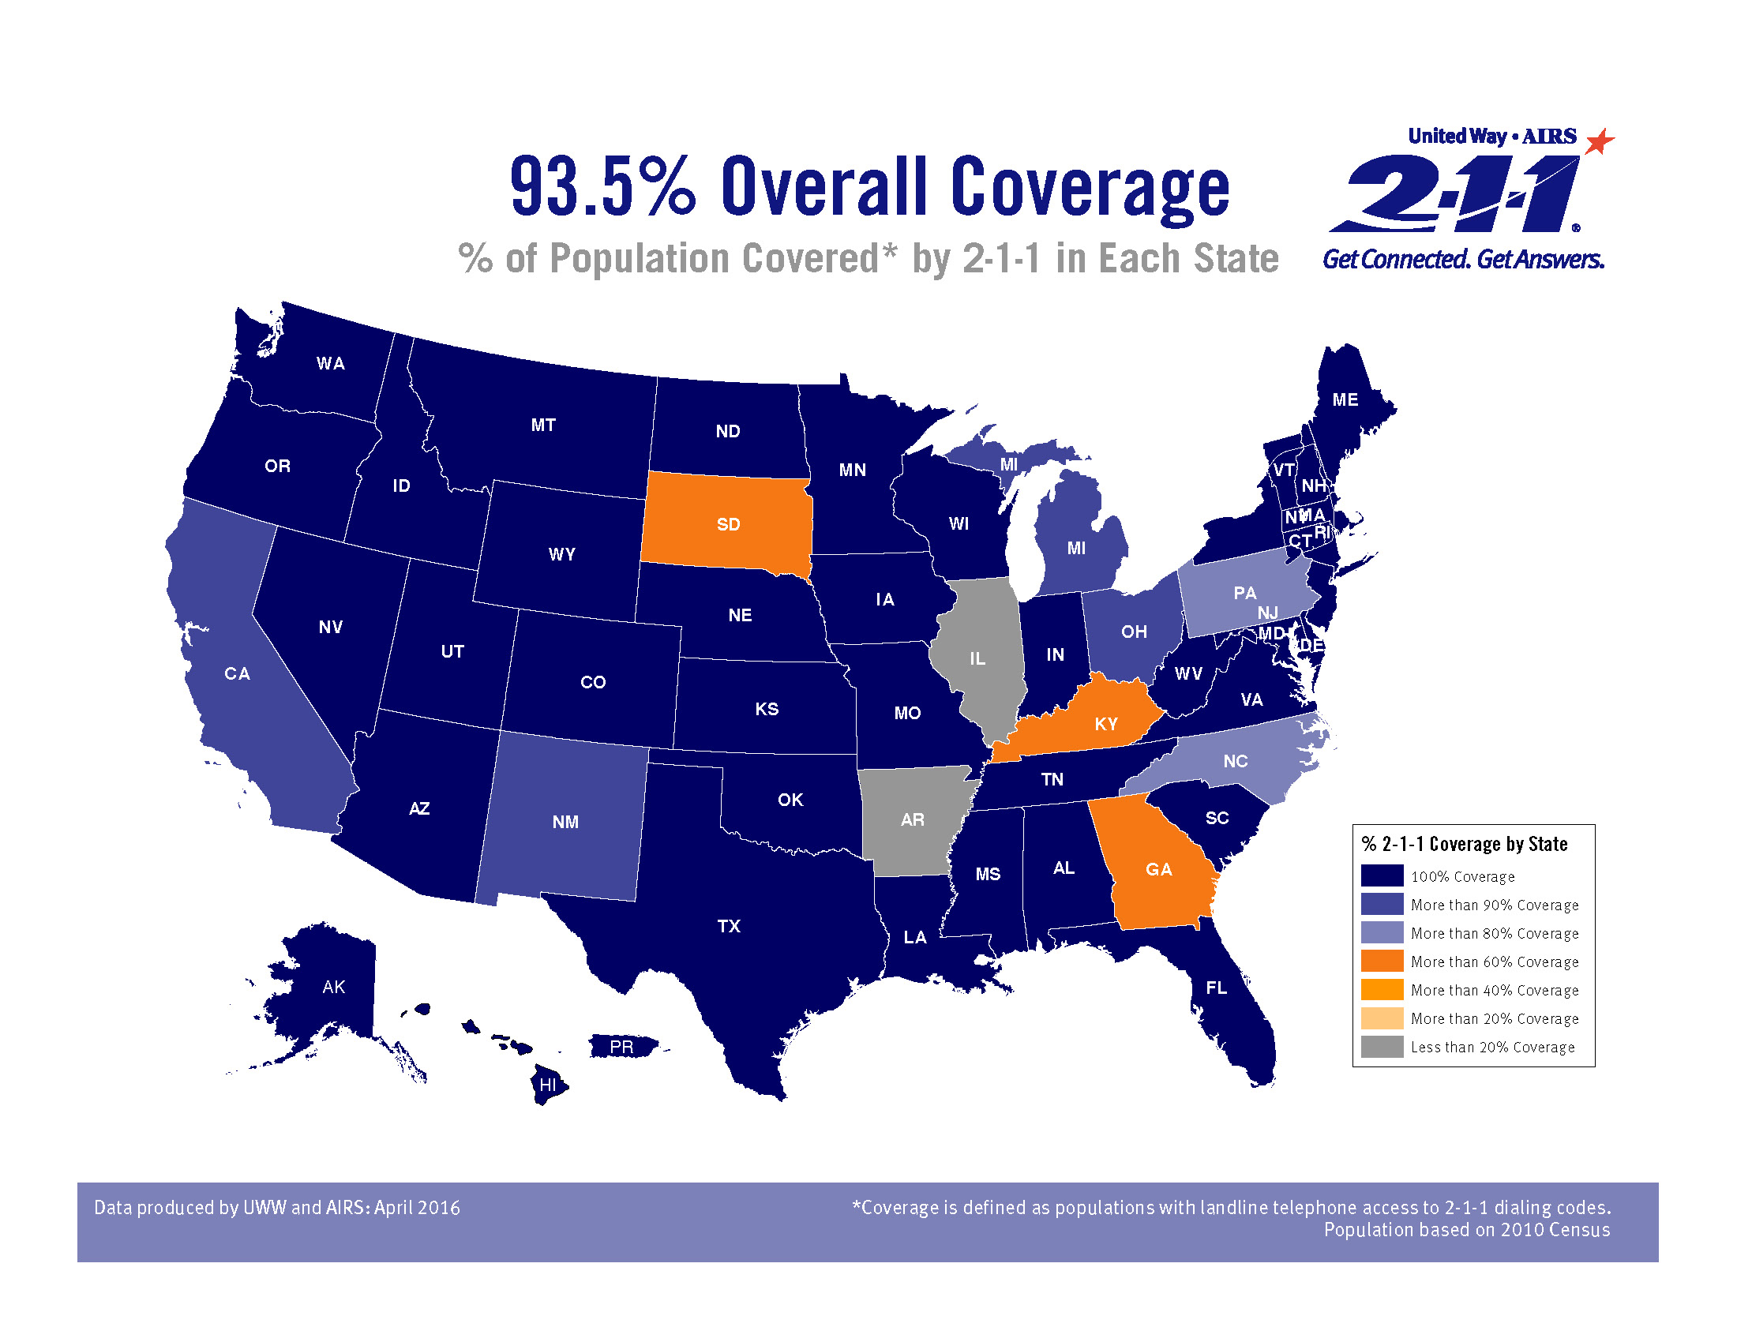

Slide 27
Study Design: A Randomized Controlled Trial
Children ages 12-42 months who receive care at CR
Intervention Group
*Connect to 211
Conduct online screening, make referrals and follow-up
Send screening report and referral plan to clinic provider
Control Group
Usual Care
Screening, referrals and follow-up done by clinic staff
Recruitment & Informed Consent
Randomization
Procedures*
*Baseline interview for all participants; then attempt “warm transfer” to 211

Slide 28
Intervention
Connect parent with 211:
“Warm hand-off” between RA and 211, OR
RA exchanges contact info between parent and 211
211 conducts screening using PEDS Online system:
PEDS, age-appropriate PEDS:DM, M-CHAT if >16 months old
Automated summary of risk, recommendations for evaluation and next steps
211 makes referrals as indicated, preferably via 3-way calls, and faxes care plan to clinic
Regular follow-up to assess outcomes: connection, receipt of services; outcome summary to clinic at 6 mo

Slide 29
Baseline Sample
 | Total | Intervention | Control | p-value
 | 152 | 77 | 75
Child age in months (mean) | 24.5 | 25.7 | 23.4 | 0.16
Child gender: Male Female | 76 (50%) 76 (50%) | 44 (57%) 33 (43%) | 32 (43%) 43 (57%) | 0.07
Race/Ethnicity: Hispanic or Latino Other | 143 (97%) 5 (3%) | 72 (95%) 4 (7%) | 71 (99%) 1 (5%) | 0.25
Language of interview: English Spanish | 60 (39%) 92 (61%) | 28 (36%) 49 (64%) | 32 (43%) 43 (57%) | 0.43

Slide 30
Baseline Sample
 | Total | Intervention | Control | p-value
US-born parent | 44 (29%) | 22 (29%) | 22 (29%) | 0.92
Annual household income: <$20,000 $20,000-34,999 $35,000-69,999 $70,000-99,000 $100,000+ | 86 (66%) 31 (24%) 11 (8%) 2 (1.5%) 1 (0.8%) | 42 (63%) 16 (24%) 6 (9%) 2 (3%) 1 (1.5%) | 44 (69%) 15 (23%) 5 (8%) 0 0 | 0.72
Parent education: Less than HS HS grad or GED Some college ≥ 4-year degree | 75 (49%) 43 928%) 26 (17%) 8 (5%) | 39 (51%) 21 (27%) 13 (17%) 4 (5%) | 36 (48%) 22 (29%) 13 (17%) 4 (5%) | 0.99

Slide 31
Results
 | Total | Intervention | Control | p-value
 | 152 | 77 | 75
Parental concern about child’s development or behavior (DB) in past 6 months? | 57 (38%) | 28 (36%) | 29 (39%) | 0.77
High or moderate developmental risk? | 62 (45%) | 31 (47%) | 31 (43%) | 0.08
Developmental surveillance done by MD (EPIC milestone questions)? | 140 (92%) | 70 (91%) | 70 (93%) | 0.77

Slide 32
Results
 | Total | Intervention | Control | Retrospective Control | p-value
DB concerns noted in record? | 19 (13%) | 10 (13%) | 9 (12%) | 16 (11%) | 1.00
Referrals to evaluation and services | 32 (21%) | 25 (33%) | 7 (9%) | 11 (8%) | 0.001
Evaluated | 16 (11%) | 15 (20%) | 1 (1%) | n/a | 0.00
Eligible | 13 (9%) | 12 (16%) | 1 (1%) | n/a | 0.002
Receiving services | 13 (9%) | 12 (16%) | 1 (1%) | n/a | 0.002

Slide 33
Voltage Drops
with 211

Slide 34
Additional Results
Controlling for child age, gender, and primary home language, participants assigned to the intervention had significantly higher odds of referral (OR = 4.1, p=0.003) and services (OR 11.6, p=0.02) at 6 months.
(Referrals and services defined as Early Intervention (EI), Early Childhood Special Education (ECSE), speech, physical, or occupational therapy.)
In addition to EI and ECSE, 211LA made referrals to Head Start and Early Head Start, other child care and preschool programs (68%), family literacy, parenting, behavioral health, and other family supports

Slide 35
Did 211 Affect Primary Care Experiences?
 | Intervention Group |  | Control Group |  | Difference-in-differences
 | Baseline | 6 months | Baseline | 6 months
%Recommend anticipatory guidance topics discussed | 61% | 68% | 55% | 55% | 0.14
Family-centered care (%usually/always) | 87% | 85% | 89% | 83% | 0.55
Assessment of parental smoking /substance use | 88% | 89% | 88% | 84% | 0.52
Assessment of parental well-being | 60% | 67% | 50% | 57% | 0.92

Slide 36
Cross-over design
Intervention offered to control group at 6 months
Phase I: Baseline to 6 months→ Outcomes = referrals, connection to services, family experiences of care
Phase II: 6-12 months → Outcomes = services received, time in intervention

Slide 37
6-12 Month Results
 | Outcome at 6 months |  | Outcome at 12 months
Group assignment | Intervention | Control | Intervention | Control
DB Surveillance done in clinic | 91% | 93% | 91% | 95%
DB Concern noted in EMR | 13% | 12% | 18% | 17%
Screened with validated tool | 74%** | 0% | 87%** | 60%
Referred to EI/ ECSE | 32%** | 9% | 36% | 21%
Receiving services | 16%** | 1% | 18% | 11%
**p ≤ 0.001, testing difference between groups

Slide 38
Discussion
Limitations: Single clinic site may have limited generalizability.
Future multi-site research study planned– with larger sample, longer follow-up time and measures of developmental outcomes.
Potential for spread to other clinics in LA, with hybrid models for those already screening.
Potential for spread to other 211 call centers.

Slide 39
LET’S TALK
Q&A

Slide 40
Part of Connecticut Children’s Office for Community Child Health

