Slide 1
Help Me Grow Texas
Community Cohort Technical Assistance
March 2021
Facilitated by Sarah Zucker
Senior Program Specialist
Help Me Grow National Center
March 16, 2021

Slide 2
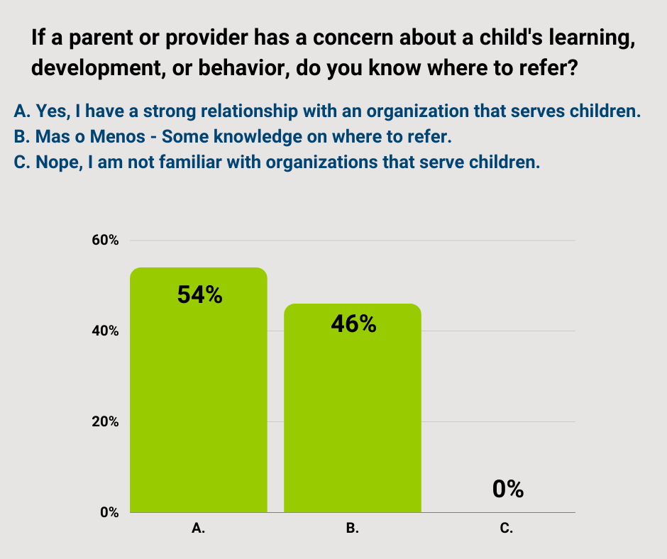
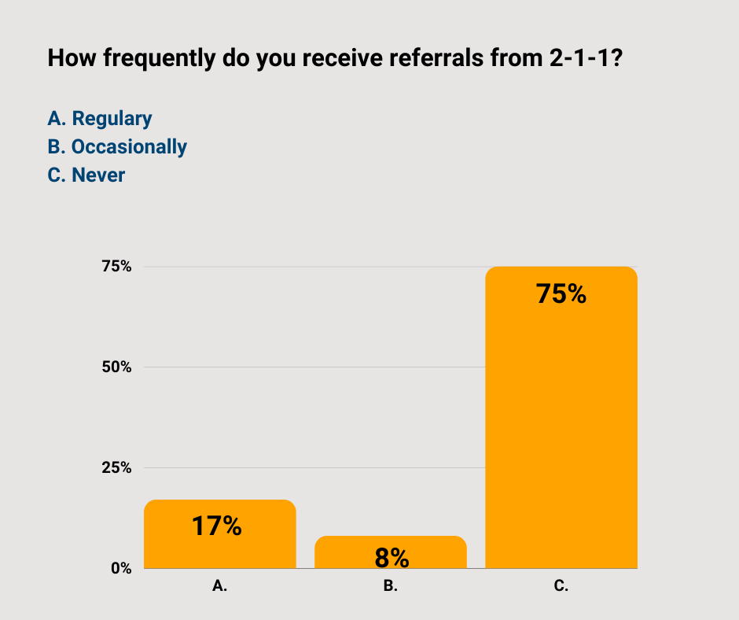
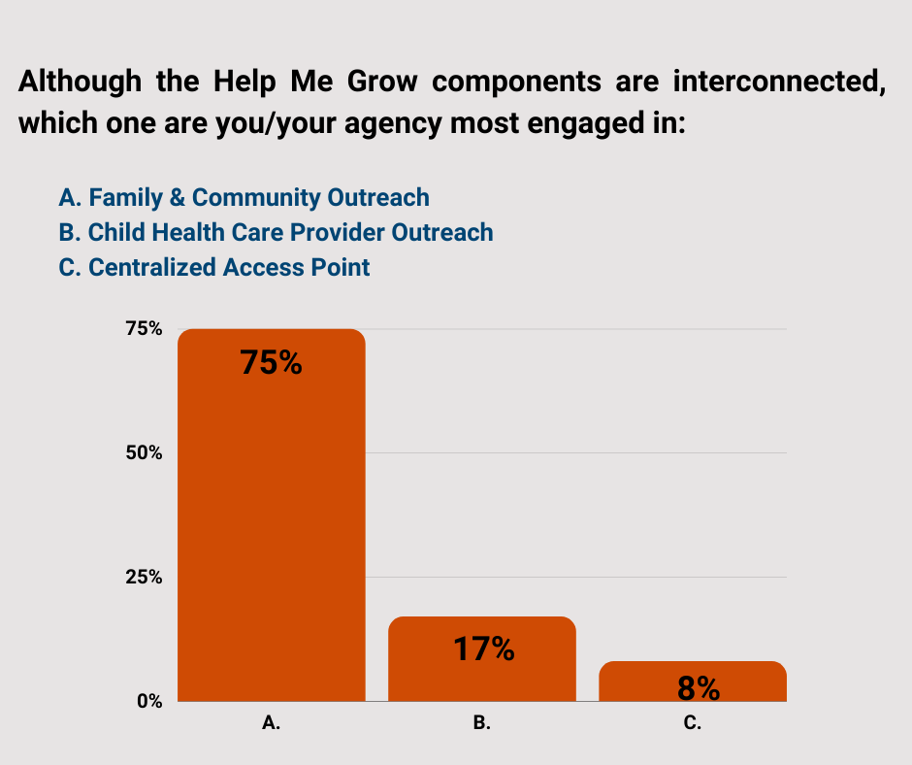
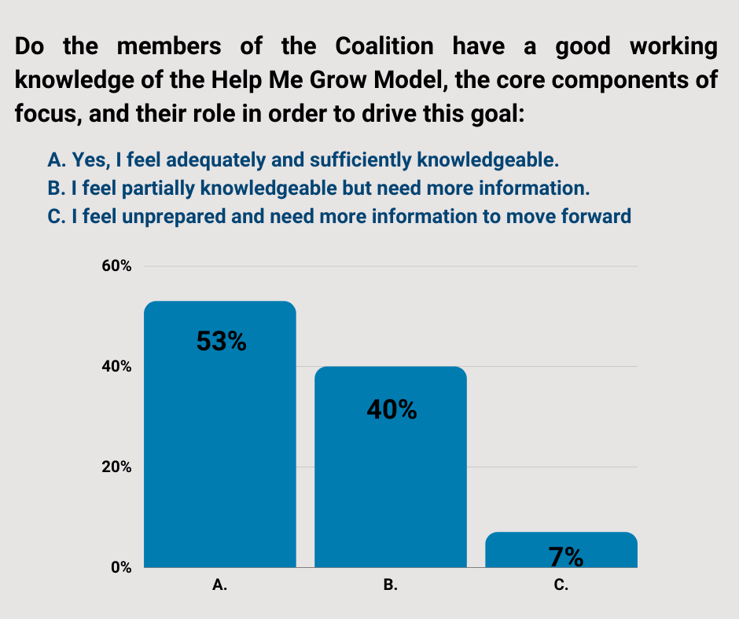
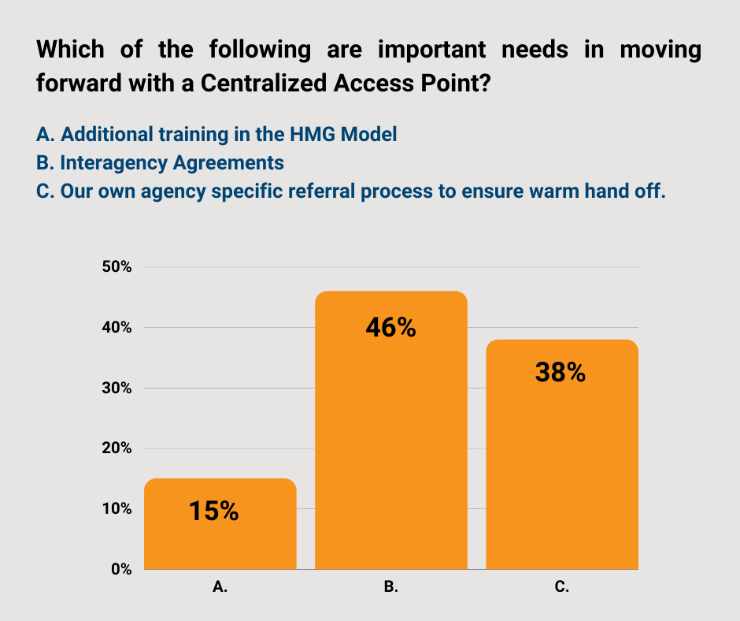
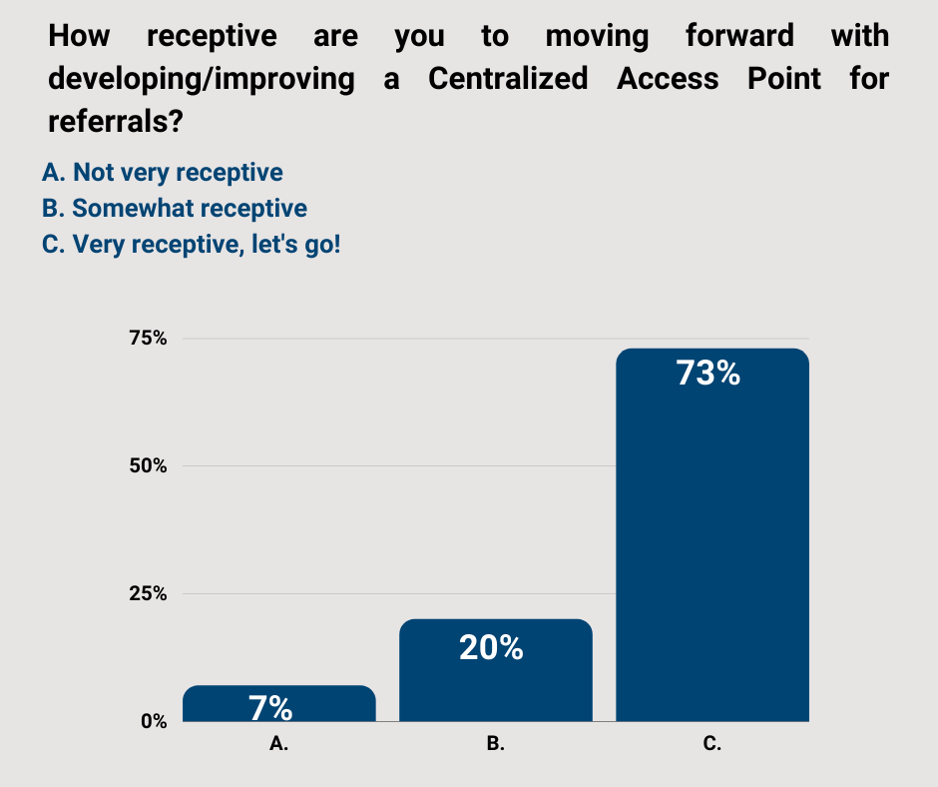
Help Me Grow Readiness Assessment Community: Help Me Grow Rio Grande Valley
Utilizing the Readiness Assessment tools
Used modified questions from the Readiness Assessment Tool with the Lager Coalition Group focused on Centralized Access
Used virtual poll format and shared answers as completed in real time
Focus of this meeting was to assess readiness for implementation of Centralized Access Point component
Results provided foundation for further discussion and planning
6 Questions and Results:

Slide 3
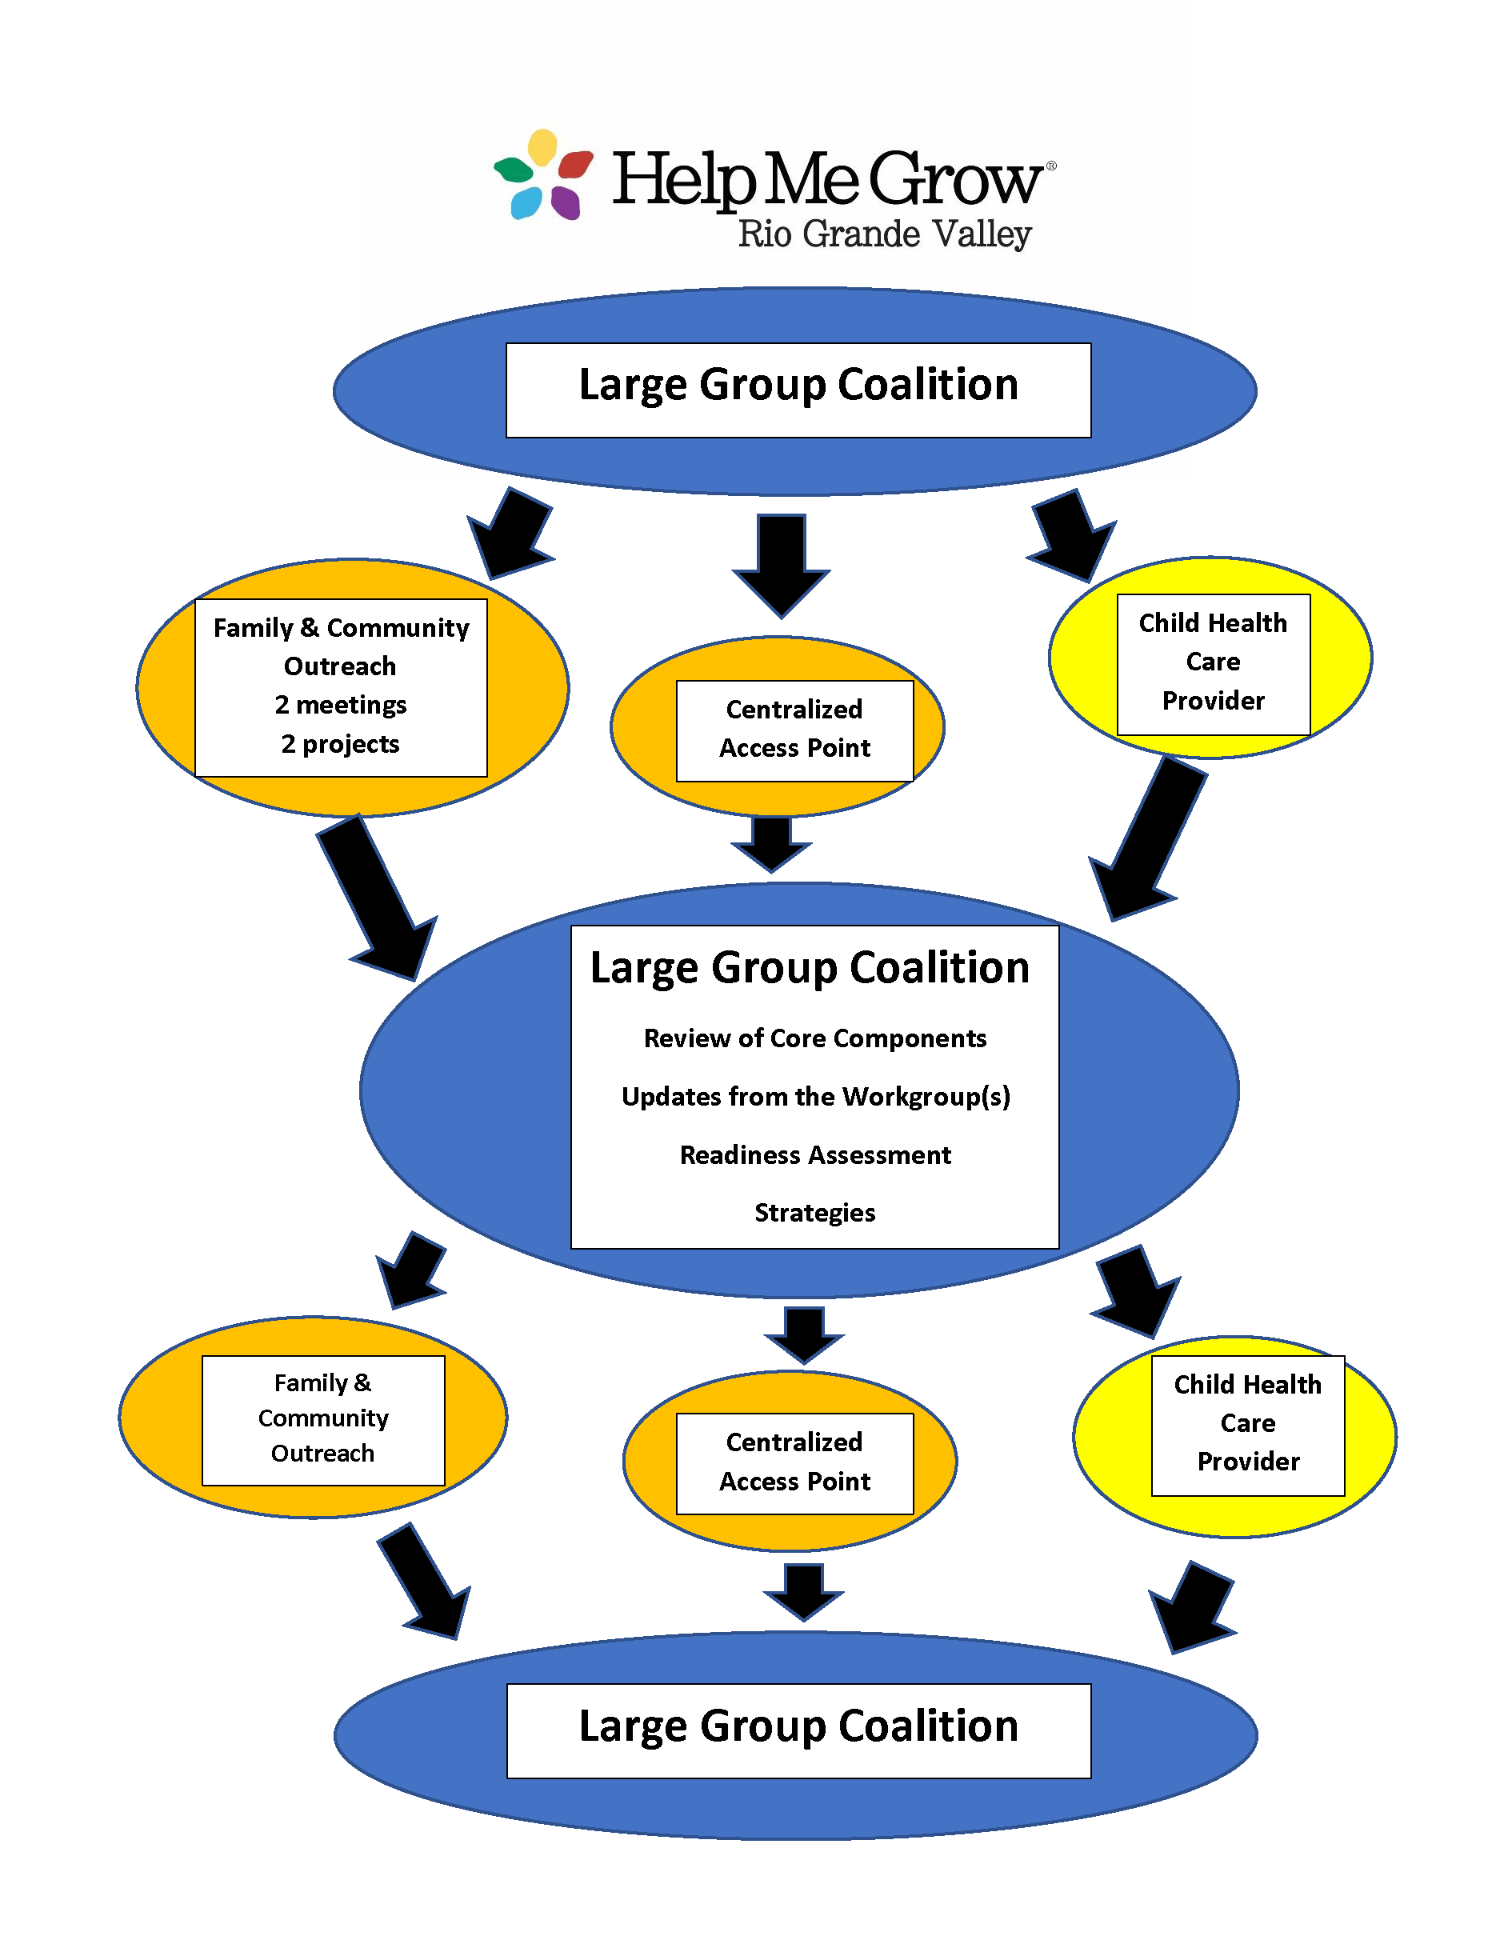
Help Me Grow Readiness Assessment Community: Help Me Grow Rio Grande Valley
Ensuring joint planning
The Workgroups meet and then
Report back to the large Coalition
Group.
Family Community Outreach is the
First work group formed
Next work group formed is the
Centralized Access Point
Both work groups report back to the larger
Coalition/Leadership

Slide 4
Help Me Grow Readiness Assessment Community: Help Me Grow Rio Grande Valley
Tips & Tricks
Keep plugging: look for a partner that shows a spark and will move the process forward
find the “what’s in it for them”
Keep the larger Coalition/leadership group engaged--- a nugget that was shared and has been helpful
Keep Reviewing the core components: keeps the group on the path and helps stop the wandering
Don’t wait for everything to be perfect--- move with what you have and continue to refine and define

Slide 5
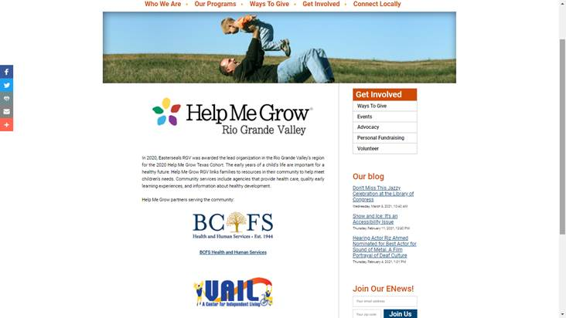
Help Me Grow Readiness Assessment Community: Help Me Grow Rio Grande Valley
Core Component Work Group support
Specific tasks with follow up has moved the group toward the bigger picture.
Example: The Family and Community Outreach work group focused on:
Joint professional development presentation
Joint invitation to a family group connection
School of Medicine Outreach Project
Example: Centralized Access Point work group:
HMG partners on Easterseals website
211 presented on options to create HMG group
Continue to review the core components and the HMG framework– each meeting builds stronger understanding.
Shared the HMG website as a source of reference and resources.

Slide 6
Help Me Grow Readiness Assessment Community: Help Me Grow El Paso

Slide 7
Help Me Grow Readiness Assessment Community: Help Me Grow El Paso

Slide 8
Help Me Grow Readiness Assessment Community: Help Me Grow El Paso

Slide 9
Help Me Grow Readiness Assessment Community: Help Me Grow El Paso

Slide 10
Help Me Grow Readiness Assessment Community: Help Me Grow North Texas
Utilizing the Readiness Assessment tools
Q: Have you begun using the RAs in any way? (reviewed them, shared them, used them to identify Core Component Work Group members, passed to Work Groups, Leadership Teams, used them to better understand the requirements of the Model, etc)
If not, are you planning to employ them? How?
Reviewed Readiness Assessment as we built Subcommittees. Our previous local initiative work had many of the same activities, structures, and strategies as Help Me Grow components.
Shared with Leadership and embedded many of the Steps into the Strategic Plans for each Subcommittee.
Used Questions as talking points in discussions as Subcomittees formed.

Slide 11
Help Me Grow Readiness Assessment Community: Help Me Grow North Texas
Ensuring joint planning
Qs: How are you planning to make certain key activities of the Model are jointly discussed across Core Component Work Groups to come to a consensus on a recommendation/decision?
How is/will information, updates, questions, recommendations be funneled from Work Groups to Leadership Team?
What is the process when a Work Group has a question or needs guidance/support?
Chairs of each Subcommittee reach out to each other to discuss. Attend other Subcommittee mtgs.
MHMR Help Me Grow staff meet 2 x month to update and collaborate on projects.
Share resources from other Help Me Grows –BEMI webinars etc from affiliate site.

Slide 12
Help Me Grow Readiness Assessment Community: Help Me Grow North Texas
Tips & Tricks
Qs: What would be your best tip, lesson learned, or cautionary tale that you would have to share right now with another community exploring the HMG Model and considering affiliation?
This could be anything! No limits here!
Know your Audience- Tailor discussion so partners see where they plug in.
Don’t forget the Why when explaining Help Me Grow and what sets Navigators apart.
Celebrate Developmental milestones, early identification, linking families to resources/services they may need.
Use ASQ Online for screening implementation if possible.
Outreach- Build on what already is being done in community.

Slide 13
Help Me Grow Readiness Assessment Community: Help Me Grow North Texas
Core Component Work Group support
Q: Do any of your HMG Core Component Work Groups have a question about their role & responsibilities? Are they fully familiar with the Model? Do they have any needs for resources, guidance, connection to other HMG systems? Questions? Challenges they are facing?
Do all Work Group members have access to the affiliate side of the HMG site?
As questions arise – we reach out to others.
Opportunities for dialogue and collaborate in breakout rooms as needed-help to decrease duplication of work.
Turnover can be Challenging-Catching others up on Strategic Plan goals/projects, however opportunity to strengthen relationships.
Some members of Leadership team have access to HMG site.

Slide 14
Help Me Grow Readiness Assessment Community: Help Me Grow Austin/Travis County
Utilizing the Readiness Assessment tools
Q: Have you begun using the RAs in any way? (reviewed them, shared them, used them to identify Core Component Work Group members, passed to Work Groups, Leadership Teams, used them to better understand the requirements of the Model, etc)
If not, are you planning to employ them? How?
A: We have started using the Readiness Assessments to guide the development of a vision for HMG – Austin as we build out a detailed work plan. They have been helpful to identify both things we already have in place and additional ways to grow as HMG – Austin is being built out.

Slide 15
Help Me Grow Readiness Assessment Community: Help Me Grow Austin/Travis County
Ensuring joint planning
Qs: How are you planning to make certain key activities of the Model are jointly discussed across Core Component Work Groups to come to a consensus on a recommendation/decision?
How is/will information, updates, questions, recommendations be funneled from Work Groups to Leadership Team?
What is the process when a Work Group has a question or needs guidance/support?
We are still in the process of working out what work groups/leadership team will look like. We currently have an informal leadership team that has served in an advisory group capacity thus far and we have communicated with them via email. This will likely continue until work groups are established.

Slide 16
Help Me Grow Readiness Assessment Community: Help Me Grow Austin/Travis County
Tips & Tricks
Qs: What would be your best tip, lesson learned, or cautionary tale that you would have to share right now with another community exploring the HMG Model and considering affiliation?
This could be anything! No limits here!
A: Generally, know your pitch and your limits before getting involved with external partners. Otherwise, there will be a temptation to say yes without more fully understanding the scope of the work your organization can commit to.

Slide 17
Help Me Grow Readiness Assessment Community: Help Me Grow Austin/Travis County
Core Component Work Group support
Q: Do any of your HMG Core Component Work Groups have a question about their role & responsibilities? Are they fully familiar with the Model? Do they have any needs for resources, guidance, connection to other HMG systems? Questions? Challenges they are facing?
Do all Work Group members have access to the affiliate side of the HMG site?
A: We don’t have work groups established yet; we are in the process of identifying these folks and figuring out the structure that would best suit UWATX’s model of implementation.

Slide 18
Help Me Grow Readiness Assessment Community: North Texas Area United Way, Wichita Falls
Utilizing the Readiness Assessment tools
Q: Have you begun using the RAs in any way? (reviewed them, shared them, used them to identify Core Component Work Group members, passed to Work Groups, Leadership Teams, used them to better understand the requirements of the Model, etc)
If not, are you planning to employ them? How?
Completing the assessment helped us understand HMGTX better and note areas where we are already in tune with the core areas.
We will be sharing the assessment with the Leadership team during our April meetings

Slide 19
Help Me Grow Readiness Assessment Community: North Texas Area UW, Wichita Falls
Ensuring joint planning
Qs: How are you planning to make certain key activities of the Model are jointly discussed across Core Component Work Groups to come to a consensus on a recommendation/decision?
How is/will information, updates, questions, recommendations be funneled from Work Groups to Leadership Team?
What is the process when a Work Group has a question or needs guidance/support?
Our leadership team will consist of a person from each partner organization, ECC Sub-Committees and NTAUW programs. Each rep will have discussions with their area and bring information and ideas back to the leadership team for discussions and final decisions.
See number 1
Questions and requests for guidance can be emailed to the program managers who will determine if they can help or need to refer to someone on the leadership team.

Slide 20
Help Me Grow Readiness Assessment Community: North Texas Area United Way, Wichita Falls
Tips & Tricks
Qs: What would be your best tip, lesson learned, or cautionary tale that you would have to share right now with another community exploring the HMG Model and considering affiliation?
This could be anything! No limits here!
Consider having a staff position to manage Help Me Grow. There is a lot to learn and a lot of time commitment. We are excited for the opportunity, but our plates are very full already. We have 3 people sharing the management and implementation.
Also, remember that you don’t have to dump your work and start over. We are simply analyzing our work to see what areas meet the core components and where we have gaps to work on next.

Slide 21
Help Me Grow Readiness Assessment Community: North Texas Area United Way, Wichita Falls
Core Component Work Group support
Q: Do any of your HMG Core Component Work Groups have a question about their role & responsibilities? Are they fully familiar with the Model? Do they have any needs for resources, guidance, connection to other HMG systems? Questions? Challenges they are facing?
Do all Work Group members have access to the affiliate side of the HMG site?
We are just now at the point of completing informational meetings and getting the leadership team started. We know that there will be questions and a need for guidance once each group is well informed and ready to go.
We currently do not have access for all group members to the HMG site. We will want to set this up in the near future.

Slide 22
Help Me Grow Readiness Assessment Community: ReadyKidSA - United Way, Bexar County
Utilizing the Readiness Assessment tools
Q: Have you begun using the RAs in any way? (reviewed them, shared them, used them to identify Core Component Work Group members, passed to Work Groups, Leadership Teams, used them to better understand the requirements of the Model, etc)
If not, are you planning to employ them? How?
HMG Community Workgroup: United Way Internal Leadership Team:
Baseline - Communication
Check-In & Focus - Establishing quarterly milestones

Slide 23
Help Me Grow Readiness Assessment Community: ReadyKidSA – United Way, Bexar County
Ensuring joint planning
Qs: How are you planning to make certain key activities of the Model are jointly discussed across Core Component Work Groups to come to a consensus on a recommendation/decision?
How is/will information, updates, questions, recommendations be funneled from Work Groups to Leadership Team?
What is the process when a Work Group has a question or needs guidance/support?
HMG Community Workgroup:
Local model – one HMG Workgroup of RKSA representatives
Leadership team is part of the work group
Focusing on 2 of the 4 components: Centralized Access Point & Child Healthcare Provider Outreach

Slide 24
Help Me Grow Readiness Assessment Community: ReadyKidSA – United Way, Bexar County
Tips & Tricks
Qs: What would be your best tip, lesson learned, or cautionary tale that you would have to share right now with another community exploring the HMG Model and considering affiliation?
This could be anything! No limits here!
Child Healthcare Physician Outreach:
Value add to physicians
Understanding existing processes / systems
Supporting value based billing process

Slide 25
Help Me Grow Readiness Assessment Community: ReadyKidSA – United Way, Bexar County
Core Component Work Group support
Q: Do any of your HMG Core Component Work Groups have a question about their role & responsibilities? Are they fully familiar with the Model? Do they have any needs for resources, guidance, connection to other HMG systems? Questions? Challenges they are facing?
Do all Work Group members have access to the affiliate side of the HMG site?
Strong understanding of the model
Role clarification
Progression & Evolution

Slide 26
Discussion

Slide 27
Coming Up
Texas-specific:
BEMI session – March 25, Getting Started with Help Me Grow Child Health Care Provider Outreach
HMG Texas community cohort resource hub
Brief survey to facilitate connection call between each community and an established affiliate well-positioned to share content on current priorities
Network-wide:
Going Virtual with Help Me Grow Outreach four-part webinar series, every Wednesday in April, registration goes out tomorrow
Help Me Grow National Forum call for proposals opens March 29

